Slide 1

Transition from Physical Media to Streaming
Nature of Enterprise Computing – Group 15
By: Cezary Janus, Akaisha Gurung, Domagoj Jurisic, Chris Kiala and Jamiu Kusimo

Slide 2
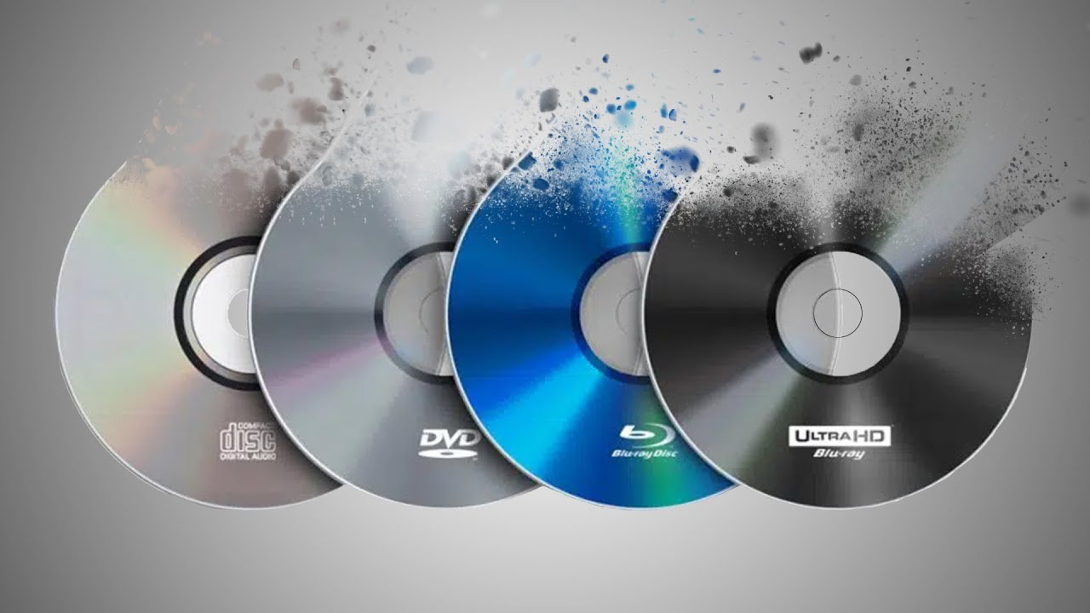
What our project is about:
Transition from CD’s, DVD’s and VHS towards services like Spotify and Netflix
Historical Development of it
Looking it it from business and (x) viewpoints
Considering ethical implications of it

Slide 3
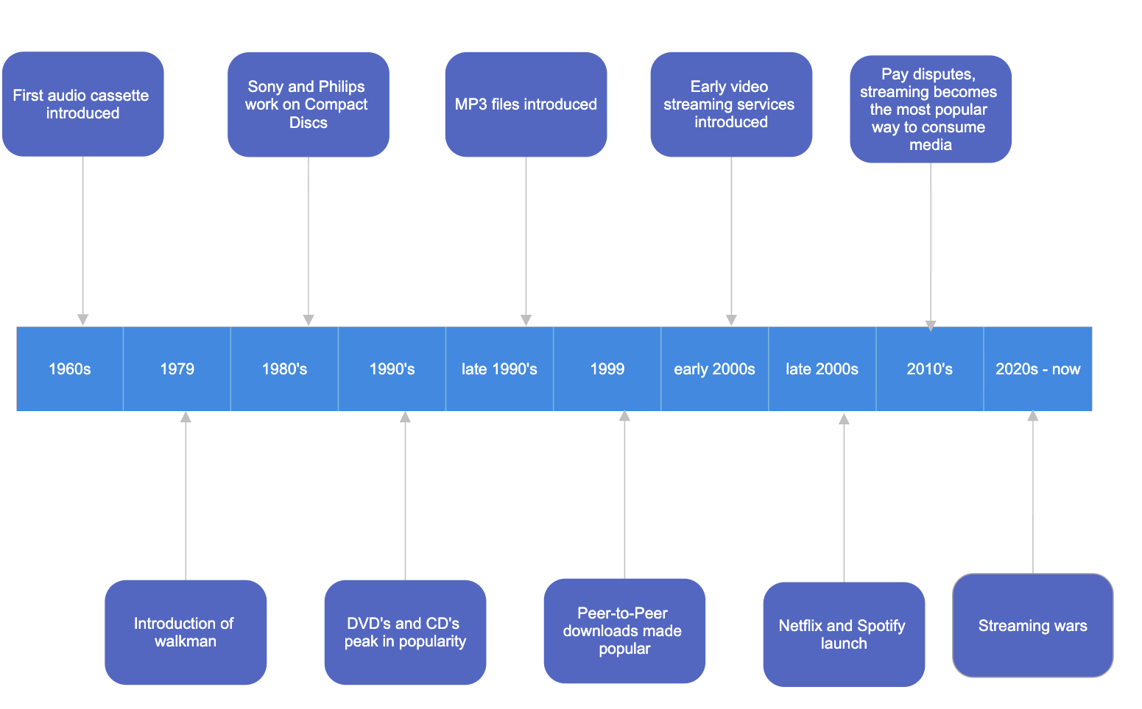
Historical Timeline

Slide 4
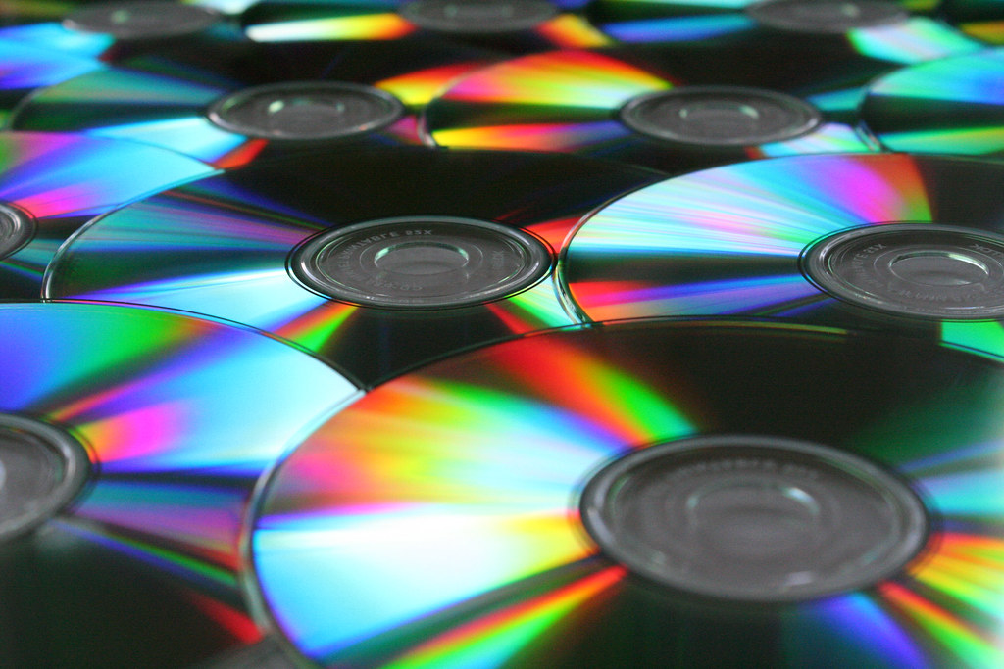
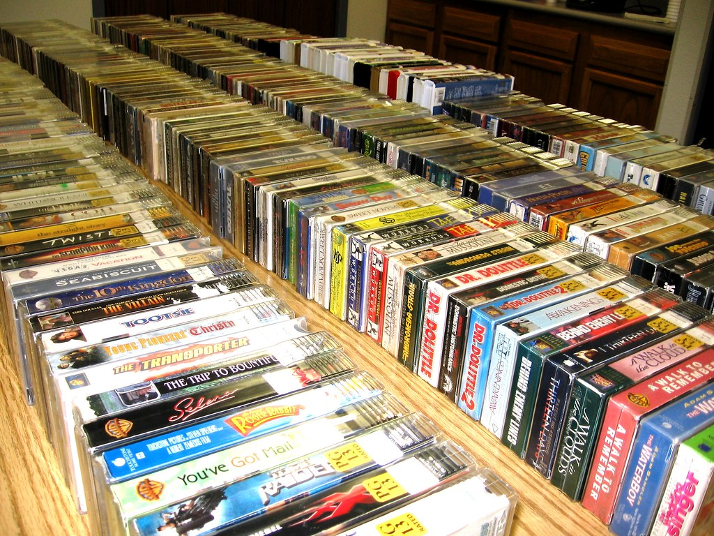
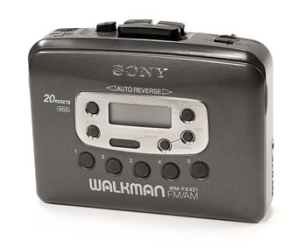
Physical Era
Media was mostly consumed on cassettes, CD’s, DVD’s, vinyl records and VHS
It was expensive and inconvenient for users
Walkman, introduced in 1979, introduced the “mixtape culture” – similar to Playlists nowadays
CD’s
VHS Tapes in Stores
Walkman

Slide 5
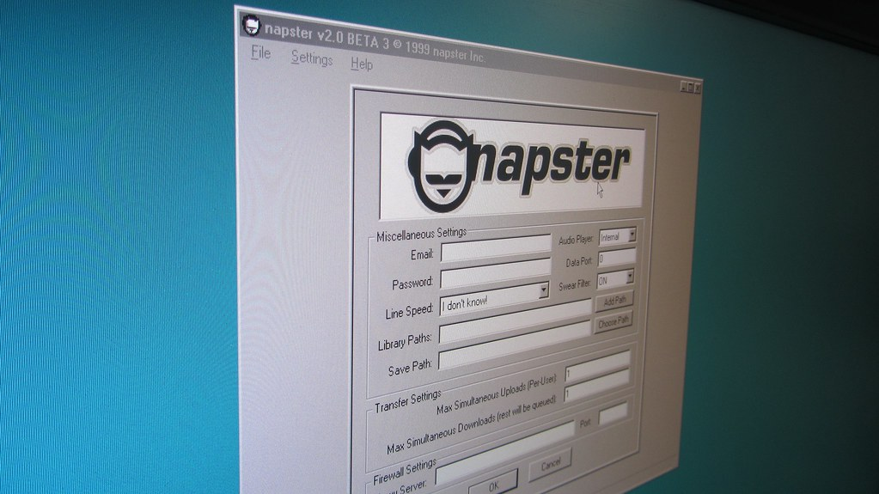
Transitional Period
MP3 File introduced in the 1990s compressing size of audio files
Peer-To-Peer era launched by Napster; filesharing erupted in popularity
Napster entered a legal battle with the music industry and shut in 2001
Peer-To-Peer era clearly showed that the idea of free music was revolutionary for customers
This Photo by Unknown Author is licensed under CC BY-SA

Slide 6
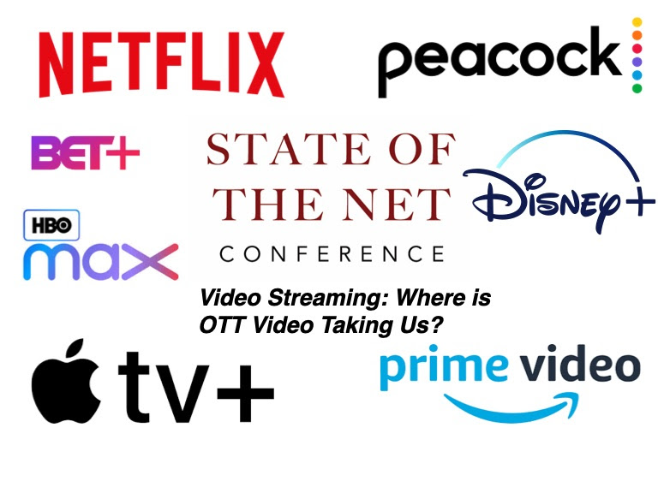
Streaming Era
Apple launches iTunes offering digital downloads for less than $1
iPod released and becomes a symbol of portable listening
YouTube launched streaming user-generated content
Spotify and Netflix launch in late 2008’s
Netflix produces and releases 2013 shifting from simply licensing content
Spotify faces pay disputes
Competition grows; studios create their own streaming apps instead of licensing.
Streaming wars started.

Slide 7
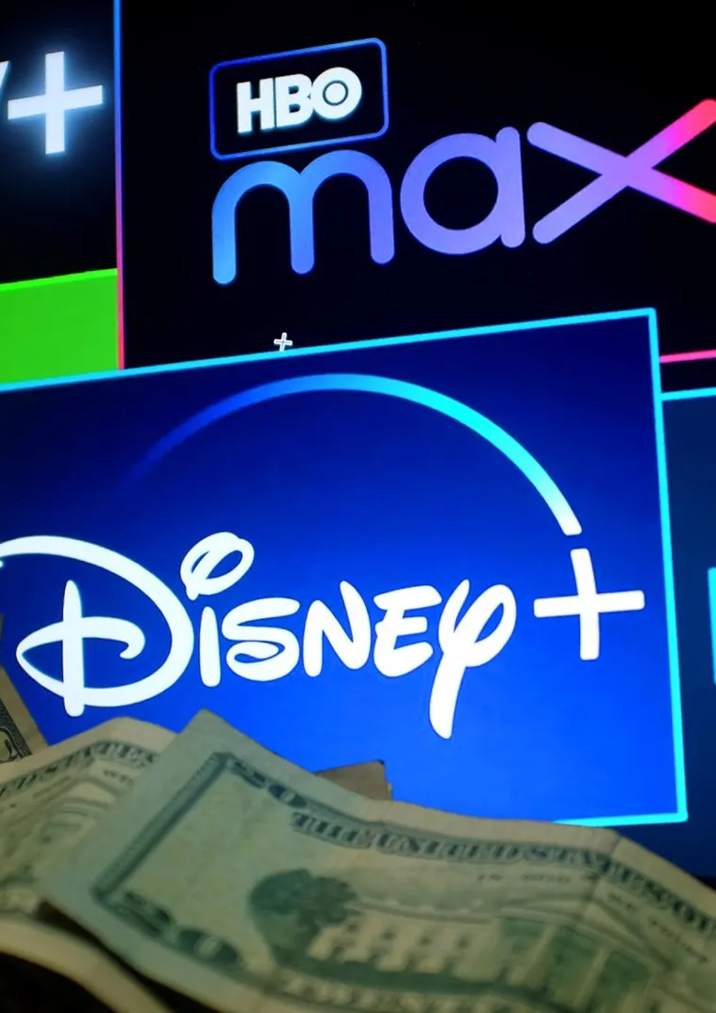
Business Viewpoint
Streaming changed how companies make money because instead of people buying DVDs or digital copies once, they now get steady monthly income. This makes it easier for companies to plan what they want to do next. They also spend a lot on new shows and movies so people don’t cancel. The downside is that prices keep going up and a lot of content gets removed whenever deals change.
Key Points:
Monthly payments instead of one-time purchases
Big spending on new shows
Customers pay for access, not ownership
Content can be removed anytime
Prices keep increasing

Slide 8
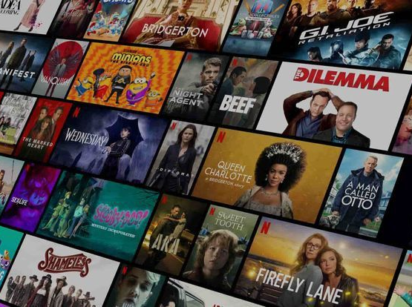
Societal Viewpoint
Streaming made things more accessible because people can watch almost anything at home. It got even more popular during COVID when everyone was stuck inside. But price increases and content leaving platforms cause problems, and a lot of people end up turning to piracy because they can’t afford multiple subscriptions.
Main Points:
Easier access for everyone
COVID made streaming grow
Price hikes increase piracy
Original shows keep people loyal
Less demand for physical media

Slide 9
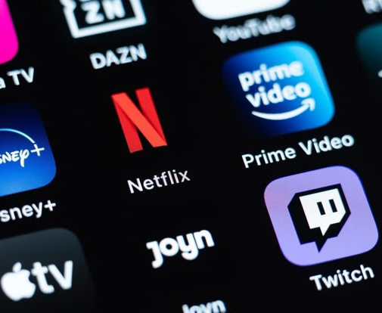
Ethical Considerations
Streaming is handy, but it does have issues. Some platforms make cancellation harder than it should be. They collect a lot of data about what people watch. Creators usually don’t earn much from streams, and even though it’s digital, streaming still adds to environmental impact.
Points to Highlight:
Hard-to-cancel accounts
Lots of data collected
Low creator pay
Environmental impact
Content can disappear anytime

Slide 10
Thank you for listening!
Any questions?

