Slide 1
DARK WEB MONITORING
BY CIPHER-SHIELD INNOVATORS

Slide 2
CONTENT
Introduction
Key Concepts
Why Monitor the Dark Web?
Monitoring Tools and Techniques
Legal and Ethical Consideration
Challenges and Limitations
Security Measures
Future Trends
Working
Conclusion

Slide 3
Introduction
The dark web is a part of the internet that is intentionally hidden and only accessible through specific software. It plays a significant role in cybersecurity due to its use for illegal activities, such as trading stolen data, hacking tools, and engaging in cybercrime. Monitoring the dark web is crucial to proactively identify potential threats, prevent data breaches, and safeguard sensitive information. Without vigilant monitoring, organizations risk being blindsided by malicious activities that could harm their reputation and compromise their security.

Slide 4
Key Concepts
Dark Web: The dark web refers to a part of the internet that is intentionally hidden and accessible only through specialized software. It is often associated with illicit activities due to its anonymous nature.
Deep Web: The deep web includes all parts of the internet that are not indexed by traditional search engines. It encompasses legal and legitimate content, such as private databases, academic resources, and password-protected websites.
Encryption: Encryption is the process of converting information into a code to prevent unauthorized access. On the dark web, encryption is commonly used to secure communications and transactions, enhancing user privacy and security.
Anonymity: Anonymity on the dark web is achieved through various means, including the use of pseudonyms, virtual private networks (VPNs), and cryptocurrencies. Users can operate with reduced risk of identification, contributing to the dark web's appeal for both legal and illegal purposes.

Slide 5
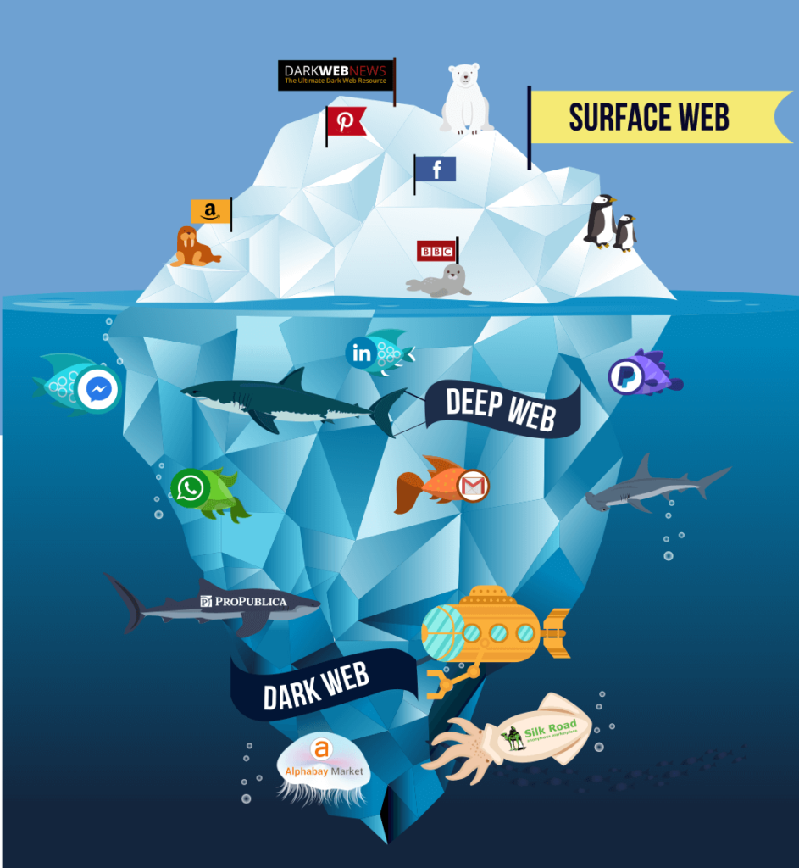

Slide 6
Why Monitor the Dark Web?
Cyber Threats: The dark web is a breeding ground for cyber threats, including malware, ransomware, and hacking tools. These can be employed against individuals and businesses, posing a significant risk to digital security.
Data Breaches: Stolen data, including personal and financial information, is frequently traded on the dark web. This contributes to a higher likelihood of data breaches and identity theft.
Legal Consequences: Businesses may face legal consequences if implicated in illegal activities on the dark web, even if unintentional. Compliance and regulatory issues may arise.
Identity Theft: Stolen personal information from the dark web can be used for identity theft, causing financial and emotional distress for individuals.
Privacy Invasion: Dark web activities can compromise individuals' privacy, with personal information exposed or used for malicious purposes without their knowledge.

Slide 7
Monitoring Tools and Techniques
Tools for Dark Web Monitoring:-
Dark Web Intelligence Platforms: Offer comprehensive monitoring by crawling the dark web for mentions of specific keywords, providing insights into potential threats and activities.
Crawlers and Scrapers: Automated tools that navigate the dark web, collecting data from forums, marketplaces, and other platforms. They help in tracking trends and identifying potential risks.
Threat Intelligence Feeds: Subscriptions to threat intelligence services that provide real-time updates on emerging threats, compromised data, and other security-related information on the dark web.

Slide 8
Advanced Search Techniques:-
Keyword and Pattern Matching: Utilize advanced search algorithms to identify specific keywords, patterns, or indicators related to cybersecurity threats, ensuring a focused and targeted approach.
Natural Language Processing (NLP): Incorporate NLP algorithms to understand context and sentiment in dark web communications, improving the ability to detect potential threats.
Data Analysis Methods:-
Link Analysis: Explore connections between different entities on the dark web, revealing relationships and uncovering potential networks engaged in cyber threats or illegal activities.
Temporal Analysis: Examine changes and patterns over time, helping to identify trends, shifts in cybercriminal behavior, and potential upcoming threats.
Behavioral Analysis: Assess user behavior on the dark web to identify abnormal activities, flagging potential threats or activities that deviate from established norms.

Slide 9
Legal and Ethical Considerations
Legal Implications:
International Jurisdiction: The dark web operates across borders, making legal jurisdiction challenging. Monitoring activities may involve legal complexities, requiring collaboration between international law enforcement agencies.
Privacy Laws: Striking a balance between monitoring for security and respecting privacy is crucial. Violating privacy laws during monitoring can lead to legal consequences and damage an organization's reputation.
Regulatory Compliance: Organizations must adhere to relevant laws and regulations when conducting dark web monitoring. Failure to comply may result in legal penalties and regulatory actions.

Slide 10
Ethical Considerations:
Informed Consent: Ethical monitoring involves obtaining informed consent when applicable. Users' consent should be obtained, especially when monitoring involves accessing private information.
Avoiding Entrapment: Ethical monitoring prohibits entrapment or creating situations that lead individuals to engage in illegal activities that they wouldn't have otherwise pursued.
Minimizing Collateral Damage: Efforts should be made to minimize the impact on innocent individuals. Unintended consequences of monitoring should be carefully considered and mitigated.
Privacy Concerns:
Anonymity: Users on the dark web often rely on anonymity. Monitoring activities that compromise this anonymity can raise ethical and privacy concerns.
Data Security: The security of data collected during monitoring is crucial. Breaches can result in the exposure of sensitive information, leading to legal and ethical complications.
Third-Party Involvement: Organizations collaborating with third-party monitoring services should ensure that these entities adhere to ethical standards and respect privacy rights.

Slide 11
Challenges and Limitation
Challenges in Dark Web Monitoring:
Technical Complexity: The dark web's technical intricacies, such as the use of encryption and anonymity tools like Tor, pose challenges for effective monitoring.
Constant Evolution: The landscape of the dark web is dynamic, with platforms, communication methods, and tactics evolving rapidly. Keeping monitoring strategies up-to-date is challenging.
False Positives and Noise: Distinguishing between genuine threats and false positives can be difficult, leading to wasted resources and potential oversight of actual risks.
International Jurisdiction: Legal and jurisdictional challenges arise when monitoring activities traverse international borders, complicating the legal framework for effective enforcement.

Slide 12
Limitations and Blind Spots:
Encrypted Communication: End-to-end encryption hampers monitoring efforts, making it challenging to intercept and analyze secure communications on the dark web.
Proliferation of New Platforms: The emergence of new, decentralized platforms on the dark web may go unnoticed, creating blind spots for monitoring systems focused on traditional channels.
Steganography and Obfuscation Techniques: The use of steganography and obfuscation methods allows malicious actors to hide information within other files or communications, evading detection.
Limited Access to Certain Areas: Some parts of the dark web may require specific invitations or credentials, limiting access for monitoring efforts and creating blind spots in understanding activities within those areas.

Slide 13
Security Measures
Recommendations for Securing Systems Against Dark Web Threats:
User Education and Awareness: Train employees on recognizing phishing attempts and social engineering tactics commonly used on the dark web. Promote a cybersecurity-aware culture within the organization.
Dark Web Monitoring Tools: Invest in dark web monitoring tools to proactively detect potential threats and data breaches. Regularly review and update the capabilities of these tools to keep pace with evolving dark web tactics.
Protection of Reputation: A proactive approach to cybersecurity helps protect an organization's reputation by demonstrating a commitment to security and the safeguarding of sensitive information.
Regulatory Compliance: Proactive cybersecurity measures ensure compliance with regulations and industry standards, reducing the risk of legal and financial consequences.
Early Threat Detection: Proactive measures enable the early detection of potential threats, preventing them from escalating into more significant security incidents.

Slide 14
Future Update
Enhanced Encryption Detection: Development of more advanced tools capable of detecting and deciphering encrypted communications, allowing for better monitoring of secure channels on the dark web.
Integration of AI in Monitoring Tools: Implementation of artificial intelligence and machine learning algorithms in monitoring tools to analyze vast amounts of data, identify patterns, and predict emerging threats more accurately.
Behavioral Analysis and Anomaly Detection: Increased emphasis on behavioral analysis to identify anomalies in user activity, helping to distinguish normal behavior from potentially malicious actions on the dark web.
Collaboration and Information Sharing: Greater collaboration among organizations, sharing threat intelligence and information to create a more comprehensive and collective defense against evolving dark web threats.
Regulatory Adaptation: Evolving regulations and international cooperation to address the challenges of monitoring the dark web, allowing for more effective and legal cross-border collaboration in tracking cybercriminal activities.

Slide 15
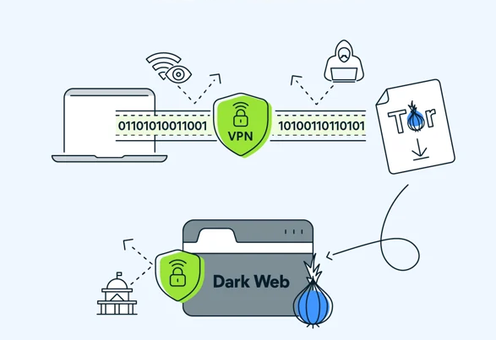
Working
Dark web monitoring continuously searches the dark web and pulls in raw intelligence in near real time. Millions of sites are monitored for specific information (e.g., corporate email addresses), or general information (e.g., the company name and industry).
When a threat is discovered, users can create a customized alert that notifies team members and anyone else in the organization who is relevant to the threat, such as marketing, legal, human resources or fraud teams.

Slide 16
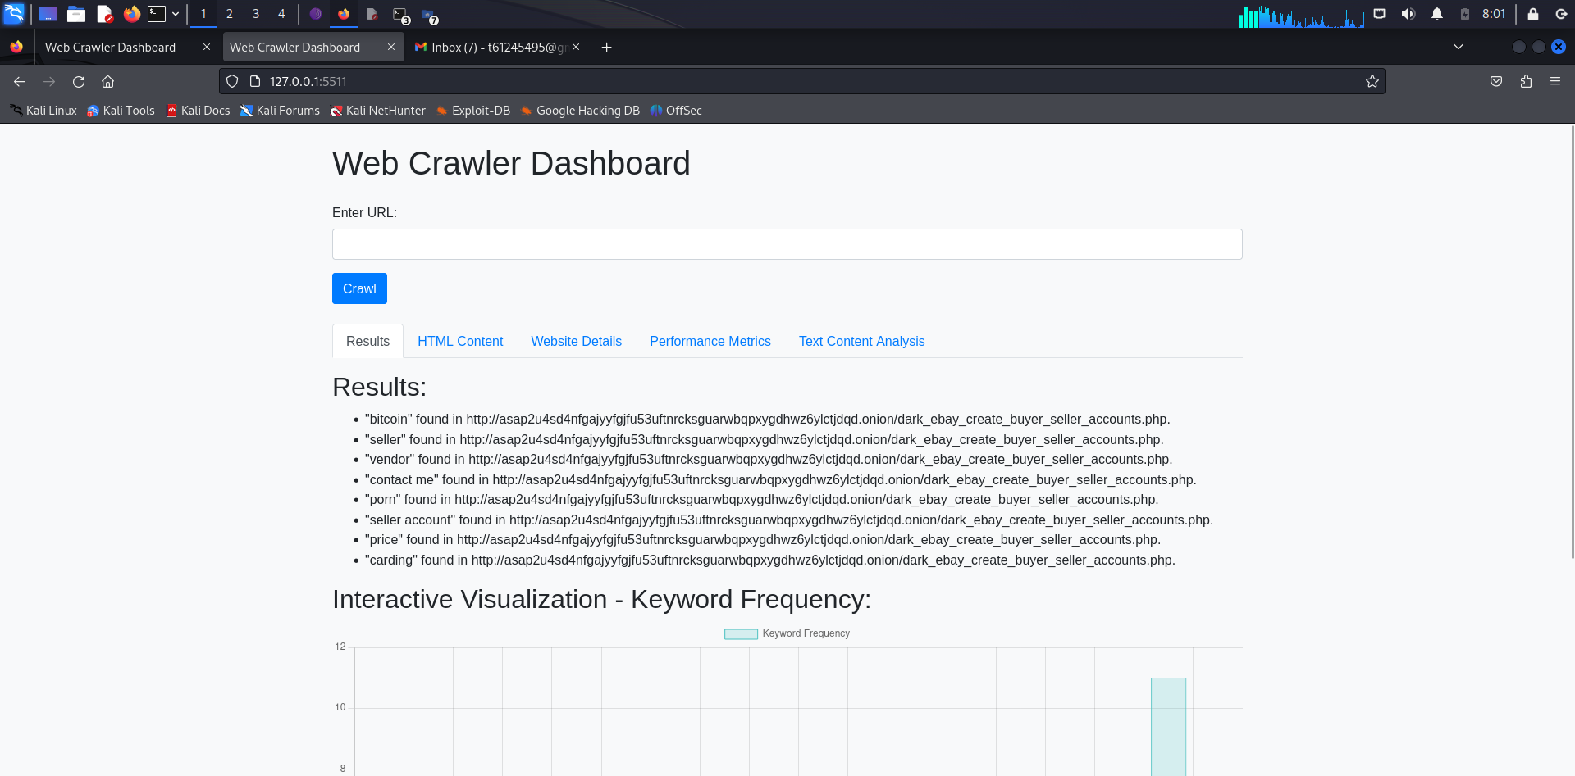

Slide 17
Conclusion
Dark web monitoring is essential for cybersecurity, involving tools like intelligence platforms, crawlers, and threat feeds. Challenges include technical complexities and legal issues. Continuous monitoring is crucial to detect evolving threats, such as blockchain-based marketplaces and Ransomware-as-a-Service. To secure systems effectively, organizations must invest in education, robust authentication, and proactive cybersecurity measures. Staying ahead requires adapting monitoring strategies, integrating AI, and fostering collaboration. In summary, continuous dark web monitoring is paramount to identify and mitigate risks in the ever-evolving landscape, ensuring robust cybersecurity defenses.

Slide 18
THANK YOU

