Slide 1



myChart.py
myChart
import pandas as pd
import piesparrow as ps
df = pd.read_csv('pop.csv')
ps.init(filename = 'myChart',title = ‘My Chart')
ps.row(
col1 = ps.bar(
title = 'Population of Cities',
dataframe = df,
xlabel = 'City',
xdata = 'Population 2020',
ylabel = ‘2020 Population in Millions'
)
)
myChart.py
Terminal
$<piesparrow>

Slide 2
myChart.py
myChart
import pandas as pd
import piesparrow as ps
df = pd.read_csv('pop.csv')
ps.init(filename = 'myChart',title = ‘My Chart')
ps.row(
col1 = ps.bar(
title = 'Population of Cities',
dataframe = df,
xlabel = 'City',
xdata = 'Population 2020',
ylabel = ‘2020 Population in Millions'
)
)
myChart.py
Terminal
$<piesparrow>
python myChart.py

Slide 3

myChart.py
myChart
import pandas as pd
import piesparrow as ps
df = pd.read_csv('pop.csv')
ps.init(filename = 'myChart',title = ‘My Chart')
ps.row(
col1 = ps.bar(
title = 'Population of Cities',
dataframe = df,
xlabel = 'City',
xdata = 'Population 2020',
ylabel = ‘2020 Population in Millions'
)
)
myChart.py
myChart.html
Terminal
$<piesparrow>
python myChart.py

Slide 4

myChart.py
myChart
import pandas as pd
import piesparrow as ps
df = pd.read_csv('pop.csv')
ps.init(filename = 'myChart',title = ‘My Chart')
ps.row(
col1 = ps.bar(
title = 'Population of Cities',
dataframe = df,
xlabel = 'City',
xdata = 'Population 2020',
ylabel = ‘2020 Population in Millions'
)
)
myChart.py
myChart.html
Terminal
$<piesparrow>
$<piesparrow>
python myChart.py

Slide 5
myChart.py
myChart
import pandas as pd
import piesparrow as ps
df = pd.read_csv('pop.csv')
ps.init(filename = 'myChart',title = ‘My Chart')
ps.row(
col1 = ps.bar(
title = 'Population of Cities',
dataframe = df,
xlabel = 'City',
xdata = 'Population 2020',
ylabel = ‘2020 Population in Millions'
)
)
myChart.py
myChart.html
Terminal
$<piesparrow>
$<piesparrow>
python myChart.py

Slide 6
myChart.py
myChart
import pandas as pd
import piesparrow as ps
df = pd.read_csv('pop.csv')
ps.init(filename = 'myChart',title = ‘My Chart')
ps.row(
col1 = ps.bar(
title = 'Population of Cities',
dataframe = df,
xlabel = 'City',
xdata = 'Population 2020',
ylabel = ‘2020 Population in Millions'
)
)
myChart.py
myChart.html
Terminal
$<piesparrow>
$<piesparrow>
python myChart.py

Slide 7

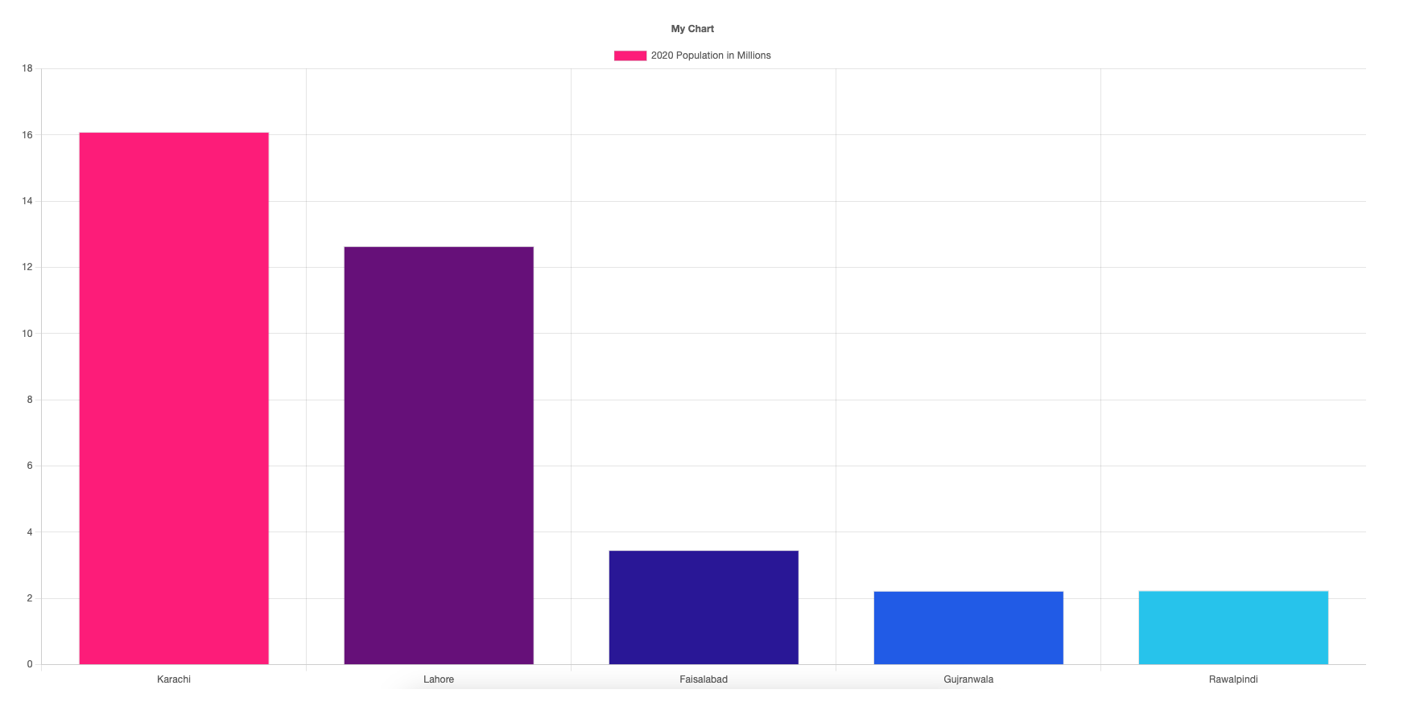
myChart.py
myChart.html
python myChart.py

Slide 8

myChart.py
pieSparrow
python myChart.py

Slide 9
myChart.py
myChart
Terminal
$<piesparrow>

