Slide 1


import pandas as pd
import piesparrow as ps
df = pd.read_csv('pop.csv')
ps.init(filename = 'myChart',title = ‘My Chart')
ps.row(
col1 = ps.bar(
title = 'Population of Cities',
dataframe = df,
xlabel = 'City',
xdata = 'Population 2020',
ylabel = ‘2020 Population in Millions'
)
)
$<piesparrow>

Slide 2
import pandas as pd
import piesparrow as ps
df = pd.read_csv('pop.csv')
ps.init(filename = 'myChart',title = ‘My Chart')
ps.row(
col1 = ps.bar(
title = 'Population of Cities',
dataframe = df,
xlabel = 'City',
xdata = 'Population 2020',
ylabel = ‘2020 Population in Millions'
)
)
$<piesparrow>
python myChart.py

Slide 3

import pandas as pd
import piesparrow as ps
df = pd.read_csv('pop.csv')
ps.init(filename = 'myChart',title = ‘My Chart')
ps.row(
col1 = ps.bar(
title = 'Population of Cities',
dataframe = df,
xlabel = 'City',
xdata = 'Population 2020',
ylabel = ‘2020 Population in Millions'
)
)
$<piesparrow>
python myChart.py
$<piesparrow>

Slide 4

import pandas as pd
import piesparrow as ps
df = pd.read_csv('pop.csv')
ps.init(filename = 'myChart',title = ‘My Chart')
ps.row(
col1 = ps.bar(
title = 'Population of Cities',
dataframe = df,
xlabel = 'City',
xdata = 'Population 2020',
ylabel = ‘2020 Population in Millions'
)
)
$<piesparrow>
python myChart.py
$<piesparrow>

Slide 5

import pandas as pd
import piesparrow as ps
df = pd.read_csv('pop.csv')
ps.init(filename = 'myChart',title = ‘My Chart')
ps.row(
col1 = ps.bar(
title = 'Population of Cities',
dataframe = df,
xlabel = 'City',
xdata = 'Population 2020',
ylabel = ‘2020 Population in Millions'
)
)
$<piesparrow>
python myChart.py
$<piesparrow>

Slide 6
import pandas as pd
import piesparrow as ps
df = pd.read_csv('pop.csv')
ps.init(filename = 'myChart',title = ‘My Chart')
ps.row(
col1 = ps.bar(
title = 'Population of Cities',
dataframe = df,
xlabel = 'City',
xdata = 'Population 2020',
ylabel = ‘2020 Population in Millions'
)
)
$<piesparrow>
python myChart.py
$<piesparrow>

Slide 7
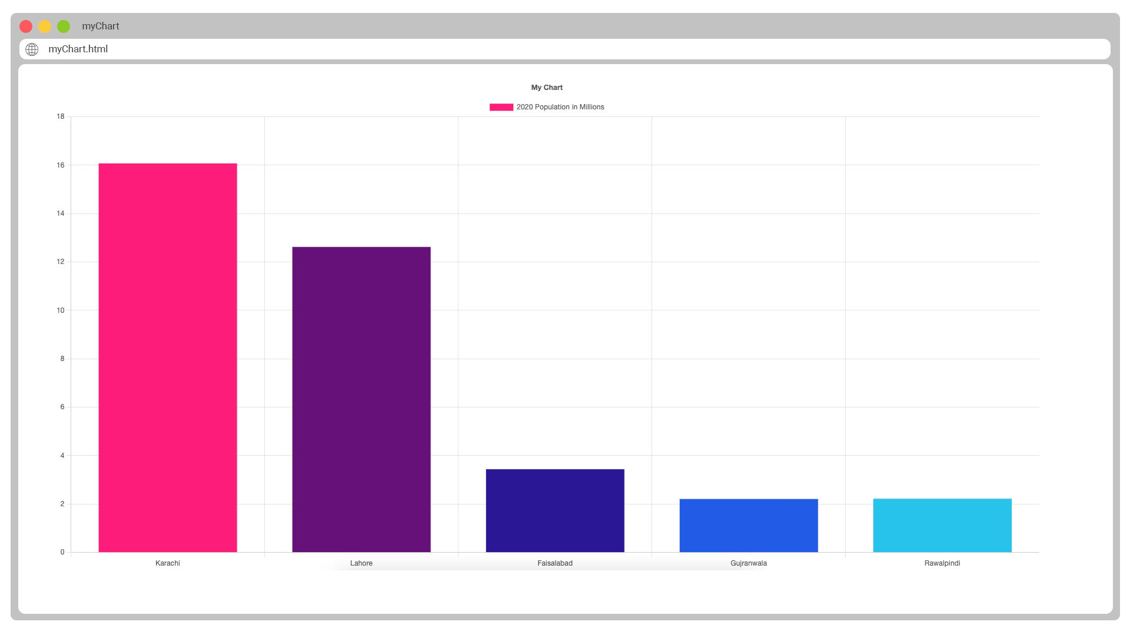

Slide 9

pieSparrow

Slide 10
pieSparrow

Slide 11
pieSparrow

Slide 12
$<piesparrow>

