Slide 1
mobile and web application
-Which deals with Transportation Service
Team Members:
1)Veerendra
2)Pranathi
3)Naveen Kumar Reddy
4)Charan Tej Reddy
5)Deekshith Reddy

Slide 2
WHY WE CHOOSE THIS AS PCL PROJECT?
1)First thing is we wanted to do something from which we are learning.so as java is going on so we wanted to do something w.r.t java
2)so we thank of a mobile application then when all of our team members used to have a conversion of what to do some one of us raised a point i.e we want to do something which should be used after implementation.it should not be like which is just implemented and kept a side
3)so we thank for such a thing then we came to know one of our team members dad runs transportation service on contract base .then when we used to discuss like how could we implement a app for such thing.

Slide 3
What exactly THE BUSSINESS IS?
SLAP
SWIFT SS
KIA
SUB COMAPANYS
SUB COMAPANYS
SUB COMPANYS
SUB COMAPANYS
BOGOOK
SEOYEN

Slide 4
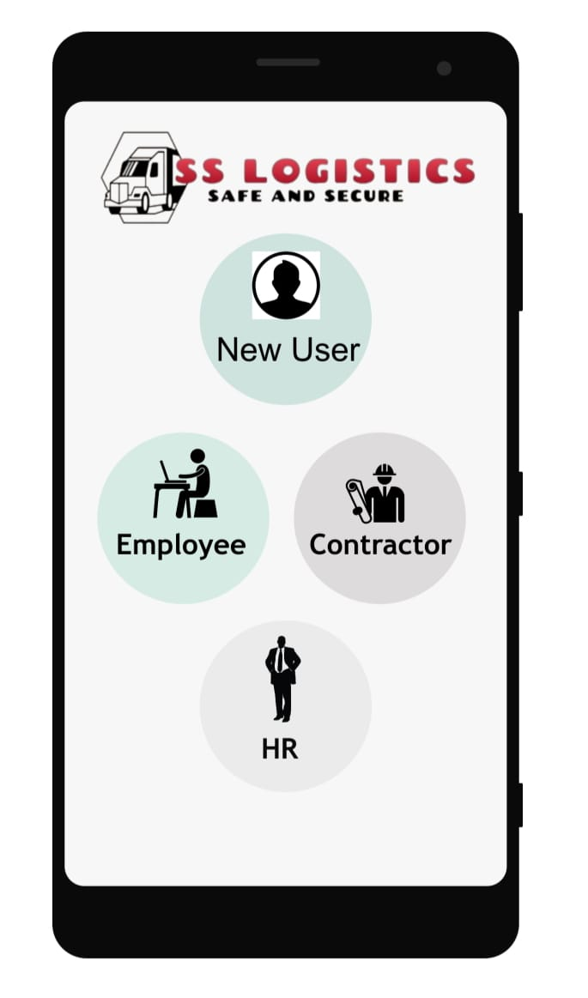

Slide 5
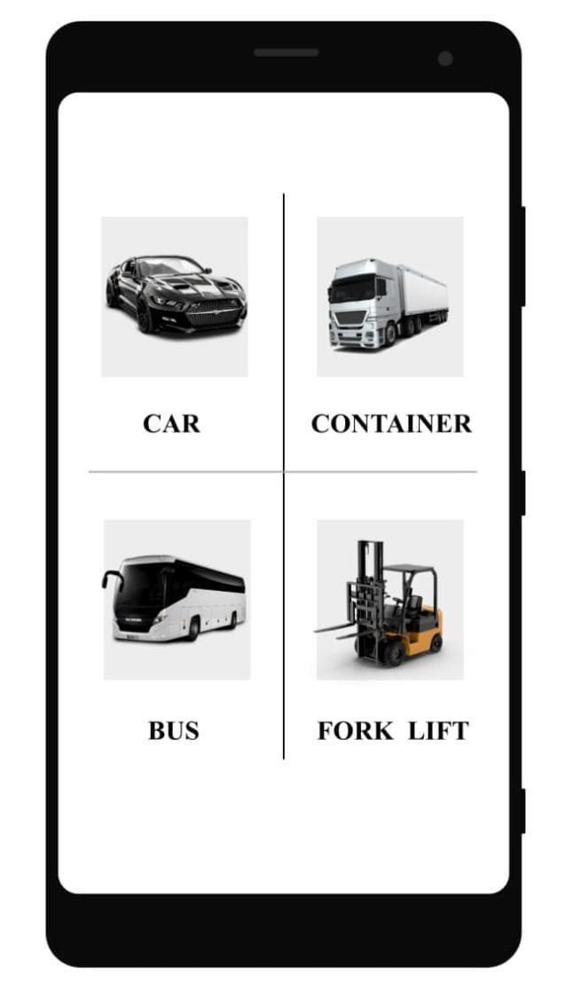

Slide 6
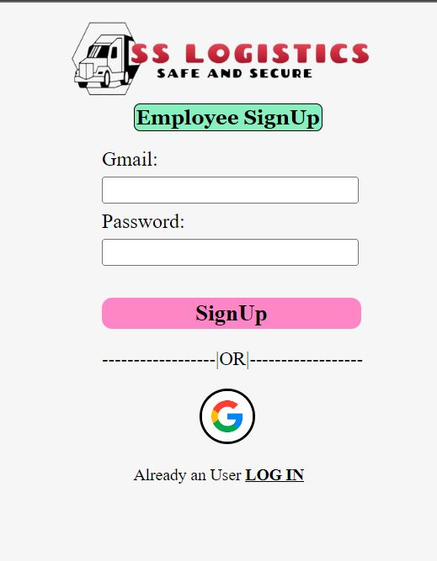
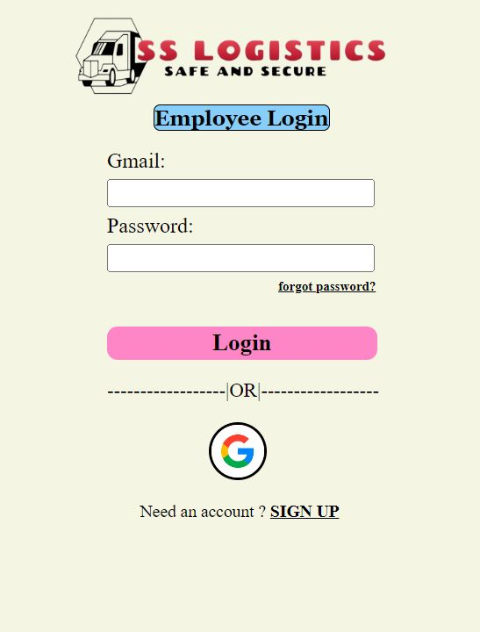

Slide 7
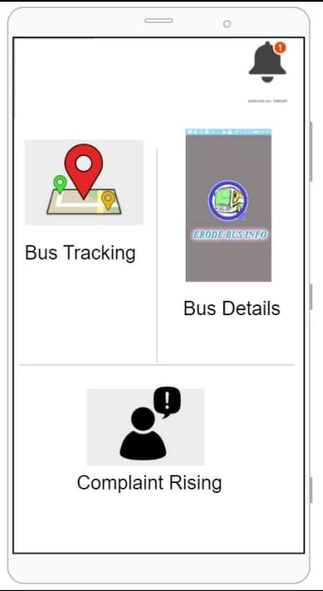

Slide 8
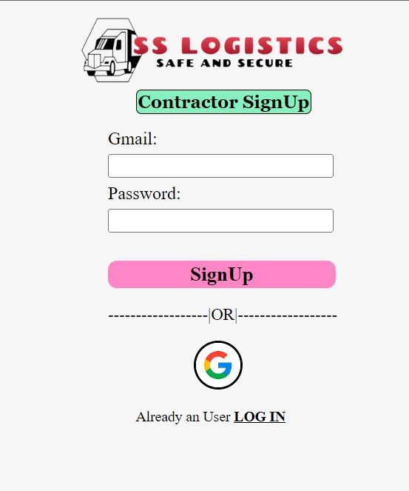
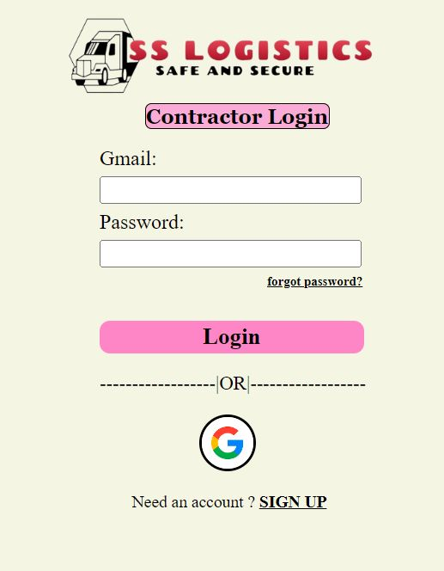

Slide 9
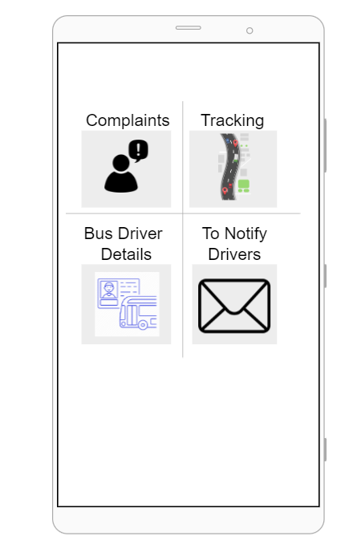

Slide 10
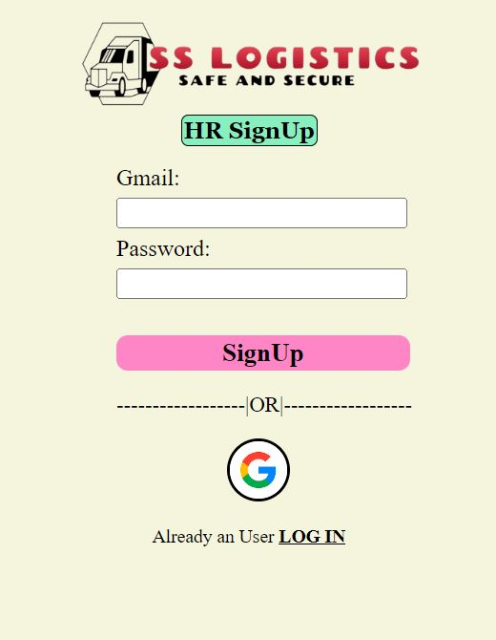
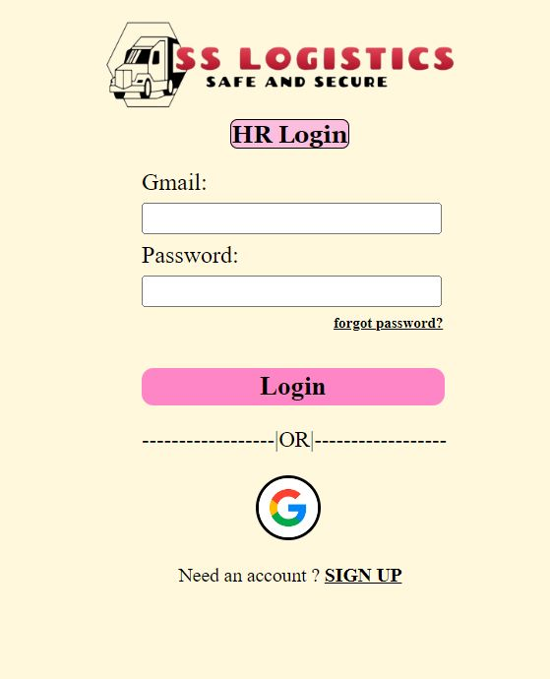

Slide 11
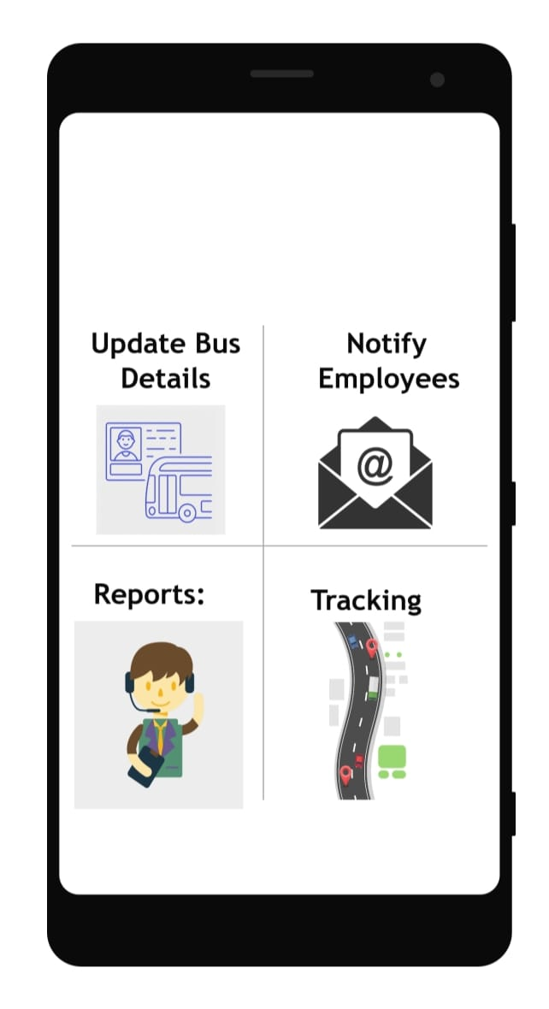

Slide 12
What could we contribute?
1)when we decided to implement a app based on that then we got a dout like what all we could do in order to make that business better and run smoothly
2)Then we asked our team member like say what all problems are being faced in the business which could be solved by a app.
3)Then the problems came in picture are:
➔Raising quotations
➔Problems faced by companies(HR for transport)with respect to transportation service:
Vehicle status
Vehicle location
Driver left the employee from pickup.
Driver not coming on time for pickup.

Slide 13
Problems faced by the Employees:
Not knowing whether the vehicle left the stop or not
Being in a confusion of whether to reach workplace by other means of transport bcz of not knowing location of vehicle
Problems faced by the contractor:
➔Calls from driver regarding:
diesel completion in middle of route
vehicle breakdown
➔Calls from HR regarding :
Vehicle status
Vehicle location
Driver left the employee from pickup.
Driver not coming on time for pickup
➔Stealing of diesel by drivers and selling it .
➔quoting high and requesting from owner of vehicle for small breakdowns.

Slide 14
How could we involve to solve these things??
Raising Quotations:
Now a days in every big companies are calling contractors for online quotations or tenders, but it not w.r.t KIA but as we need to be in advance w.r.t online tenders so we are planning to create quotation In app itself by asking necessary things as input from the contracter and converting that information into quotation(only for lenders)
we are going to have an option for the user like get a quotation on a particular vehicle . where in which he will be asked for route,duration of contract, number of seats based on the vehicle.
So the information collected will be sent to all trusted lenders we have with us they will send a quotation with images and video of vehicle to us in all of those which is suitable(suitable In the sense of less quote and nice vehicle(model),nice body) one is sent to the user who requested along with details of vehicle images and videos of vehicle.

Slide 15
2&3)Solving problems faced by companies and employees:
The main problem faced by the employees and companies is not knowing the location of vehicle exactly
To know location of vehicle:
See we are in a plan to keep a tracker in the vehicle and add API of that tracker into our app and give access to the company heads and vehicle owners to track all the moves of the vehicle
With respect to the employees we collect the data of them like name , phno ,route(in the sense location) of the employee, based on the location he belongs to he will be given access to see the location of the vehicle of that route.
To make employee picked up by driver:
We are in a idea of employee being noticed when the vehicle is 10 KMS away from him.so that he will be hurried an get ready faster in order to get into bus and not to miss the bus.
If any employee is in the way to reach the bus and bus is at stop as he knows bus is on location he could request the driver to wait as every employee of particular route will be provided with the drivers name and number of that particular day

Slide 16
See if employee is too late to pick up a particular bus he could see whether any other company bus is there for that route, if it is there he could wait for that and go in it .
To avoid consequences due to driver negligence or emergency:
Normally what happens with respect to drivers is they stop the vehicle in a location which is not a stop for silly reasons like for drinking tea ,having a cigarette or talking to friends or it might be an emergency like tire puncture or any other emergency, this leads to late reach of employees to company,
so in order to avoid this problem are we are planning like if a vehicle stops for more than some x(probably 10) minutes HR and OWNER of the vehicle will be notified like it might be emergency or driver negligence and displayed with the number of that vehicle driver .so he or she could call and know what’s the issue and he will be asked with pictures in case of emergency.

Slide 17
Solving problems faced by the contractor:
Problems related to fuel completion and emergency:
See regarding fuel and condition of vehicle before starting the vehicle driver or HR or vehicle supervisor need to update fuel sufficiency for route , brakes condition , driver number , drive name for particular route.
So that there will be no issue with fuel as fuel is checked , drive name and number will be updated so that employees ,HR’s Owners could access driver.
Regarding Scam in fuel by drivers:
The problem of fuel scam by drivers is the major issue faced by the vehicle owners
see we are planning to have a sensor which could detect sudden decrease in fuel capacity or a sensor which detects fuel cap opening and closing.so that if fuel is open for more than required time a notification alert to be sent to owner so that could save amount of fuel that is being eaten by drivers.

Slide 18
Having network of mechanics :
Drivers , owners will be provided with an option of displaying the phone numbers of trusted mechanics in a locality
See for example if a vehicle breaks down in a particular location then if he goes through the break down option in the app he will be asked with phone number if he matches with drivers data base then he will be asked for location u want to search for than the phone numbers and names of the mechanics will be displayed.so that he could call them and bring back the vehicle into good condition reach company on time.
See if the mechanics knows these are vehicles requested from our app they even quote for less value for more calls.

Slide 19
THANK YOU

