Slide 1
Real-Time Object Detection Using OpenCV
Team Members:
Amrit Rai
Shivam Rathour
Deepak Kumar Singh

Slide 2

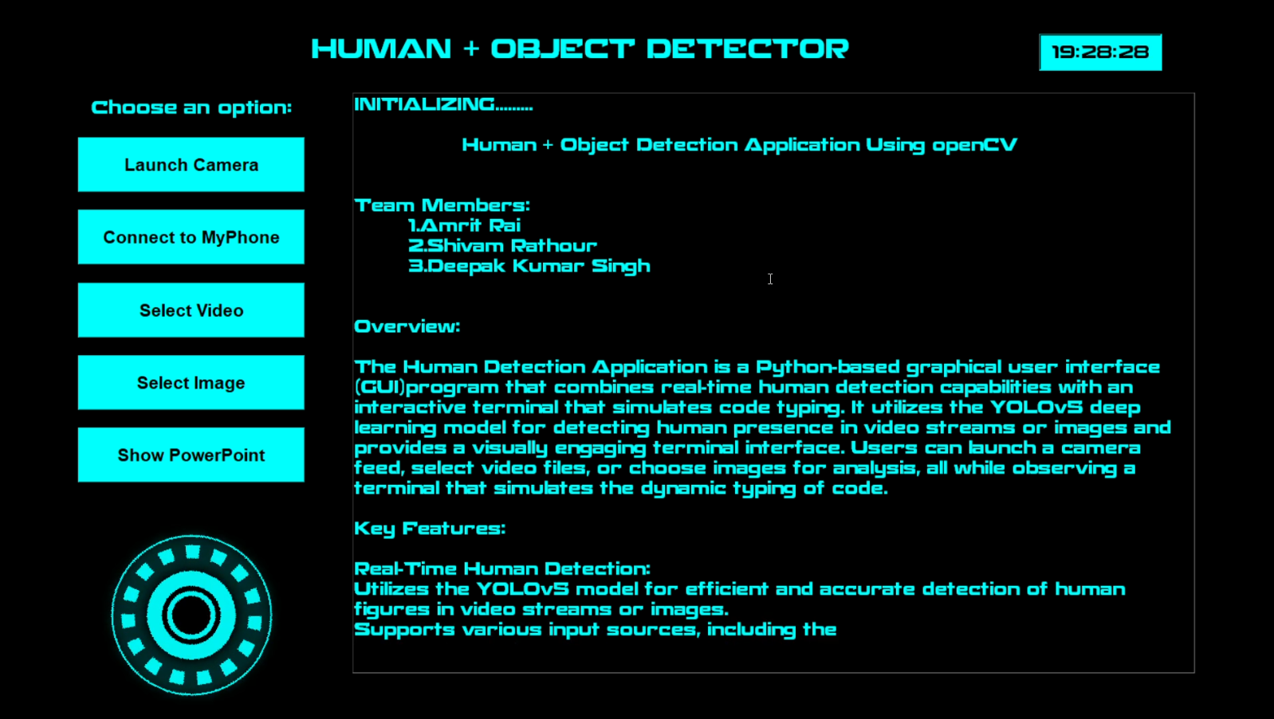
Introduction
Object detection is a crucial aspect of computer vision, enabling machines to identify and localize objects within images or video streams. This project focuses on utilizing OpenCV and deep learning techniques to implement a real-time object detection system.
Using the YOLOv5 Model For the better performance in detection .

Slide 3
Problem Description & Motivation
The increasing need for automation in various fields such as security, autonomous vehicles, and robotics highlights the importance of efficient object detection systems. Current solutions often struggle with accuracy and speed in real-time applications.

Slide 4
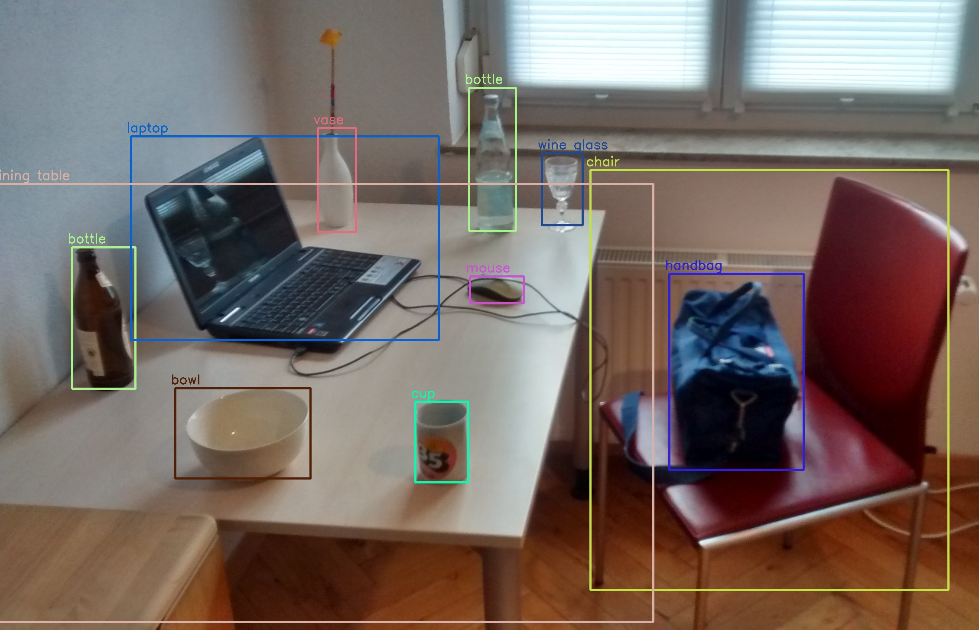
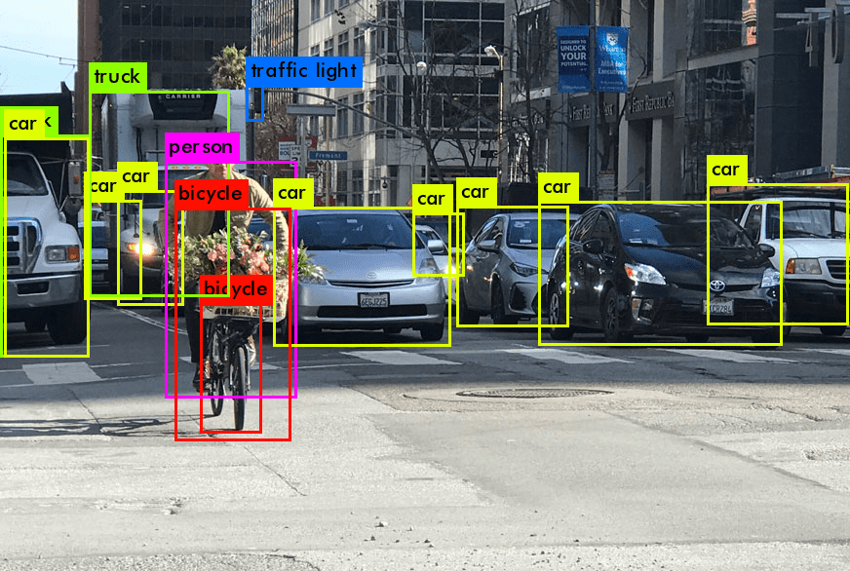
Objectives of Project
- A real-time object detection system using OpenCV.
- Human Count Application.
- Integrate deep learning models for effective detection.
- Validate the system in diverse conditions.
- checking the accuracy of the object finding using phone camera(for the better Quality image Detection)
- Identification of image and video

Slide 5
Flow of Project
Requirement Analysis
Data Acquisition & Preprocessing
Model Training
Real-Time Detection Integration
User Interface Development
Testing & Validation
Deployment
Data collection
Model Selection
Model Training
Model Optimization
System Integration
Testing and Validation

Slide 6





Technology to be Used
- Programming Language: Python
- Libraries: OpenCV, TensorFlow/PyTorch, Pygame
- Model: YOLOv5
- IDE: Visual Studio Code

Slide 7
Applications
Autonomous Vehicle
Augmented Reality (AR):
Security and Surveillance
Smart Cities:
Robotics
Agriculture
Healthcare
Manufacturing and Quality
Control

Slide 8
Advantages & Limitations
**Advantages:**
- High accuracy with deep learning models.
- Real-time processing capabilities.
- Wide range of applications.
**Limitations:**
- Requires substantial computational resources.
- May struggle with overlapping objects.
- Performance varies with different environments.

Slide 9
References
- Goodfellow et al. (2016). Deep Learning. MIT Press.
- Redmon et al. (2016). You Only Look Once: Unified Real-Time Object Detection. arXiv.
- Liu et al. (2016). SSD: Single Shot MultiBox Detector. arXiv.
- Forsyth, D.A., & Ponce, J. (2012). Computer Vision: A Modern Approach. Prentice Hall.

Slide 10
Conclusion
The project aims to create an efficient real-time object detection system using OpenCV and deep learning techniques, addressing the growing demand for such technologies in various sectors.

