Slide 1
Project Title: PCB Defect Detection System
By- Deepali Singh

Slide 2
Introduction and Project Overview
PCB Defect Detection and Classification System
Project Overview:
Printed Circuit Boards (PCBs) are critical components in electronic systems. Manual inspection of PCB defects is time-consuming, error-prone, and inefficient for large-scale production.
This project presents an automated PCB defect detection and classification system using:
Reference-based Image Subtraction (OpenCV)
Contour Detection & ROI Extraction
Transfer Learning with EfficientNet (Deep Learning)
Streamlit-based Web Application for real-time prediction
Project Objectives:
Detect and localize PCB defects using template comparison
Extract defect regions automatically
Classify defects into 6 predefined categories
Provide a user-friendly web interface for image upload and visualization

Slide 3
Dataset Description and Preparation
The project uses the DeepPCB Dataset, which contains paired images of:
Template (Golden) PCB images – defect-free boards
Defective PCB test images
Each test image contains one or more defects.
Defect Categories (6 Classes):
Missing Hole
Mouse Bite
Open Circuit
Short
Spur
Spurious Copper
Data Preparation Steps:
Template and test image alignment
Automatic template matching
Mask generation using subtraction
ROI extraction and labeling
Train–Validation split (80% / 20%)

Slide 4
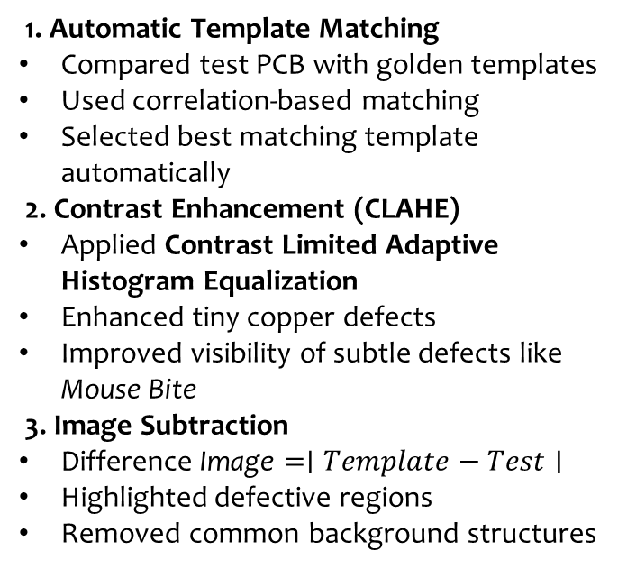
Data Preprocessing Techniques
1. Automatic Template Matching
Compared test PCB with golden templates
Used correlation-based matching
Selected best matching template automatically
2. Contrast Enhancement (CLAHE)
Applied Contrast Limited Adaptive Histogram Equalization
Enhanced tiny copper defects
Improved visibility of subtle defects like Mouse Bite
3. Image Subtraction
$\text{Difference} \text{Image}=∣Template−Test∣$
Highlighted defective regions
Removed common background structures
4. Adaptive Thresholding
Converted difference image into binary mask
Local thresholding for detecting faint defects
5. Morphological Filtering
Removed noise
Refined defect boundaries
Generated clean defect masks
Output of Preprocessing:
✔ Accurate defect mask ✔ Clean separation of defective regions ✔ Ready for contour detection

Slide 5
Exploratory Data Analysis and Visualization
Sample ROI Visualizations:
We visualized cropped defect regions extracted from masks:
Each ROI resized to 128×128
Padding added for contextual information
Normalized before feeding into CNN
Mask and Contour Visualization:
Contours detected using OpenCV
Bounding boxes drawn around defects
Verified correctness visually
Insight from EDA:
✔ Defects vary in shape and size ✔ Some defects are subtle (e.g., Mouse Bite) ✔ Proper preprocessing is crucial for classification accuracy
📈 Dataset Analysis:
Before training the model, we analyzed the dataset to understand:
Class distribution
Defect frequency
Visual characteristics of each defect type
ROI size variations
Class Distribution:
Observed imbalance in some defect categories
Ensured proper train–validation split
Used data augmentation to improve generalization

Slide 6
Model Architecture and Design
Training Configuration
Loss Function: Cross Entropy
Optimizer: Adam
Learning Rate: 0.0001
Early Stopping enabled
Why EfficientNet?
✔ Balanced depth, width, and resolution ✔ High accuracy with fewer parameters ✔ Fast inference suitable for web deployment
Model Used: EfficientNet-B0 (Transfer Learning)
Pretrained on ImageNet
Fine-tuned for 6 PCB defect classes
Modified final fully connected layer
Architecture Overview
Input (128×128 ROI) ↓ EfficientNet Feature Extractor ↓ Global Average Pooling ↓ Fully Connected Layer (6 classes) ↓ Softmax Output

Slide 7
Experimental Setup and Training Details
Training Configuration:
Image Size: 128 × 128
Batch Size: 32
Optimizer: Adam
Learning Rate: 0.0001
Loss Function: Cross Entropy
Early Stopping: Enabled
Data Split:
80% Training
20% Validation
Training Performance:
Final Test Accuracy: ~99%
Stable convergence
Low validation loss
Minimal overfitting

Slide 8
Challenges and Limitations
Challenges Faced:
Subtle defects like Mouse Bite were harder to detect
Threshold tuning required for accurate mask generation
Template mismatch could produce false positives
Class imbalance in dataset
Technical Limitations:
Sensitive to lighting variations
Requires correct template for accurate subtraction
Performance depends on mask quality
Learning Outcome:
Importance of preprocessing in computer vision
Transfer learning improves performance significantly
End-to-end system integration is complex but powerful

Slide 9
Future Work and Scope
Future Improvements:
Deploy system to cloud (AWS / Azure)
Enable real-time camera-based PCB inspection
Add batch processing for industrial use
Implement defect severity scoring
Improve mask generation using deep segmentation models
Scalability:
Extend to multi-layer PCB inspection
Support additional defect categories
Optimize inference time further
Vision:
To develop a fully automated, production-ready PCB inspection system for industrial manufacturing environments.

Slide 10
Feature Engineering
ROI-Based Feature Preparation for CNN:
Contour-based defect detection
Bounding box extraction with padding
Cropped ROIs resized to 128×128
Normalized using ImageNet statistics
Data Augmentation:
Horizontal & Vertical Flip
Random Rotation
Color Jitter
✔ Improves generalization ✔ Reduces overfitting
Final Input to Model:
Clean defect-focused ROIs
Standardized format for EfficientNet

Slide 11
Methodology
System Workflow:
1. User Uploads Images
Template (Golden PCB)
Test (Defective PCB)
2. Image Subtraction
Compute absolute difference
3. Mask Generation
CLAHE enhancement
Adaptive thresholding
Morphological filtering
4. Contour Detection
Identify defect boundaries
5. ROI Extraction
Crop defect regions with padding
6. CNN Classification
EfficientNet predicts defect class
7. Annotated Output
Bounding boxes + labels displayed in UI
Exportable image and CSV log
📌 Final Pipeline
Upload → Subtraction → Mask → Contours → ROI → EfficientNet → Annotated Result

Slide 12
Conclusion
Developed an automated PCB defect detection system
Implemented image subtraction & contour-based ROI extraction
Trained EfficientNet-B0 using transfer learning
Achieved ~99% classification accuracy
Built a Streamlit web application for real-time inference
Integrated backend pipeline with exportable results
Key Achievements:
✔ End-to-end working system ✔ High model accuracy and stability ✔ Real-time UI with annotated outputs ✔ Professional GitHub repository structure
💡 Final Statement:
This project demonstrates a complete integration of Computer Vision, Deep Learning, and Web Deployment for automated PCB inspection.

Slide 13
Thank you!

