Slide 1
Surveying Phylogenetic Forests
DeAngelo Wilson

Slide 2
Draft
Methods
DNA → Tree
Analysis Tools
Symmetric Difference
Quartet Compatibility
Quartet Agreement
Induced Quartet Agreement
Timing differences
Results

Slide 3
Computational Phylogenetics
DNA sequences → Phylogenetic trees
Notes:
background

Slide 4
Timings
Our horse: NCD
16 DNA sequences
XXXXX
59 DNA sequences
XXXXX
The standard: MrBayes
16 DNA sequences
XXXXX
59 DNA sequences
XXXXX
Notes:
CREATE GRAPIC FOR TIMINGS TABLE
Motivation

Slide 5
MrBayes
Monte Carlo Mark-off chain
Process + Speed
Notes:
Context

Slide 6
Normalized Compression Distance
Based on Kolomogrov Complexity
Based on Normalized information distance
Unprovable… NCD is based on………………
Used in vitany paper as example, we are trying to prove with results, that it is a valid method for phylogeny creation.
Avoids Multiple Sequence Alignment
Notes:
Context

Slide 7
Compression
Compression algorithms
Basis…
Speed
Notes:
Context

Slide 8
Analysis Tools
Symmetric Difference
Quartet Compatibility
Quartet Agreement
Induced Quartet Agreement
Notes:
Context

Slide 9
Bipartition
Tree diagram (build – slide_1)

Slide 10
Bipartition
Biparted tree diagram (build – slide_2)

Slide 11
Symmetric Difference

Slide 12
Results
Notes:
Examples

Slide 13
Timings
Notes:
Example

Slide 14
PhyloTools
Swiss army knife
Input:
FASTA sequences
…
Output:
Tree analysis document
…

Slide 15
Future Steps?

Slide 16
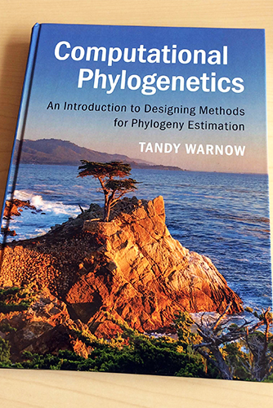
Reference
NCD paper citation
Tandy Warnow citation

