Slide 1
Surveying Phylogenetic Forests
DeAngelo Wilson

Slide 2
Draft
Methods
DNA → Tree
MrBayes (MCMC)
NCD
Maximum parsimony
Maximum likelihood
Analysis Tools
Symmetric Difference
Quartet Compatibility
Quartet Agreement
Induced Quartet Agreement
Timing differences
Results

Slide 3
Computational Phylogenetics
Phylogeny estimation
DNA sequences → Phylogenetic trees
Phylogenetic Trees identify evolutionary relationships between species
From single gene phylogenies → Genome-scale phylogenies
As with everything, hardware can only improve so much, many of the standard or best methods are fat too computationally expensive
Improved DNA sequencing allows readily available genomes + algorithms
Notes:
background

Slide 4
Timings
Our horse: NCD
16 DNA sequences
XXXXX
59 DNA sequences
XXXXX
The standard: MrBayes
16 DNA sequences
XXXXX
59 DNA sequences
XXXXX
Notes:
CREATE GRAPIC FOR TIMINGS TABLE
Motivation

Slide 5
MrBayes
Markov Chain Monte Carlo
Process + Speed
Multiple Sequence Alignment
costly precursor
Bells and whistles
Parameters of MrBayes
Substitution rates
Assumptions!
Notes:
Context

Slide 6
Normalized Compression Distance
Based on Kolomogrov Complexity
Based on Normalized information distance
Unprovable… NCD is based on………………
Used in vitany paper as example, we are trying to prove with results, that it is a valid method for phylogeny creation.
Avoids Multiple Sequence Alignment
Muscle timings
Notes:
Context

Slide 7
Compression
Compression algorithms
Basis…
Speed
Notes:
Context

Slide 8
Analysis Tools
Symmetric Difference
Quartet Compatibility
Quartet Agreement
Induced Quartet Agreement
Notes:
Context

Slide 9
Bipartition
Tree diagram (build – slide_1)

Slide 10
Bipartition
Biparted tree diagram (build – slide_2)

Slide 11
Phylogeny Estimation: Quantifying Error
False Negatives
Bipartitions in true tree, not in T*
False Positives
Bipartitions in T not in true-tree
Robinson-Foulds (RF) Distance
Number of non-trivial bipartitions present in one tree but not the other
FN + FP / 2n - 6

Slide 12
Symmetric Difference
Range:
0 – Identical structures
2n – 6 – maximally different trees
N – 3 internal edges

Slide 13
Homeomorphic Subtrees
EXAMPLE! (build)
Large-tree → induced tree highlighted → induced tree refined and extracted
Homeomorphic subtree of T induced by X
AKA: T|X

Slide 14
Compatibility
Identical trees / Total tree count
Quartet compatibility – induced quartets compared to directly generated quartets
(p. 91) St. John et al (2003) proved induced quartets from NJ more accuarete than directly generated Quartets from FPM
T & t
If T|X is refinement of t ( i.e. C(T|X) contains all bipartitions of C(t) )
NOTE: C(T|X) may have additional bipparitions (refinement)
(p. 52) → For every tree (t-i) in tree set, sum of RF(T|t-i) == 0

Slide 15
Agreement
Q(T0) (intersection) Q(T)
T0 → “true tree”
Quartet Agreement
Agreement between directly generated quartet trees
Induced Quartet Agreement
Agreement between induced quartet trees

Slide 16
Results
Notes:
Examples

Slide 17
Timings
Notes:
Example

Slide 18
PhyloTools
Swiss army knife
Input:
FASTA sequences
…
Output:
Tree analysis document
…

Slide 19
Future Steps?
Exploring compression methods
7zip vs. WinZip
Biological assumptions in compression (MFC)

Slide 20
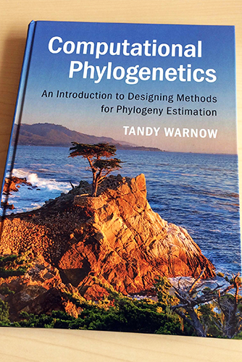
Reference
NCD paper citation
Tandy Warnow citation
Dr. Rogers

