Slide 1
Surveying Phylogenetic Forests
DeAngelo Wilson

Slide 2
Draft
Methods
DNA → Tree
MrBayes (MCMC)
NCD
Maximum parsimony
Maximum likelihood
Analysis Tools
Symmetric Difference
Quartet Compatibility
Quartet Agreement
Induced Quartet Agreement
Timing differences
Results

Slide 3
Outline
NID/Kolomogorov
NCD → Formula + basis
Distance matrices
Distance based alignment-free methods
examples
Trees
Datasets…
justification
Methods
DNA → Tree
MrBayes (MCMC)
Neighbor Joining with p-value(NJp)
NCD
Analysis by comparison…
Results
Analysis Tools
Symmetric Difference
Quartet Compatibility
Quartet Agreement
Induced Quartet Agreement
Timing differences
Future steps

Slide 4
Computational Phylogenetics
Phylogeny estimation
DNA sequences → Phylogenetic trees
Phylogenetic Trees identify evolutionary relationships between species
From single gene phylogenies → Genome-scale phylogenies
As with everything, hardware can only improve so much, many of the standard or best methods are fat too computationally expensive
Improved DNA sequencing allows readily available genomes + algorithms
Notes:
background

Slide 5
Timings
Our horse: NCD
16 DNA sequences
XXXXX
59 DNA sequences
XXXXX
The standard: MrBayes
16 DNA sequences
XXXXX
59 DNA sequences
XXXXX
Notes:
CREATE GRAPIC FOR TIMINGS TABLE
Motivation

Slide 6
MrBayes
Markov Chain Monte Carlo
Process + Speed
Multiple Sequence Alignment
costly precursor
Notes:
Context

Slide 7
Normalized Compression Distance
Based on Kolomogrov Complexity
Based on Normalized information distance
Unprovable… NCD is based on………………
Used in vitany paper as example, we are trying to prove with results, that it is a valid method for phylogeny creation.
Avoids Multiple Sequence Alignment
Muscle timings
Notes:
Context

Slide 8
Compression
Compression algorithms
Basis…
Speed
Notes:
Context

Slide 9
Analysis Tools
Symmetric Difference
Quartet Compatibility
Quartet Agreement
Induced Quartet Agreement
Quartet Compatibility
Sum of RF distance for each pairing
LargeTree ← → LargeTree
True distance
Induced Quartets ←→ Quartets
??? Purpose
Quartets ←→ Quartets
??? Purpose
Analyzing tree on smaller scale -> results
Induced Quartets ←→ Induced Quartet
Should be similar (identical relations?) results to largetree ←→ largetree
Notes:
Context

Slide 10
Simulations
True tree

Slide 11
Bipartition
Tree diagram (build – slide_1)

Slide 12
Bipartition
Biparted tree diagram (build – slide_2)

Slide 13
Phylogeny Estimation: Quantifying Error
False Negatives
Bipartitions in true tree, not in T*
False Positives
Bipartitions in T not in true-tree
Robinson-Foulds (RF) Distance
Number of non-trivial bipartitions present in one tree but not the other
FN + FP / 2n - 6

Slide 14
Symmetric Difference
Range:
0 – Identical structures
2n – 6 – maximally different trees
N – 3 internal edges
- importance of difference in biparititons
(fitting into biological standard ) proof of concept

Slide 15
Homeomorphic Subtrees
EXAMPLE! (build)
Large-tree → induced tree highlighted → induced tree refined and extracted
Homeomorphic subtree of T induced by X
AKA: T|X

Slide 16
Compatibility
Identical trees / Total tree count
Wilson-rogers compatability
Quartet compatibility – induced quartets compared to directly generated quartets
(p. 91) St. John et al (2003) proved induced quartets from NJ more accuarete than directly generated Quartets from FPM
WHY QUARTETS?
Smallest unit -- Building blocks???
(behaving like mrBayes – proof of concept)
T & t
If T|X is refinement of t ( i.e. C(T|X) contains all bipartitions of C(t) )
NOTE: C(T|X) may have additional bipparitions (refinement)
(p. 52) → For every tree (t-i) in tree set, sum of RF(T|t-i) == 0

Slide 17
Agreement
Q(T0) (intersection) Q(T)
T0 → “true tree”
Quartet Agreement
Agreement between directly generated quartet trees
Induced Quartet Agreement
Agreement between induced quartet trees
What does this result say???
Why quartets???

Slide 18
Results
Pick tables that show argument
Notes:
Examples

Slide 19
Timings
Notes:
Example

Slide 20
PhyloTools
Swiss army knife
Input:
FASTA sequences
…
Output:
Tree analysis document
…

Slide 21
Future Steps?
Exploring compression methods
7zip vs. WinZip
Biological assumptions in compression (MFC)

Slide 22
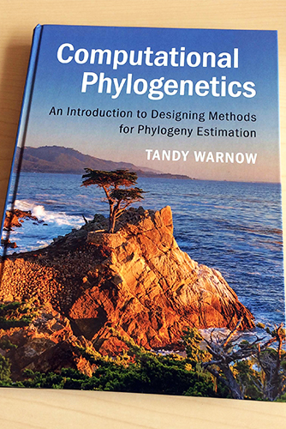
Reference
NCD paper citation
Tandy Warnow citation
Dr. Rogers

