Slide 1
Surveying Phylogenetic Forests
DeAngelo Wilson

Slide 2
Draft
Methods
DNA → Tree
MrBayes (MCMC)
NCD
Maximum parsimony
Maximum liklihood
Analysis Tools
Symmetric Difference
Quartet Compatibility
Quartet Agreement
Induced Quartet Agreement
Timing differences
Results

Slide 3
Computational Phylogenetics
Phylogeny estimation
DNA sequences → Phylogenetic trees
Phylogenetic Trees identify evolutionary relationships between species
From single gene phylogenies → Genome-scale phylogenies
As with everything, hardware can only improve so much, many of the standard or best methods are fat too computationally expensive
Improved DNA sequencing allows readily available genomes + algorithms
Notes:
background

Slide 4
Timings
Our horse: NCD
16 DNA sequences
XXXXX
59 DNA sequences
XXXXX
The standard: MrBayes
16 DNA sequences
XXXXX
59 DNA sequences
XXXXX
Notes:
CREATE GRAPIC FOR TIMINGS TABLE
Motivation

Slide 5
MrBayes
Markov Chain Monte Carlo
Process + Speed
Multiple Sequence Alignment
Notes:
Context

Slide 6
Normalized Compression Distance
Based on Kolomogrov Complexity
Based on Normalized information distance
Unprovable… NCD is based on………………
Used in vitany paper as example, we are trying to prove with results, that it is a valid method for phylogeny creation.
Avoids Multiple Sequence Alignment
Notes:
Context

Slide 7
Compression
Compression algorithms
Basis…
Speed
Notes:
Context

Slide 8
Analysis Tools
Symmetric Difference
Quartet Compatibility
Quartet Agreement
Induced Quartet Agreement
Notes:
Context

Slide 9
Bipartition
Tree diagram (build – slide_1)

Slide 10
Bipartition
Biparted tree diagram (build – slide_2)

Slide 11
Phylogeny Estimation: Quantifying Error
False Negatives
False Positives
Robinson-Foulds (RF) Distance
Number of non-trivial bipartitions present in one tree but not the other

Slide 12
Symmetric Difference

Slide 13
Homeomorphic Subtrees
EXAMPLE!
Homeomorphic subtree of T induced by X
AKA: T|X

Slide 14
Compatibility

Slide 15
Results
Notes:
Examples

Slide 16
Timings
Notes:
Example

Slide 17
PhyloTools
Swiss army knife
Input:
FASTA sequences
…
Output:
Tree analysis document
…

Slide 18
Future Steps?

Slide 19
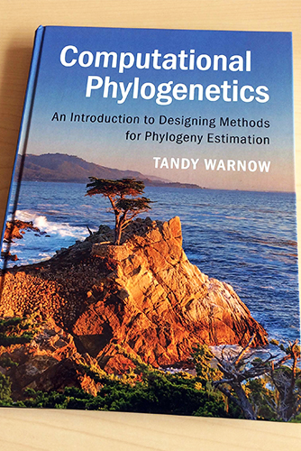
Reference
NCD paper citation
Tandy Warnow citation

