Slide 1

Supervised Learning Telco Customer Churn IART Project 2
Carlos Gomes – up201906622
Domingos Santos – up201906680
Filipe Pinto – up201907747

Slide 2
Specification
It is important for a company to retain customers in order to maintain or even increase profit, so it might be very useful to predict their behaviour. To do that we need to make a market research to answer some questions.
So, given a dataset with information about telco customers we want to predict if a customer will churn or not, according to the percentage of churn in the dataset and if that number is affected by any other variable such as gender, services subscribed or even the charges of the customer.
Other important analysis for the company are the profit evaluation such as the most profitable service or feature and the ones not sot profitable.
All of this questions/doubts should be after the study of the dataset and that'ś the main goal of this project.

Slide 3
Related Work
https://moodle.up.pt/ (course files)
https://www.kaggle.com/datasets/easonlai/sample-telco-customer-churn-dataset
https://www.kaggle.com/datasets/blastchar/telco-customer-churn

Slide 4
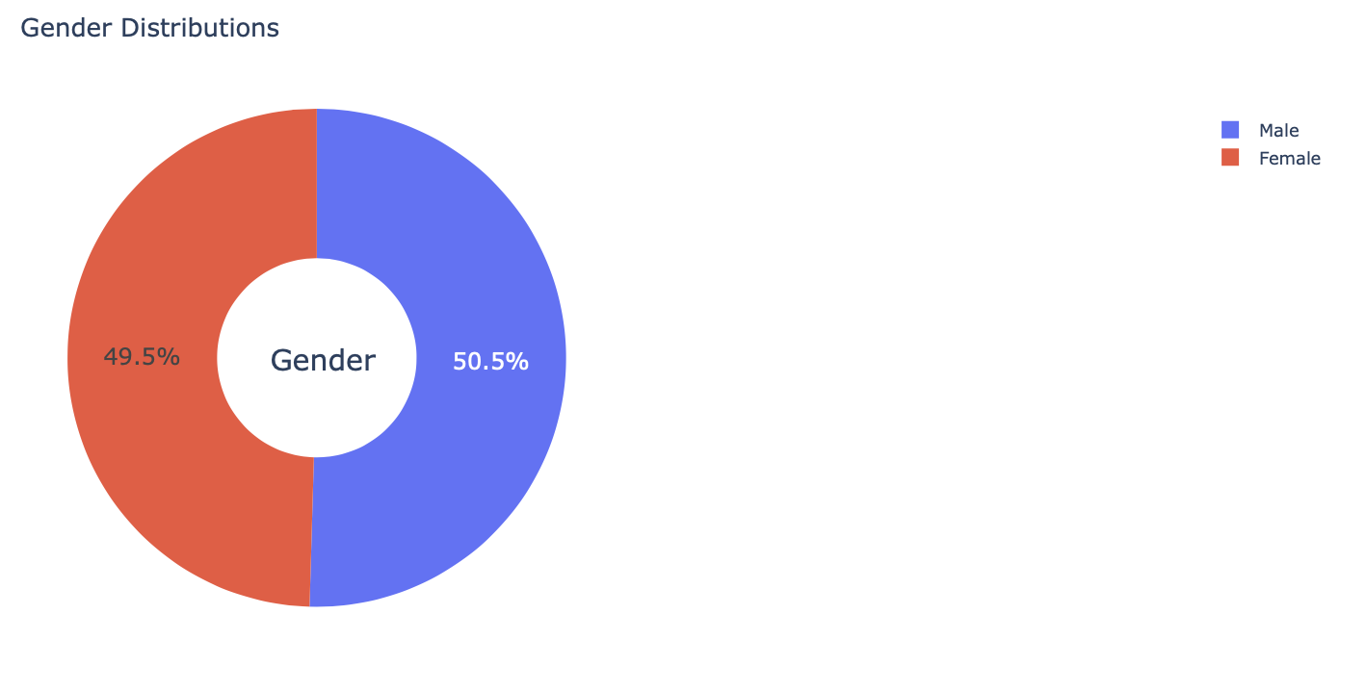
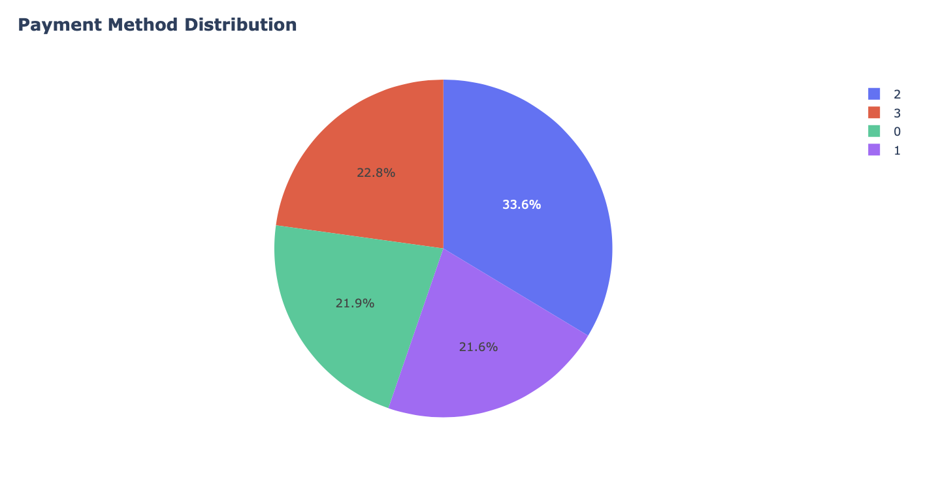
Dataset Analysis
After analysing our data, we concluded that gender distribution is equal for both genders, however, payment method distribution is not uniform, verifying distinct distribution;

Slide 5
Data Preprocessing
After analysing our dataset, we verified the existance of any missing values (no null values were found) or repeated values (only the customerId must be unique) and removed unnecessary columns for our study case (customerId will have no impact for the data study);

Slide 6
Data processing
Train and split our data;
Oversampling and undersampling data;
To contribute for an equally to model fitting, we used automatic scales;

Slide 7
Tools and algorithms
For this assignment we will use some python tools and libraries also used in classes which are:
numpy (library used for working with arrays);
pandas (data science/data analysis and machine learning tasks);
cikit-learn (machine learning and statistical modeling including classification, regression, clustering and dimensionality reduction);
matplotlib (comprehensive library for creating static, animated, and interactive visualizations in Python);
seaborn (uses Matplotlib underneath to plot graphs),
plotpy;
Our work will be developed in a python notebook- In our case Jupyter Notebook, so this packages come standard with the Anaconda python distribution;
To reach the main goal, we need to implement some classification algorithms for supervised learning such as Support Vector Machine, K-Nearest Neighbours or Decision Tree Classification;

Slide 8
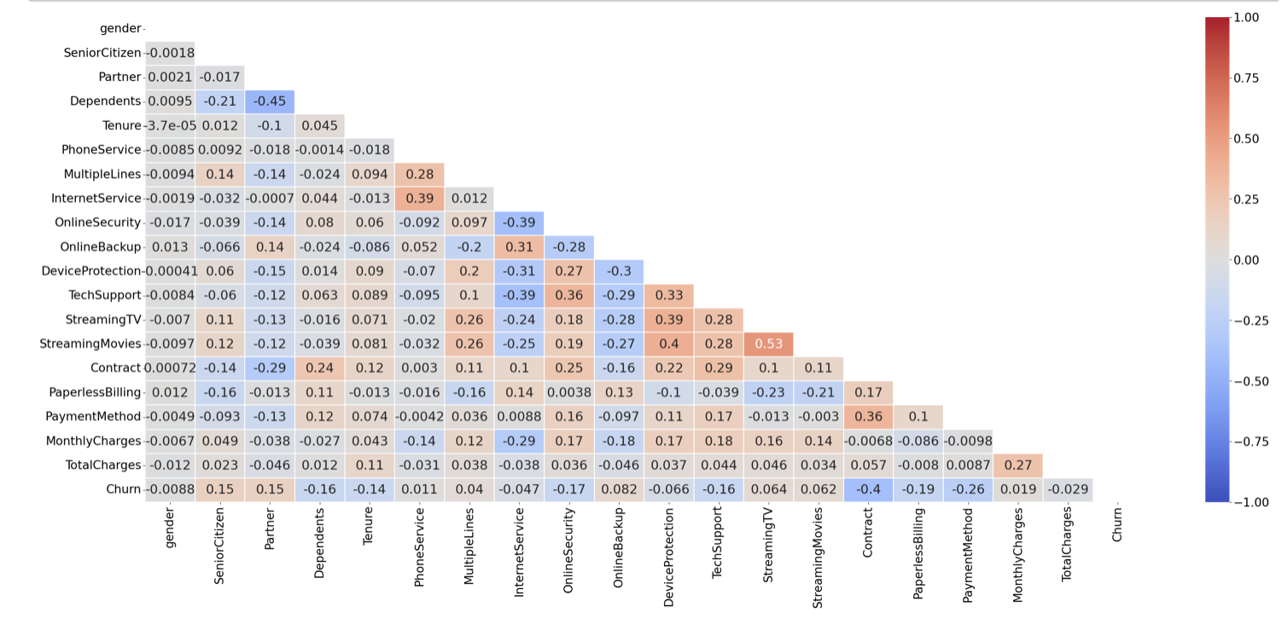
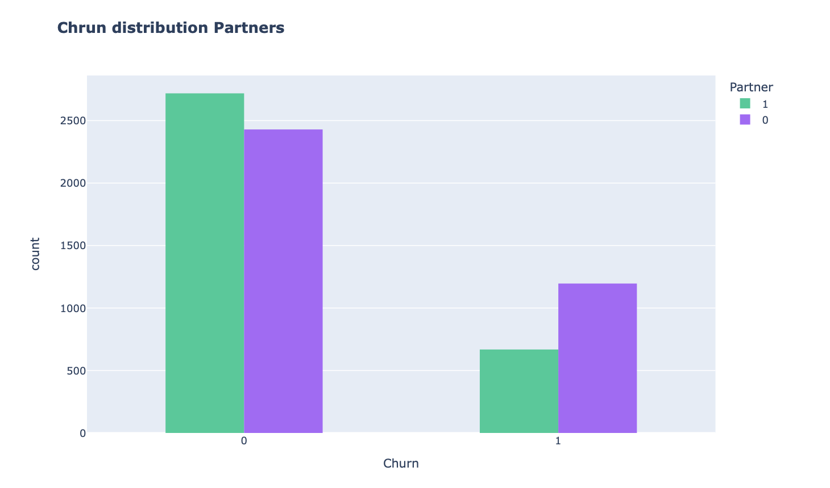
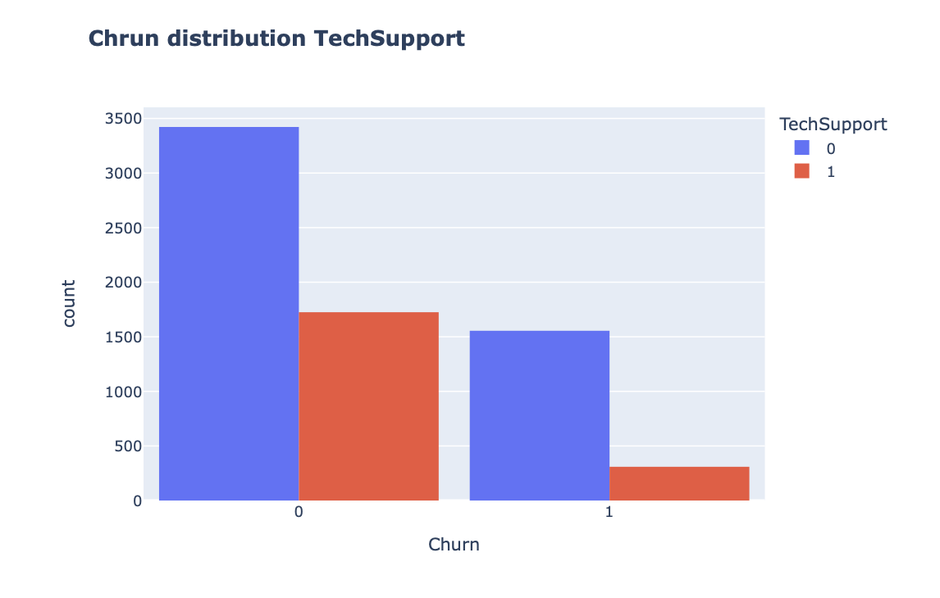
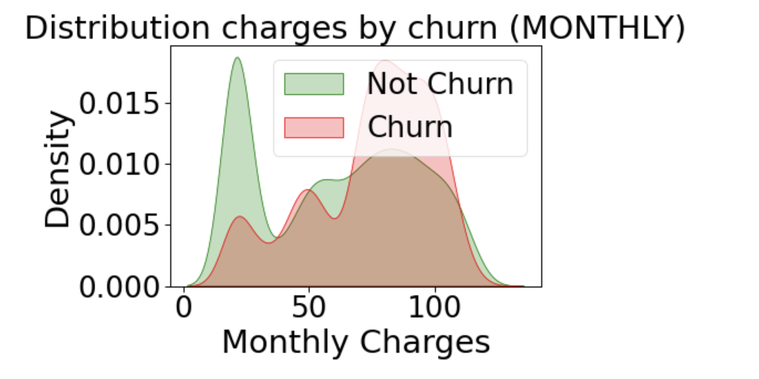
Data Visualisation – Some Examples

Slide 9
Developed Algorithms - Supervised Learning
Decision Tree Classifier: Using a DTC, we want to predict the value of a target variable by learning simple decision rules from our data features;
Neural Networks: By processing exemples, our algorithm learns what it should do, forming probability-weighted associations between “input” and “result”, stored in the data structure of the net itself;
Support Vector Classification: Learning problem is formulated as a convex optimization problem and is robust to noise;
K-nearest Neighbors: assuming the similarity between data and available cases, put a new case into a certain category that is most similar to the available categories;
NOTE: To improve our results, we also used Parameter Tuning using GridSearchCV;

Slide 10
Developed Algorithms – Results Comparison

Slide 11
Conclusion

