Slide 1
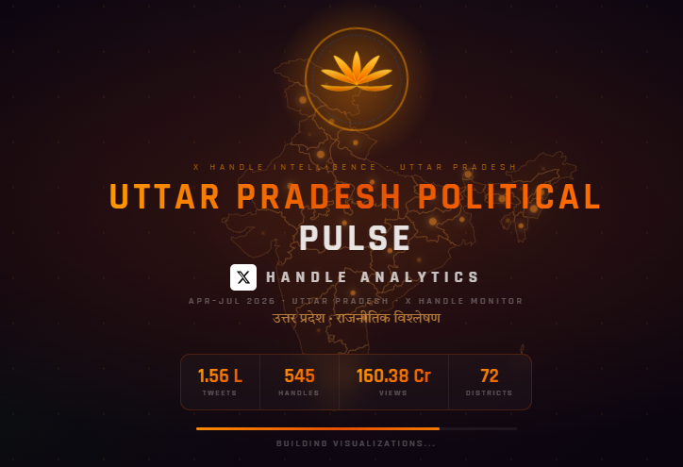
UTTAR PRADESH
POLITICAL PULSE
X (Twitter) Analytics Dashboard
A deep-dive into every tab, module and metric
1,56,136 tweets · 545 handles · 75 districts · Apr–Aug 2026

Slide 2
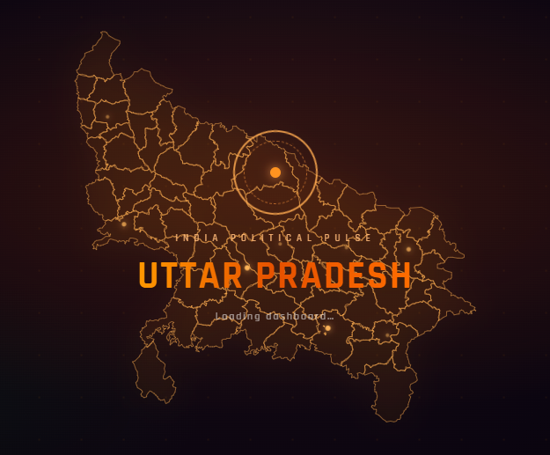
INDIA POLITICAL PULSE
3
Introduction
11
Hashtags
Contents
4
Numbers at a Glance
12
Sentiment
Uttar Pradesh Political Pulse
X (Twitter) Analytics Dashboard
5
The Loader
13
Parties
6
The Ten Tabs
14
Growth
7
Overview
15
Profiles
8
Top Leaders
16
Data-Driven Filters
9
UP District Map + Viral
17
Reports ★
10
MLA Tracker

Slide 3
i
What is Uttar Pradesh Political Pulse?
One live, filterable view of UP’s political conversation on X
An interactive analytics dashboard that tracks the political conversation on X (Twitter) across Uttar Pradesh.
It brings together every tweet from tracked political handles — MPs, MLAs, MLCs, the Chief Minister and Deputy CMs — into a single explorable view.
Who is saying what · how much reach & engagement · the sentiment behind it · and how it shifts by party, district and date.
Organised into ten focused tabs, each answering a specific question — from headline numbers to a single leader’s activity.
The loader — a live glowing map of all 75 UP districts

Slide 4
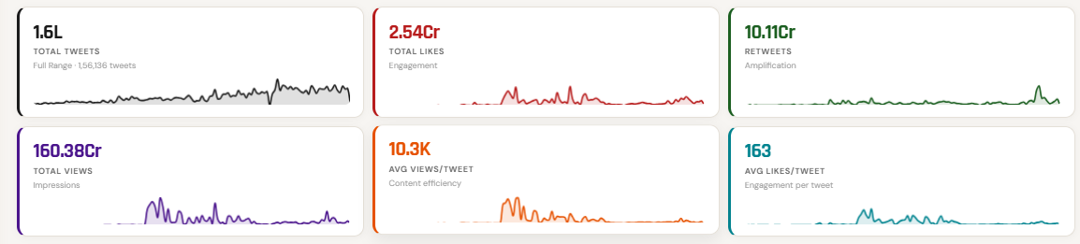
ii
The Numbers at a Glance
Headline KPI cards, each with a live sparkline trend
1.6 L
Total tweets
2.54 Cr
Total likes
10.11 Cr
Retweets
160.38 Cr
Total views
10.3 K
Avg views/tweet
163
Avg likes/tweet
Every card responds to the active date range — pick "Last 7 Days" and the whole strip recalculates.

Slide 5
The Loader — a living map of Uttar Pradesh
Glowing 75-district map
Every UP district outlined, city markers pulsing
Ashoka Chakra motif
Rotating chakra rings at the centre
Tricolour strip
Saffron–white–green identity across the top
Live headline stats
Tweets · Handles · Views · Districts, shown while loading

Slide 6
#
The Ten Tabs
Each answers a specific question — explored one by one next
1
Overview
6
Sentiment
Headline KPIs, trends & distribution
Positive / Neutral / Negative mix
2
Top Leaders
7
Parties
Ranked by avg views per post
Top-5 party cards + live filters
3
UP District Map
8
Growth
75 districts + top viral tweets
Followers & engagement over time
4
MLA Tracker
9
Profiles
Activity of individual MLAs
CM, Dy CMs & key leaders
5
Hashtags
10
Reports ★
Trending tags, ranked by reach
Type a topic → instant PDF report

Slide 7
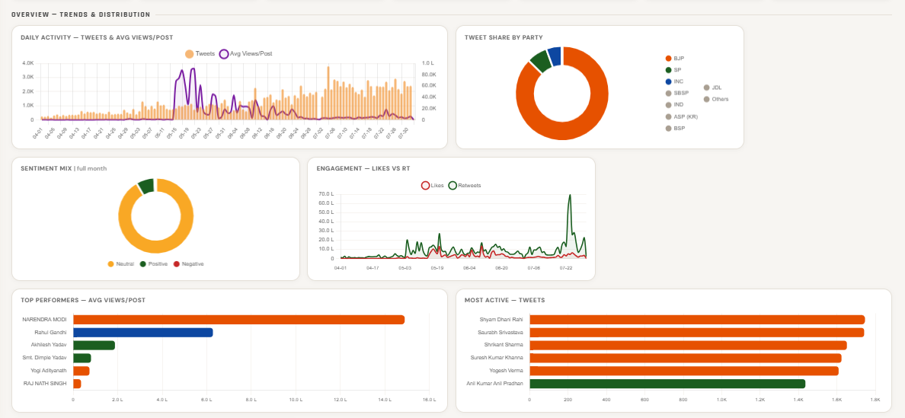
1
Overview — Trends & Distribution
The command-centre landing view
Six coordinated visuals + KPI strip
Daily Activity — tweets & avg views/post over time
Tweet Share by Party — top-5 party donut
Sentiment Mix — pos / neu / neg
Engagement — Likes vs Retweets trend
Top Performers (avg views) & Most Active (volume)
KEY INSIGHT
One screen to read the entire conversation for any date range.

Slide 8
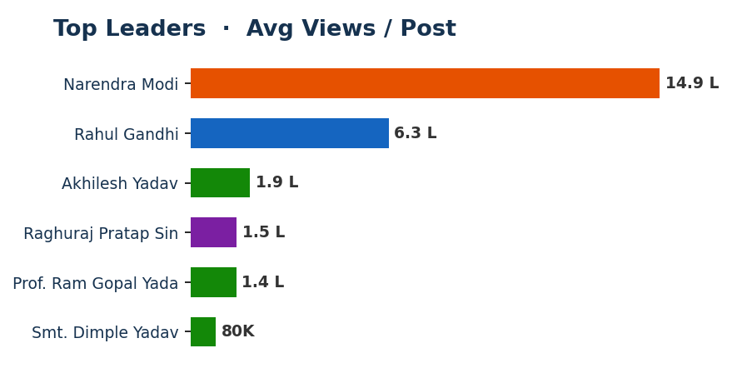
2
Top Leaders
Who is actually breaking through
Ranked by average views per post
Reach-per-post ranking — not just raw volume
Filter by level: LS/RS MP, MLA, MLC, CM, Dy CM
Filter by party to compare within a bloc
Surfaces the highest-impact individual voices
KEY INSIGHT
Narendra Modi (14.9 L avg) and Rahul Gandhi (6.3 L) lead on reach per post.

Slide 9
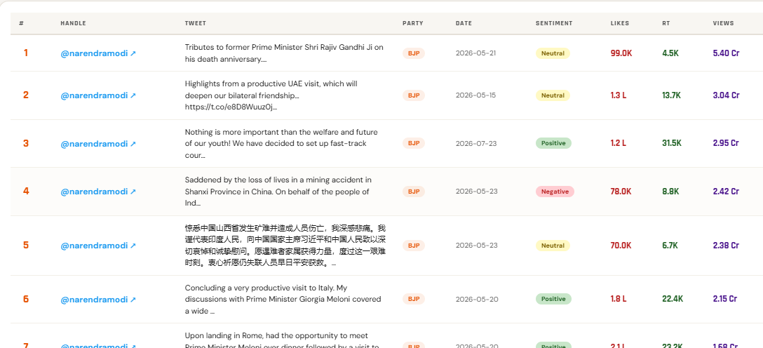
3
UP District Map + Viral Tweets
Geography meets the biggest posts
Interactive map + the top viral tweets
All 75 districts, colour-coded by activity
Handle → opens that person’s X profile
View Post button → opens the exact tweet
Party · Date · Sentiment · Likes · RT · Views per row
KEY INSIGHT
See where the noise is — and the exact posts driving it.

Slide 10
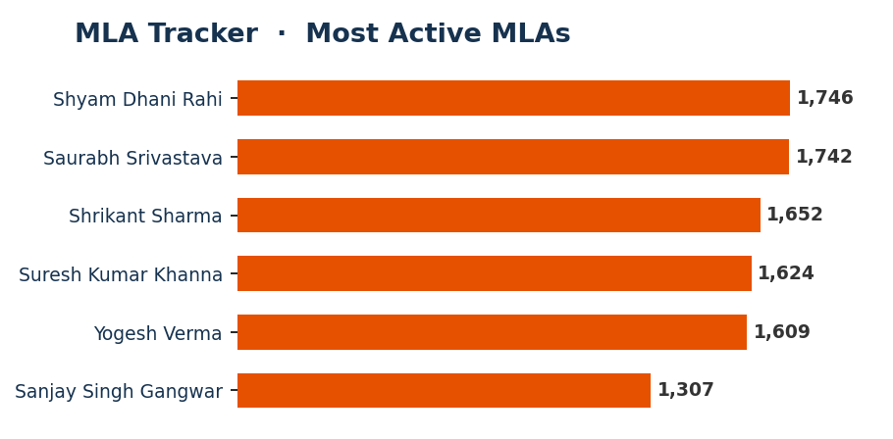
4
MLA Tracker
Seat-by-seat, MLA-level view
Activity of individual MLAs across UP
Drill from state → assembly-constituency member
Tweet volume and engagement per MLA
Compare representatives side by side
Built for ground-level, seat-by-seat monitoring
KEY INSIGHT
The most active MLAs post 1,600–1,750 tweets each over the period.

Slide 11
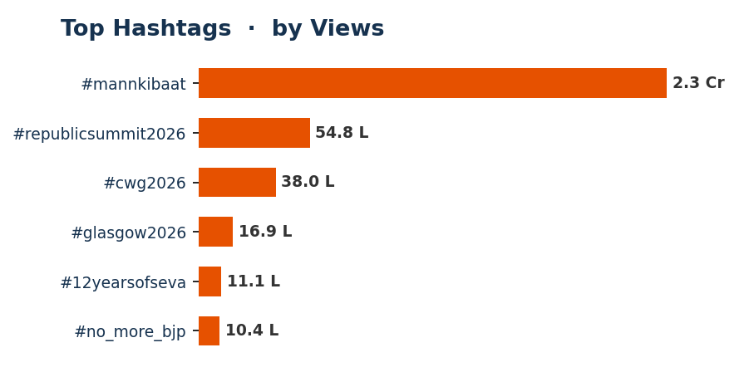
5
Hashtags
The narratives being pushed
Top hashtags ranked by reach
Ranked by views, not just count
Party filter — attribute campaigns to a bloc
Spot coordinated / repeated messaging
Track a hashtag’s rise across the window
KEY INSIGHT
#mannkibaat leads the period with 2.3 Cr views.

Slide 12
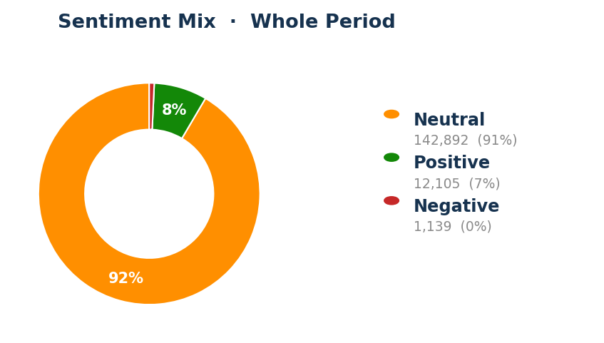
6
Sentiment
The mood of the conversation
Positive / Neutral / Negative breakdown
Split across time and by party
See who is on the offensive vs defensive
Quantifies tone, not just volume
Extensible to Pro-/Anti-party labels (e.g. Pro-BJP, Anti-BJP)
KEY INSIGHT
Currently ~91% neutral; the model can be extended with party-stance categories.

Slide 13
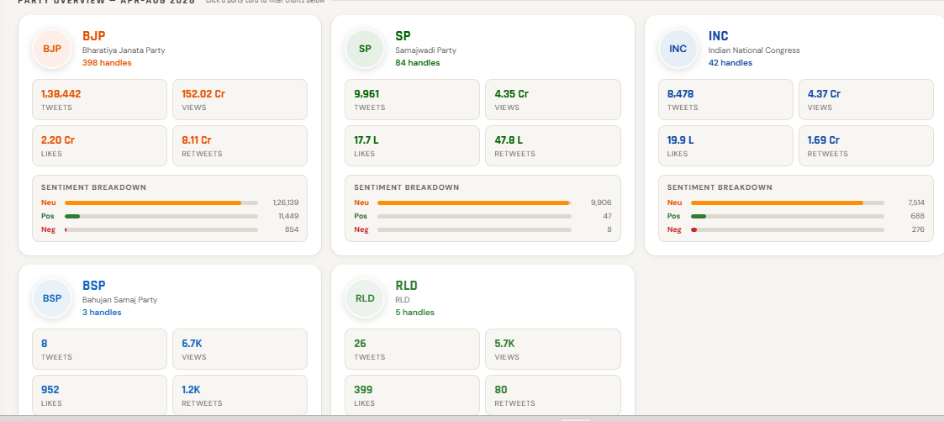
7
Parties — the top 5
Party-level scoreboard
Overview cards, ranked by tweet volume
Tweets · Views · Likes · Retweets per party
Handle count and sentiment per party
UP-only — national/other-state parties auto-excluded
Click a card to filter the charts below
KEY INSIGHT
BJP dominates volume; SP and INC lead the opposition conversation.

Slide 14
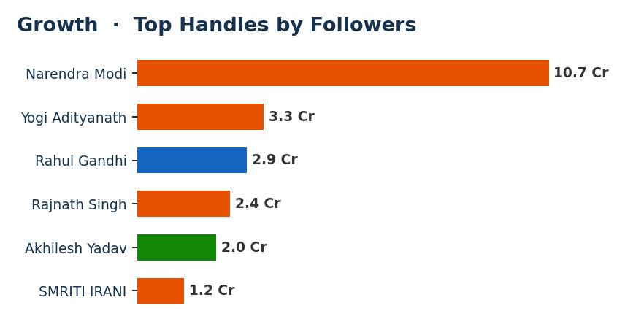
8
Growth
How audiences are built over time
Followers & engagement trajectories
Per-handle and per-party growth
See who is gaining momentum
Time-series across the tracking window
Compare audience size at a glance
KEY INSIGHT
Tracks reach-building for the largest handles across the period.

Slide 15
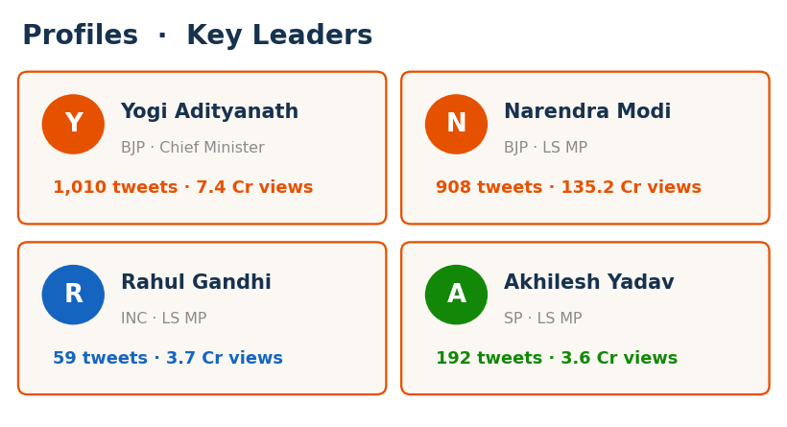
9
Profiles
The people behind the handles
Dedicated pages for key leaders
Chief Minister, Deputy CMs and top figures
Volume, reach and engagement at a glance
A quick who’s-who of the UP political map
Jump straight to a leader’s activity
KEY INSIGHT
The CM, Deputy CMs and leading MPs each get a dedicated profile page.

Slide 16
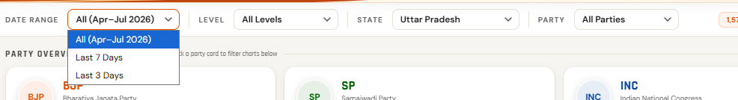
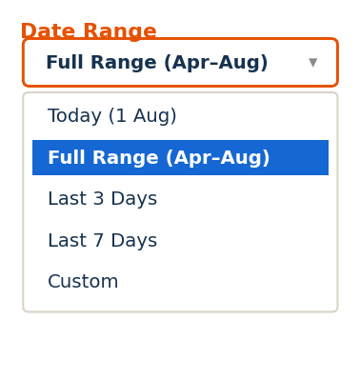
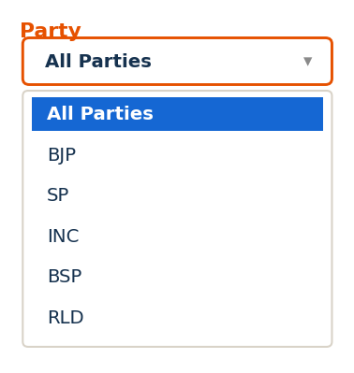
10
Dependent, Data-Driven Filters
Change any filter — cards and charts recompute live
Four linked filters
Date range — All / Last 7 / Last 3 days
Level — LS MP, RS MP, MLA, MLC, CM, Dy CM
State — Uttar Pradesh
Party — every UP party
Date labels and "Today" always follow the latest date available.

Slide 17
★
Reports — instant keyword analysis
Type a topic → get a formatted, downloadable report
How it works
Enter a Topic + Keywords (e.g. "Ram Mandir, Ayodhya, ghotala")
The tweet text is scanned and the report builds instantly
Preview on screen, then download a full-colour PDF
Every report contains
Overall Volume Summary — tweets, RT, likes, unique handles, total views, sentiment
Party-wise Mentions by Position — CM/DyCM/MP/MLA + top tweet
Key Insights — auto-generated with the exact date-range

Slide 18
UTTAR PRADESH POLITICAL PULSE
Every tab. Every angle. One clear view of UP’s political conversation.
1,56,136 tweets · 545 handles · 75 districts · 5 parties · Apr–Aug 2026

