Slide 1
Generating Game Recommendations and Analyzing Feature Importance from Steam Dataset
Team
Akshay Elavia
Akshay Orpe
Mukesh Mogal

Slide 2
Motivation
Steam is the largest online game distribution platform for Personal Computing games with over 35000 games and 95 million active users.
Having a great recommendation platform is key part of business for online Game Distribution Platform like Steam.
Along with individual games, Steam also recommends Game Bundles to it’s users.
Creating relevant Bundles is one of the most challenging task for online gaming platforms. It plays the significant part in the Sales.
In this project we are going to focus on Games Recommendation as well as Bundle Recommendation.

Slide 3
Data Set
The Steam Dataset contains multiple files pertaining to game metadata, purchases of users, game reviews, and game bundles:
Dataset | Rows | No. of Features | Size
Users | 2,567,538 | 9 | 553 MB
Items | 15,474 | 14 | 21 MB
Reviews | 7,793,069 | 10 | 4.27 GB
Game Bundles | 615 | 12 | 834 KB

Slide 4
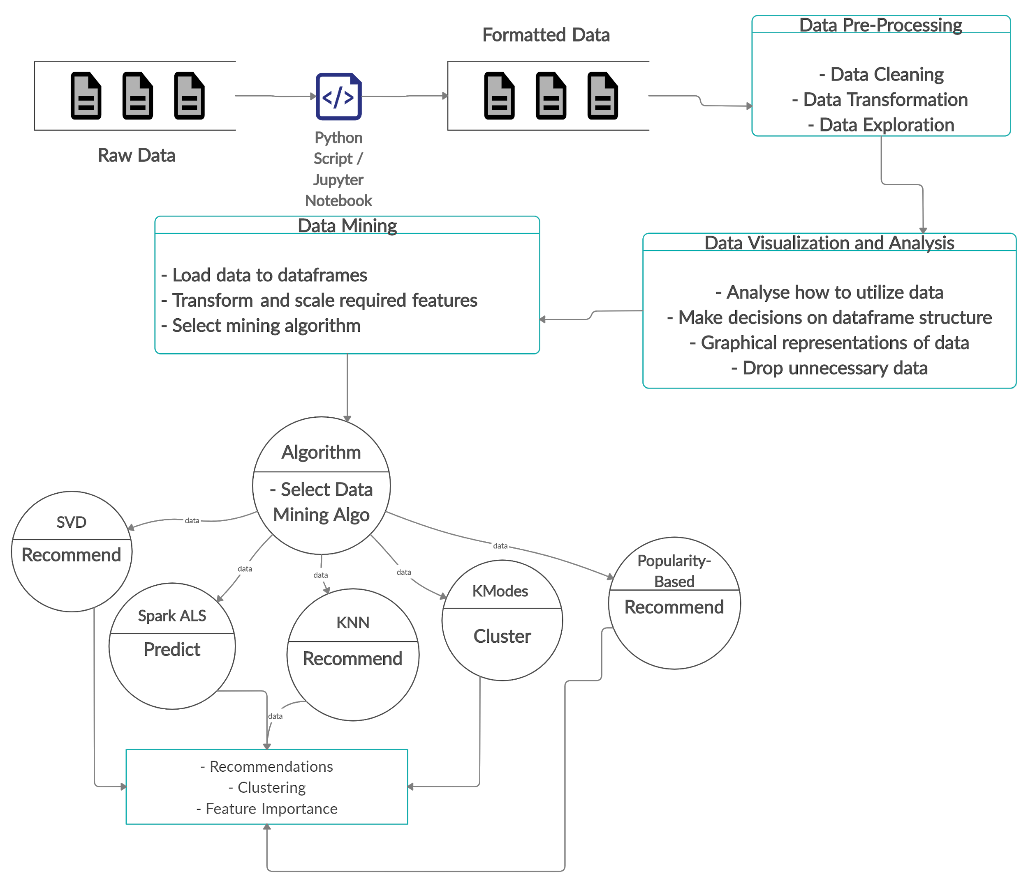
Data Flow Diagram

Slide 5
Pre-Processing and Feature Engineering
Custom scripts to clean the data and convert to valid JSON format
Create a recommendation dataset for predicting user ratings. This dataset is prepared from the raw users data, with the format: user_id,item_id,rating
In absence of explicit rating in the dataset, playtime is used as an implicit rating and scaled between 1 and 100
Extract game attributes from metadata and transform them into rich features to provide better insight.

Slide 6
Algorithms Used : Individual Game Recommendation
Popularity-based recommendation: Used for recommending top 20 games for every new user who logs in for first time. Helps in avoiding cold start problem.
Spark ALS: For Individual game recommendation. Spark helps in processing large amount of data using distributed processing.

Slide 7
Algorithms Used : Bundle Recommendation
Predict user ratings for unseen items using SVD
Create a classifier to determine whether to recommend a particular game to a user
Calculate the predicted cumulative ratings of users for each bundle and recommend highly rated bundles to the user

Slide 8
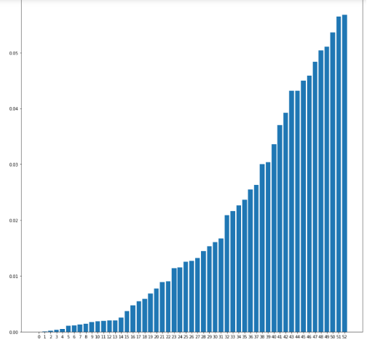
Evaluation: Feature Importance
Playtime is the only tangible feature to measure user-item ratings in the given dataset.
We extracted multiple features from game attributes and computed their importance using Random Forest Classifier.
These extracted features provide a great metric to provide recommendations to users based on genre and game specifications.

Slide 9
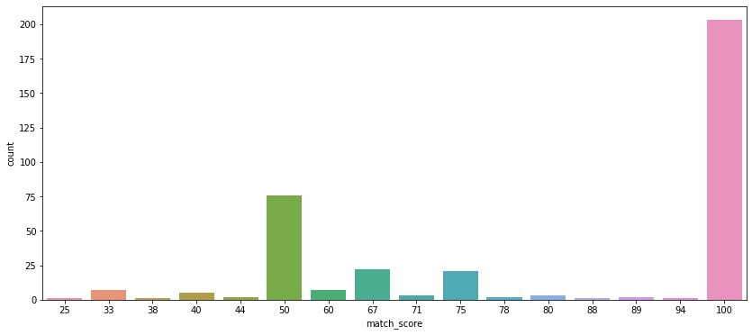
Evaluation: Bundle Similarity
Every feature in the game metadata is a categorical feature, hence KModes is used to create clusters from game attributes dataset
Once these clusters of games are created, they are compared against actual bundles of games to see till what degree they match the clusters created by the KModes algorithm.

Slide 10
Conclusion
Things that worked?
We were able to achieve good accuracy for individual game recommendation.
Clusters generated based on game attributes dataset match very closely to actual game bundles
Features extracted from game metadata helped enhance the accuracy of game predictions by adding a new dimension
Things that didn't work?
The dataset did not have any feature to indicate actual rating for the Game/bundle. Because of this we had to scale the “playtime_forever” value as an implicit rating.
The datasets were out of sync as many item ids and user ids available in one data didn’t have the corresponding mapping in its related dataset

