Slide 1
Basics of Networking
PRESENTED BY: KEVIN SHEA
OTTAWA-CARLETON DISTRICT SCHOOL BOARD
Kevin_Shea@ocdsb.edu.on.ca
ACSE CONFERENCE
FEBRUARY 20, 2004

Slide 2
Basics of Networking
Networking began its infancy in the mid -1960’s.
by the US Department of Defence (DoD).
The original intention of networking was being
developed to withstand a nuclear war.
Telephone networks were to vulnerable and would
terminate all conversations should a nuclear war
occur.

Slide 3
Basics of Networking
You wake up at 3 a.m. to go to the bathroom and
stop and check your e-mail on the way back to bed.

Slide 4
Basics of Networking
  WE ARE DEALING WITH MACHINES INSTEAD OF
  PEOPLE IN TODAY’S WORLD. OUR PRIVACY IS
  AFFECTED AND ALMOST ALL OF OUR PERSONAL
  INFORMATION CAN BE FOUND IN
  THE “VIRTUAL WORLD” .

Slide 5
Basics of Networking
ARPA (Advanced Research Projects Agency)
was created in response with the launching of the Sputnik in 1957.
ARPA decided that a DoD network should be packet-
switched networked consisting of a subnet and
host computers.
Experimental network research was awarded to
UCLA, UCSB, SRI and Univ. of Utha in 1969. These
areas were because they all had a large number
of ARPA contracts.

Slide 6
Basics of Networking
These 4 universities also had different and completely
incompatible host computers.
ARPANET protocols were not suitable for running over
multiple networks, so TCP/IP model and protocols
were invented in 1974.
ARPA awarded several other contracts and specifically
Univ.. of California at Berkeley to integrate the
protocols with the Berkeley UNIX.

Slide 7
Basics of Networking
Berkeley developed a convenient program interface
to the network and wrote many applications, utility,
and management programs to make networking easier.
In it early infancy, the OSI protocols were crushed and
the TCP/IP protocols were already in widespread use.
The OSI Model had seven layers because at the time,
IBM had a propriety seven -layer protocol called
SNA (Systems Network Architecture).

Slide 8
Basics of Networking
At the time, IBM dominated the computer companies
and every was scared to death that IBM would use
its clout to force everyone to use SNA.
The OSI was to be produced like an IBM-reference
model.
The OSI model became the world standard and was
not controlled by one company, but by a neutral
organization, ISO (International Standards Association).

Slide 9
Basics of Networking
TYPES OF NETWORKS
LAN – LOCAL AREA NETWORK IS A SMALL
GEOGRAPHICAL AREA SUCH AS OUR SCHOOL
BOARD.
MAN – METROPOLITAN AREA NETWORK IS A
NETWORK OVER A LARGER GEOGRAPHICAL AREA
SUCH AS THE PROVINCIAL GOVERNMENT.
WAN – WIDE AREA NETWORK IS A NETWORK USED
OVER AN EXTREMELY LARGE GEOGRAPHICAL AREA
SUCH AS THE FEDERAL GOVERNMENT.

Slide 10
Basics of Networking
NETWORKS ARE BROKEN INTO 3 TOPOLOGIES.
THEY ARE:
    BUS TOPOLOGY
    STAR TOPOLOGY
    RING TOPOLOGY

Slide 11
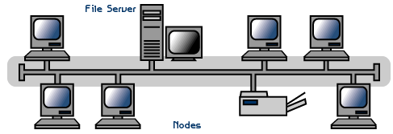
Basics of Networking
BUS TOPOLOGY ALLOWS INFORMATION TO BE
DIRECTED FROM ONE COMPUTER TO THE OTHER.
LOTS OF BINARY COLLISION THOUGH.

Slide 12
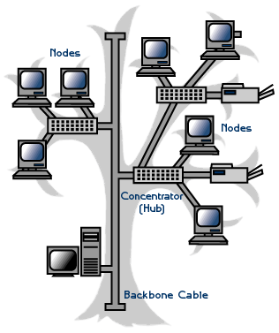
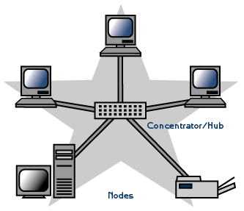
Basics of Networking
STAR TOPOLOGY IS THE MOST COMMON TYPE
USED. ALL COMPUTERS ARE ATTACHED TO A HUB.
LESS COLLISIONS AND MOST EFFICIENT.

Slide 13
Basics of Networking
RING TOPOLOGY- USES A TOKEN TO PASS
INFORMATION FROM 1 COMPUTER TO THE OTHER.
A TOKEN IS ATTACHED TO THE MESSAGE BY THE
SENDER TO IDENTIFY WHICH COMPUTER SHOULD
RECEIVE THE MESSAGE. AS THE MESSAGE MOVES
AROUND THE RING, EACH COMPUTER EXAMINES
THE TOKEN. IF THE COMPUTER IDENTIFIES THE TOKEN
AS ITS OWN, THEN IT WILL PROCESS THE
INFORMATION.

Slide 14
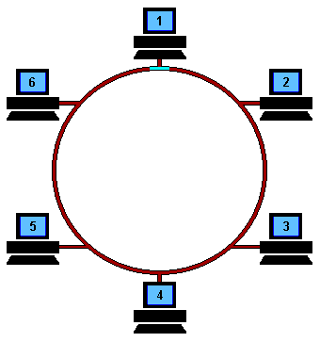
Basics of Networking
A DISADVANTAGE OF A TOKEN RING IS IF ONE
COMPUTER IS BROKEN OR DOWN, THE MESSAGE
CANNOT BE PASSED TO THE OTHER COMPUTERS.

Slide 15
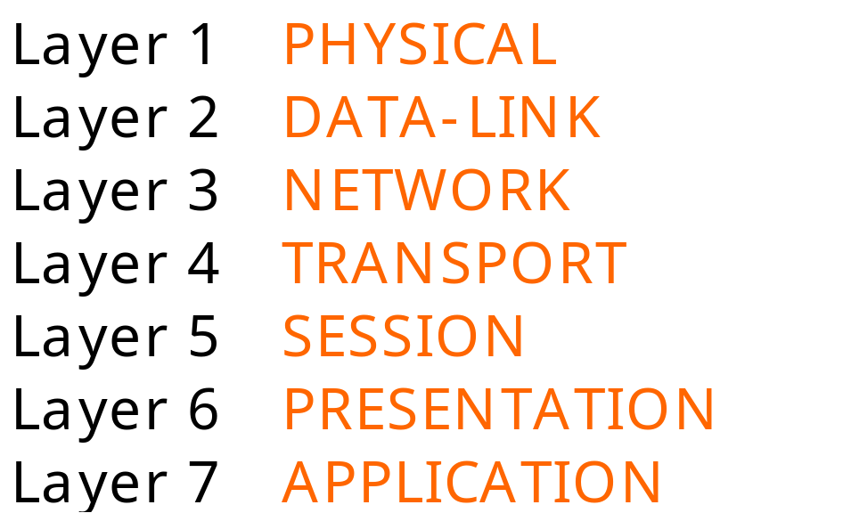
Basics of Networking
The seven layers of the OSI Model are:

Slide 16
Basics of Networking
Each one of you was assigned a number when
you entered the lab. Get together with your team
member(s).
Begin to research the layer that your number is
associated with.
Research as much information as you can in
15 minutes and make notes of your finding.

Slide 17
Basics of Networking
Once complete, we will create a bigger group
with all the layer present.
You will present your finding to your group about
the layer. You will only have 2 minutes to present.

Slide 18
Basics of Networking
THE PHYSICAL LAYER
The physical layer is concerned with transmitting
raw bits over a communication channel though
hubs, wires (cat5UTP), modems, network cards…
basically anything that is physical to the network.
In networking, computers are also known as
Hosts or Nodes.
When looking at network cables, there are
2 types that affect nodes. They are:

Slide 19
Basics of Networking
Straight though cables or also known as patch cables
Cross-over cables
The difference in the cables are the way the wires
are connected within the RJ45. I have attached a
sheet for you in your package.

Slide 20
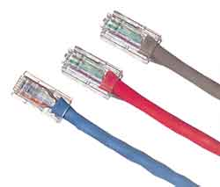
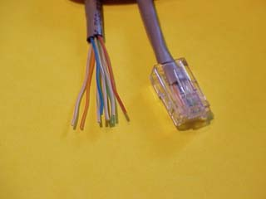
Basics of Networking
Typical Crossover Cable
Wiring:
1-3 White/Orange
2-6 Orange
3-1 White/Green
6-2 Green
4-4 Blue
5-5 White/Blue
7-7 White/Brown
8-8 Brown

Slide 21
Basics of Networking
COMMUNICATION CHANNELS
TWISTED SHIELDED PAIR – USED IN PHONE LINES, NETWORKS
UNSHIELDED TWISTED PAIR “ “ “ “
COAXIAL CABLE – USED IN CABLEVISION GREAT FOR VIDEO
FIBRE OPTIC CABLES - USES LIGHT TO CARRY SIGNAL BUT
HARD TO WORK WITH AND LOOSES SIGNAL OVER LONGER
DISTANCES

Slide 22
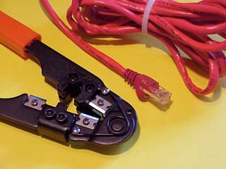
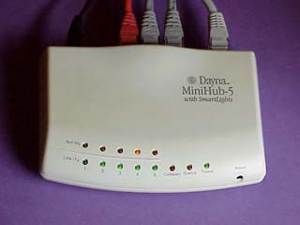
Basics of Networking
Crimping Tool
Hub

Slide 23
Basics of Networking
THE DATA-LINK LAYER
The data link layer takes raw transmission and
transform it into a line that appears free of
transmission errors in the network layer.
The Data-Link Layer also is where you would find
the MAC Address. (Media Access Control). To find the
MAC Address of your computer, or any computer:
Start/Programs/MS Prompt and type: ipconfig/all
"C:\WINDOWS>" prompt, type "tracert
www.howstuffworks.com"

Slide 24
Basics of Networking
THE DATA-LINK LAYER
You will also find smart devices such as switches in
the Data-Link Layer.
The digital information that needs to be sent such as
and e-mail, attachments, etc needs to be broken into
smaller bits known as packets.
These packets require some information similar to
sending a letter in the mail.

Slide 25
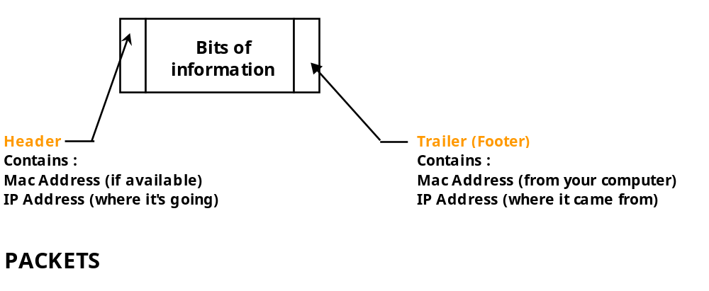
Basics of Networking
THERE ARE A NUMBER OF PACKETS THAT WILL
FOLLOW EACH OTHER TO THE FINAL DESTINATION.

Slide 26
Basics of Networking
THE NETWORK LAYER
The network layer is concerned with controlling
the operation of the subnet. A ROUTER is used to
determining how packets are routed from source
to destination.
If one path is busy, then the router will select another
path for the packets to travel. So really, the packets
can all have different paths and find their way to the
final destination.

Slide 27
Basics of Networking
THE NETWORK LAYER
The router has millions of IP addressing built into
the software, and knows where to send the packets.
IP stands for Internet Protocol and is basically an
address that the packets will be sent to.
An example would be 216.27.61.137

Slide 28
Basics of Networking
THE NETWORK LAYER
If you look at the IP Address, the number are broken
into different categories.
216. 27.61.137
Classification
Hosts
216. 27.61.137
Octets

Slide 29
Basics of Networking
Classifications can be broken into 3 classes. They are:
Class A - Only the first octet is used for addressing and
the balance used for hosts.
Class B - The first two octet are used for addressing
and the balance used for hosts.
Class C - The first three octet are used for addressing
and the balance used for hosts.

Slide 30
Basics of Networking
Every machine on the Internet has a unique
identifying number, called an IP Address.
A typical IP address looks like this:
216.27.61.137
But computers communicate in binary form.

Slide 31
Basics of Networking
The same IP address in binary:
11011000.00011011.00111101.10001001
216.27.61.137

Slide 32
Basics of Networking
If you add all the positions together, you get 32,
which is why IP addresses are considered
32-bit numbers
11011000.00011011.00111101.10001001
Combine the four octets and you get 2³² or a possible
4,294,967,296 unique values.

Slide 33
Basics of Networking
Class A - This class is for very large networks,
such as a major international company might have.
IP addresses with a first octet from 1 to 126 are
part of this class.

Slide 34
Basics of Networking
Class B - This class is used for medium-sized networks.
A good example is a large college campus.
IP addresses with a first octet from 128 to 191
are part of this class. Class B addresses also include
the second octet as part of the Net identifier.

Slide 35
Basics of Networking
Class C - Class C addresses are commonly used for
small to mid-size businesses. IP addresses
with a first octet from 192 to 223 are part of this
class. Class C addresses also include the second
and third octets as part of the Net identifier.

Slide 36
Basics of Networking
LOOPBACK
Loopback - The IP address 127.0.0.1 is used
as the loopback address. This means that it is
used by the host computer to send a message
back to itself.

Slide 37
Basics of Networking
THE TRANSPORT LAYER
The transport layer “DIRECTS PACKETS”, splits it up into
smaller units if need be, pass these to the network
and ensure that the pieces are travelling in an
orderly fashion.
A series of protocols are also established in this
layer to ensure proper flow of the packets.
You can basically describe the Transport Layer as
a “TRAFFIC COP”.

Slide 38
Basics of Networking
THE SESSION LAYER
The session layer allows different machines to
establish sessions between themselves.
Once communications are established, encryption
then begins both parties.

Slide 39
Basics of Networking
THE PRESENTATION LAYER
The Presentation Layer’s job is managing data
structures and converting from the representation
used inside the computer to the network standard
representation an visa versa.
In English terms, the Presentation layer basically
takes the packets and re-assembles them so you can
open the e-mail or the attachment.
If any packets got lost along the way, or were
damaged, then the Presentation layer will send a
sign to the sender that it requires the specific packet.

Slide 40
Basics of Networking
THE APPLICATION LAYER
The Application layer contains a variety of protocols
that are commonly required.
Another Application layer function is file transfer.
Different file systems have different file naming
conventions, different ways of representing text lines,
and so on.
Transferring a file between two different systems
requires handling and other incompatibilities.

Slide 41
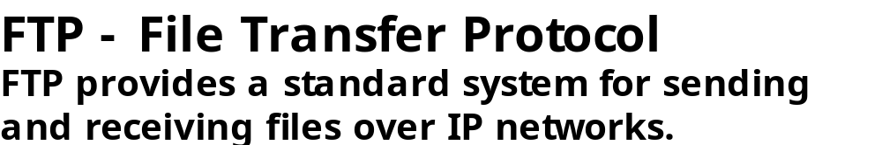

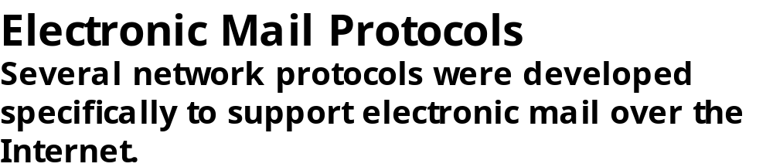
Basics of Networking
THE APPLICATION LAYER

Slide 42
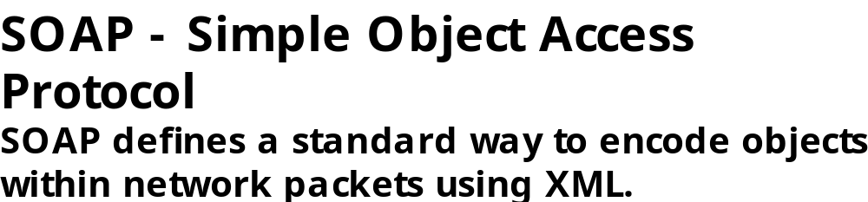
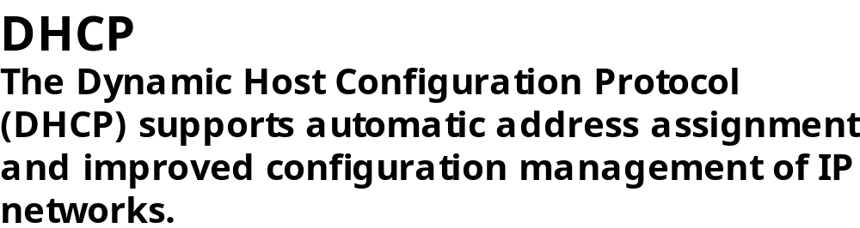
Basics of Networking
THE APPLICATION LAYER

Slide 43
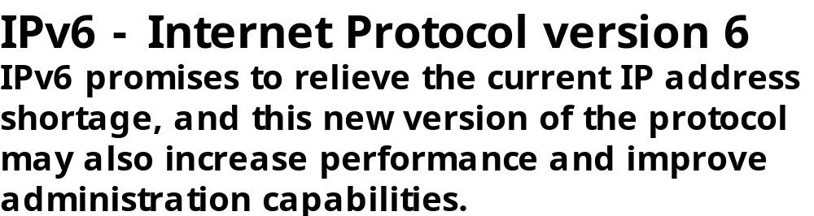
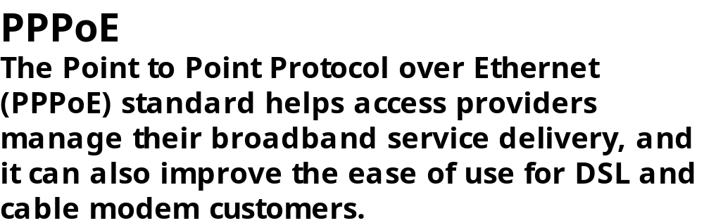
Basics of Networking
THE APPLICATION LAYER

Slide 44
Basics of Networking
As you can see, the OSI Model is a sophisticated
and complicated model, but I hope you gained
some information on the way this theoretical model
work.
The package that I have given you also has an
IP Addressing assignment that I use with my Grade
12 Computer Engineering Students.

Slide 45
Basics of Networking
Thank You.

Slide 46
Basics of Networking
RESOURCES
http://compnetworking.about.com/library/glossary/bldef-bandwidth.htm
    www.3com.com/other/pdfs/infra/ corpinfo/en_US/501302.pdf - IP Addressing
http://computer.howstuffworks.com/question549.htm
Networks, Interfaces and Integrated Circuits
( Graham Smyth and Christine Stephenson)
www.cisco.com

