Slide 1

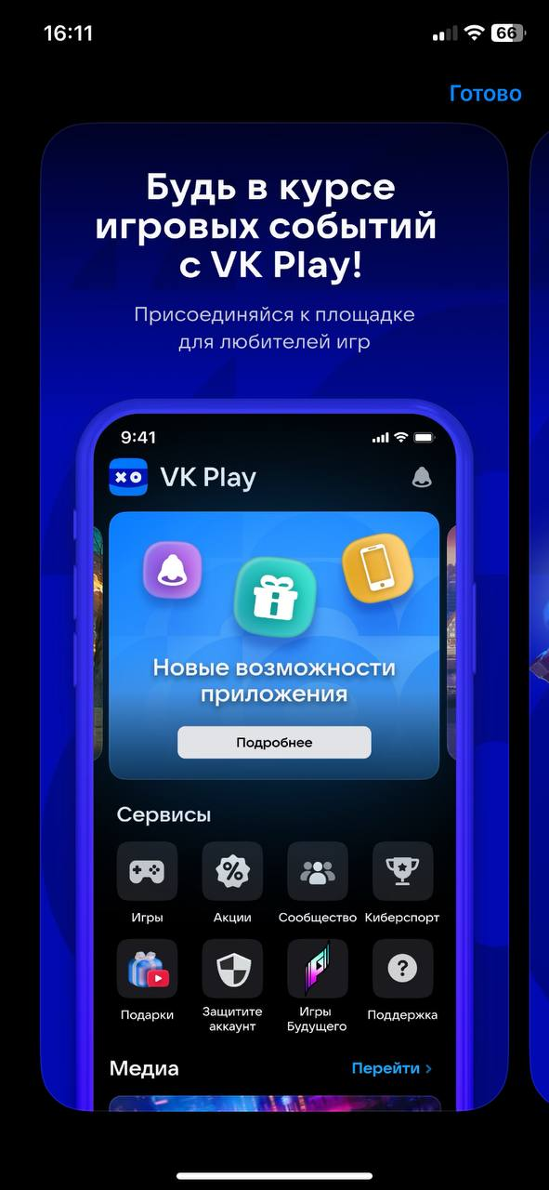
iFIPA.
App installer in your browser

Slide 2


iFIPA 🄵
🄵

