Slide 1

PRESENTATION

Slide 2
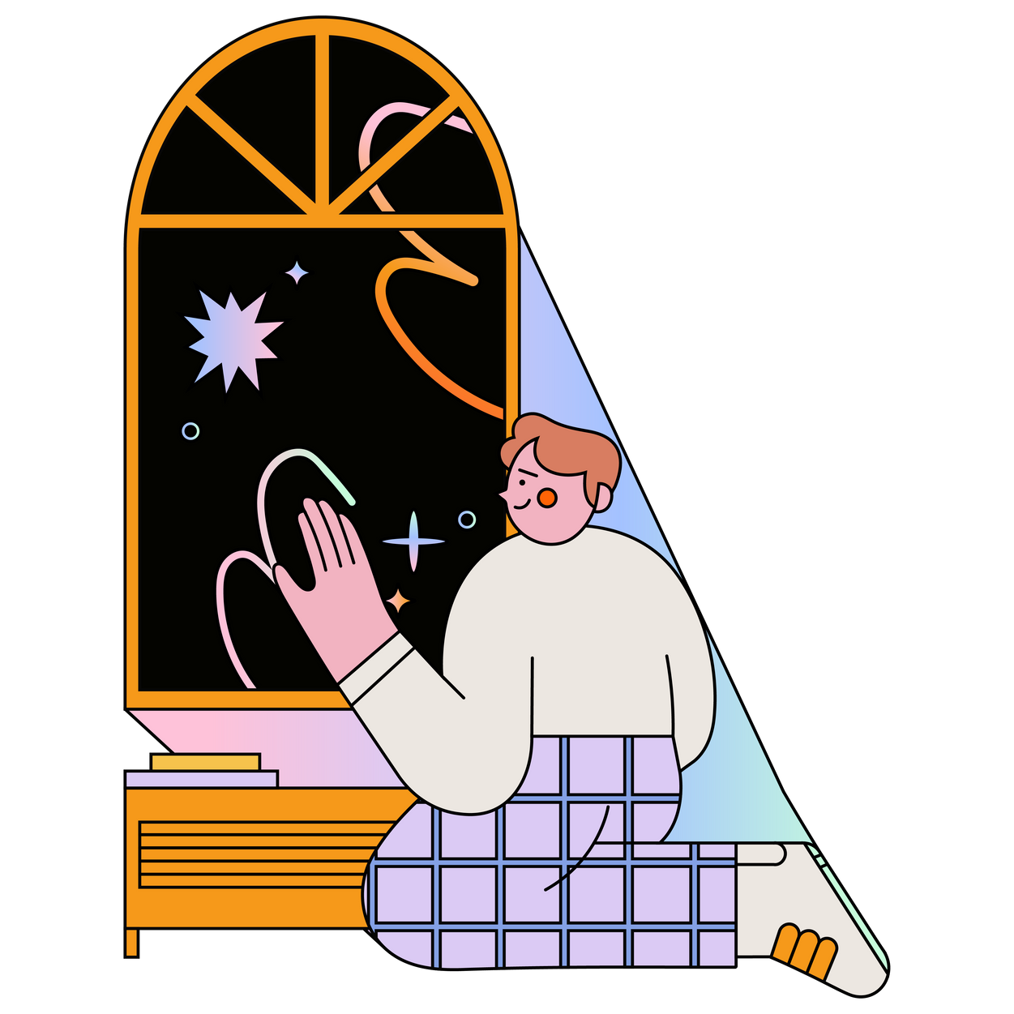
Problem
Students and working professionals experience frequent stress, anxiety, and overthinking but lack simple tools to track their emotions or receive guided support. Existing solutions are either complex, inconsistent, or not personalized. Users need an accessible way to understand their mood patterns and improve daily mental wellness
Research Summary
Conducted Google Form survey with students and professionals
– Key pain points: workload pressure, inconsistent routines, overthinking, lack of reflection time
– Users prefer quick logging, simple UI, and minimal effort
– High interest in mood tracking, journaling, and AI-based guidance
– Privacy and ease of use are critical for engagement

Slide 3
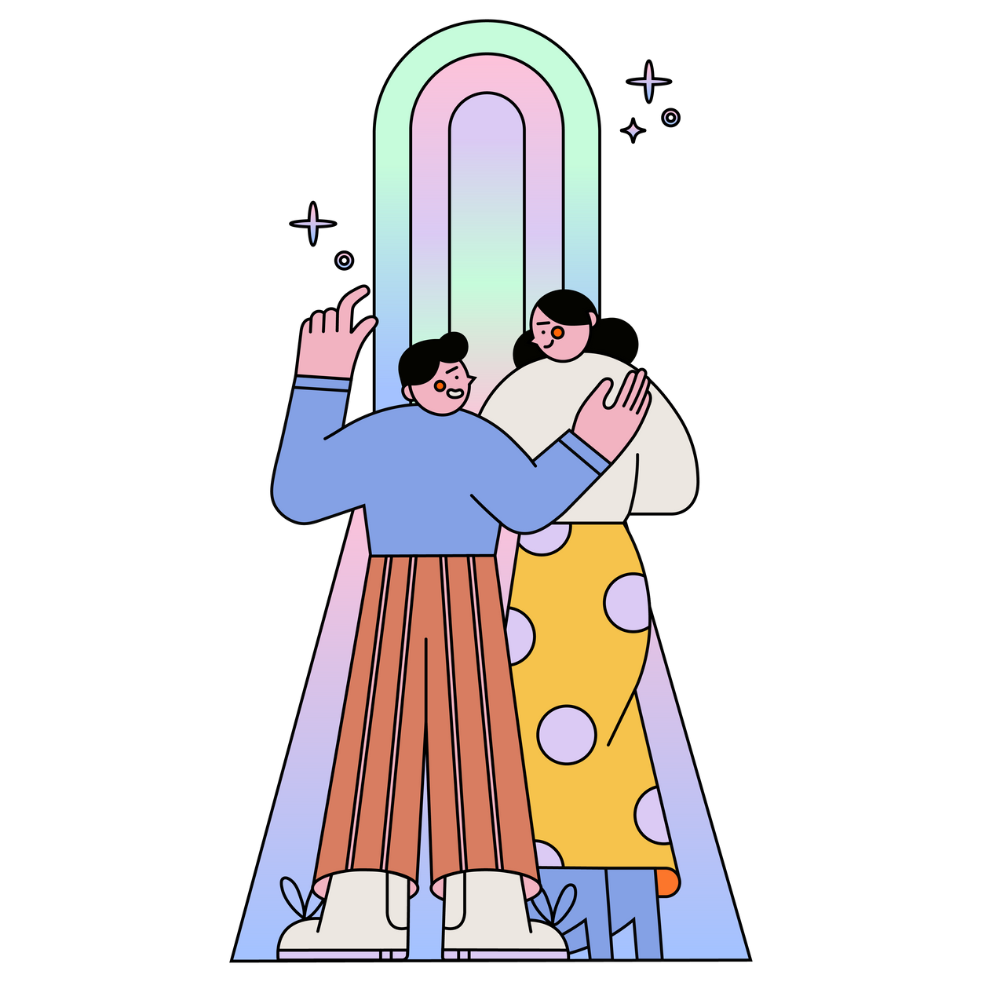
Solution Overview
A minimal, calming mental wellness mobile app that allows users to:
– Track moods through simple inputs
– Receive personalized AI-based suggestions
– Journal their thoughts
– View mood patterns through clear visual insights
– Build consistent wellness habits with reminders

Slide 4
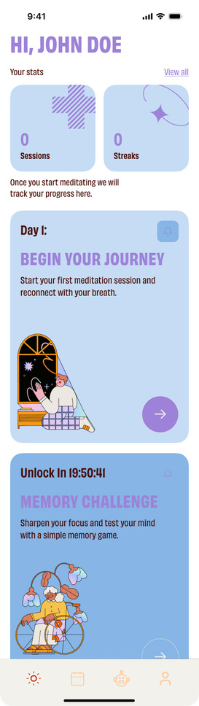
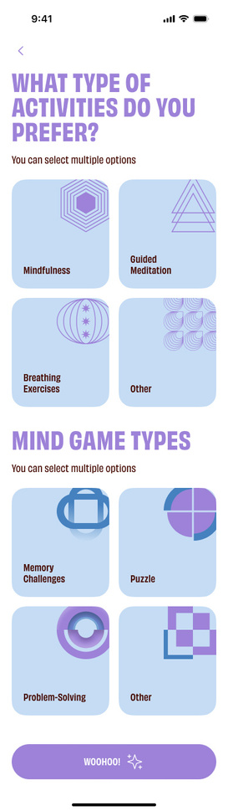
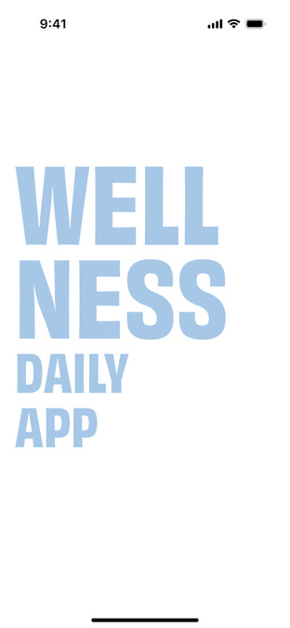
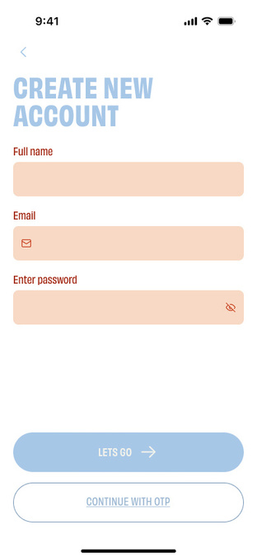
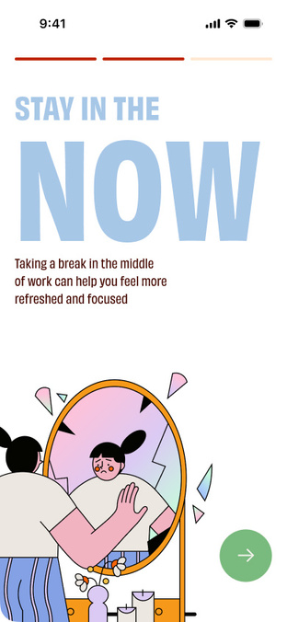
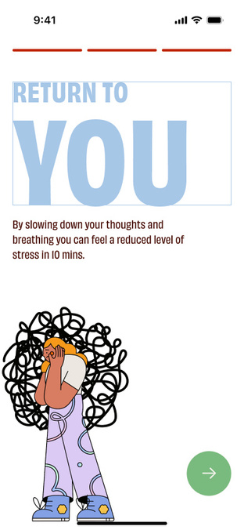

Slide 5
Demo of prototype
Prototype link

Slide 6
Conclusion
The project demonstrates how a structured UI/UX process can address real mental wellness challenges faced by college students and working professionals. Through research, surveys, and persona development, the key issues identified were stress, anxiety, overthinking, and inconsistent self-management habits. The final design presents a minimal, calming mobile app with AI-based mood tracking, personalized suggestions, journaling, and visual insights to help users build awareness and healthier routines. The solution aligns with user needs by focusing on simplicity, accessibility, and guided support.
Key Learnings
– Research insights are essential for validating user needs and shaping meaningful features.
– Students and professionals want quick, easy ways to track emotions without complex interactions.
– Visual clarity, color psychology, and minimal UI significantly influence user comfort in wellness products.
– AI-driven suggestions must remain simple, supportive, and non-intrusive to ensure trust.
– Usability testing highlights real navigation issues and helps refine the final experience.
– Designing for mental wellness requires balancing functionality with sensitivity and clarity.

