Slide 1
Phishing Domain Detection
Aman Gupta

Slide 2
Project Details
Problem Statement:
Phishing is a type of fraud in which an attacker impersonates a reputable company or person in order to get sensitive information such as login credentials or account information via email or other communication channels. Phishing is popular among attackers because it is easier to persuade someone to click a malicious link that appears to be authentic than it is to break through a computer's protection measures.
The main goal is to predict whether the domains are real or malicious.

Slide 3
TECHNOLOGIES : Web Application.
DOMAIN : Cyber Security.
LANGUAGE : Python.

Slide 4
OBJECTIVE :
Developing a system to find out whether a Domain (Website) is a Fake or a Real Domain. There are few websites which are not real and made by hackers or scammers to steal the information of the user. By predicting the domain is fake or not we can aware the user.

Slide 5
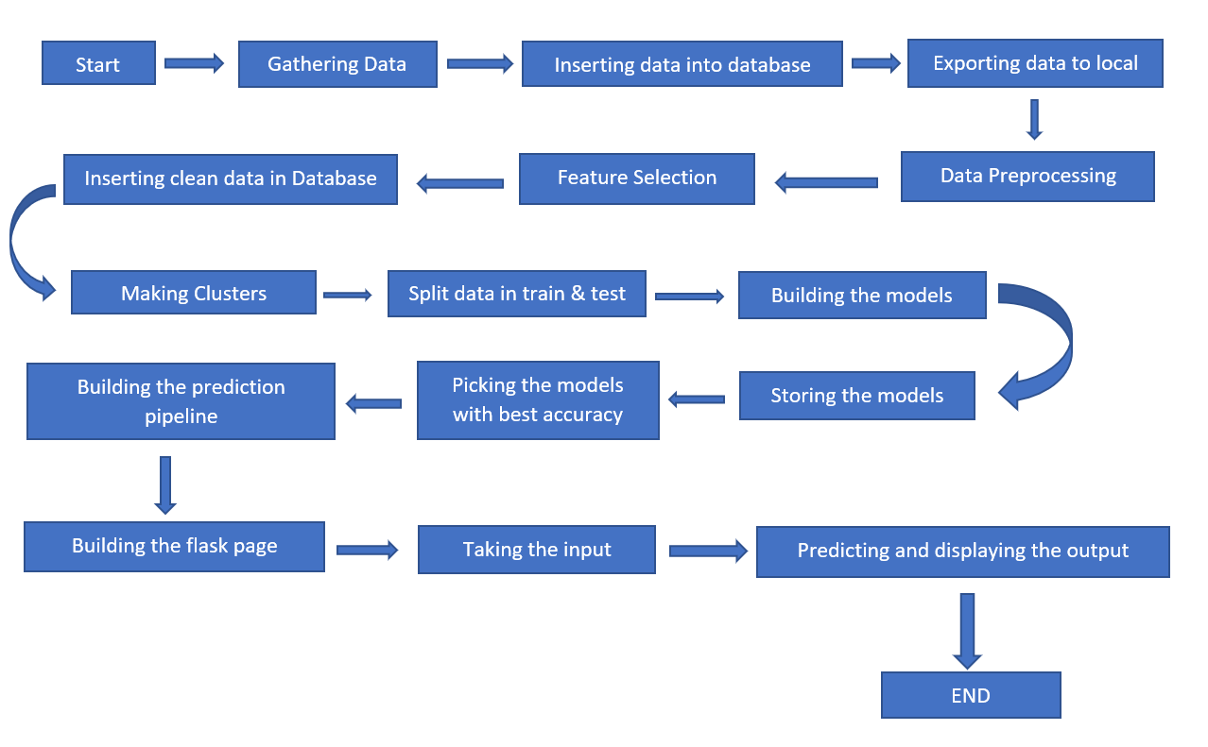
ARCHITECTURE

Slide 6
DATASET INFORMATION
This data set consist of 88,647 websites labelled as legitimate or phishing and allow the researchers to train their classification models, build phishing detection systems.
For more details of the dataset visit:
Datasets for phishing websites detection - ScienceDirect
Datasets for phishing websites detection - ScienceDirect

Slide 7
Model Training
Clustering:-
Separating the data based on same variance to the best results.
Then building separate model for each clusters. (In this we are using 2 clusters)
Train test split and Scaling: -
Splitting the data into training and testing then scaling to bring them into same scale.
Model Building and evaluating:
Building different algorithms like Logistic Regression, SVC, Random forest, Decision tree classifier, Gradient boosting, Ada boosting. And checking the
Precision, recall, specificity and f1 score because our dataset has a ratio of 65:35 we can’t use accuracy we will use recall to reduce the false negative.
Selecting the best model:-
Out of all the models from all the clusters we need to select best model for all the clusters we are using recall as a scoring parameter higher the score better the model.

Slide 8
Conclusion :
It turns out model is performing well with a recall score of 78% in the cluster one and in the cluster two it is giving recall of 93% but there are some False Positives which will affect.
THANK YOU.

