Slide 1
Introduction to Chapter 3
Now that we understand the concept of binary numbers, we will study ways of describing how systems using binary logic levels make decisions.
Boolean algebra is an important tool in describing, analyzing, designing, and implementing digital circuits.
Ronald Tocci/Neal Widmer/Gregory Moss
Digital Systems: Principles and Applications, 10e
Copyright ©2007 by Pearson Education, Inc.
Columbus, OH 43235
All rights reserved.

Slide 2
3-1 Boolean Constants and Variables
Boolean algebra allows only two values; 0 and 1.
Logic 0 can be: false, off, low, no, open switch.
Logic 1 can be: true, on, high, yes, closed switch.
Three basic logic operations: OR, AND, and NOT.
Ronald Tocci/Neal Widmer/Gregory Moss
Digital Systems: Principles and Applications, 10e
Copyright ©2007 by Pearson Education, Inc.
Columbus, OH 43235
All rights reserved.

Slide 3
3-2 Truth Tables
A truth table describes the relationship between the input and output of a logic circuit.
The number of entries corresponds to the number of inputs. For example a 2 input table would have 2² = 4 entries. A 3 input table would have 2³ = 8 entries.
Ronald Tocci/Neal Widmer/Gregory Moss
Digital Systems: Principles and Applications, 10e
Copyright ©2007 by Pearson Education, Inc.
Columbus, OH 43235
All rights reserved.

Slide 4
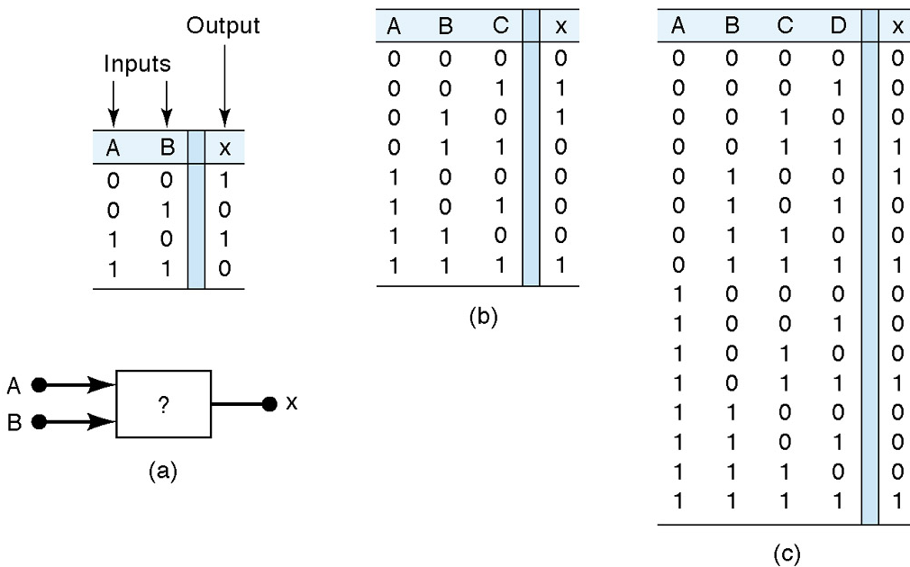
3-2 Truth Tables
Examples of truth tables with 2, 3, and 4 inputs.
Ronald Tocci/Neal Widmer/Gregory Moss
Digital Systems: Principles and Applications, 10e
Copyright ©2007 by Pearson Education, Inc.
Columbus, OH 43235
All rights reserved..

Slide 5
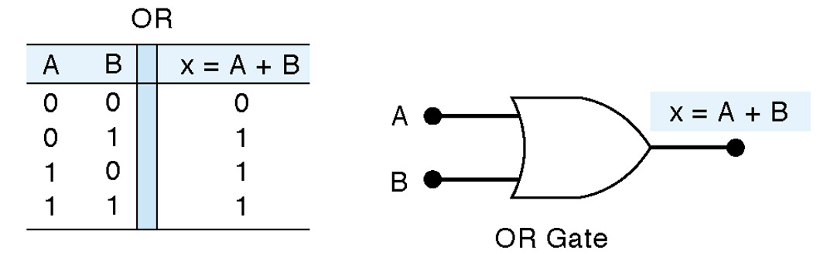
3-3 OR Operation With OR Gates
The Boolean expression for the OR operation is
    X = A + B
  This is read as “x equals A or B.”
  X = 1 when A = 1 or B = 1.
Truth table and circuit symbol for a two input OR gate:
Ronald Tocci/Neal Widmer/Gregory Moss
Digital Systems: Principles and Applications, 10e
Copyright ©2007 by Pearson Education, Inc.
Columbus, OH 43235
All rights reserved..

Slide 6
3-3 OR Operation With OR Gates
The OR operation is similar to addition but when A = 1 and B = 1, the OR operation produces 1 + 1 = 1.
In the Boolean expression
    x=1+1+1=1
    We could say in English that x is true (1) when A is true (1) OR B is true (1) OR C is true (1).
Ronald Tocci/Neal Widmer/Gregory Moss
Digital Systems: Principles and Applications, 10e
Copyright ©2007 by Pearson Education, Inc.
Columbus, OH 43235
All rights reserved..

Slide 7
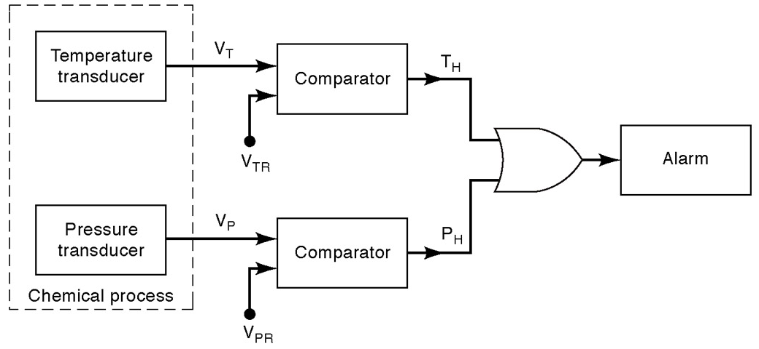
3-3 OR Operation With OR Gates
There are many examples of applications where an output function is desired when one of multiple inputs is activated.
Ronald Tocci/Neal Widmer/Gregory Moss
Digital Systems: Principles and Applications, 9e
Copyright ©2004 by Pearson Education, Inc.
Upper Saddle River, New Jersey 07458
All rights reserved.

Slide 8
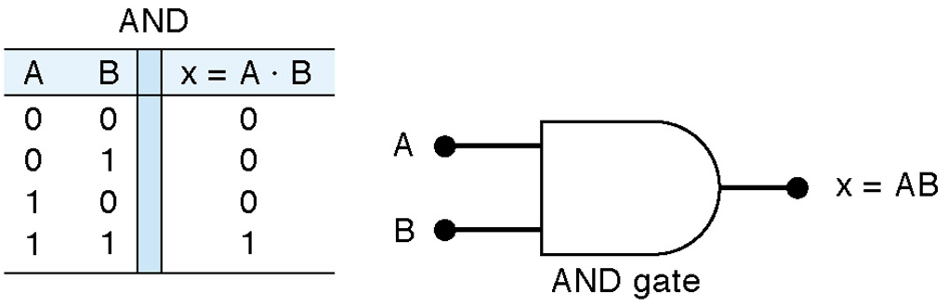
3-4 AND Operations with AND gates
The Boolean expression for the AND operation is
    X = A • B
  This is read as “x equals A and B.”
  x = 1 when A = 1 and B = 1.
Truth table and circuit symbol for a two input AND gate are shown. Notice the difference between OR and AND gates.
Ronald Tocci/Neal Widmer/Gregory Moss
Digital Systems: Principles and Applications, 10e
Copyright ©2007 by Pearson Education, Inc.
Columbus, OH 43235
All rights reserved..

Slide 9
3-4 AND Operation With AND Gates
The AND operation is similar to multiplication.
In the Boolean expression
    X = A • B • C
    X = 1 only when A = 1, B = 1, and C = 1.
Ronald Tocci/Neal Widmer/Gregory Moss
Digital Systems: Principles and Applications, 10e
Copyright ©2007 by Pearson Education, Inc.
Columbus, OH 43235
All rights reserved..

Slide 10
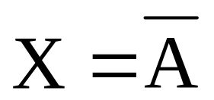
3-5 NOT Operation
The Boolean expression for the NOT operation is
This is read as:
  x equals NOT A, or
  x equals the inverse of A, or
  x equals the complement of A
Ronald Tocci/Neal Widmer/Gregory Moss
Digital Systems: Principles and Applications, 10e
Copyright ©2007 by Pearson Education, Inc.
Columbus, OH 43235
All rights reserved..

Slide 11
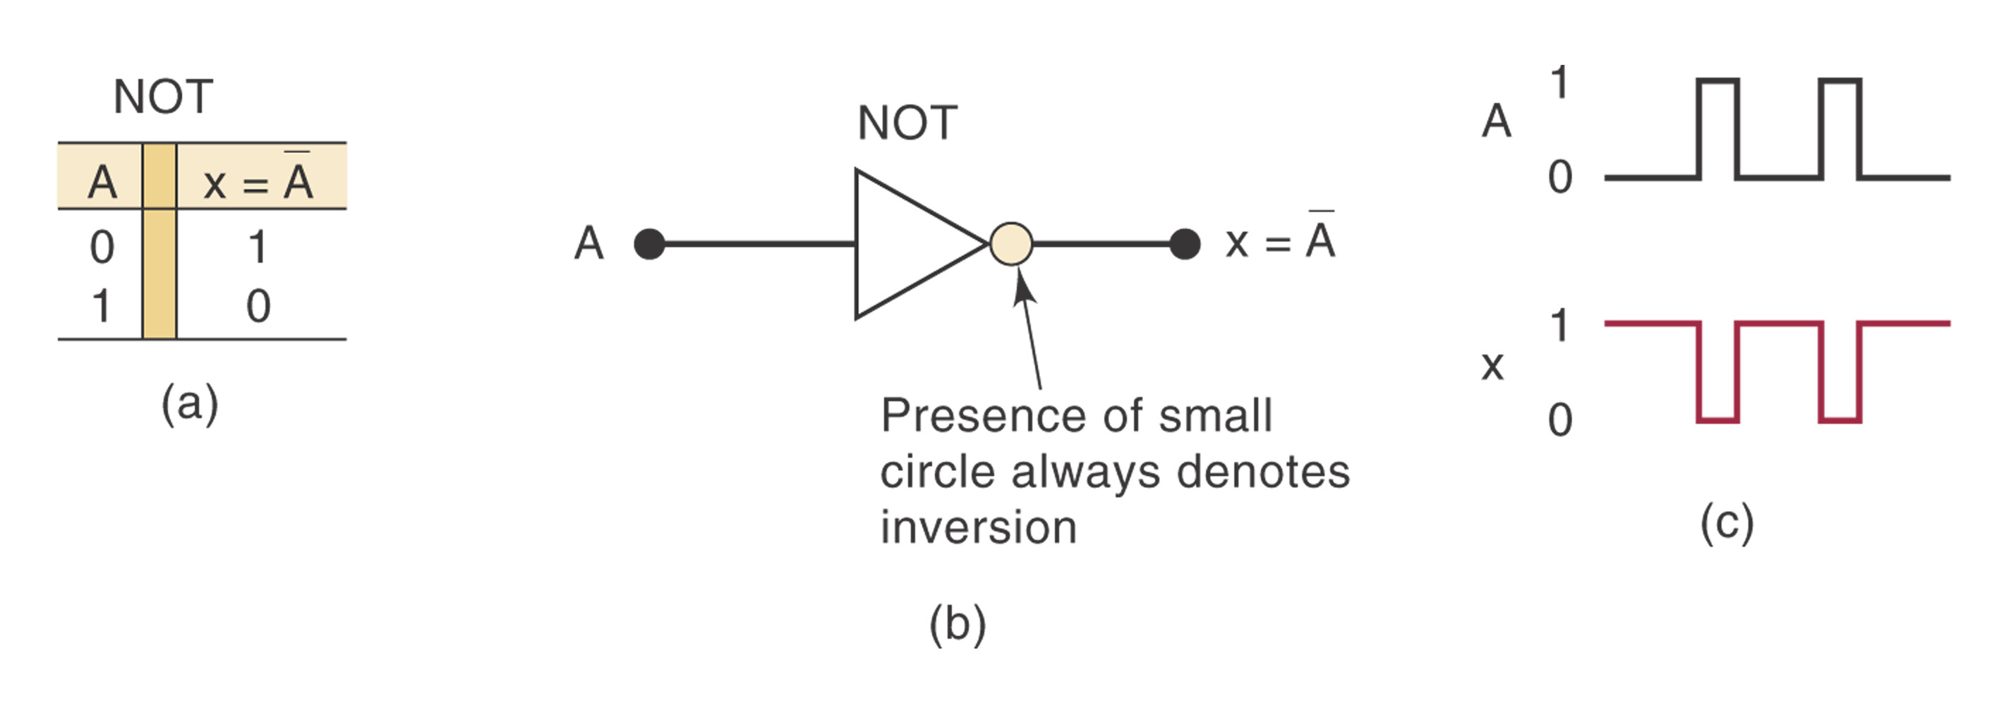
3-5 NOT Operation
Truth table, symbol, and sample waveform for the NOT circuit.
Ronald Tocci/Neal Widmer/Gregory Moss
Digital Systems: Principles and Applications, 10e
Copyright ©2007 by Pearson Education, Inc.
Columbus, OH 43235
All rights reserved..

Slide 12
3-6 Describing Logic Circuits Algebraically
The three basic Boolean operations (OR, AND, NOT) can describe any logic circuit.
If an expression contains both AND and OR gates the AND operation will be performed first, unless there is a parenthesis in the expression.
Ronald Tocci/Neal Widmer/Gregory Moss
Digital Systems: Principles and Applications, 10e
Copyright ©2007 by Pearson Education, Inc.
Columbus, OH 43235
All rights reserved..

Slide 13
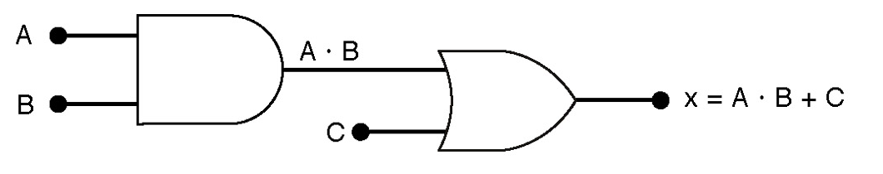
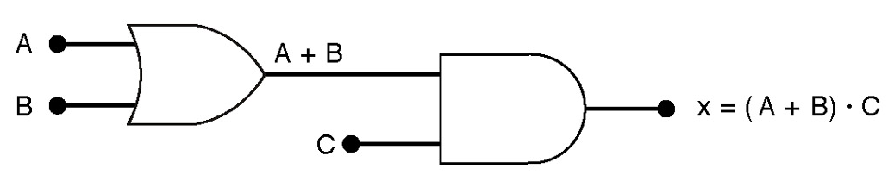
3-6 Describing Logic Circuits Algebraically
Examples of Boolean expressions for logic circuits:
Ronald Tocci/Neal Widmer/Gregory Moss
Digital Systems: Principles and Applications, 9e
Copyright ©2004 by Pearson Education, Inc.
Upper Saddle River, New Jersey 07458
All rights reserved.

Slide 14
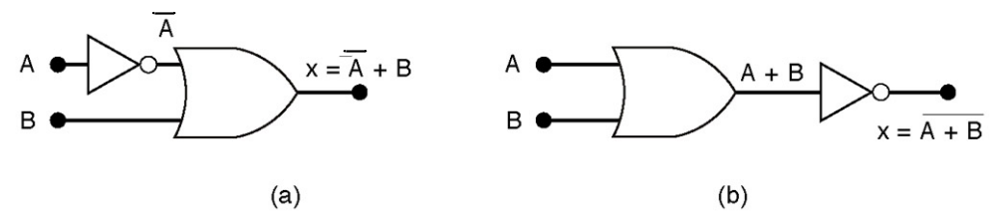
3-6 Describing Logic Circuits Algebraically
The output of an inverter is equivalent to the input with a bar over it. Input A through an inverter equals A.
Examples using inverters.
Ronald Tocci/Neal Widmer/Gregory Moss
Digital Systems: Principles and Applications, 10e
Copyright ©2007 by Pearson Education, Inc.
Columbus, OH 43235
All rights reserved..

Slide 15
3-7 Evaluating Logic Circuit Outputs
Rules for evaluating a Boolean expression:
  Perform all inversions of single terms.
  Perform all operations within parenthesis.
  Perform AND operation before an OR operation unless parenthesis indicate otherwise.
  If an expression has a bar over it, perform the operations inside the expression and then invert the result.
Ronald Tocci/Neal Widmer/Gregory Moss
Digital Systems: Principles and Applications, 10e
Copyright ©2007 by Pearson Education, Inc.
Columbus, OH 43235
All rights reserved..

Slide 16
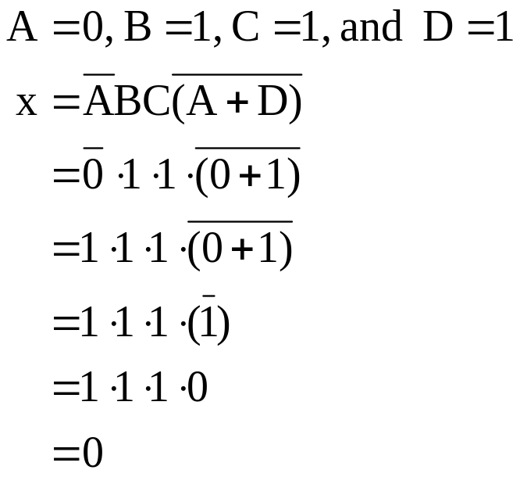
3-7 Evaluating Logic Circuit Outputs
Evaluate Boolean expressions by substituting values and performing the indicated operations:
Ronald Tocci/Neal Widmer/Gregory Moss
Digital Systems: Principles and Applications, 10e
Copyright ©2007 by Pearson Education, Inc.
Columbus, OH 43235
All rights reserved...

Slide 17
3-7 Evaluating Logic Circuit Outputs
Output logic levels can be determined directly from a circuit diagram.
Technicians frequently use this method.
The output of each gate is noted until a final output is found.
Ronald Tocci/Neal Widmer/Gregory Moss
Digital Systems: Principles and Applications, 9e
Copyright ©2004 by Pearson Education, Inc.
Upper Saddle River, New Jersey 07458
All rights reserved.

Slide 18

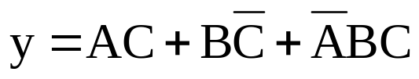
3-8 Implementing Circuits From Boolean Expressions
It is important to be able to draw a logic circuit from a Boolean expression.
The expression
could be drawn as a three input AND gate.
A more complex example such as
could be drawn as two 2-input AND gates and one 3-input AND gate feeding into a 3-input OR gate. Two of the AND gates have inverted inputs.
Ronald Tocci/Neal Widmer/Gregory Moss
Digital Systems: Principles and Applications, 10e
Copyright ©2007 by Pearson Education, Inc.
Columbus, OH 43235
All rights reserved..

Slide 19
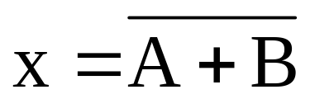
3-9 NOR Gates and NAND Gates
Combine basic AND, OR, and NOT operations.
The NOR gate is an inverted OR gate. An inversion “bubble” is placed at the output of the OR gate.
The Boolean expression is,
Ronald Tocci/Neal Widmer/Gregory Moss
Digital Systems: Principles and Applications, 10e
Copyright ©2007 by Pearson Education, Inc.
Columbus, OH 43235
All rights reserved..

Slide 20
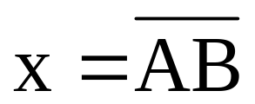
3-9 NOR Gates and NAND Gates
The NAND gate is an inverted AND gate. An inversion “bubble” is placed at the output of the AND gate.
The Boolean expression is
Ronald Tocci/Neal Widmer/Gregory Moss
Digital Systems: Principles and Applications, 10e
Copyright ©2007 by Pearson Education, Inc.
Columbus, OH 43235
All rights reserved..

Slide 21
3-9 NOR Gates and NAND Gates
The output of NAND and NOR gates may be found by simply determining the output of an AND or OR gate and inverting it.
The truth tables for NOR and NAND gates show the complement of truth tables for OR and AND gates.
Ronald Tocci/Neal Widmer/Gregory Moss
Digital Systems: Principles and Applications, 10e
Copyright ©2007 by Pearson Education, Inc.
Columbus, OH 43235
All rights reserved..

Slide 22
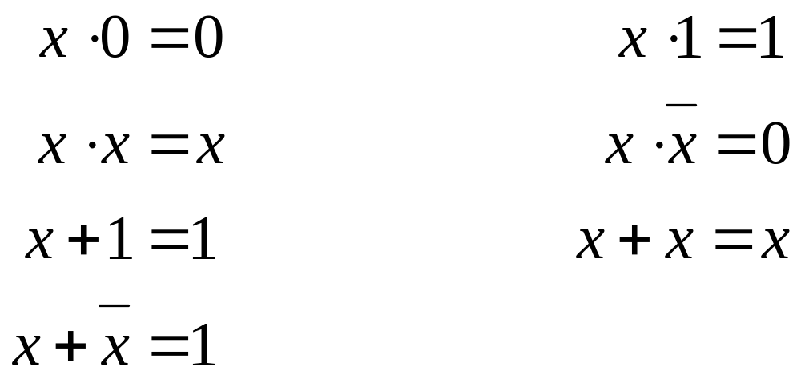
3-10 Boolean Theorems
The theorems or laws below may represent an expression containing more than one variable.
Ronald Tocci/Neal Widmer/Gregory Moss
Digital Systems: Principles and Applications, 10e
Copyright ©2007 by Pearson Education, Inc.
Columbus, OH 43235
All rights reserved..

Slide 23
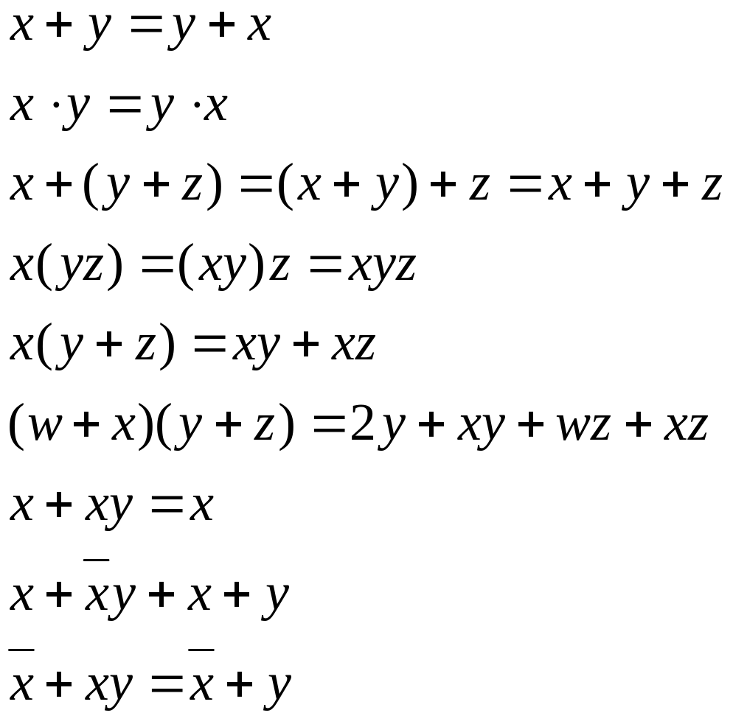
3-10 Boolean Theorems
Multivariable theorems:
Understanding all of the Boolean theorems will be useful in reducing expressions to their simplest form.
Ronald Tocci/Neal Widmer/Gregory Moss
Digital Systems: Principles and Applications, 10e
Copyright ©2007 by Pearson Education, Inc.
Columbus, OH 43235
All rights reserved..

Slide 24
3-11 DeMorgan’s Theorems
When the OR sum of two variables is inverted, it is equivalent to inverting each variable individually and ANDing them.
When the AND product of two variables is inverted, it is equivalent to inverting each variable individually and ORing them.
Ronald Tocci/Neal Widmer/Gregory Moss
Digital Systems: Principles and Applications, 10e
Copyright ©2007 by Pearson Education, Inc.
Columbus, OH 43235
All rights reserved...

Slide 25
3-11 DeMorgan’s Theorems
A NOR gate is equivalent to an AND gate with inverted inputs.
A NAND gate is equivalent to an OR gate with inverted inputs.
Ronald Tocci/Neal Widmer/Gregory Moss
Digital Systems: Principles and Applications, 10e
Copyright ©2007 by Pearson Education, Inc.
Columbus, OH 43235
All rights reserved..

Slide 26
3-12 Universality of NAND and NOR Gates
NAND or NOR gates can be used to create the three basic logic expressions (OR, AND, and INVERT)
Figures 3-29 and 3-30 illustrate how combinations of NANDs or NORs are used to create the three logic functions.
This characteristic provides flexibility and is very useful in logic circuit design.
Ronald Tocci/Neal Widmer/Gregory Moss
Digital Systems: Principles and Applications, 10e
Copyright ©2007 by Pearson Education, Inc.
Columbus, OH 43235
All rights reserved..

Slide 27
3-13 Alternate Logic-Gate Representations
To convert a standard symbol to an alternate:
  Invert each input and output (add an inversion bubble where there are none on the standard symbol, and remove bubbles where they exist on the standard symbol.
  Change a standard OR gate to and AND gate, or an AND gate to an OR gate.
Ronald Tocci/Neal Widmer/Gregory Moss
Digital Systems: Principles and Applications, 10e
Copyright ©2007 by Pearson Education, Inc.
Columbus, OH 43235
All rights reserved..

Slide 28
3-13 Alternate Logic-Gate Representations
The equivalence can be applied to gates with any number of inputs.
No standard symbols have bubbles on their inputs. All of the alternate symbols do.
The standard and alternate symbols represent the same physical circuitry.
Figure 3-33 compares the standard and alternate symbols.
Ronald Tocci/Neal Widmer/Gregory Moss
Digital Systems: Principles and Applications, 10e
Copyright ©2007 by Pearson Education, Inc.
Columbus, OH 43235
All rights reserved..

Slide 29
3-13 Alternate Logic-Gate Representations
Active high – an input or output has no inversion bubble.
Active low – an input or output has an inversion bubble.
An AND gate will produce an active output when all inputs are in their active states.
An OR gate will produce an active output when any input is in an active state.
Ronald Tocci/Neal Widmer/Gregory Moss
Digital Systems: Principles and Applications, 10e
Copyright ©2007 by Pearson Education, Inc.
Columbus, OH 43235
All rights reserved..

Slide 30
3-14 Which Gate Representation to Use
Using alternate and standard logic gate symbols together can make circuit operation clearer.
When possible choose gate symbols so that bubble outputs are connected to bubble input and nonbubble outputs are connected to nonbubble inputs.
Ronald Tocci/Neal Widmer/Gregory Moss
Digital Systems: Principles and Applications, 10e
Copyright ©2007 by Pearson Education, Inc.
Columbus, OH 43235
All rights reserved..

Slide 31
3-14 Which Gate Representation to Use
When a logic signal is in the active state (high or low) it is said to be asserted.
When a logic signal is in the inactive state (high or low) it is said to be unasserted.
A bar over a signal means asserted (active) low.
The absence of a bar over a signal means asserted (active) high.
Ronald Tocci/Neal Widmer/Gregory Moss
Digital Systems: Principles and Applications, 10e
Copyright ©2007 by Pearson Education, Inc.
Columbus, OH 43235
All rights reserved..

Slide 32
3-15 IEEE/ANSI Standard Logic Symbols
Rectangular symbols represent logic gates and circuits.
Dependency notation inside symbols show how output depends on inputs.
A small triangle replaces the inversion bubble.
Ronald Tocci/Neal Widmer/Gregory Moss
Digital Systems: Principles and Applications, 10e
Copyright ©2007 by Pearson Education, Inc.
Columbus, OH 43235
All rights reserved..

Slide 33
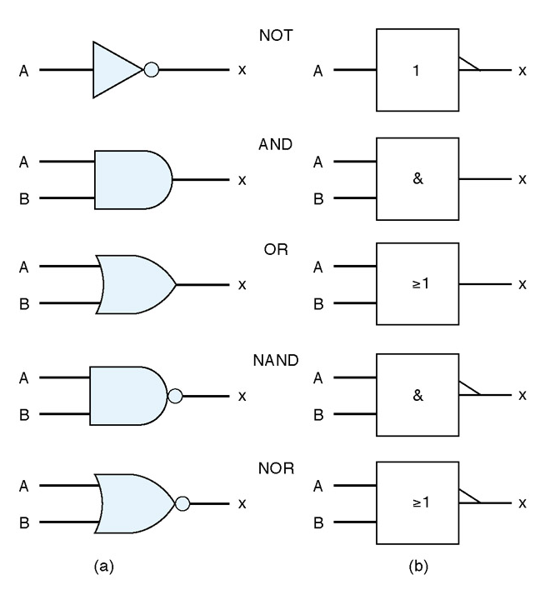
3-15 IEEE/ANSI Standard Logic Symbols
Compare the IEEE/ANSI symbols to traditional symbols.
These symbols are not widely accepted but may appear in some schematics.
Ronald Tocci/Neal Widmer/Gregory Moss
Digital Systems: Principles and Applications, 10e
Copyright ©2007 by Pearson Education, Inc.
Columbus, OH 43235
All rights reserved..

Slide 34
3-16 Summary of Methods to Describe Logic Circuits
The three basic logic functions are AND, OR, and NOT.
Logic functions allow us to represent a decision process.
  If it is raining OR it looks like rain I will take an umbrella.
  If I get paid AND I go to the bank I will have money to spend.
Ronald Tocci/Neal Widmer/Gregory Moss
Digital Systems: Principles and Applications, 10e
Copyright ©2007 by Pearson Education, Inc.
Columbus, OH 43235
All rights reserved..

Slide 35
3-17 Description Languages vs. Programming Languages
HDL – Hardware Description Languages allow rigidly defined language to represent logic circuits.
  AHDL – Altera Hardware Description Language.
  VHDL – Very High Speed Integrated circuit Hardware Description Language.
Ronald Tocci/Neal Widmer/Gregory Moss
Digital Systems: Principles and Applications, 10e
Copyright ©2007 by Pearson Education, Inc.
Columbus, OH 43235
All rights reserved..

Slide 36
3-17 Description Languages vs. Programming Languages
VHDL
  Developed by DoD
  Standardized by IEEE
  Widely used to translate designs into bit patterns that program actual devices.
AHDL
  Developed by Altera
  Used to configure Altera Programmable Logic Devices (PLDs)
Ronald Tocci/Neal Widmer/Gregory Moss
Digital Systems: Principles and Applications, 10e
Copyright ©2007 by Pearson Education, Inc.
Columbus, OH 43235
All rights reserved..

Slide 37
3-18 Implementing Logic Circuits With PLDs
Programmable Logic Devices (PLDs) are devices that can be configured in many ways to perform logic functions.
Internal connections are made electronically to program devices.
The hardware description language defines the connections to be made and is loaded into the device after translation by a compiler.
Ronald Tocci/Neal Widmer/Gregory Moss
Digital Systems: Principles and Applications, 10e
Copyright ©2007 by Pearson Education, Inc.
Columbus, OH 43235
All rights reserved..

Slide 38
3-19 HDL Format and Syntax
Syntax refers to the order of elements. Languages that are interpreted by computers must follows strict rules of syntax.
Format refers to a definition of inputs, outputs, and how the output responds to the input (operation). Inputs and outputs may be called ports.
  The mode of a port indicates if it is input or output.
  The type of a port indicates the number of bits and how they are grouped.
Ronald Tocci/Neal Widmer/Gregory Moss
Digital Systems: Principles and Applications, 10e
Copyright ©2007 by Pearson Education, Inc.
Columbus, OH 43235
All rights reserved..

Slide 39
3-19 HDL Format and Syntax
Boolean description using AHDL
Figure 3-47 defines an AND gate.
  The keyword SUBDESIGN names the circuit block, in this case: and_gate
  The input and output definitions are enclosed in parenthesis. Variables are separated by commas and are followed by :INPUT;
  The logic section is between the BEGIN and END keywords. Operators are:
    & = AND # = OR
    ! = NOT $ = XOR
Ronald Tocci/Neal Widmer/Gregory Moss
Digital Systems: Principles and Applications, 10e
Copyright ©2007 by Pearson Education, Inc.
Columbus, OH 43235
All rights reserved..

Slide 40
3-19 HDL Format and Syntax
Boolean Description Using VHDL
Figure 3-48 defines an AND gate.
  The keyword ENTITY names the circuit block, in this case: and_gate
  The keyword PORT defines the inputs and outputs.
  The keyword ARCHITECTURE describes the operation inside the block.
  The BEGIN and END contain a description of the operation
Ronald Tocci/Neal Widmer/Gregory Moss
Digital Systems: Principles and Applications, 10e
Copyright ©2007 by Pearson Education, Inc.
Columbus, OH 43235
All rights reserved..

Slide 41
3-20 Intermediate signals
Buried nodes or local signals in HDL are reference points inside a circuit block that are not inputs or outputs.
AHDL local signals
  comments are enclosed by % characters.
  Text after two dashes is for documentation only.
  Keyword VARIABLE defines intermediate signal.
  Keyword NODE designates the nature of the variable.
Ronald Tocci/Neal Widmer/Gregory Moss
Digital Systems: Principles and Applications, 10e
Copyright ©2007 by Pearson Education, Inc.
Columbus, OH 43235
All rights reserved..

Slide 42
3-20 Intermediate signals
VHDL local signals
  Text after two dashes is for documentation only.
  Keyword SIGNAL defines intermediate signal.
  Keyword BIT designates the type of signal
Ronald Tocci/Neal Widmer/Gregory Moss
Digital Systems: Principles and Applications, 10e
Copyright ©2007 by Pearson Education, Inc.
Columbus, OH 43235
All rights reserved..

