Slide 1
Introduction to Chapter 1
Digital technology is widely used. Examples:
  Computers
  Manufacturing systems
  Medical Science
  Transportation
  Entertainment
  Telecommunications
Basic digital concepts and terminology are introduced
Ronald Tocci/Neal Widmer/Gregory Moss
Digital Systems: Principles and Applications, 10e
Copyright ©2007 by Pearson Education, Inc.
Columbus, OH 43235
All rights reserved.

Slide 2
1-1 Numerical Representations
Physical systems use quantities which must be manipulated arithmetically.
Quantities may be represented numerically in either analog or digital form
Ronald Tocci/Neal Widmer/Gregory Moss
Digital Systems: Principles and Applications, 10e
Copyright ©2007 by Pearson Education, Inc.
Columbus, OH 43235
All rights reserved.

Slide 3
1-1 Numerical Representations
Analog Representation
  A continuously variable, proportional indicator.
  Examples of analog representation:
    Sound through a microphone causes voltage changes.
    Automobile speedometer changes with speed.
    Mercury thermometer varies over a range of values with temperature.
Ronald Tocci/Neal Widmer/Gregory Moss
Digital Systems: Principles and Applications, 10e
Copyright ©2007 by Pearson Education, Inc.
Columbus, OH 43235
All rights reserved.

Slide 4
1-1 Numerical Representations
Digital Representation
  Varies in discrete (separate) steps.
  Examples of digital representation:
    Passing time is shown as a change in the display on a digital clock at one minute intervals.
    A change in temperature is shown on a digital display only when the temperature changes at least one degree.
Ronald Tocci/Neal Widmer/Gregory Moss
Digital Systems: Principles and Applications, 10e
Copyright ©2007 by Pearson Education, Inc.
Columbus, OH 43235
All rights reserved.

Slide 5
1-2 Digital and Analog Systems
Digital system
  A combination of devices that manipulate values represented in digital form.
Analog system
  A combination of devices that manipulate values represented in analog form
Ronald Tocci/Neal Widmer/Gregory Moss
Digital Systems: Principles and Applications, 10e
Copyright ©2007 by Pearson Education, Inc.
Columbus, OH 43235
All rights reserved.

Slide 6
1-2 Digital and Analog Systems
Advantages of digital
  Ease of design
  Well suited for storing information.
  Accuracy and precision are easier to maintain
  Programmable operation
  Less affected by noise
  Ease of fabrication on IC chips
Ronald Tocci/Neal Widmer/Gregory Moss
Digital Systems: Principles and Applications, 10e
Copyright ©2007 by Pearson Education, Inc.
Columbus, OH 43235
All rights reserved.

Slide 7
1-2 Digital and Analog Systems
There are limits to digital techniques:
  The world is analog
  The analog nature of the world requires a time consuming conversion process:
      Convert the physical variable to an electrical signal (analog).
      Convert the analog signal to digital form.
      Process (operate on) the digital information
      Convert the digital output back to real-world analog form.
Ronald Tocci/Neal Widmer/Gregory Moss
Digital Systems: Principles and Applications, 10e
Copyright ©2007 by Pearson Education, Inc.
Columbus, OH 43235
All rights reserved.

Slide 8
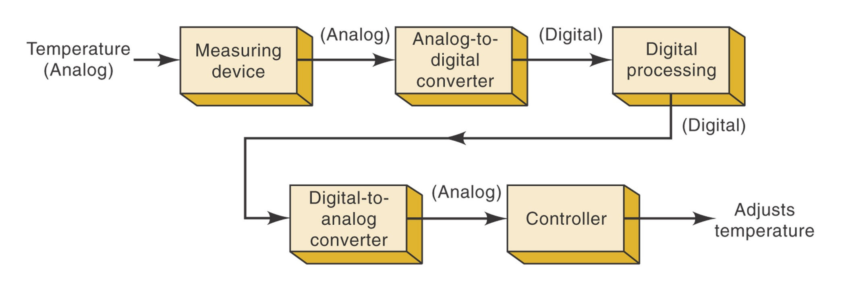
1-2 Digital and Analog Systems
Analog-to-digital conversion (ADC) and digital-to-analog conversion (DAC) complicate circuitry.
Ronald Tocci/Neal Widmer/Gregory Moss
Digital Systems: Principles and Applications, 10e
Copyright ©2007 by Pearson Education, Inc.
Columbus, OH 43235
All rights reserved.

Slide 9
1-2 Digital and Analog Systems
The audio CD is a typical hybrid (combination) system.
  Analog sound is converted into analog voltage.
  Analog voltage is changed into digital through an ADC in the recorder.
  Digital information is stored on the CD .
  At playback the digital information is changed into analog by a DAC in the CD player.
  The analog voltage is amplified and used to drive a speaker that produces the original analog sound.
Ronald Tocci/Neal Widmer/Gregory Moss
Digital Systems: Principles and Applications, 10e
Copyright ©2007 by Pearson Education, Inc.
Columbus, OH 43235
All rights reserved.

Slide 10
1-2 Digital and Analog Systems
There have been remarkable recent advances in digital technology.
Advances will continue as digital technology expands and improves.
This text will introduce tools and concepts that will prepare you to work with digital systems.
Ronald Tocci/Neal Widmer/Gregory Moss
Digital Systems: Principles and Applications, 10e
Copyright ©2007 by Pearson Education, Inc.
Columbus, OH 43235
All rights reserved.

Slide 11
1-3 Digital Number Systems
Understanding digital systems requires an understanding of the decimal, binary, octal, and hexadecimal numbering systems.
Ronald Tocci/Neal Widmer/Gregory Moss
Digital Systems: Principles and Applications, 10e
Copyright ©2007 by Pearson Education, Inc.
Columbus, OH 43235
All rights reserved.

Slide 12
1-3 Digital Number Systems
Number systems differ in the amount of symbols they use
  Decimal – 10 symbols (base 10)
  Hexadecimal – 16 symbols (base 16)
  Octal – 8 symbols (base 8)
  Binary – 2 symbols (base 2)
Ronald Tocci/Neal Widmer/Gregory Moss
Digital Systems: Principles and Applications, 10e
Copyright ©2007 by Pearson Education, Inc.
Columbus, OH 43235
All rights reserved.

Slide 13
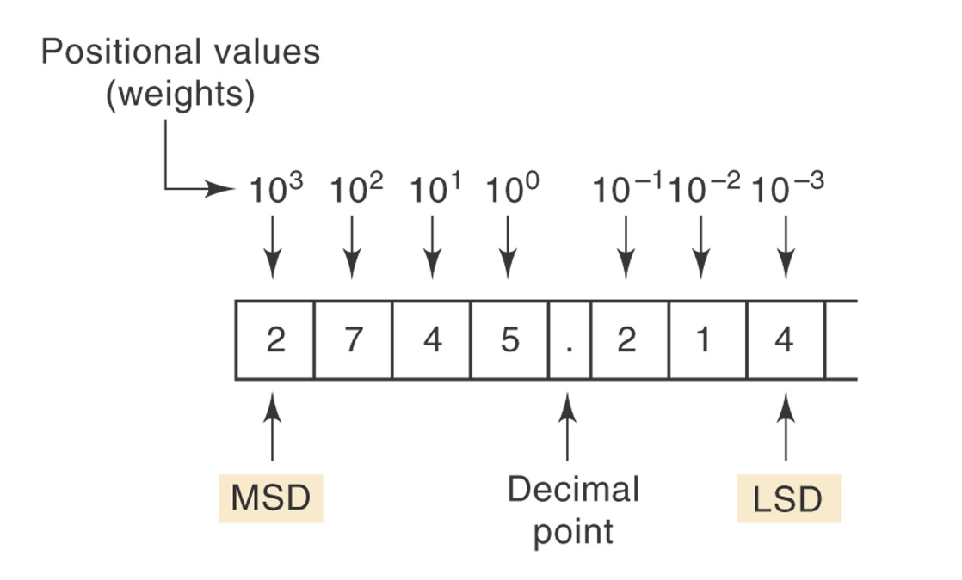
1-3 Digital Number Systems
The Decimal (base 10) System
  10 symbols: 0, 1, 2, 3, 4, 5, 6 , 7, 8, 9
  Each number is a digit (from Latin for finger)
  Most significant digit (MSD) and least significant digit (LSD)
  Positional value may be stated as a digit multiplied by a power of 10
Ronald Tocci/Neal Widmer/Gregory Moss
Digital Systems: Principles and Applications, 10e
Copyright ©2007 by Pearson Education, Inc.
Columbus, OH 43235
All rights reserved.

Slide 14
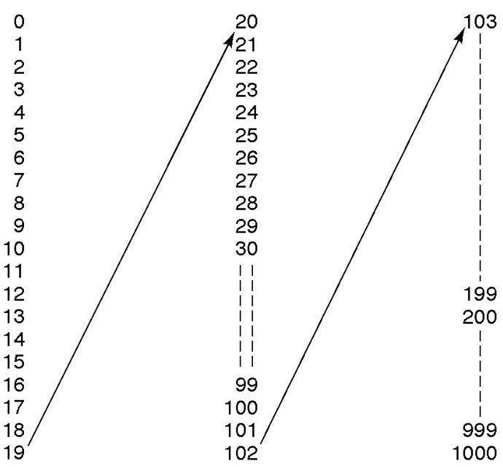
1-3 Digital Number Systems
Decimal Counting
Ronald Tocci/Neal Widmer/Gregory Moss
Digital Systems: Principles and Applications, 10e
Copyright ©2007 by Pearson Education, Inc.
Columbus, OH 43235
All rights reserved.

Slide 15
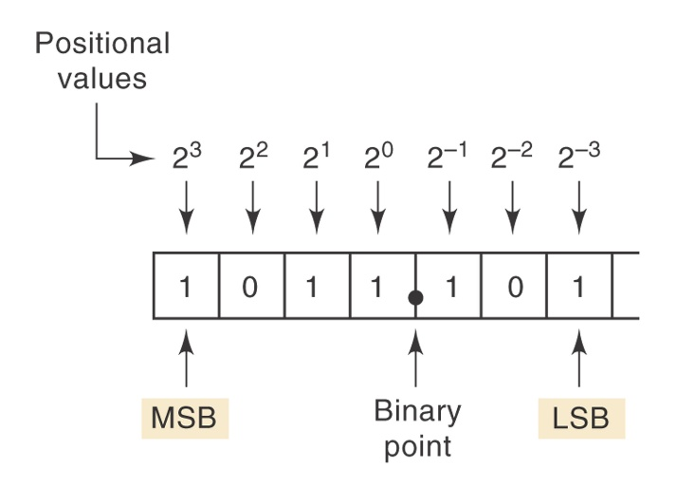
1-3 Digital Number Systems
The Binary (base 2) System
  2 symbols: 0,1
  Lends itself to electronic circuit design since only two different voltage levels are required.
  Other number systems are used to represent binary quantities.
  Positional value may be stated as a digit multiplied by a power of 2.
Ronald Tocci/Neal Widmer/Gregory Moss
Digital Systems: Principles and Applications, 10e
Copyright ©2007 by Pearson Education, Inc.
Columbus, OH 43235
All rights reserved..

Slide 16
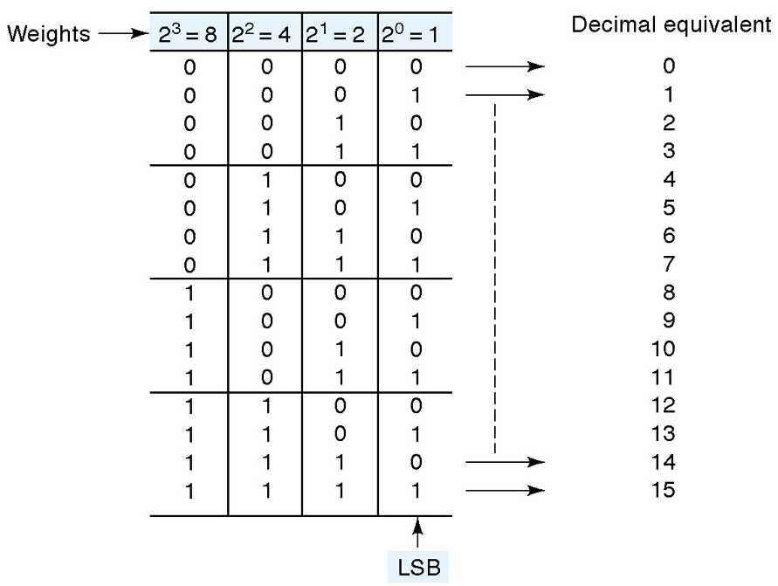
1-3 Digital Number Systems
Binary Counting
Ronald Tocci/Neal Widmer/Gregory Moss
Digital Systems: Principles and Applications, 10e
Copyright ©2007 by Pearson Education, Inc.
Columbus, OH 43235
All rights reserved.

Slide 17
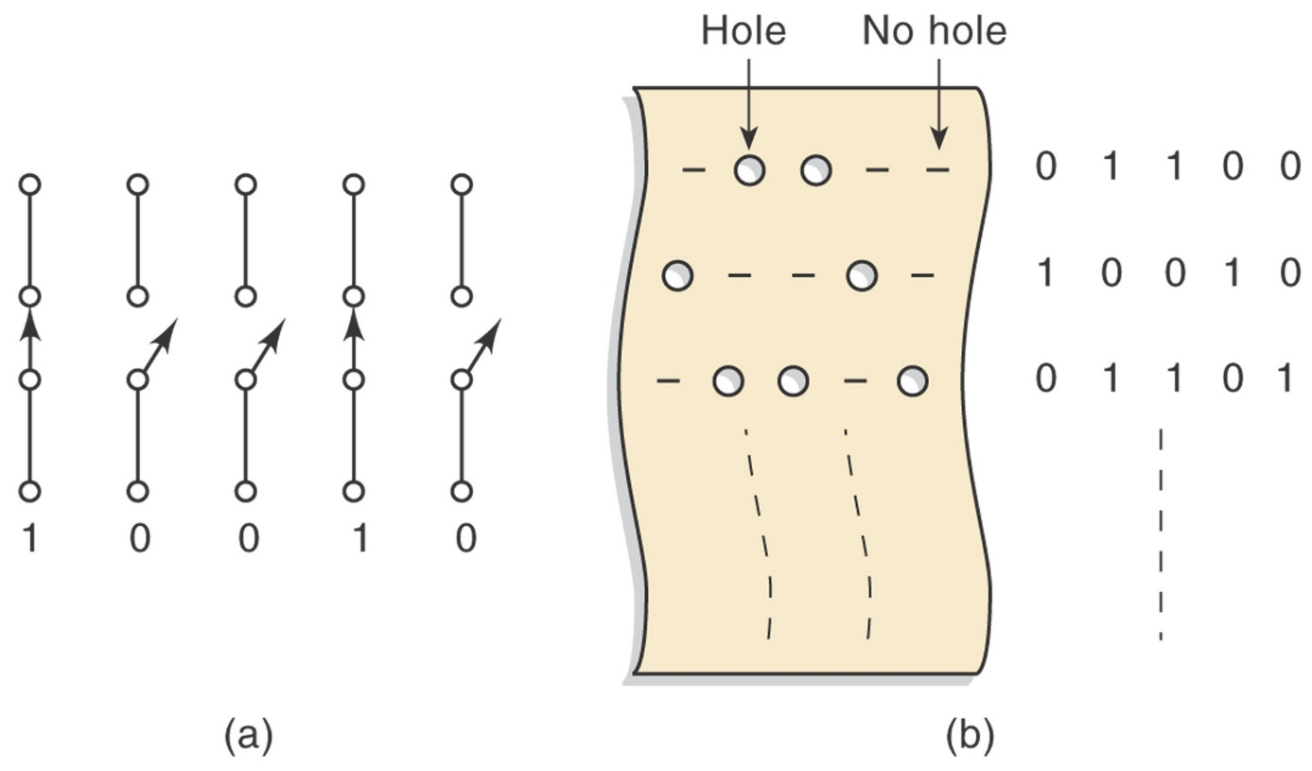
1-4 Representing Binary Quantities
Open and closed switches
Paper Tape
Ronald Tocci/Neal Widmer/Gregory Moss
Digital Systems: Principles and Applications, 9e
Copyright ©2007 by Pearson Education, Inc.
Columbus, OH 43235
All rights reserved.

Slide 18
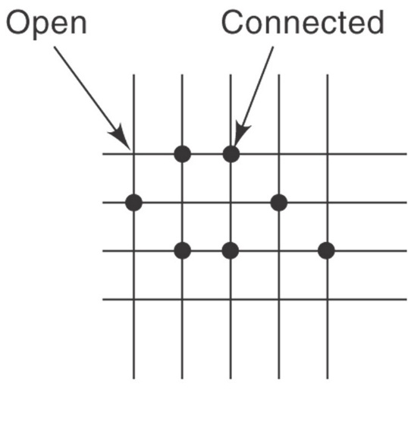
1-4 Representing Binary Quantities
Wires and rows form a matrix. This forms the foundation for programmable logic devices that will be studied in depth later.
Ronald Tocci/Neal Widmer/Gregory Moss
Digital Systems: Principles and Applications, 10e
Copyright ©2007 by Pearson Education, Inc.
Columbus, OH 43235
All rights reserved.

Slide 19
1-4 Representing Binary Quantities
Other two state devices:
  Light bulb (off or on)
  Diode (conducting or not conducting)
  Relay (energized or not energized)
  Transistor (cutoff or saturation)
  Photocell (illuminated or dark)
Ronald Tocci/Neal Widmer/Gregory Moss
Digital Systems: Principles and Applications, 9e
Copyright ©2007 by Pearson Education, Inc.
Columbus, OH 43235
All rights reserved.

Slide 20
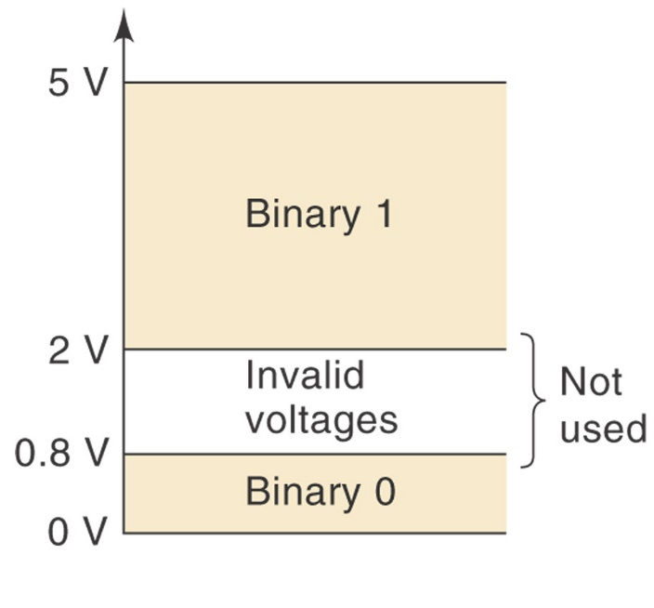
1-4 Representing Binary Quantities
Exact voltage level is not important in digital systems.
A voltage of 3.6 V will mean the same (binary 1) as a voltage of 4.3 V.
Ronald Tocci/Neal Widmer/Gregory Moss
Digital Systems: Principles and Applications, 10e
Copyright ©2007 by Pearson Education, Inc.
Columbus, OH 43235
All rights reserved.

Slide 21
1-4 Representing Binary Quantities
Digital Signals and Timing Diagrams
  Timing diagrams show voltage versus time.
  Horizontal scale represents regular intervals of time beginning at time zero.
  Timing diagrams are used to show how digital signals change with time.
  Timing diagrams are used to compare two or more digital signals.
  The oscilloscope and logic analyzer are used to produce timing diagrams.
Ronald Tocci/Neal Widmer/Gregory Moss
Digital Systems: Principles and Applications, 10e
Copyright ©2007 by Pearson Education, Inc.
Columbus, OH 43235
All rights reserved.

Slide 22
1-5 Digital Circuits/Logic Circuits
Digital circuits - produce and respond to predefined voltage ranges.
Logic circuits – used interchangeably with the term, digital circuits.
Digital integrated circuits (ICs) – provide logic operations in a small reliable package.
Ronald Tocci/Neal Widmer/Gregory Moss
Digital Systems: Principles and Applications, 10e
Copyright ©2007 by Pearson Education, Inc.
Columbus, OH 43235
All rights reserved.

Slide 23
1-6 Parallel and Serial Transmission
Parallel transmission – all bits in a binary number are transmitted simultaneously. A separate line is required for each bit.
Serial transmission – each bit in a binary number is transmitted per some time interval.
Ronald Tocci/Neal Widmer/Gregory Moss
Digital Systems: Principles and Applications, 10e
Copyright ©2007 by Pearson Education, Inc.
Columbus, OH 43235
All rights reserved.

Slide 24
1-6 Parallel and Serial Transmission
Parallel transmission is faster but requires more paths.
Serial is slower but requires a single path.
Both methods have useful applications which will be seen in later chapters.
Ronald Tocci/Neal Widmer/Gregory Moss
Digital Systems: Principles and Applications, 10e
Copyright ©2007 by Pearson Education, Inc.
Columbus, OH 43235
All rights reserved.

Slide 25
1-7 Memory
A circuit which retains a response to a momentary input is displaying memory.
Memory is important because it provides a way to store binary numbers temporarily or permanently.
Memory elements include:
  Magnetic
  Optical
  Electronic latching circuits
Ronald Tocci/Neal Widmer/Gregory Moss
Digital Systems: Principles and Applications, 10e
Copyright ©2007 by Pearson Education, Inc.
Columbus, OH 43235
All rights reserved.

Slide 26
1-8 Digital Computers
Computer – a system of hardware that performs arithmetic operations, manipulates data (usually in binary form), and makes decisions.
Computers perform operations based on instructions in the form of a program at high speed and with a high degree of accuracy.
Ronald Tocci/Neal Widmer/Gregory Moss
Digital Systems: Principles and Applications, 10e
Copyright ©2007 by Pearson Education, Inc.
Columbus, OH 43235
All rights reserved.

Slide 27
1-8 Digital Computers
Major parts of a computer
  Input unit – processes instructions and data into the memory.
  Memory unit – stores data and instructions.
  Control unit – interprets instructions and sends appropriate signals to other units as instructed.
  Arithmetic/logic unit – arithmetic calculations and logical decisions are performed.
  Output unit – presents information from the memory to the operator or process.
  The control and arithmetic/logic units are often treated as one and called the central processing unit (CPU)
Ronald Tocci/Neal Widmer/Gregory Moss
Digital Systems: Principles and Applications, 10e
Copyright ©2007 by Pearson Education, Inc.
Columbus, OH 43235
All rights reserved.

Slide 28
1-8 Digital Computers
Types of computers
  Microcomputer
    Most common (desktop PCs)
    Has become very powerful
  Minicomputer (workstation)
  Mainframe
  Microcontroller
    Designed for a specific application
    Dedicated or embedded controllers
    Used in appliances, manufacturing processes, auto ignition systems, ABS systems, and many other applications.
Ronald Tocci/Neal Widmer/Gregory Moss
Digital Systems: Principles and Applications, 10e
Copyright ©2007 by Pearson Education, Inc.
Columbus, OH 43235
All rights reserved.

