Slide 1
Telco Churn Analysis
Abir Chakraborty, Shruti Deshpande, Tam Pham, Evelyn Lee

Slide 2
Dataset Description
Source: Kaggle
Telecommunication Service Provider data that shows Churn and customer specific information within the last month.
CustomerID
Tenure
Contract
PaperlessBilling
Payment Method
MonthlyCharges
TotalCharges
1
Churn: Whether Customer left within the last month.
(Binomial Dependent Variable)
PhoneService
MultipleLines
InternetService
OnlineSecurity
OnlineBackup
DeviceProtection
TechSupport
StreamingTV
StreamingMovies
2
Customer Account Info:
Telco Services the customer has signed up for:
3
Gender
SeniorCitizen
Partner
Dependents
4
Demographic Info:

Slide 3
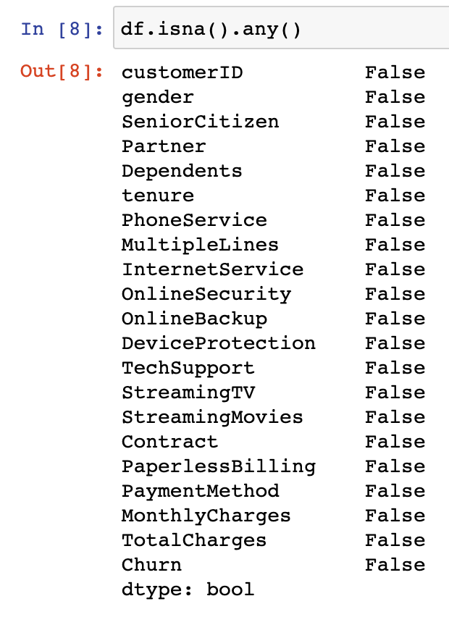

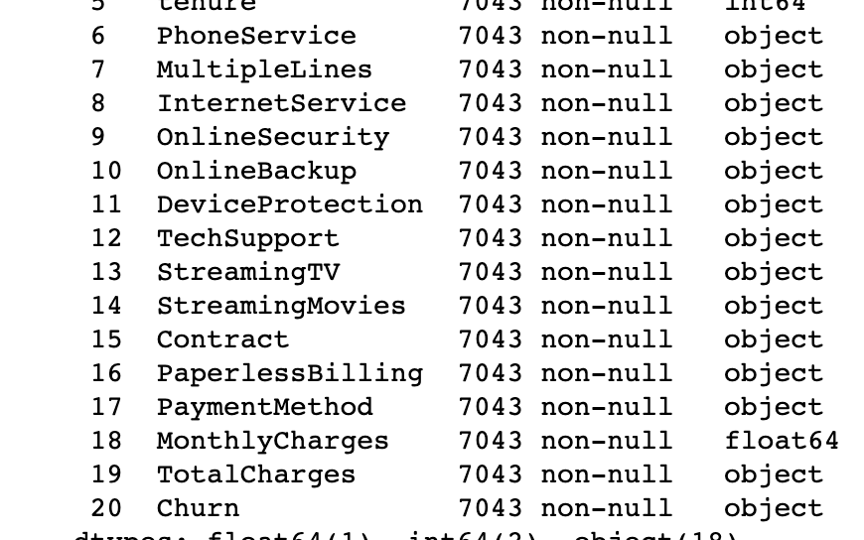
Data Cleaning Strategy
1
There are no NA values:
2
Total Charges shows as ‘object’ instead of ‘float’, indicating the presence of odd or missing values.

Slide 4
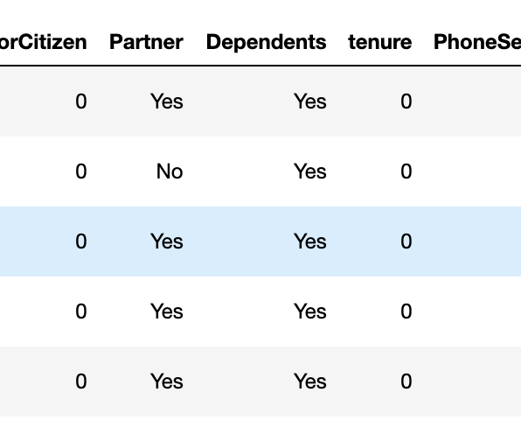
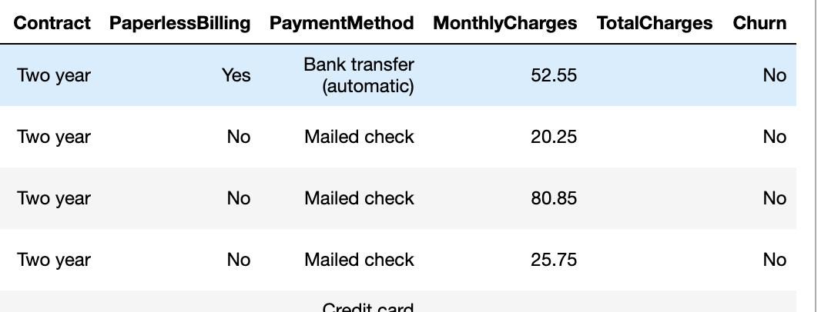
Data Cleaning Strategy
3
4
Solutions:
Remove rows with empty values in TotalCharges.
Drop less relevant columns, such as CustomerID.
Convert all multi-categorical columns to dummy columns.
Replace binary columns with 1’s and 0’s.
Looking closely, TotalCharges contains 11 missing values (empty cells), all of which have Tenure = 0. These are the people that have not made a payment to the company.

Slide 5
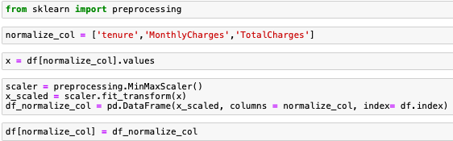
Data Normalization
Data Normalization
Import sklearn.preprocessing package.
Select relevant columns from the dataset.
Use the MinMaxScaler function in the package to transform column values.
Append columns with newly transformed values back to our dataset.
Problem: There are noticeable disparity in the variations of our numerical columns (i.e. tenure and TotalCharges). The program will give greater weight to those with larger variations, leading to potential inaccurate results without data normalization.

Slide 6
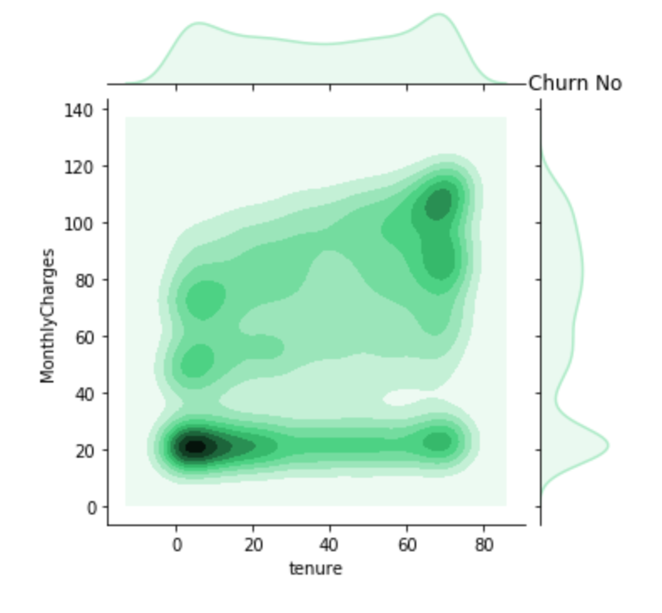
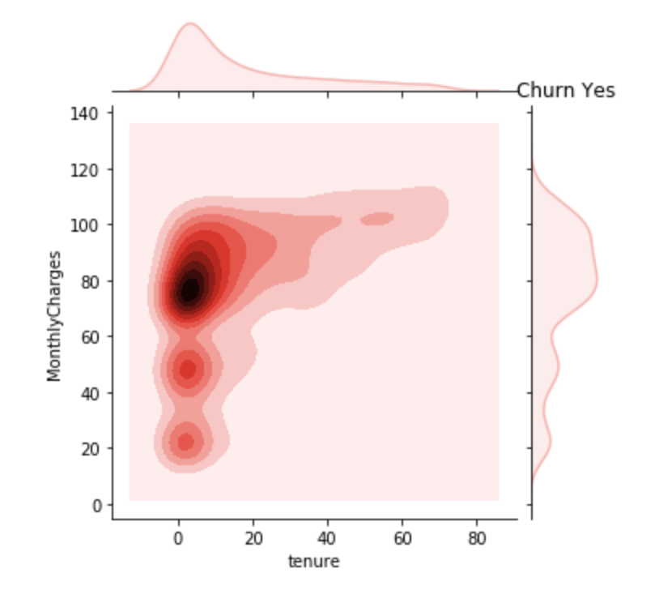
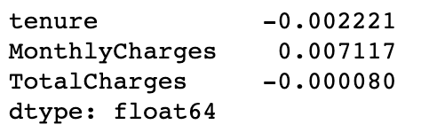
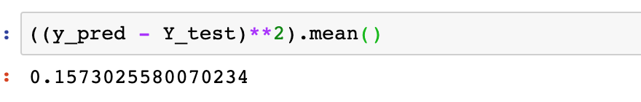
Lasso Regression:
Data Analysis Approach:
Test data with different models.
Compare accuracy of each model, and choose best performing models.
Use graphs to explore results from chosen models.
1
Findings:
With lower tenure, Those with low charges (around $20) tend to stay compared to those with higher charges(around $80) .
Managerial Insights:
The company may need to examine if their products and pricing strategy are aligned with the value and price that customers seek.
Results:

Slide 7
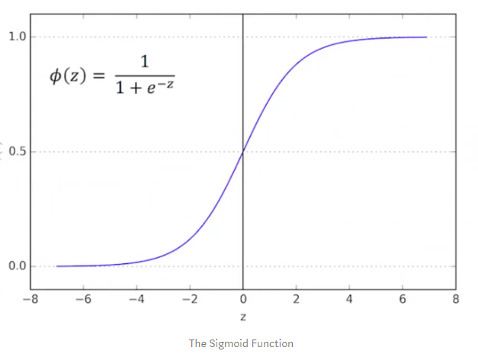
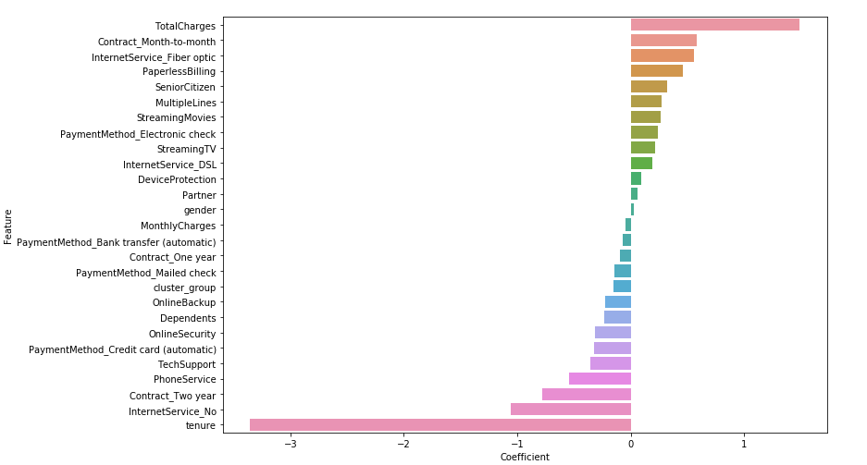
Logistic Regression:
2
Key Finding
The Logit has shown us : those with Fiber optics tends to churn more.

Slide 8
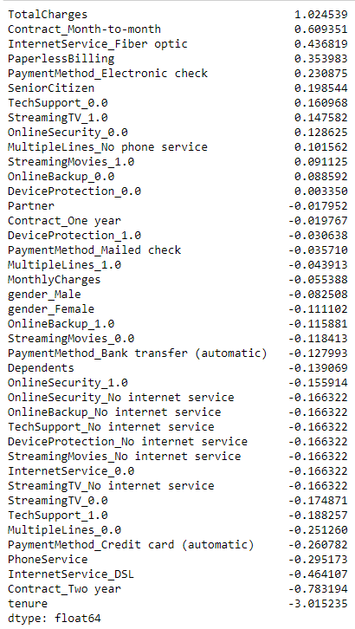
Logistic Regression:
2
Managerial Insights :
Total Churn rate is explained by the first graph. It is the total Charges of the product that determines the customer churn. If Market demand is elastic in nature, We would like to suggest looking at reducing the price of a product for higher month on month contract.
Though fibre optics is perceived as “What’s next”, our model with 80% accuracy tells that having fibre optic increases the customer churn. This in combination with higher churn rate for non young group, we might recommend to market fibre optics lines juxtaposed with the age group of the customer.

Slide 9
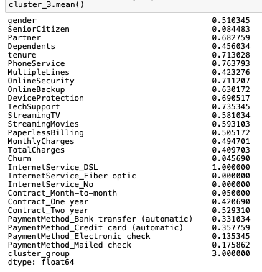

Clustering Analysis
3
Summary | Cluster (3)
K-means Analysis
Proportion
of churned customers in each customer segment.
Key Finding
The customer segment with the lowest churn rate is comprised of long-term customers who use DSL internet and enroll in a wide variety of tech services.

Slide 10
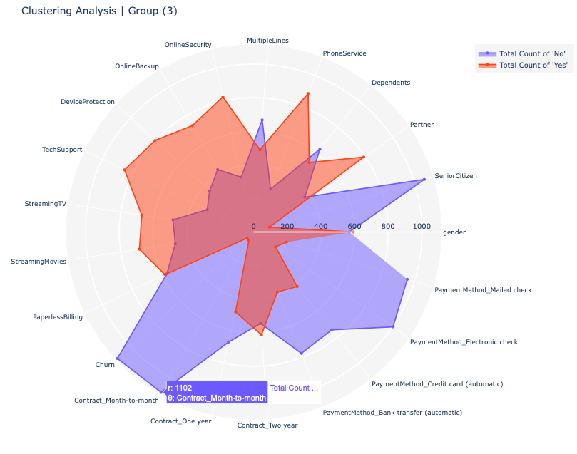
Managerial Insights:
The significantly low churn rate of this customer segment is explained by their high engagement and commitment (4-year average tenure) with Telco services. This segment is non-senior which explains why they are actively using high tech services such online backup, online security, or device protection. Yet, the fact that 100% of them use DSL internet, ~70% of them have partners, and nearly half have dependents show that they are likely to be families.
This finding provides a good basis for Telco to devise their customer retention program, especially on how to personalize their retargeting marketing efforts (i.e. which product/service should be the focus of advertising) and develop a playbook for organization adoption at scale.

