Slide 1

COURIER OPERATIONS MANAGEMENT
From Booking to Final Delivery — a step-by-step walkthrough of the real system
BOOKING › LOADING SHEET › THC › IN SCAN › DRS › DELIVERY › POD UPLOAD
Notes:
Welcome. This deck follows one shipment through the real application, screen by screen, in the exact order operations actually uses it: booking, loading sheet, THC dispatch, in scan, DRS, delivery, and POD upload. Every screenshot from here on is the live system, not a mockup.

Slide 2








INTRODUCTION
Operations Overview
This is the exact sequence a shipment follows in the system, and the order this deck walks through it.
1
2
3
4
5
6
7
Booking
Loading Sheet
THC
In Scan
DRS
Delivery
POD Upload
Booking itself has four parts — pincode & destination, item details, sender & receiver, and payment type — each shown on its own slide next.
02
Notes:
This is the full lifecycle, and it is also the exact order of the slides that follow — nothing here is reordered or simplified from how the system actually works. Booking alone breaks into four screens, which we will go through one at a time, then loading sheet, THC, in scan, DRS, delivery, and POD upload.

Slide 3
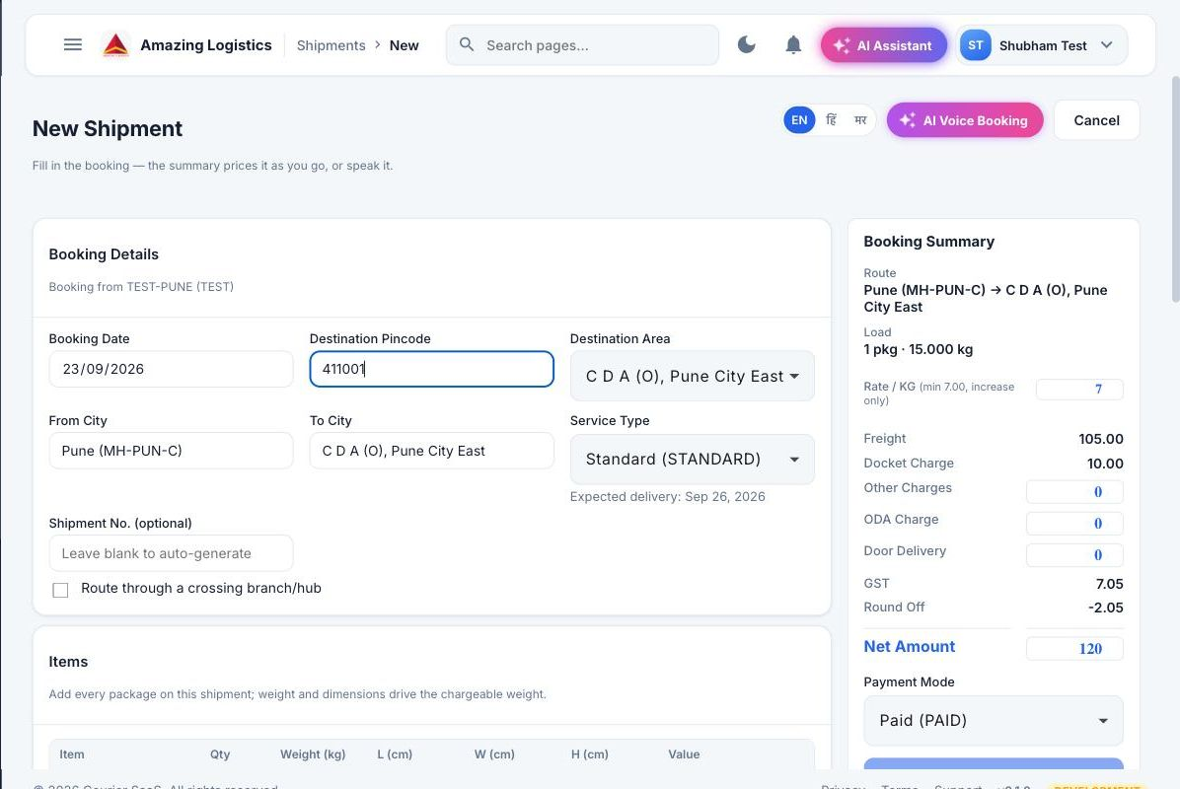
BOOKING · STEP 1 OF 4
Pincode → Destination Area
The operator enters the destination pincode; the system resolves the destination area and prices the freight live, before anything else is filled in.
BOOKING › LOADING SHEET › THC › IN SCAN › DRS › DELIVERY › POD UPLOAD
Destination Area, service type and freight all populate the moment a valid pincode is entered.
03
Notes:
This is the very first thing that happens in a booking. The operator types the destination pincode, and the system immediately resolves the destination area and starts pricing the shipment live in the Booking Summary panel on the right — freight, docket charge, GST, right down to the net amount. Nothing else needs to be filled in yet for the price to already be forming.

Slide 4
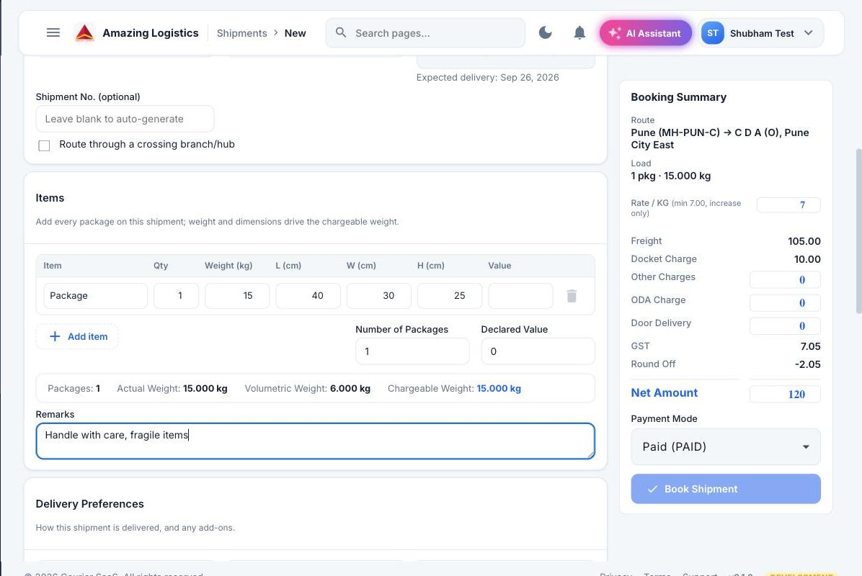
BOOKING · STEP 2 OF 4
Item & Package Details
Weight, dimensions and package count are entered next — this is what actually drives the chargeable weight and the freight shown on the right.
BOOKING › LOADING SHEET › THC › IN SCAN › DRS › DELIVERY › POD UPLOAD
Volumetric weight is calculated from L × W × H automatically and compared against actual weight.
04
Notes:
Next, item details. The operator records actual weight and dimensions per package. The system computes volumetric weight from length, width and height automatically, and charges on whichever of actual or volumetric weight is higher — that comparison is shown live at the bottom of the items table.

Slide 5
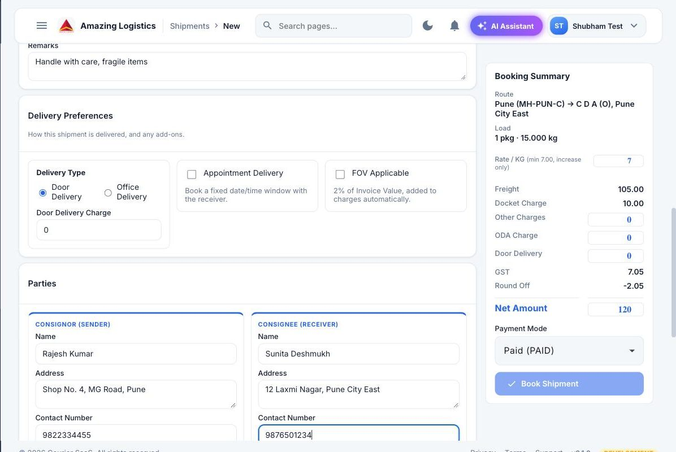
BOOKING · STEP 3 OF 4
Sender & Receiver Details
Consignor and consignee — name, address and contact number — are captured side by side in the Parties section.
BOOKING › LOADING SHEET › THC › IN SCAN › DRS › DELIVERY › POD UPLOAD
Pincode on each side lets the same pincode-driven pricing logic apply to pickup as well as delivery.
05
Notes:
With pricing already forming, the operator fills in who the shipment is from and who it is going to — the consignor and consignee, each with name, address, contact number and pincode. This is the same information that ends up on the shipping label and the POD at the end of the journey.

Slide 6
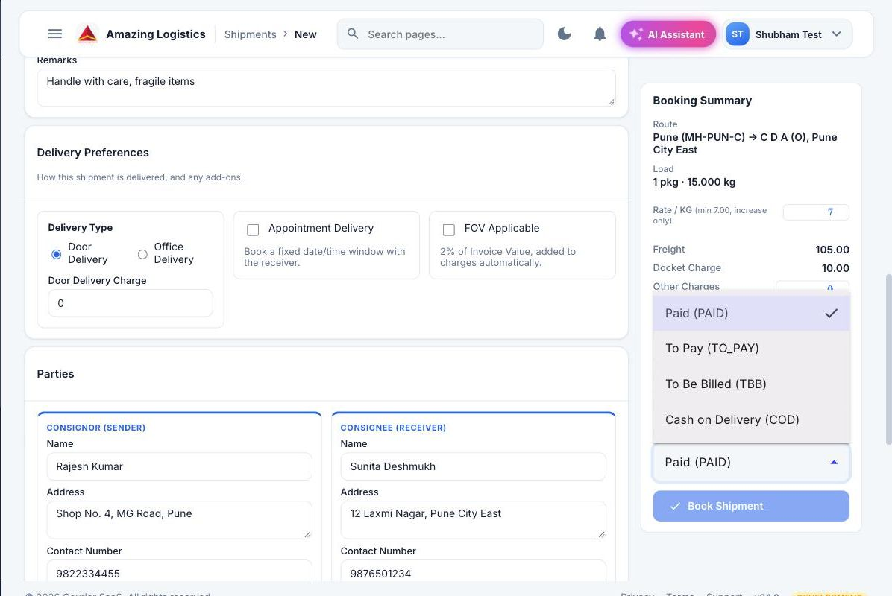
BOOKING · STEP 4 OF 4
Payment Type Selection
The last decision before booking: how this shipment gets paid for — Paid, To Pay, To Be Billed, or Cash on Delivery.
BOOKING › LOADING SHEET › THC › IN SCAN › DRS › DELIVERY › POD UPLOAD
COD triggers cash collection at delivery; To Pay and TBB are settled later. Booking finishes with an auto-generated AWB.
06
Notes:
The last step in booking is picking the payment mode — Paid upfront, To Pay, To Be Billed on account, or Cash on Delivery. This choice is what later drives the COD collection step during Out For Delivery. Once this is set, Book Shipment generates the AWB and the shipment formally exists in the system.

Slide 7
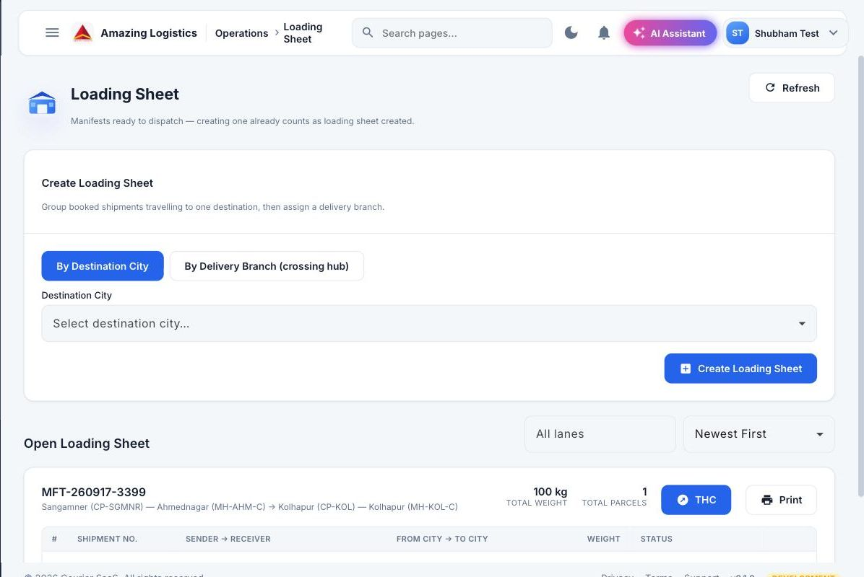
STAGE 2 OF 7
Loading Sheet Creation
Booked shipments travelling to the same destination are grouped into a manifest before they move anywhere.
BOOKING › LOADING SHEET › THC › IN SCAN › DRS › DELIVERY › POD UPLOAD
Grouped by destination city, or by delivery branch when the load is crossing a hub. This becomes the THC next.
07
Notes:
Once a shipment is booked, it does not move alone. The Loading Sheet screen groups every booked shipment heading to the same destination city — or the same delivery branch, when routed through a crossing hub — into a single manifest. Creating this loading sheet is what the system counts as manifest creation, and it is the direct input to the next screen, the Trip Hire Challan.

Slide 8
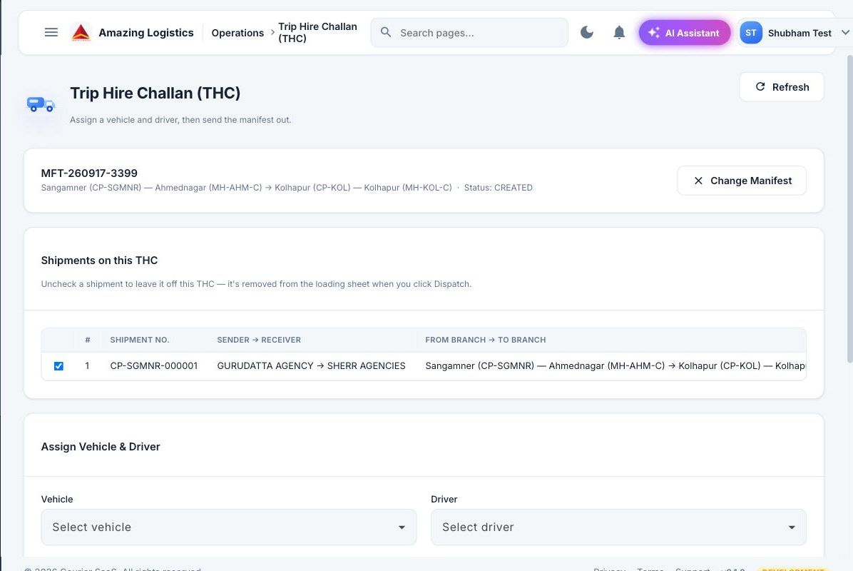
STAGE 3 OF 7
Trip Hire Challan (Dispatch)
The THC turns a loading sheet into an actual dispatch — a vehicle and a driver are assigned to the manifest.
BOOKING › LOADING SHEET › THC › IN SCAN › DRS › DELIVERY › POD UPLOAD
Once Vehicle and Driver are both set, Dispatch locks the manifest and releases it for movement.
08
Notes:
The Trip Hire Challan is where a manifest becomes a real dispatch. The operator opens the manifest, confirms exactly which shipments are riding on it, then assigns a vehicle and a driver from the two dropdowns shown here. Clicking Dispatch locks the manifest and the load is officially on its way.

Slide 9
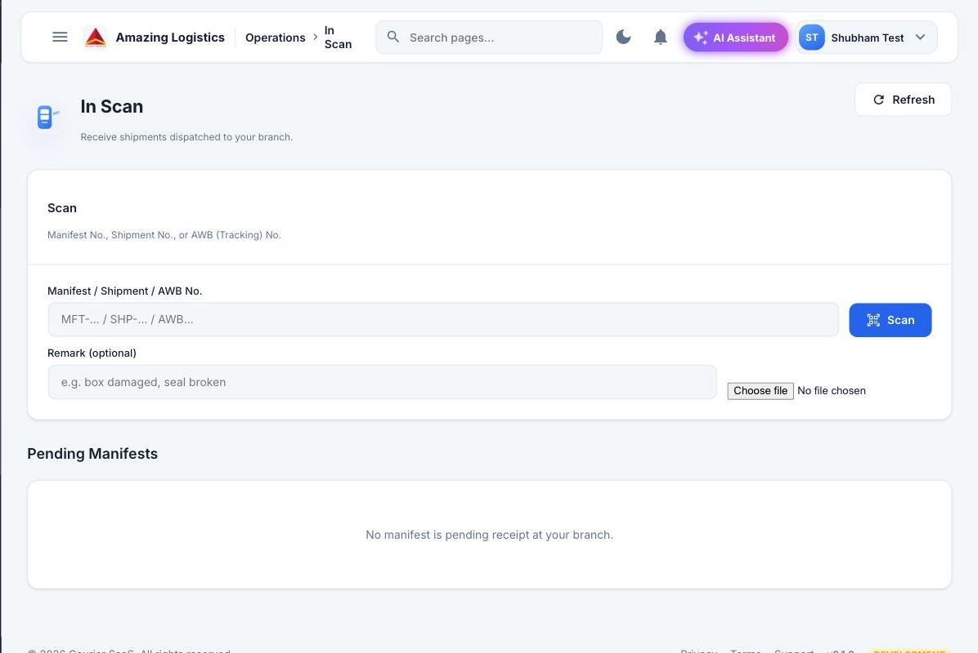
STAGE 4 OF 7
In Scan
Every shipment is scanned on arrival — whether that is out of the origin branch, into a hub, or into the delivery branch.
BOOKING › LOADING SHEET › THC › IN SCAN › DRS › DELIVERY › POD UPLOAD
AWB, shipment or manifest number is scanned; the system checks it belongs to this movement and updates status live.
09
Notes:
The In Scan screen is used at every handover point — leaving the origin branch, arriving at a hub, or arriving at the delivery branch. The operator scans the AWB, shipment or manifest number, the system verifies it belongs to that movement, and the shipment’s status updates in real time the moment the scan succeeds.

Slide 10
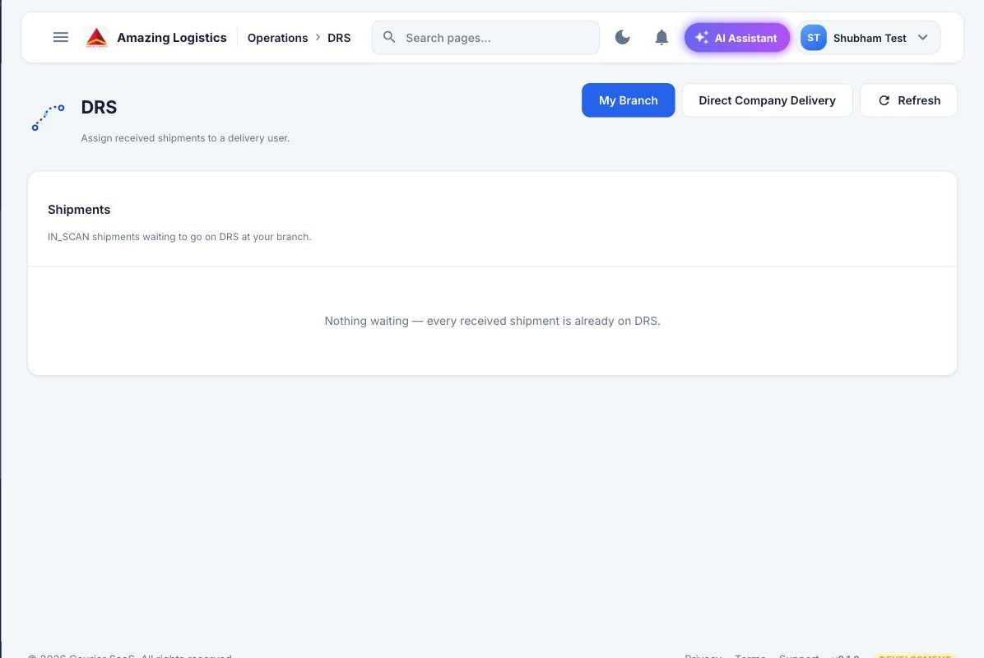
STAGE 5 OF 7
DRS Creation (Out for Delivery)
At the delivery branch, received shipments are assigned to a delivery executive through the DRS screen.
BOOKING › LOADING SHEET › THC › IN SCAN › DRS › DELIVERY › POD UPLOAD
A Direct Company Delivery toggle exists on this same screen for shipments bypassing the delivery branch entirely.
10
Notes:
Once a shipment is received at the delivery branch, the DRS screen is where it gets assigned to a specific delivery executive for the last mile. This same screen also has a Direct Company Delivery mode, for shipments the booking branch sends straight out on a company vehicle without a delivery branch involved at all.

Slide 11
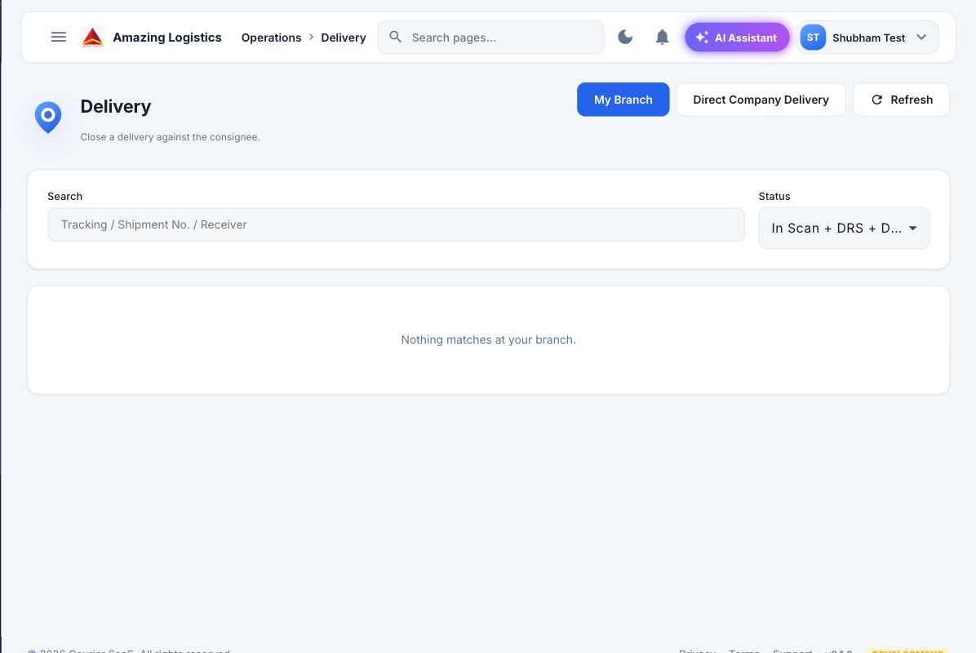
STAGE 6 OF 7
Delivery
The delivery executive closes the shipment against the consignee, right here on the Delivery screen.
BOOKING › LOADING SHEET › THC › IN SCAN › DRS › DELIVERY › POD UPLOAD
Receiver identity is confirmed and the shipment is searched by tracking number, shipment number or receiver name.
11
Notes:
This is the Delivery screen the executive uses to close a shipment out. It is searched by tracking number, shipment number or receiver name, receiver identity is confirmed, and the shipment is marked delivered against the consignee. That status change is what the next screen, POD upload, attaches proof to.

Slide 12
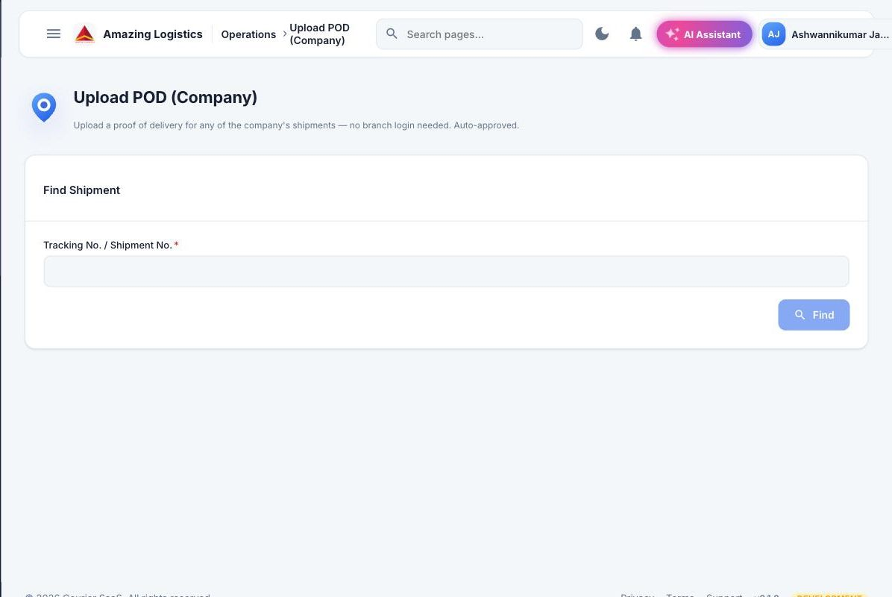
STAGE 7 OF 7
POD Upload
Proof of delivery — signature or photo — is attached to the shipment, closing the loop on the entire journey.
BOOKING › LOADING SHEET › THC › IN SCAN › DRS › DELIVERY › POD UPLOAD
Works for any of the company’s shipments by tracking or shipment number, no branch login needed, and is auto-approved.
12
Notes:
The final screen in the chain. POD Upload lets proof of delivery be attached to any shipment in the company by its tracking or shipment number, without needing to be logged into that specific branch, and it is auto-approved on upload. This is what closes the loop that started on the very first booking slide.

Slide 13
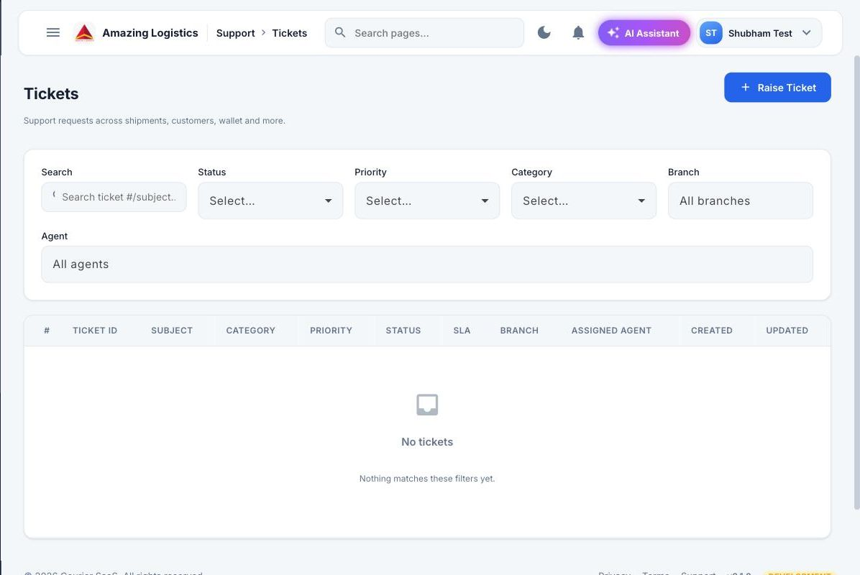







EXCEPTION HANDLING
Shipment Exceptions
Every exception is logged as a ticket and tracked to resolution, not handled informally.
Misroute
Missing Shipment
Damaged Shipment
Delivery Failed
Customer Unavailable
Address Issue
Hold Shipment
RTO
Category, priority, SLA, branch and assigned agent are tracked per ticket.
13
Notes:
Things go wrong — misroutes, damaged shipments, addresses that do not exist, customers who are not home. Every one of these eight exception types gets logged as a ticket on this same screen, with category, priority, SLA and the branch and agent responsible, so exceptions never quietly disappear.

Slide 14
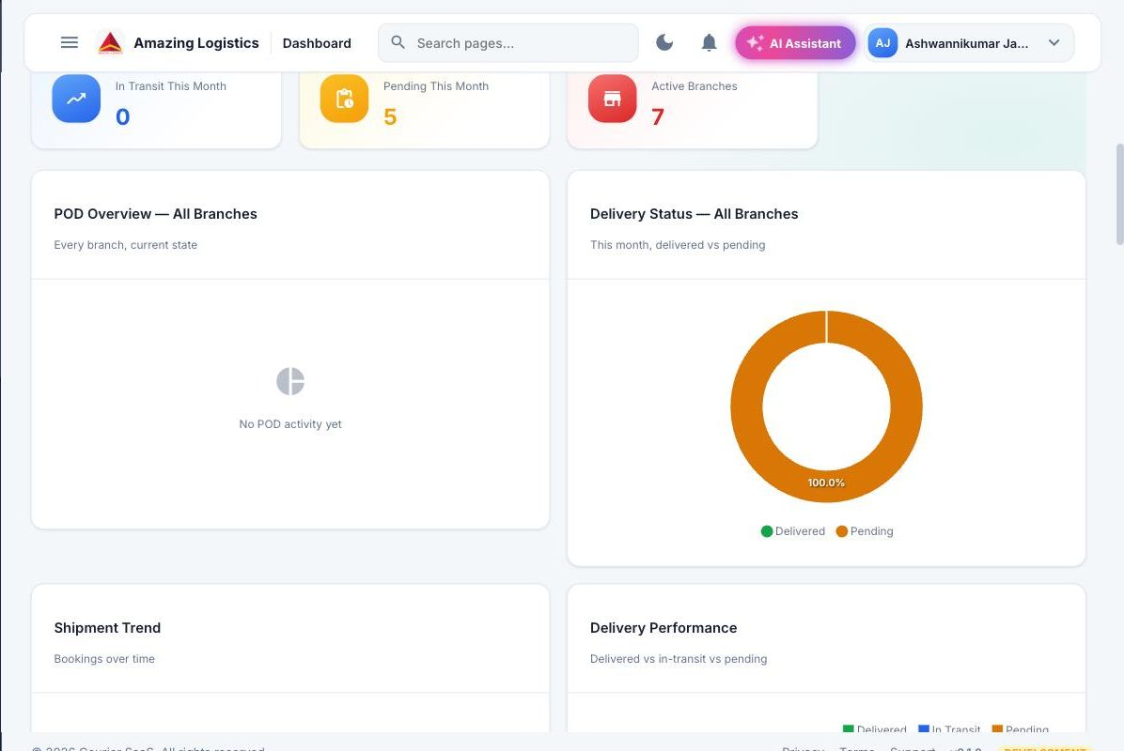
VISIBILITY
Operations Dashboard
A single, live view of shipment activity across every stage of the operation, company-wide.
14
Notes:
This is the real dashboard, company-wide across all branches. POD activity and delivered-versus-pending are tracked as live charts, not static numbers, so trends are visible at a glance instead of buried in a report. This is the same visibility every screen before it feeds into.

Slide 15




IMPACT
Operational Benefits
Faster Shipment Processing
Real-Time Shipment Visibility
Reduced Manual Work
Better Branch & Hub Coordination
Controlled Dispatch Process
Accurate Shipment Tracking
Faster Delivery Operations
15
Notes:
Bringing it together — this is why the process discipline we just walked through matters. Real-time visibility, less manual chasing, tighter coordination between branches and hubs, and a controlled dispatch process end to end.

