Slide 1
FarmOwl.ai – AI-powered Drone Solutions
Autonomous drones for small & medium farms
Precision agriculture through AI-driven crop care

Slide 2
Problem: Small & Medium Farm Challenges
Labor shortages and rising costs
Limited access to precision agriculture tools
High chemical costs due to non-targeted spraying
Manual livestock monitoring and inefficient field scouting

Slide 3
Our Product: FarmOwl.ai
Compact, AI-enabled UAV kits
Real-time crop and livestock monitoring
Automated seeding and targeted see-and-spray
Dynamic chemical mixing mid-flight based on AI/ML detection
Rugged tablet UI for farmers – simple, intuitive control

Slide 4
System Architecture
Tablet (Qt/QML, ROS2 Agent, GraphQL API)
ROS2 pipeline over DDS connects tablet to drone
Drone: ROS2 Client + PX4 autopilot
Onboard AI/ML models (CV for crop/livestock health detection)
Backend: PostgreSQL + GraphQL APIs for analytics and updates

Slide 5
Workflow
1. Plan missions on rugged tablet
2. Drone autonomously scans fields/livestock
3. AI detects pests, diseases, nutrient issues
4. Drone mixes chemicals in-air and applies precisely
5. Data synced to backend for farmer dashboards

Slide 6
Business Use Cases
Crop health monitoring
Cattle/livestock monitoring
Targeted spraying: fungicide, pesticide, fertilizer
Seeding for small plots
Reducing chemical waste and improving yields

Slide 7
How We Address Farmer Pain Points
Affordable technology tailored for 10–100 acre farms
Minimizes labor needs and costs
Reduces chemical usage by 30–50%
Improves yield through data-driven farming
Easy to deploy and manage without technical expertise

Slide 8
Tech Stack
Frontend: Qt/QML, Figma, SVG
Middleware: C++, ROS2, PX4
Backend: Python, PostgreSQL, GraphQL
AI/ML: PyTorch, OpenCV
OS: Ubuntu Linux
Devices: Rugged tablets + UAVs

Slide 9
Roadmap – Next 12 Months
0–3 mo: Complete software prototype & vision pipeline
3–6 mo: Assemble UAV prototypes and start pilot testing
6–9 mo: Automated see-and-spray with dynamic mixing
9–12 mo: Beta hardware/software, Part 137 approval, seed round

Slide 10
Competitive Landscape
FarmOwl.ai – built for small/medium farms
DJI (Agras) – focus on large plantations
XAG – large farms, heavy systems
Blue River/John Deere – tractor-mounted see-and-spray

Slide 11
Market Opportunity
1.5M small & medium farms in the U.S.
~30M farms globally
Capturing just 2% of U.S. = $150M+/yr revenue potential
Hardware + SaaS + services = recurring revenue model

Slide 12
Team
Ashutosh Singh – CEO & Co-Founder: 12+ yrs robotics & AI
- Experience: Argo AI, SafeAI, Sentien Robotics, Restoration Robotics
Ashvinder Singh – CTO & Co-Founder: 15+ yrs edge AI & analytics
- Experience: Johnson Controls, Foghorn Systems (Edge AI), Founder of Epinotation
Worked together at Foghorn on edge AI analytics systems

Slide 13
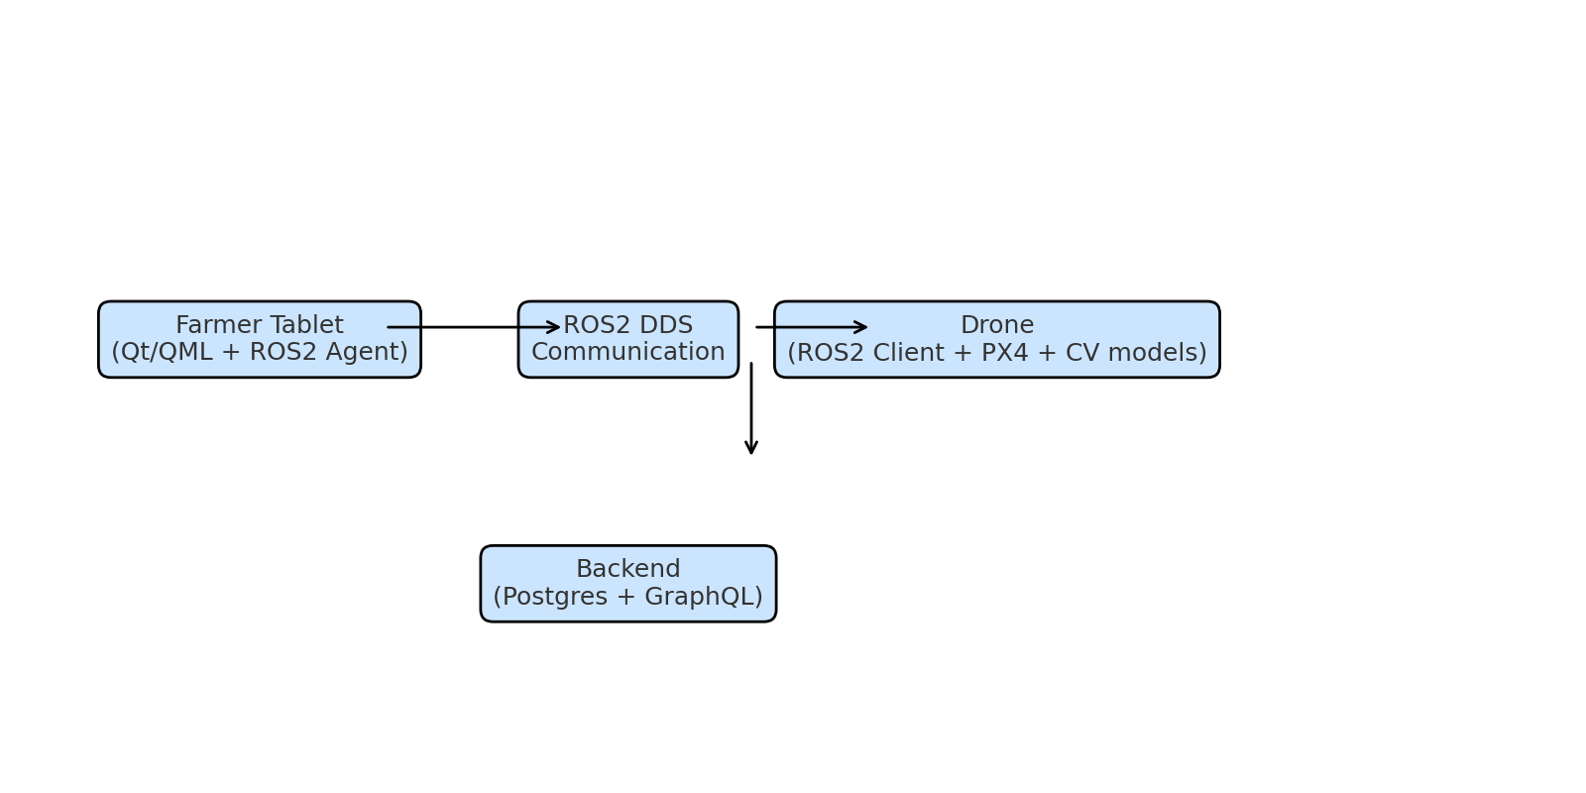
Architecture Diagram

Slide 14
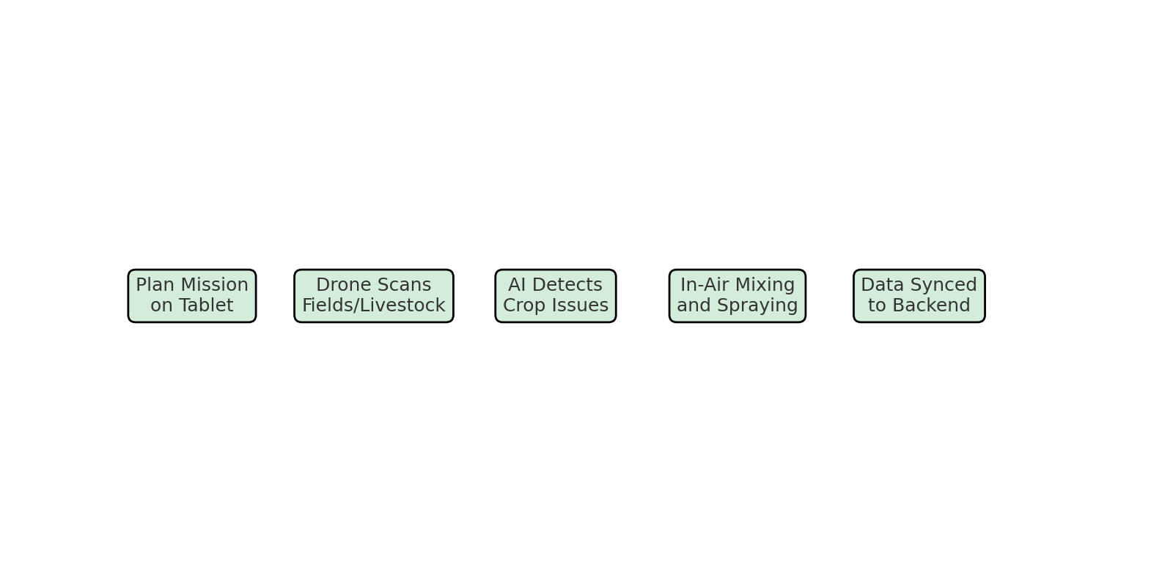
Workflow Diagram

Slide 15
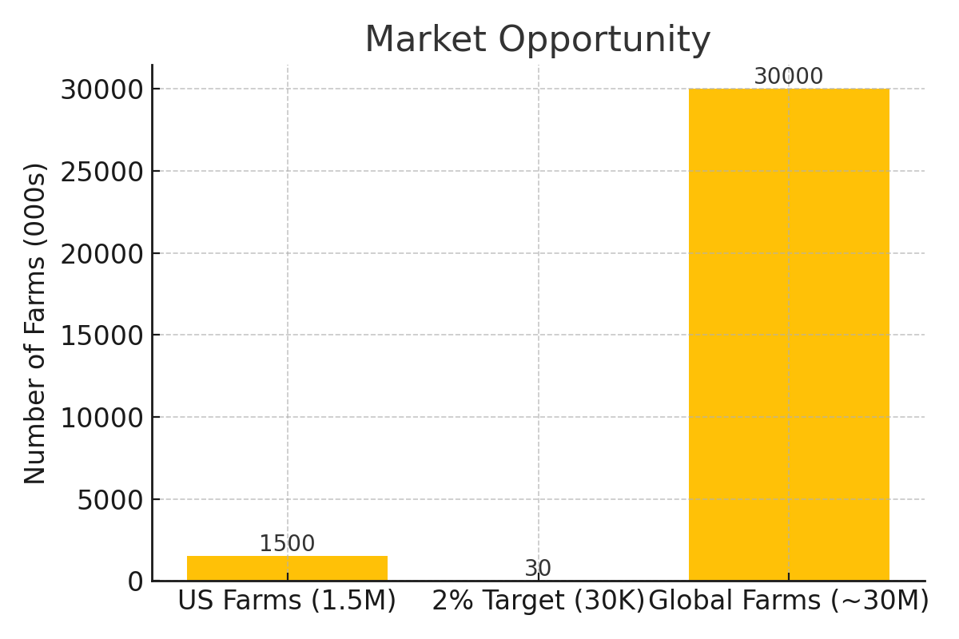
Market Opportunity Chart

Slide 16
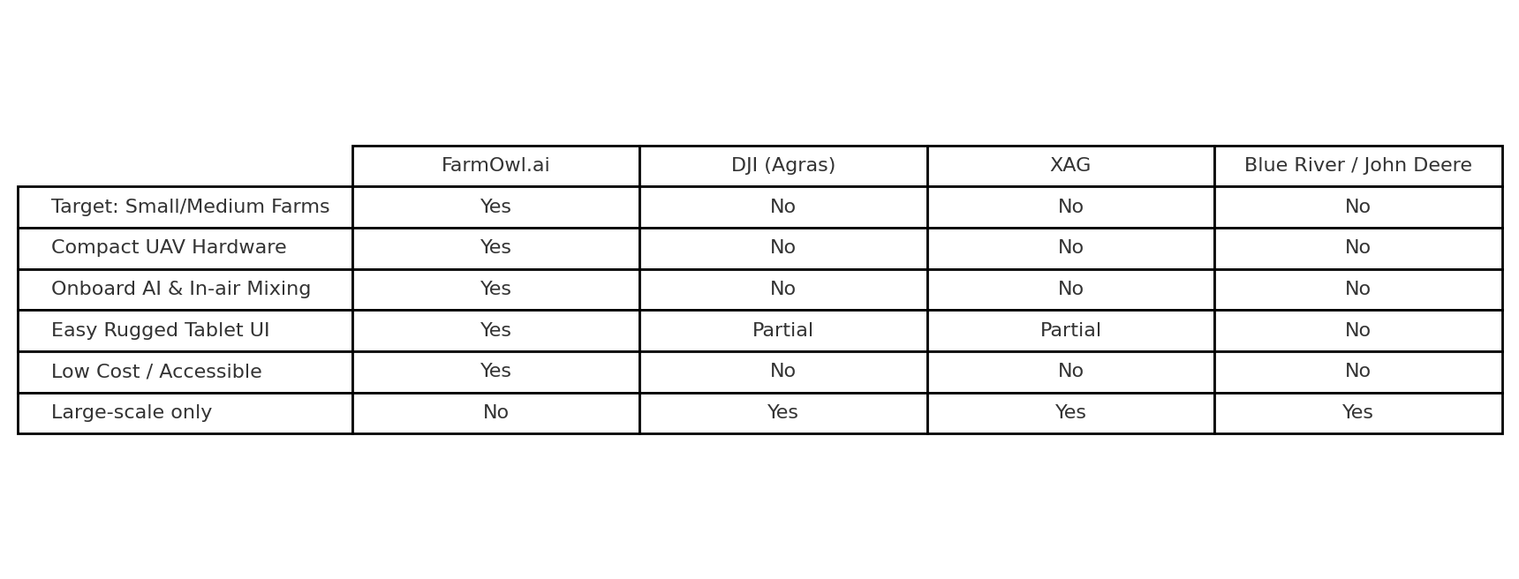
Competitor Comparison

Slide 17
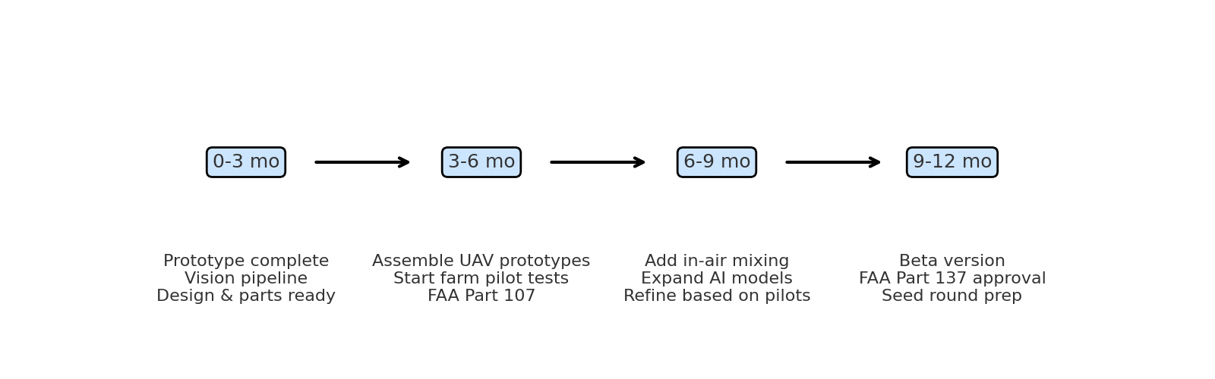
12-Month Roadmap

