Slide 1
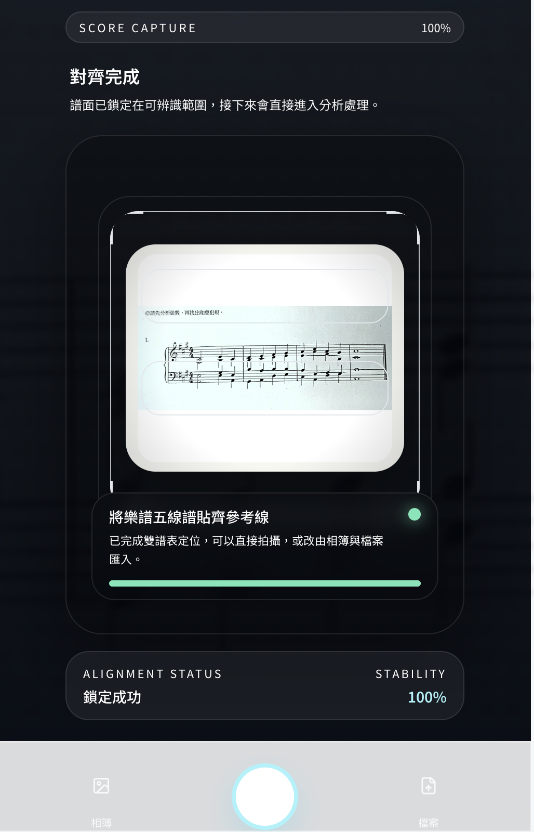
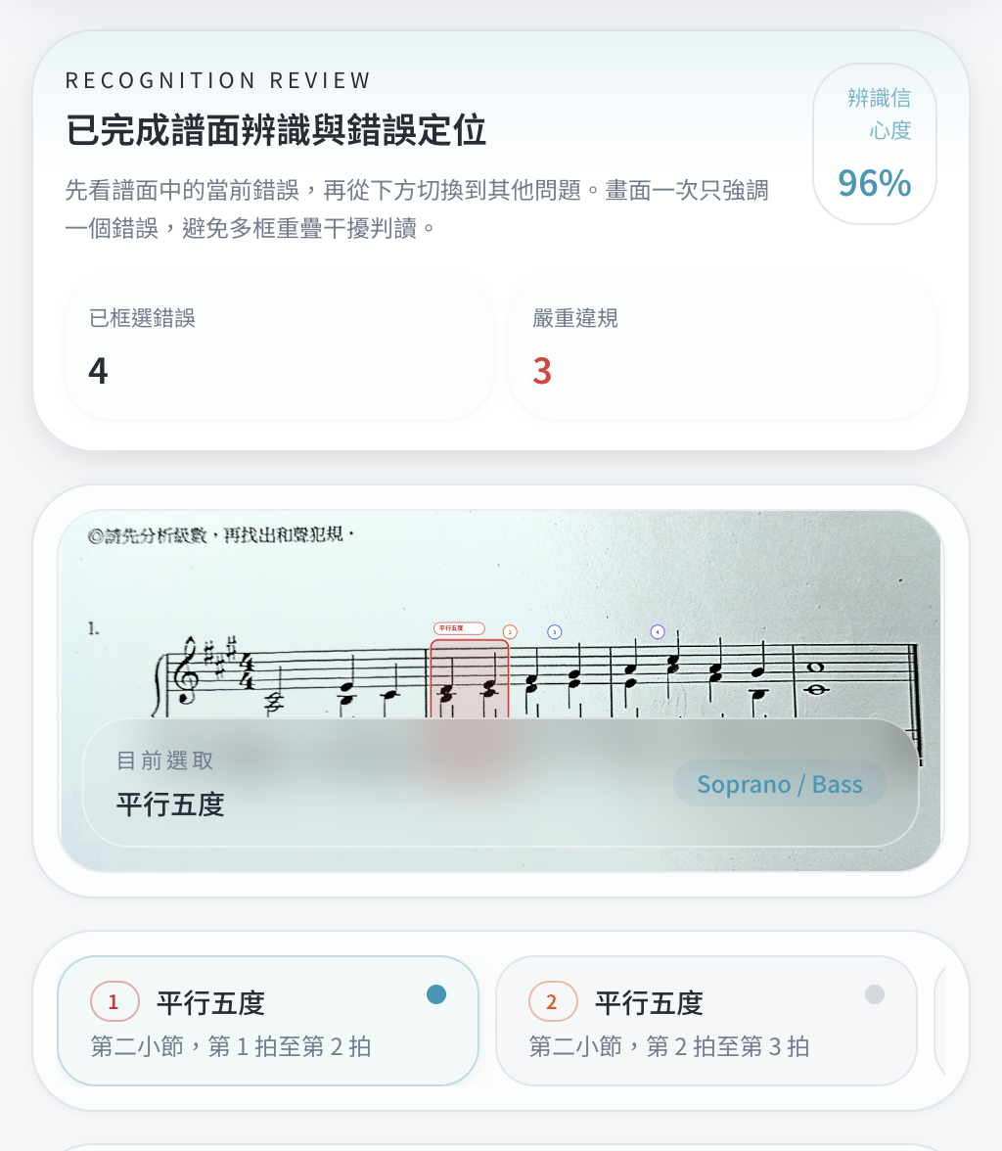
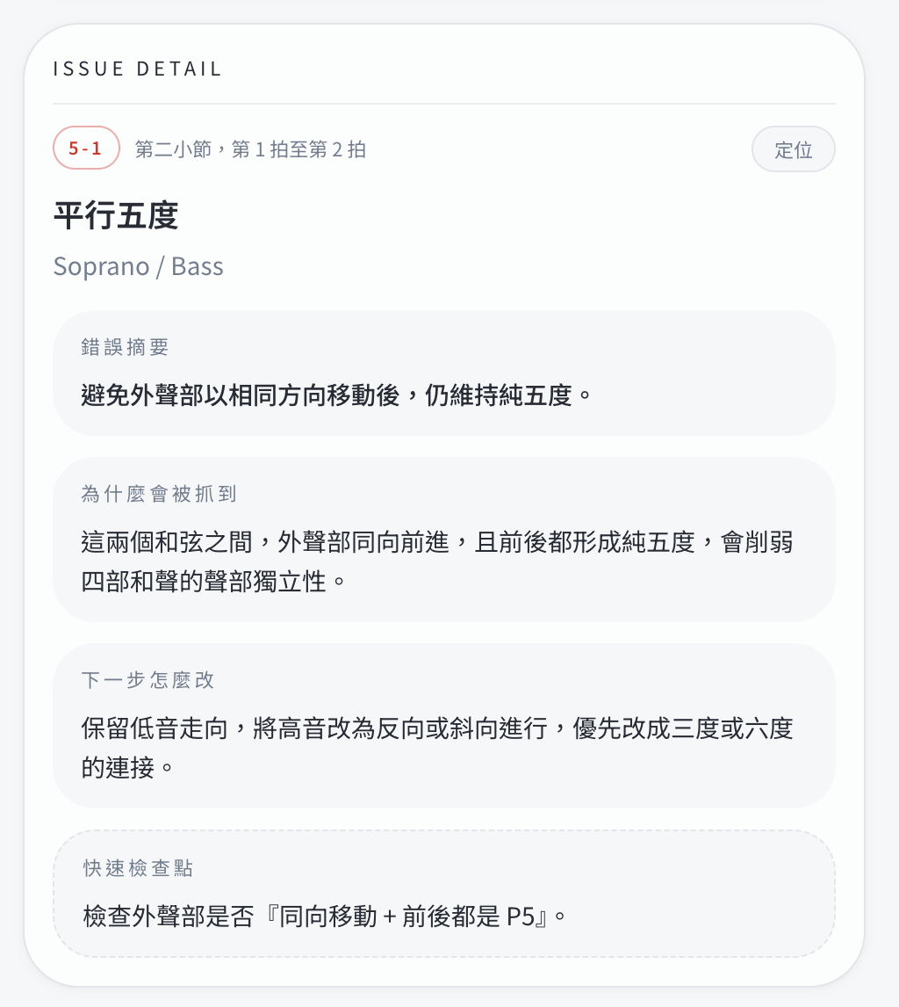
An Automatic Four-Part Harmony Grading System
Integrating Deep Learning-Based Optical Music Recognition and Rule-Based Analysis
MA, SIAO-SHIH
Advisor: Ming-Hsueh Lin
Arete Honors Program
National Yang Ming Chiao Tung University
Abstract & Motivation
Prototype Demonstration
Four-part harmony is a fundamental component of music theory education. Students must simultaneously consider voice leading, chord spacing, doubling, leading-tone resolution, cadence structure, and other harmonic constraints. Traditional grading depends heavily on expert teachers and often requires substantial time for manual correction.
Although OMR systems can recognize notation from score images, most existing systems focus on symbol detection or transcription rather than harmony-specific analysis and explainable learning feedback.
Key Problem
How can a system convert a score image into localized and explainable four-part harmony feedback?
Objectives & Contributions
(a) Score capture
and alignment
(b) Recognition review
and error localization
(c) Rule explanation
and feedback
This study aims to design an automatic four-part harmony grading system that integrates deep learning-based OMR with rule-based harmony analysis.
Figure 2: Prototype screens showing score capture, recognition review, localized error selection, and rule-based correction feedback.
Objectives
Contributions
The web-based prototype demonstrates score input, recognition progress, error localization, rule explanation, and correction guidance.
•
Detect music notation symbols using a YOLO-based OMR model.
•
A system architecture connecting recognition and rule analysis.
•
Convert detected symbols into four-part harmony snapshots.
•
A structured representation for four-part harmony snapshots.
•
Analyze common harmony errors through a rule engine.
•
A rule-based engine for representative harmony errors.
OMR Model Performance
•
Present localized errors with explanations and suggestions.
•
A web-based prototype demonstrating the grading workflow.
The current best OMR model is based on YOLO12s Ultimate v5 Stable and is evaluated on a cleaned validation set.
System Design & Pipeline
Score Image
mAP50
mAP50–95
Precision
Recall
0.7763
0.7320
0.957
0.576
Image
Preprocessing
YOLO Symbol
Detection
Symbol-to-Voice
Assembly
Harmony Rule
Engine
Observation. High precision indicates reliable detections, while recall improvement remains the main training target, especially for small or rare notation symbols.
Localized
Feedback
Discussion & Limitations
Figure 1: Overall workflow of the proposed four-part harmony grading system.
Current strengths
Current limitations
The architecture separates visual recognition from musical reasoning, allowing the OMR model and the harmony rule engine to be improved independently.
•
Promising detection precision for music symbols.
•
Recall remains the main bottleneck of the OMR model.
•
Explainable analysis rather than only binary grading.
•
Symbol-to-voice assembly requires further improvement.
Rule-Based Harmony Analysis
•
Interface makes error locations and rule explanations visible.
•
Current rule set focuses on representative harmony errors.
The rule engine receives chord snapshots containing pitch, measure, beat, and voice assignment of Soprano, Alto, Tenor, and Bass parts.
•
Modular design allows independent improvement.
•
Advanced harmony phenomena require future expansion.
ID
Rule Type
Description
Conclusion & Future Work
M1
Melodic leap constraints
Detects excessive leaps and unstable intervals.
This study presents an automatic four-part harmony grading system integrating deep learning-based OMR and rule-based harmony analysis. The system detects music notation symbols from score images, converts them into structured harmony representations, and provides localized, explainable feedback.
V1
Voice crossing / overlap
Checks whether adjacent voices cross or overlap.
P1
Parallel fifths / octaves
Detects parallel perfect intervals between voices.
Future work
Key takeaway
P2
Hidden fifths / octaves
Checks direct motion into perfect intervals.
•
Improve recall for small and rare notation symbols.
The system does not search for a single correct answer; it detects violations of harmony rules and provides explainable learning feedback.
D1
Triad doubling / omission
Verifies root, third, fifth, and leading-tone treatment.
•
Strengthen conversion from OMR detections to four-voice structures.
L1
Leading-tone resolution
Checks whether leading tones resolve properly.
•
Expand the rule set to include non-chord tones and cadence-specific cases.
Table 1: Representative harmony rules implemented in the rule engine.
•
Deploy the system to a mobile application for classroom use.
References
[1] Edward Aldwell, Carl Schachter, and Allen Cadwallader. Harmony and Voice Leading. Schirmer, 2010.
[2] Ana Rebelo et al. Optical music recognition: state-of-the-art and open issues. International Journal of Multimedia Information Retrieval, 2012.
[3] Joseph Redmon et al. You Only Look Once: Unified, Real-Time Object Detection. CVPR, 2016.

