Slide 1
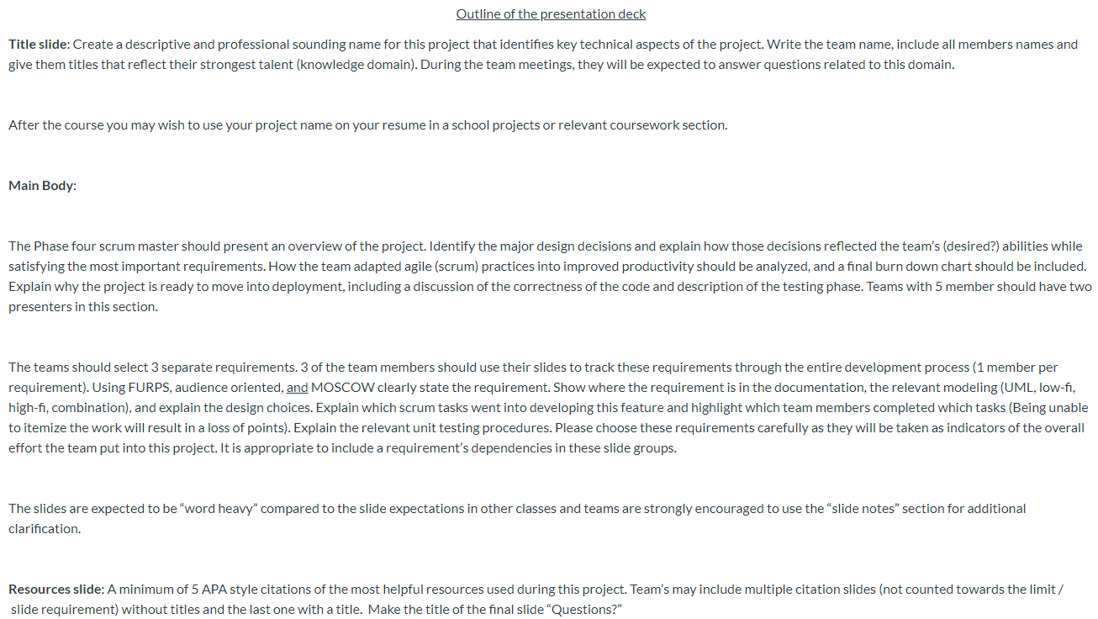
POWERPOINT REQUIREMENTS

Slide 2
ONLINE INVENTORY MANAGEMENT SYSTEM
Designed for ease of access for users and simple, direct manageability for administrators
LIJJ
Liz Howell – Front End/Back End
Ian Macfarlane – Web Hosting
Jason Boyd – Front End/Back End
Joshua Kropf – Front End

Slide 3
PROJECT OVERVIEW
Liz
We used Django as the backend because all of us were either familiar with the framework from other classes or at least knew python. Bootstrap was used for the front end because it allows to format the front end easily and it has good documentation. We originally wanted to deploy using Amazon Beanstalk, but we ran into issues due to us using the Django framework and decided using Heroku was a better idea.
None of us had worked together before, so working on a group project so learning how to adopt the agile practices was difficult at first. Once we learned how to communicate effectively, agile became an effective tool for us to stay on track and finish the project. All of us were at different skill levels with Django and this project required us to research more difficult Django applications. So our first goal was to become more familiar with the framework. Then we were able to measure our success on how much we were able to get done. Then the things we were able to get done and it being presentable.

Slide 4
PROJECT OVERVIEW
We believe this project is ready because:
It meets the basic requirements the customer wanted
It is presentable for a user
The main logic has unit tests and it currently passes its unit testing
The project can be expanded upon or enhanced if the customer would like.

Slide 5
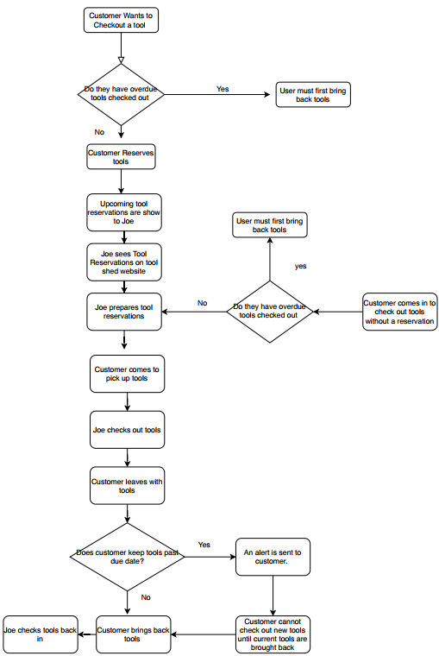
3 REQUIREMENTS TO SHOWCASE
Allow Users to Reserve Tools
Allow Users to Create and Edit Profile
Allow Admin to Check Tools In/Out

Slide 6
ALLOW USERS TO RESERVE TOOLS
Allowing users to reserve tools falls in the following requirements definitions:
MOSCOW => Should
FURPS => Functional, Usable, Reliable
Audience-Orientated => User Requirement
Joe stated that his top priority was to be able to keep track of the toolshed inventory as well as record when a tool was checked out and to whom.
While allowing users to reserve tools was not essential to accomplish that task, we believed it should be implemented as an easier way to keep track of supply and demand of the tool inventory.

Slide 7
ALLOW USERS TO RESERVE TOOLS
Scrum Tasks: Assigned FURPS
Create an inventory list/Initialize the database -Ian/Liz F
Create user profiles/sign in page - Liz U
Create a page to display the inventory list - Liz F
Create a user reservation page - Liz F/U
Create a modal to confirm a submission was accepted - Ian F/U/R

Slide 8
ALLOW USERS TO RESERVE TOOLS
These tasks were completed intermittently throughout the various sprints of phase 3 with the last being completed during the final phase of testing and development. Following the completion of phase 3.
The inventory list was put together during the first sprint, with the page to display being created during the second sprint.
The User profile pages and sign in pages were also completed during the first sprint. The user reservation page was also created at this time, but was also polished during the third sprint.
The modal to alert users their order had been accepted was completed shortly after the completion of phase 3 of this project.

Slide 9
ALLOW USERS TO
CREATE AND EDIT PROFILE
Ian
MOSCOW: Must
FURPS: Functional, Usable
Audience Oriented: Functional Requirement
This requirement is specified in the low level design documentation for project requirements. This requirement is a prerequisite to all other user requirements.
Joe wanted to be able to keep better track of the tools. The best way to do that is to have user profiles that track all of the tools the user has checked out. Joe also wanted to have more control of getting tools turned in on time. User profiles that require an email allow Joe to communicate with his customers more easily, and even automate that communication.

Slide 10
ALLOW USERS TO
CREATE AND EDIT PROFILE
Scrum Tasks:
New User Account Creation - Liz
User Profile View - Liz
User Profile Editing - Liz
Require Minimum Profile Info on Checkout - Liz

Slide 11
ALLOW USERS TO
CREATE AND EDIT PROFILE
Design Choices:
User profiles require the customers name, email, and a username.
Users can then access the website through their profile with a password.
In order to check out or reserve tools the user must also add an address to their profile.
The user can also upload a profile picture.
On the profile view users can see their reservation history.

Slide 12
ALLOW ADMIN TO CHECK TOOLS IN/OUT
Jason

Slide 13
ALLOW ADMIN TO CHECK TOOLS IN/OUT

Slide 14
ALLOW ADMIN TO CHECK TOOLS IN/OUT

Slide 15
Citations:

Slide 16
Questions?

