Slide 1
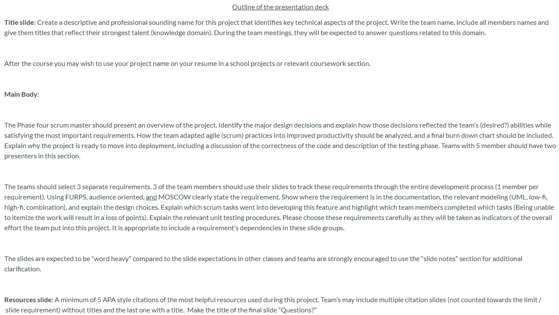
Powerpoint requirements

Slide 2
Online Inventory Management System
Designed for ease of access for users and simple, direct manageability for administrators
LIJJ
Liz Howell – Front End/Back End
Ian Macfarlane – Web Hosting
Jason Boyd – Front End/Back End
Joshua Kropf – Front End

Slide 3
Project Overview
Liz
Design Decisions
Adapting/Impleting Agile (Scrum)
Explain why its ready to deploy

Slide 4
Project Overview

Slide 5
3 requirements to Showcase
Allow Users to Reserve Tools
Allow Admin/Users to Search Tools
Allow Admin to Check Tools In/Out

Slide 6
Allow Users to Reserve Tools
Josh

Slide 7
Allow Users to Reserve Tools

Slide 8
Allow Users to Reserve Tools

Slide 9
Allow Admin/Users to Search Tools
Ian

Slide 10
Allow Admin/Users to Search Tools

Slide 11
Allow Admin/Users to Search Tools

Slide 12
Allow Admin to Check Tools In/Out
Jason

Slide 13
Allow Admin to Check Tools In/Out

Slide 14
Allow Admin to Check Tools In/Out

Slide 15
Citations:

Slide 16
Questions?

