Slide 1
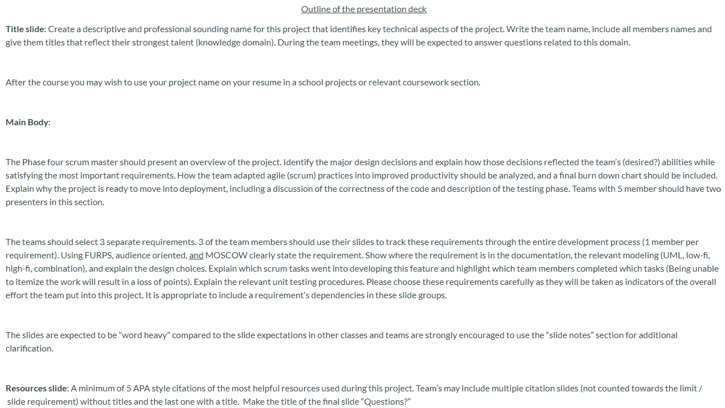
Powerpoint requirements

Slide 2
Online Inventory Management System
Designed for ease of access for users and simple, direct manageability for administrators
LIJJ
Liz Howell – Front End/Back End
Ian Macfarlane – Web Hosting
Jason Boyd – Front End/Back End
Joshua Kropf – Front End

Slide 3
Project Overview
Liz
We used Django as the backend because all of us were either familiar with the framework from other classes or at least knew python. Bootstrap was used for the front end because it allows to format the front end easily and it has good documentation. We originally wanted to deploy using Amazon Beanstalk, but we ran into issues due to us using the Django framework and decided using Heroku was a better idea.
None of us had worked together before, so working on a group project so learning how to adopt the agile practices was difficult at first. Once we learned how to communicate effectively, agile became an effective tool for us to stay on track and finish the project. All of us were at different skill levels with Django and this project required us to research more difficult Django applications. So our first goal was to become more familiar with the framework. Then we were able to measure our success on how much we were able to get done. Then the things we were able to get done and it being presentable.

Slide 4
Project Overview
We believe this project is ready because:
It meets the basic requirements the customer wanted
It is presentable for a user
The main logic has unit tests and it currently passes its unit testing
The project can be expanded upon or enhanced if the customer would like.

Slide 5
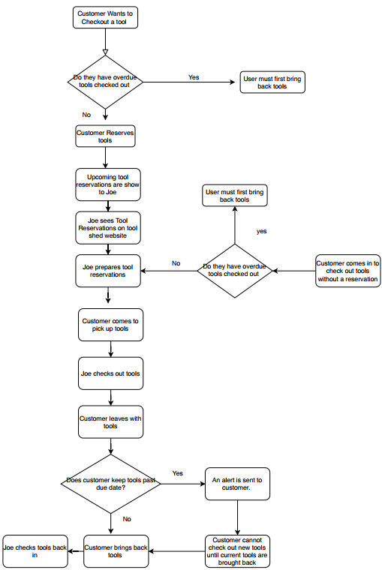
3 requirements to Showcase
Allow Users to Reserve Tools
Allow Admin/Users to Search Tools
Allow Admin to Check Tools In/Out

Slide 6
Allow Users to Reserve Tools
Allowing users to reserve tools falls in the following requirements definitions:
MOSCOW => Should
FURPS => Functional, Usable, Reliable
Audience Orientation => Audience
Joe stated that his top priority was to be able to keep track of the toolshed inventory as well as record when a tool was checked out and to whom.
While allowing users to reserve tools was not essential to accomplish that task, we believed it should be implemented as an easier way to keep track of supply and demand of the tool inventory.

Slide 7
Allow Users to Reserve Tools
Scrum Tasks: Assigned FURPS
Create an inventory list/Initialize the database -Ian/Liz F
Create user profiles/sign in page - Liz U
Create a page to display the inventory list - Liz F
Create a user reservation page - Liz F/U
Create a modal to confirm a submission was accepted - Ian F/U/R

Slide 8
Allow Users to Reserve Tools
These tasks were completed intermittently through out the various sprints of phase 3 with the last being completed during the final phase of testing and development. Following the completion of phase 3.
The inventory list was put together during the first sprint, with the page to display being created during the second sprint.
The User profile pages and sign in pages were also completed during the first sprint. The user reservation page was also created at this time, but was also polished during the third sprint.
The modal to alert users their order had been accepted was completed shortly after the completion of phase 3 of this project.

Slide 9
Allow Admin/Users to Search Tools
Ian

Slide 10
Allow Admin/Users to Search Tools

Slide 11
Allow Admin/Users to Search Tools

Slide 12
Allow Admin to Check Tools In/Out
Jason
THE REQUIREMENT:
It was of upmost importance that the administrator, Joe, would have the ability and functionality within the application to directly check out tools to customers who came to the onsite location of the tool coop.
This requirement is separate to customers reserving tools. Customers can still reserve tools online and then come to the onsite location to pick up their tools. This requirement allows Joe to serve customers who have not made any reservations on the application.
With our implementation of this feature, customers still need an account on the application so Joe can fetch their profile, create a reservation for them, and then finally check their tools out.

Slide 13
Allow Admin to Check Tools In/Out
FURPS (Functionality, Usability, Reliability, Performance, Supportability)
Admin ability to reserve tools
Admin ability to check out/check in tools
Application should keep track of how many tools in system
Application should
Joe should be an Admin user
Admin ability to extend due dates of reservations
Admin ability to add/modify/remove tools in the inventory
MOSCOW (Must, Should, Could, Won’t)
MUST
Set Joe as admin user
Allow admin to check in/out tools
Do not allow admin to check out already reserved tools
SHOULD
Allow admin to add/modify/delete tools in inventory
Do not allow users to checkout tools if they have overdue tools
COULD
Allow admin to extend due dates
WONT
Create payment system for people to pay fees

Slide 14
Allow Admin to Check Tools In/Out
Scrum Tasks: Assigned FURPS
Allow admin to see use records and reservations -Anyone U
Allow Admin to checkout/in tools - Liz U
Create checkout reservation page - Liz F/U
Set Joe as an admin user on the application - Josh U/R
Allow admin to extend the due dates on checkout log - Anyone F/U/R

Slide 15
Citations:

Slide 16
Questions?

