Slide 2
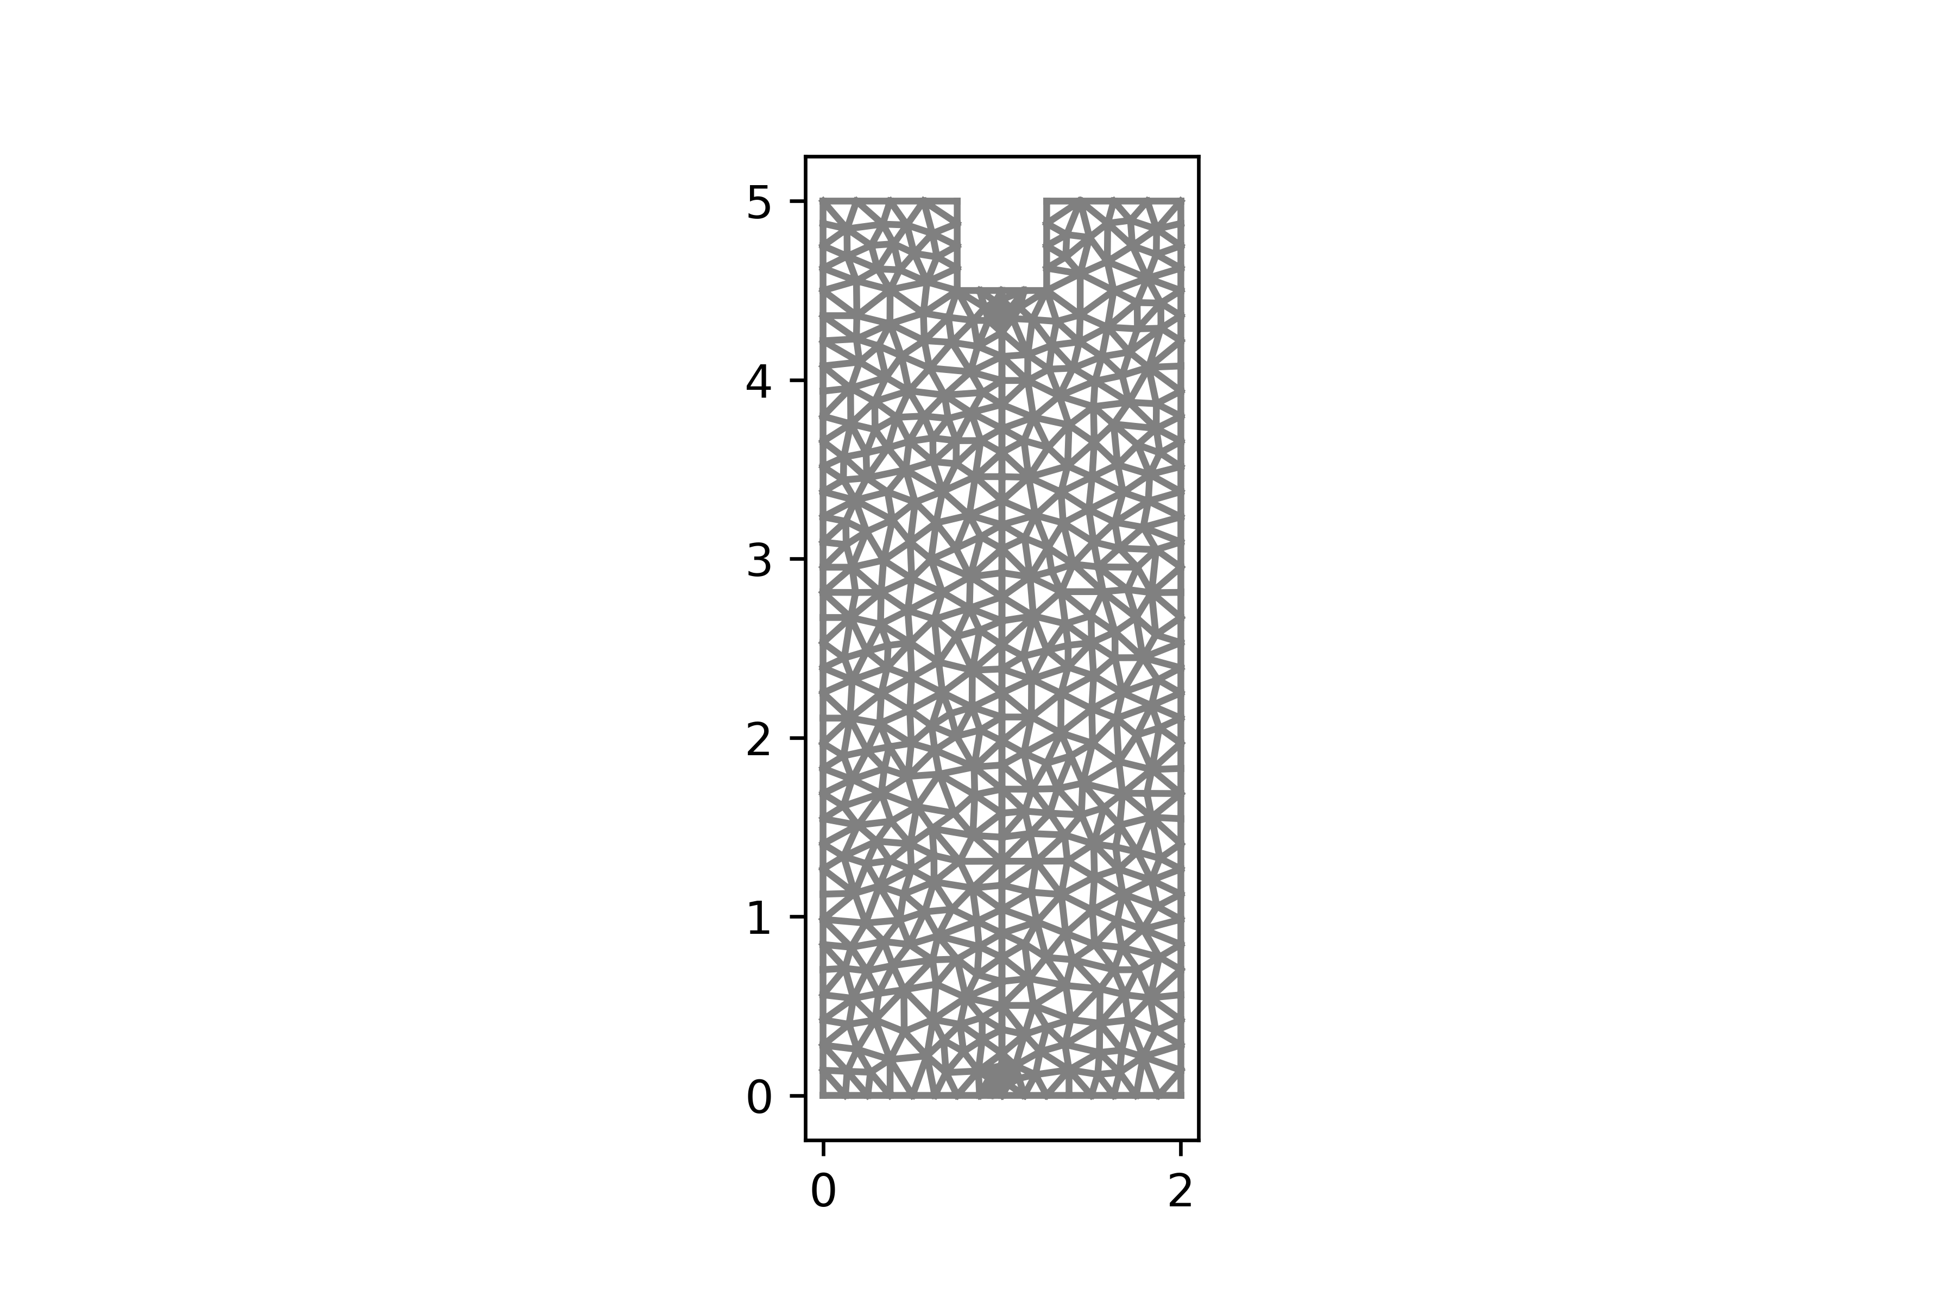





$T\left(x,5\right)$ = 25.0
$$n∙∇T=q\left(T\right) on ∂Ω_{Cathode}$$
$T\left(0,y\right)$ = 30.0
$T\left(2,y\right)$ = 30.0
$T\left(x,0\right)$ = 20.0

