Slide 1

The Adventure of Gradient Descent: Finding the Treasure on Math Mountain!
An exciting journey into the world of Deep Learning!
Mustaffa, Rayyan, Jade, Alhassane

Slide 2


Welcome to Math Mountain!
A treasure chest is hidden at the bottom.
But the mountain is covered in fog!
Gradient Descent will guide us down.
Notes:
NOTE: To change images on this slide, select a picture and delete it. Then click the Insert Picture icon in the placeholder to insert your own image.

Slide 3

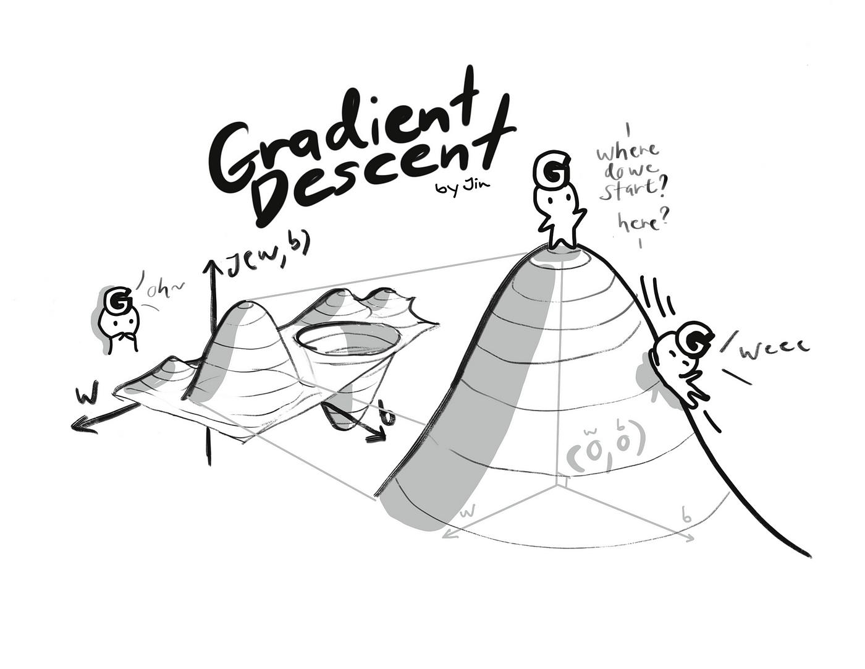
The Story of Math Mountain
The mountain is like a giant slide.
The fog represents mistakes or errors.
Our goal: Reach the treasure at the bottom!
Caption
Notes:
NOTE: To change images on this slide, select a picture and delete it. Then click the Insert Picture icon in the placeholder to insert your own image.

Slide 4

Meet Gradient Descent!
Step 1: Look around (find the slope).
Step 2: Take small steps (learning rate).
Step 3: Keep going until you find the treasure!
Caption
Notes:
NOTE: To change images on this slide, select a picture and delete it. Then click the Insert Picture icon in the placeholder to insert your own image.

Slide 5
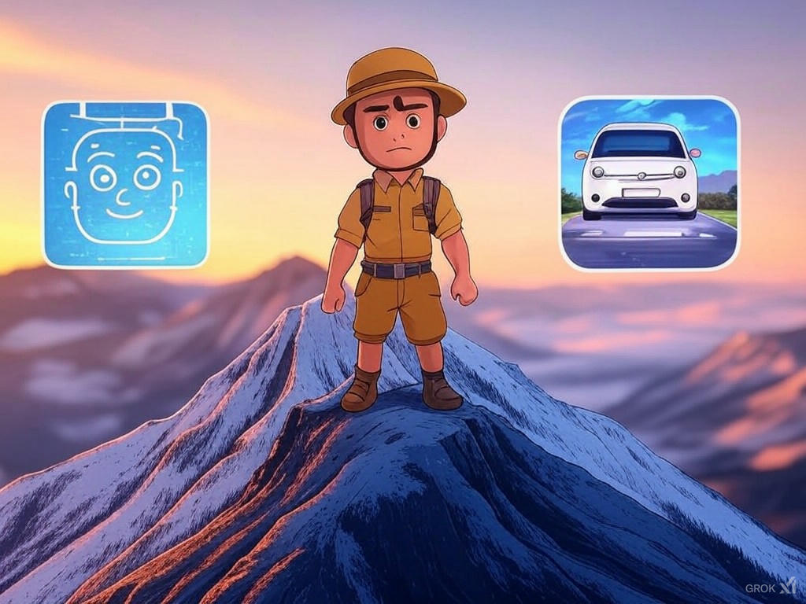
Why Is Gradient Descent Important?
Helps computers learn quickly and efficiently.
Used in face recognition, self-driving cars, and more!
It’s the secret sauce of Deep Learning!
Face Recognition: "Gradient Descent helps computers learn to recognize your face!“
Self-Driving Cars: "It helps cars learn to drive safely on their own!“
Video Games: "It helps game characters learn how to beat levels!"
Notes:
NOTE: To change images on this slide, select a picture and delete it. Then click the Insert Picture icon in the placeholder to insert your own image.

Slide 6

Mission Accomplished!
"You’ve learned how Gradient Descent works!"
"It’s a key tool in Deep Learning."
"Who knows? Maybe you’ll use it to build amazing AI projects one day!"

Slide 7
References
"Goodfellow, I., Bengio, Y., & Courville, A. (2016). Deep Learning. MIT Press."
"Gradient Descent Explained. Towards Data Science."
"What is Gradient Descent? IBM Cloud Learn Hub."

