Slide 1
Currency Converter
Project Architecture
Da Boiz: Patrick Agri, Jack Belmont, Sebastian Nevarez, Thuc Nguyen, Thomas Shea

Slide 2
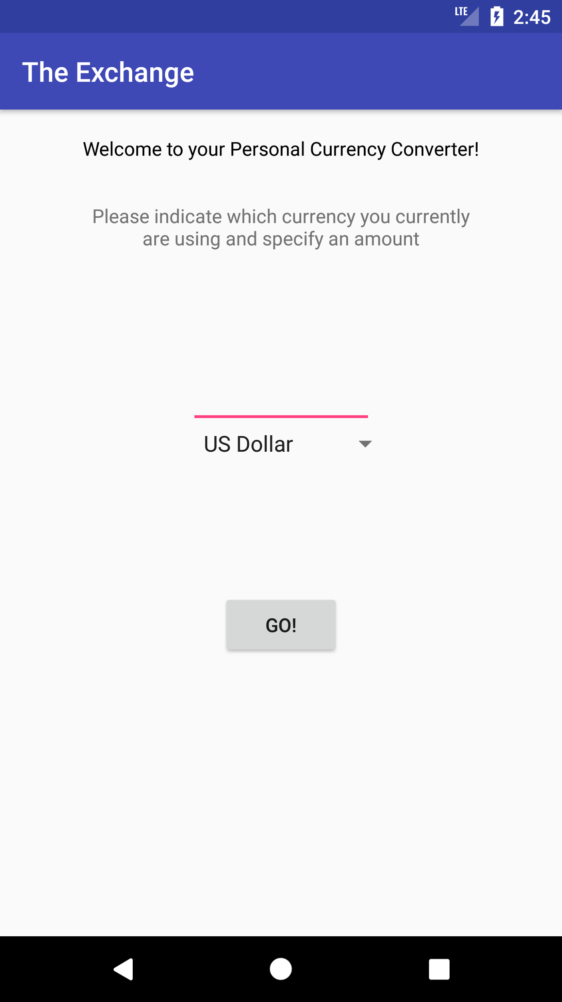
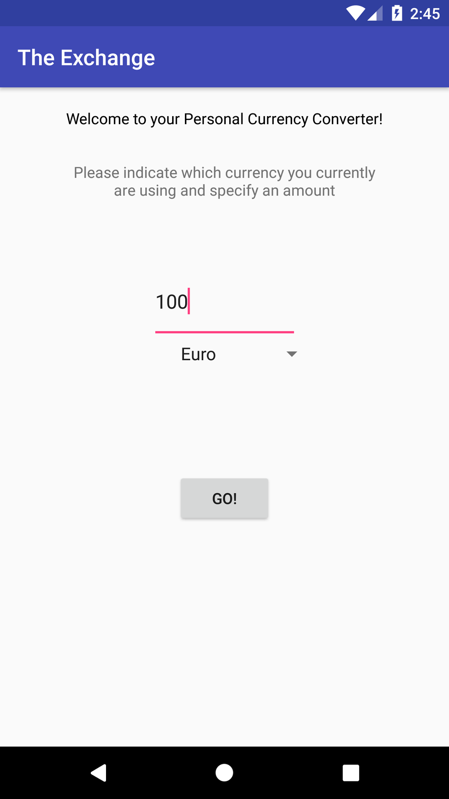
Main Screen:
The main screen opens to what is seen on the left picture to the right. You type in your current value, and then you can select a currency in the drop down menu. In order to see all of the conversion data, you need to click the “GO!” button. This button will bring you to the activities on the next slide.

Slide 3
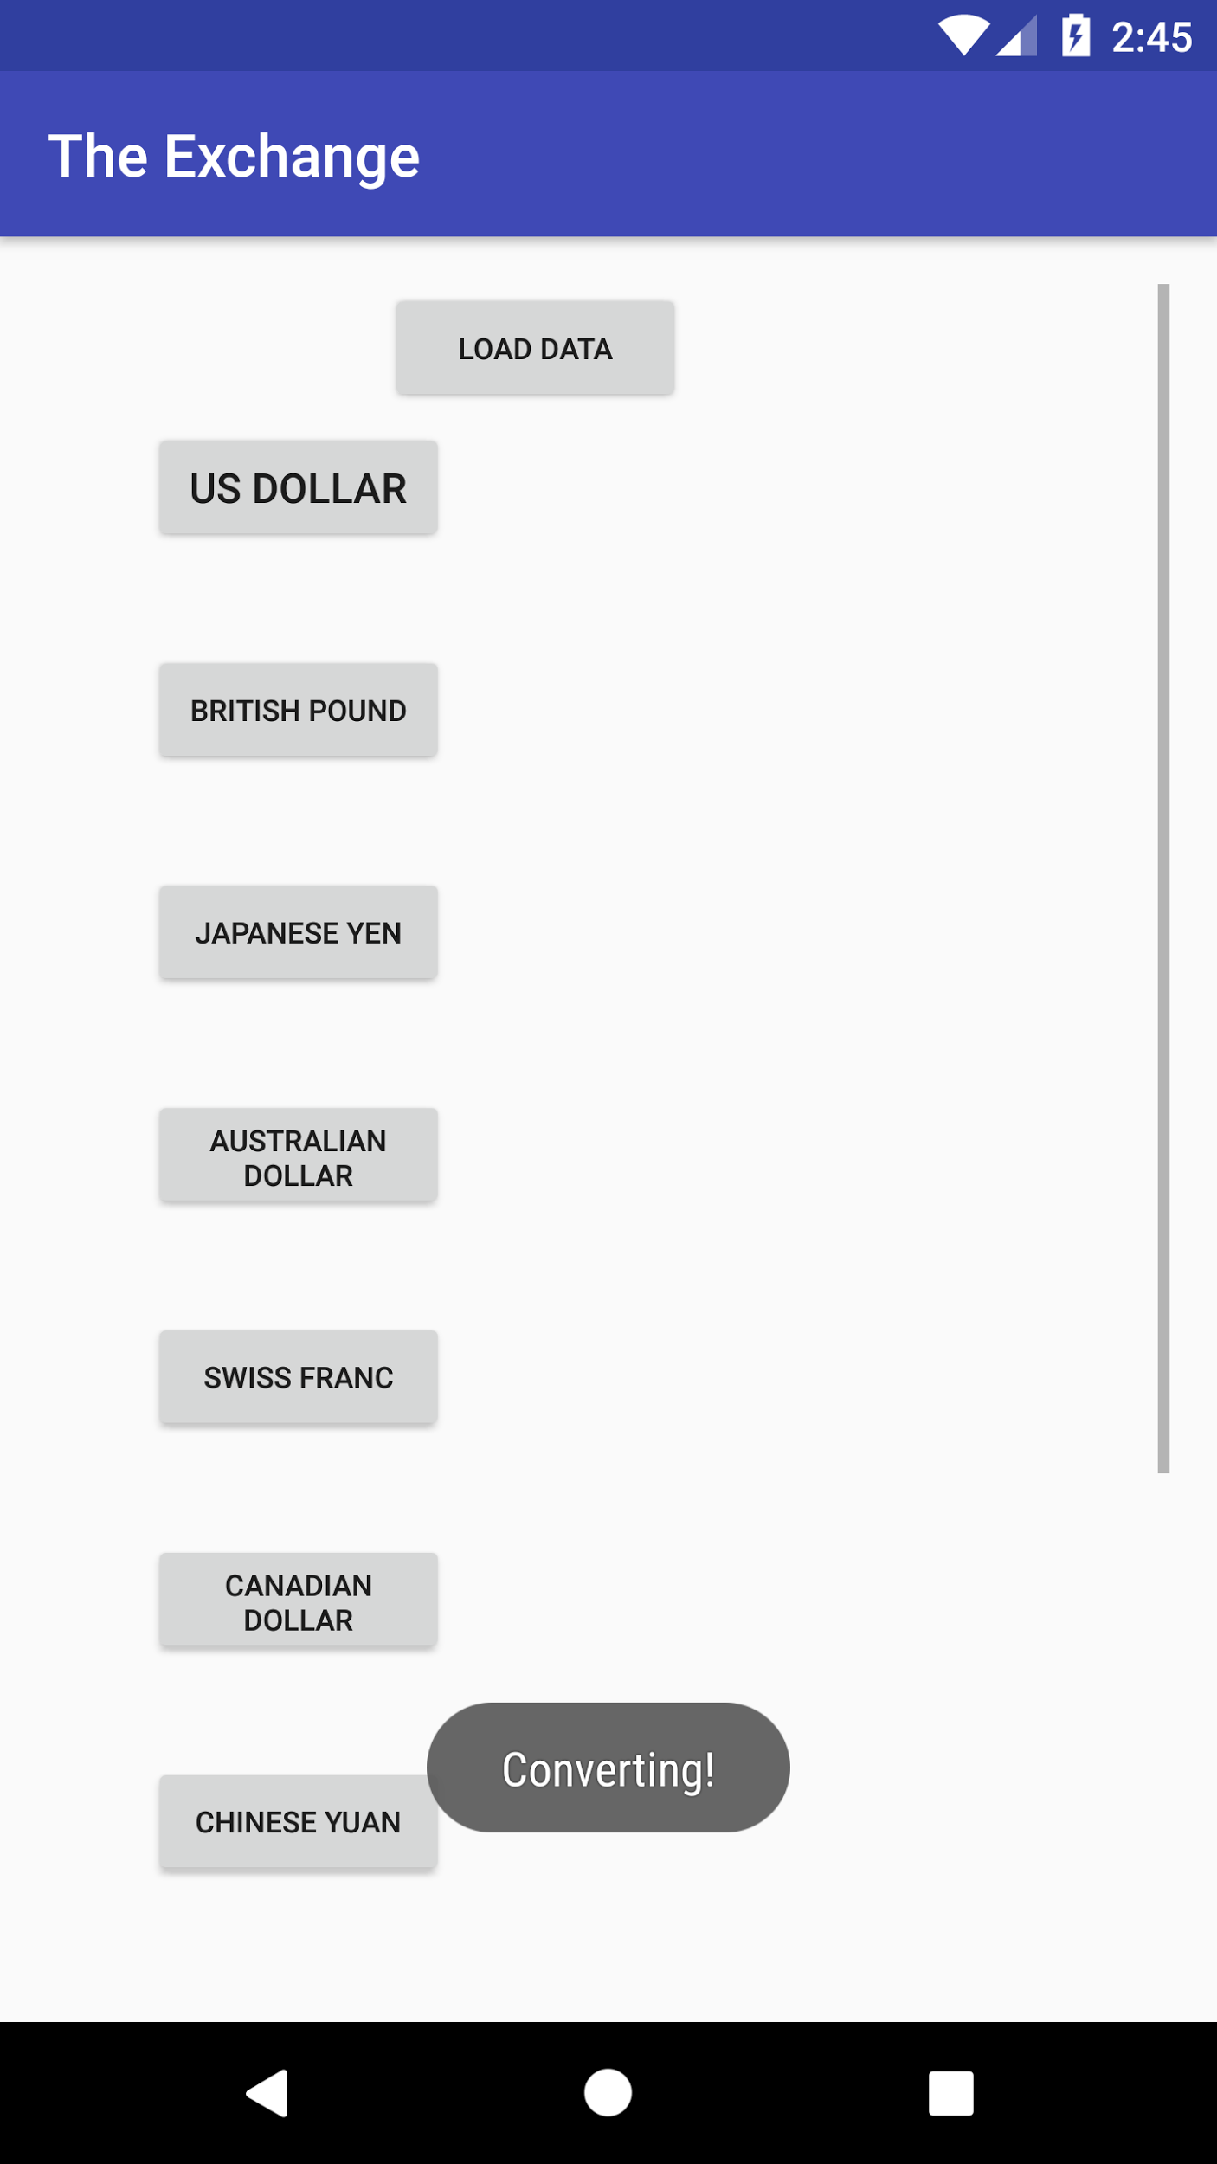
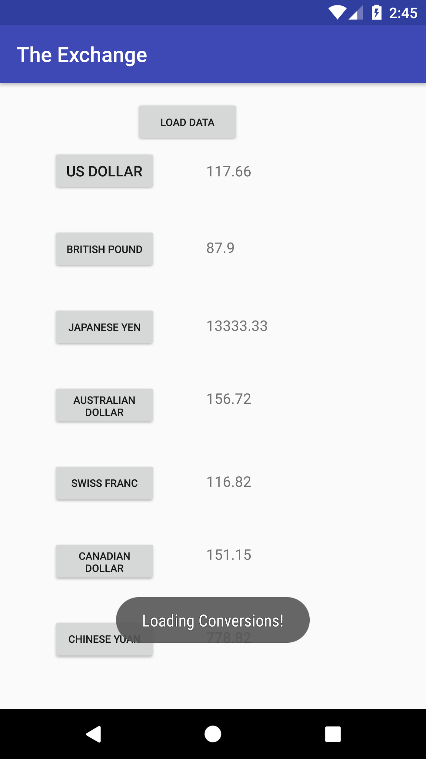
Conversion Screen:
The picture here on the left is what you first see after clicking the “GO!” button. As you can see the values do not come up right away, but once you click the load data screen, all of the text boxes with the values are filled. This screen contains a scrollview, as the currencies don’t all fit on the screen at all times. Each currency label is also a button which brings you to a third and final activity that is shown on the following slide.

Slide 4
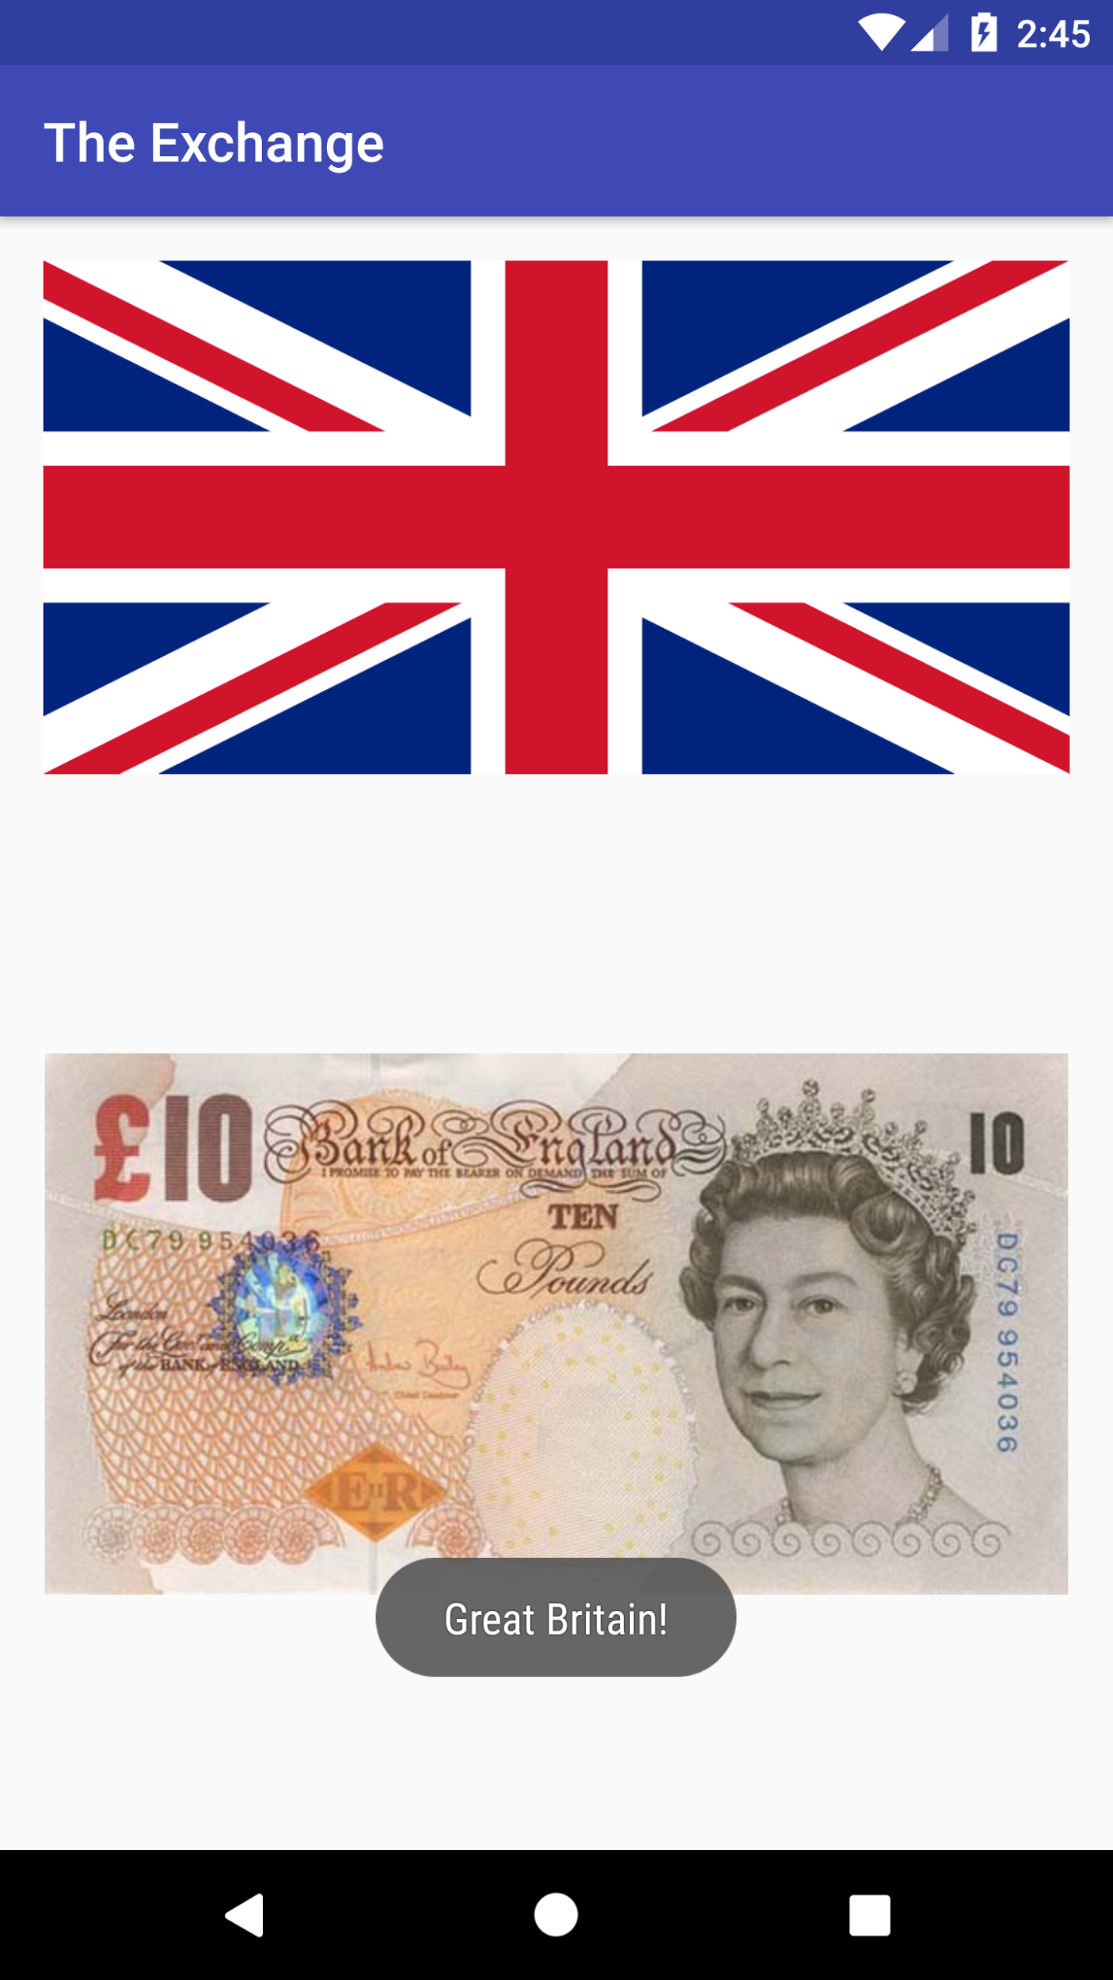
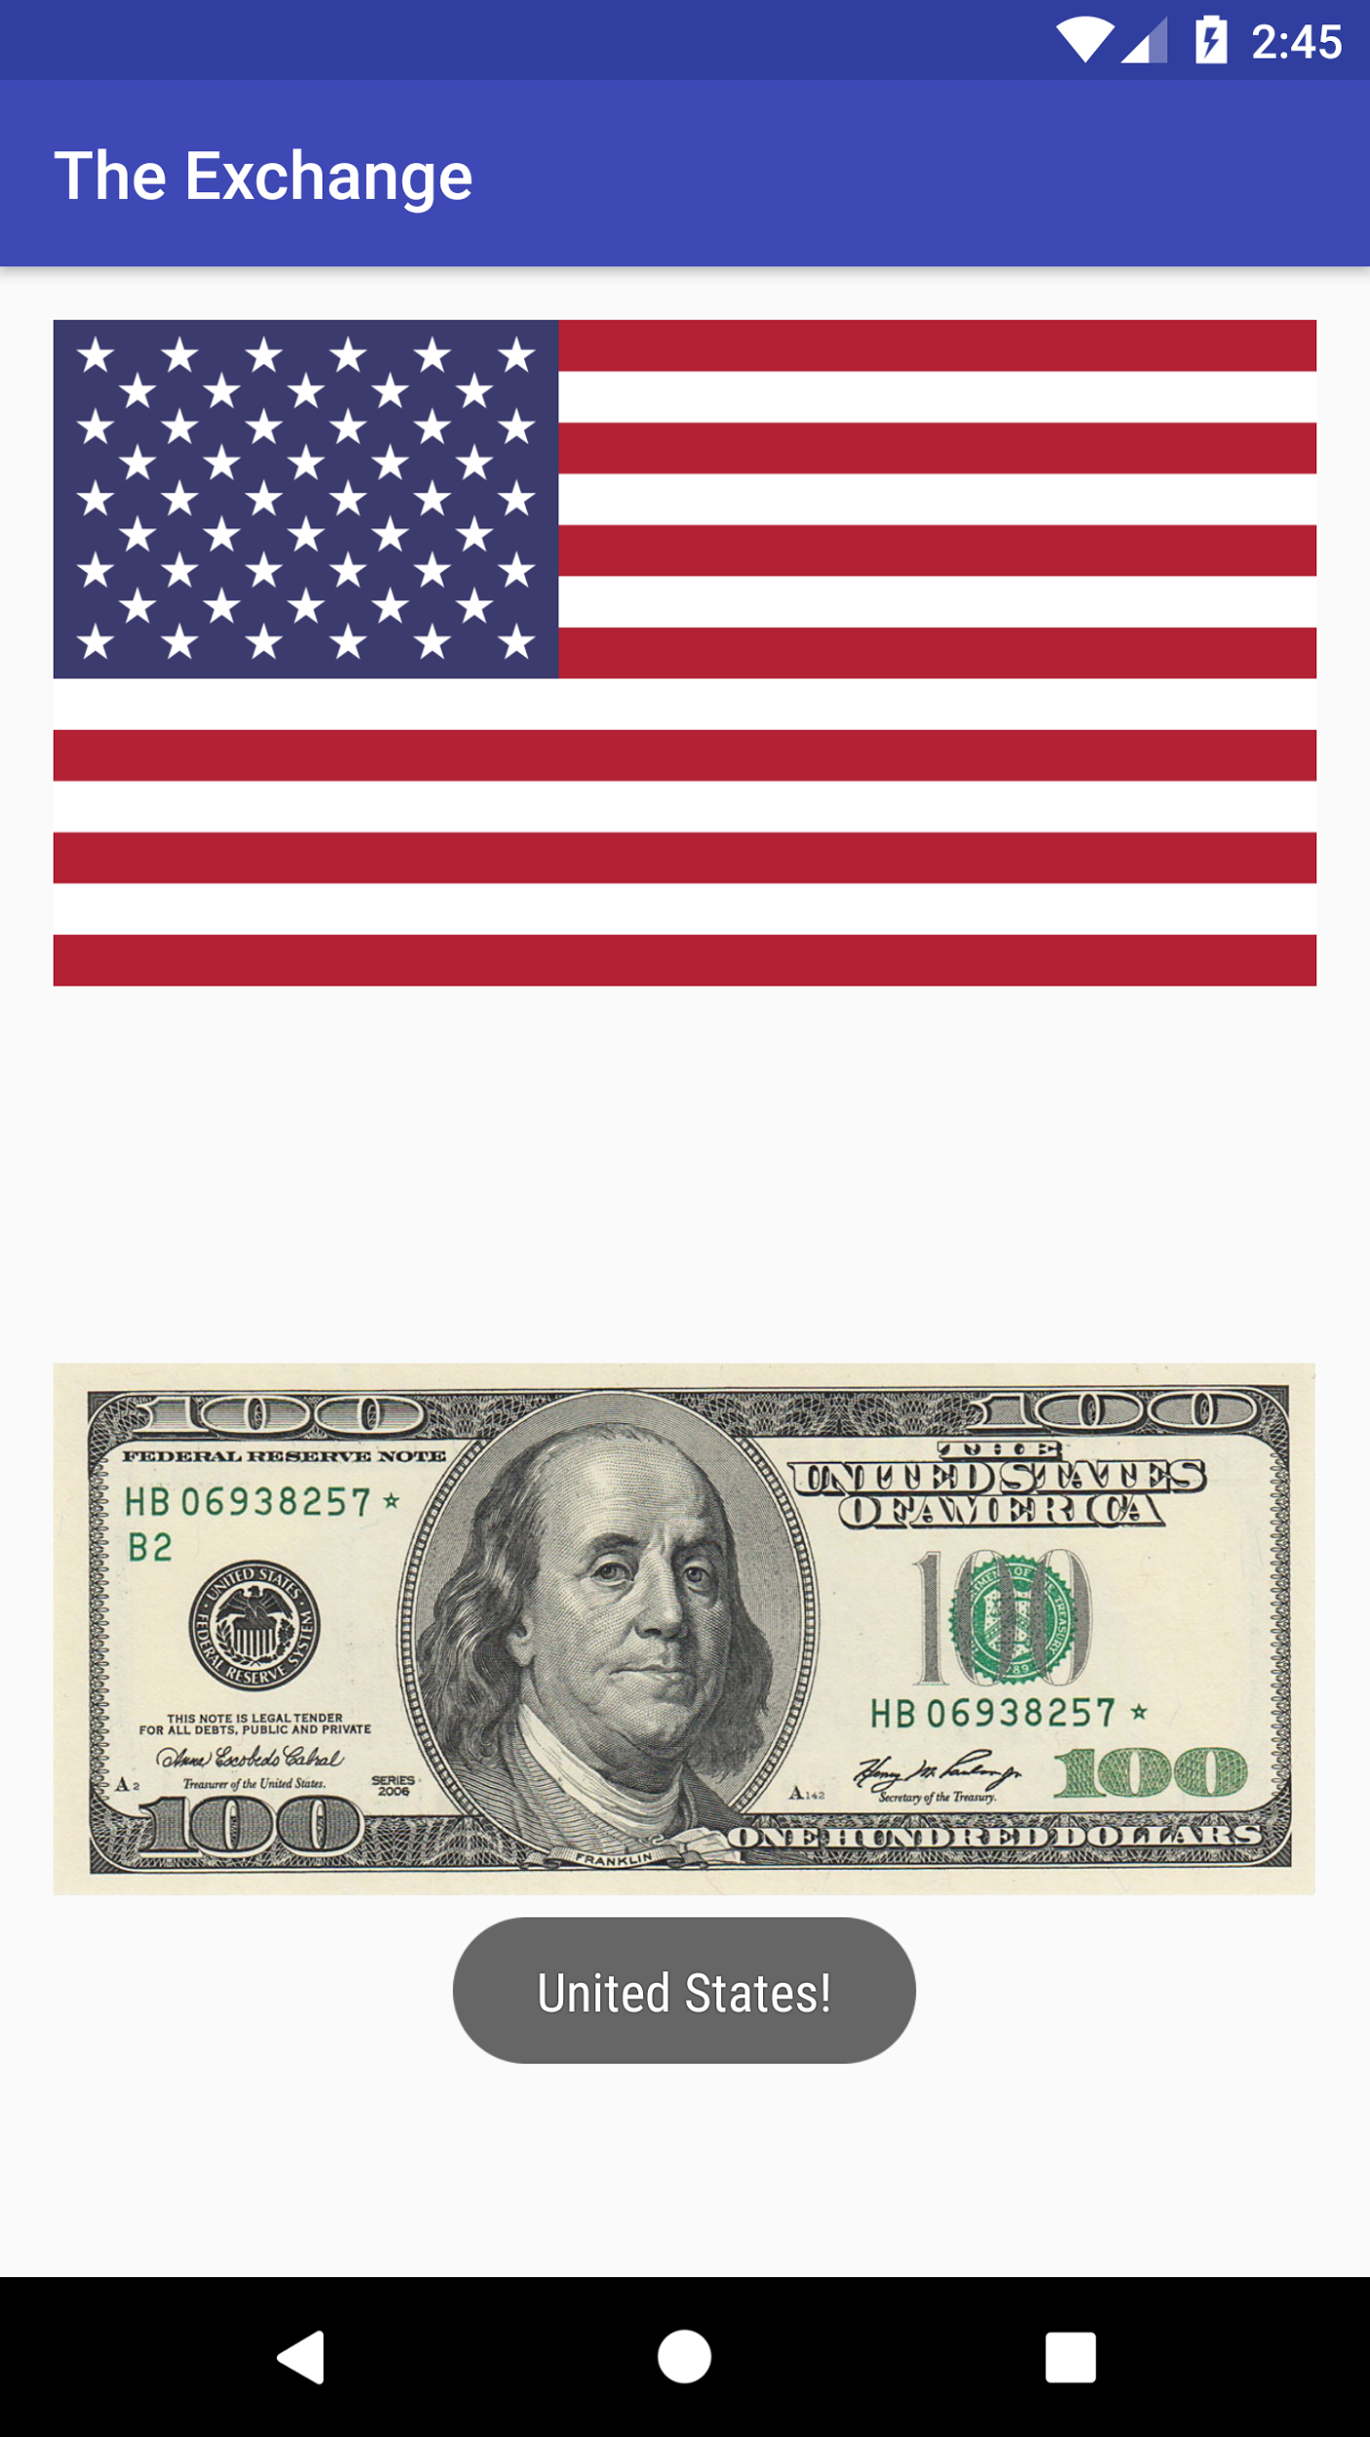
Picture Screen:
The final activity you have with out app, is the ability to view images relating to the target currency you have selected. You will see an image of the flag of the nation where the currency is used. You can also see an image of a denomination of that currency. These two images are for the British Pound as well as the US Dollar. There are different images for each currency button on the second activity.

