Slide 1
ML Assignment 2 – Spotify & YouTube Songs
Prediction and Clustering of Song Release Type (Single vs Album)

Slide 2
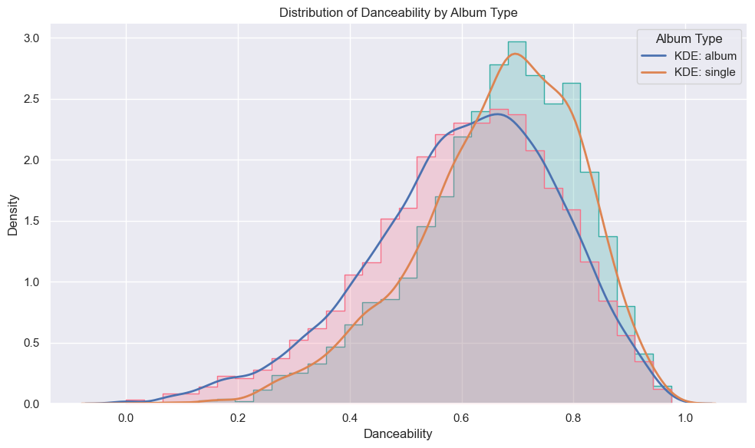
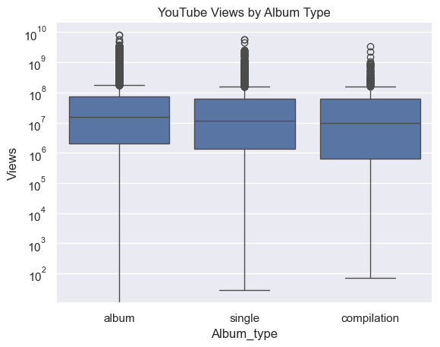
Data Exploration Insights
- 76% of songs are part of an album (including compilations)
- Loudness, Danceability show some correlation with target
- Metadata like YouTube views, likes has weak predictive value
- Notable missing data in YouTube fields (470 rows removed)

Slide 3
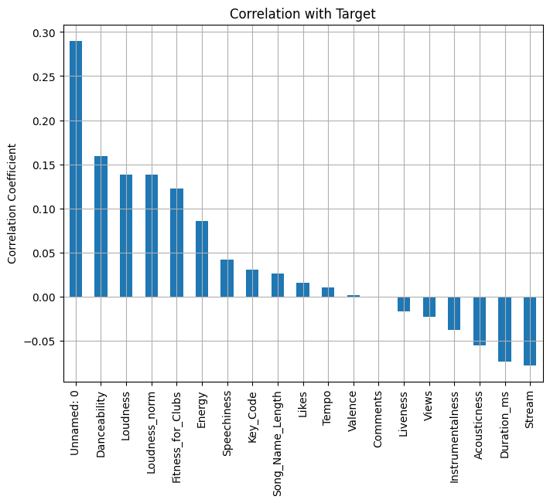
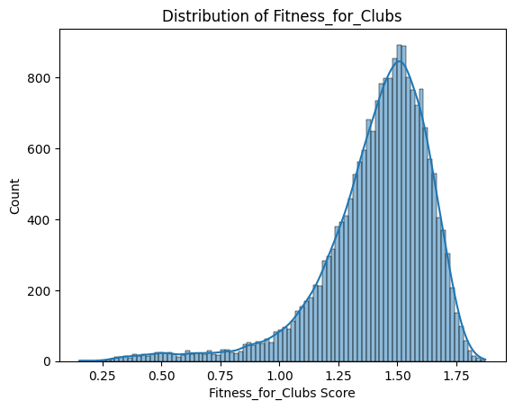
Preprocessing & Feature Engineering
- Engineered 11+ features (club fitness, artist avg views, name length...)
- Handled missing values using mean imputation
- Dropped non-numeric irrelevant columns
- Normalized features like Loudness

Slide 4
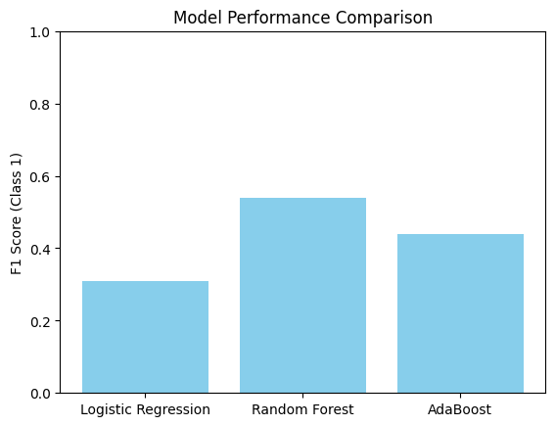
Model Results & Comparison
- Models: Logistic Regression, Random Forest, AdaBoost
- Best accuracy: Random Forest (84%)
- Recall for 'single' class remains challenging due to imbalance
- Hyperparameter tuning performed on validation set

Slide 5
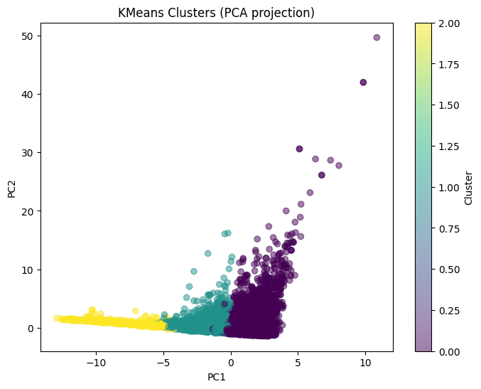
Clustering Results
- KMeans (3 clusters) used with scaled features
- Silhouette score: 0.147 (moderate cohesion)
- Cluster 0 shows higher values in fitness-related features
- DBSCAN used as secondary method (sensitive to density)

Slide 6
Summary & Recommendations
- Engineered features helped improve prediction
- Audio features more informative than YouTube metadata
- Consider SMOTE or ensemble techniques to improve minority class recall
- Clustering revealed natural groupings based on musical properties

