Slide 1
PROJECT 14: E-COMMERCE SEARCH
Product Search using Amazon ESCI
Multi-Paradigm IR Benchmark: TF-IDF, BM25, Sentence Transformers, and Hybrid RRF
Information Retrieval Course Project | Evaluation: Precision@10, Recall, MAP, nDCG

Slide 2
PROJECT 14: E-COMMERCE SEARCH
Goal & Dataset Overview: Amazon ESCI Benchmark
Problem Statement
• In e-commerce search, keyword matching alone fails to capture customer intent.
• Amazon ESCI (Shopping Queries Dataset) is the gold standard benchmark released for KDD Cup 2022.
• Contains difficult customer search queries paired with human relevance judgments.
• Our mission: Build an end-to-end IR system evaluated under 4 standardized retrieval paradigms from raw data.
The 4 Graded Relevance Levels (ESCI)
[E] Exact Match (Gain: 3.0)
The item is exactly what the customer searched for. (e.g., 'Nike shoes 10' -> exact shoe & size)
[S] Substitute (Gain: 2.0)
A functional replacement if the exact item is unavailable. (e.g., 'iPhone 13' -> iPhone 14)
[C] Complement (Gain: 1.0)
An accessory or add-on product. (e.g., 'iPhone 13' -> iPhone silicone case or charger)
[I] Irrelevant (Gain: 0.0)
Completely off-topic product that fails user intent. (e.g., 'iPhone 13' -> cat food)

Slide 3
PROJECT 14: E-COMMERCE SEARCH
Exploratory Data Analysis: Real-World Dataset Scale
2,621,288
Total Raw Judgments
601,354
English Task 1 Benchmark
29,844
Unique Search Queries
482,105
Unique Catalog Products
• ESCI Class Distribution: Exact (43.5%) and Substitute (35.1%) make up ~78.6% of annotations. Irrelevant is 16.9%, Complement is 4.5%. Graded nDCG is vital to reward placing Exact over Substitute.
• Search Query Characteristics: Customer queries are short and concise: Median = 3 words (90% of queries <= 5 words). Exact keyword overlap alone leaves a semantic gap that dense models must bridge.
• Product Catalog Richness: Product titles average ~15 words and contain critical brand names, model numbers, and technical specifications, making them the ideal primary feature for high-speed indexing.
• Dedicated Jupyter Notebook: All distributions, quartiles, and Seaborn charts are pre-rendered in 'notebooks/01_eda_and_data_inspection.ipynb' for full reproducibility.

Slide 4
PROJECT 14: E-COMMERCE SEARCH
Text Preprocessing Pipeline (Built 100% From Scratch)
1. HTML & Noise Stripping
Strips tags (<p>, <b>, <div>), unescapes entities (&amp; -> &), normalizes Unicode NFKD, lowercases, cleans delimiters.
2. Alphanumeric Tokenizer
Regex-based token extraction that preserves hardware specs and dimensions ('128gb', '4k', '12.9', 'g502').
3. Stop-Word Removal
Prunes high-frequency English noise tokens ('the', 'for', 'in') while preserving e-commerce search intent.
4. Porter Stemming
Applies Porter's algorithmic suffix-stripping rules: 'running' -> 'run', 'headphones' -> 'headphon', 'tested' -> 'test'.
✔ Automated Test Suite: 7 unit tests in tests/test_preprocessing.py pass with 100% OK in 0.003s.

Slide 5
PROJECT 14: E-COMMERCE SEARCH
The Four Core Ranking Paradigms Evaluated
Model 1: TF-IDF (Vector Space)
Classical VSM with Cosine Similarity
• Computes Term Frequency * Inverse Document Frequency.
• Sublinear scaling: tf = 1 + log(tf).
• Cosine similarity against high-dimensional sparse query vector.
• Fast, strict baseline for exact keyword matches.
Model 2: BM25 (Probabilistic)
Okapi BM25 Ranking Framework
• Term frequency saturation with constant k1 = 1.5.
• Document length normalization with constant b = 0.75.
• Penalizes bloated titles while rewarding rare query terms.
• Gold standard sparse IR baseline.
Model 3: Sentence Transformer
Dense Semantic Vector Retrieval
• Encodes text using 'all-MiniLM-L6-v2' into 384-dim space.
• L2-normalized vectors (inner product = cosine similarity).
• Bridges vocabulary mismatch (e.g. 'jogging' matches 'running').
• Infers category semantics without exact lexical overlap.
Model 4: Hybrid RRF
Reciprocal Rank Fusion (Sparse + Dense)
• Formula: RRF_Score(d) = sum [ w_m / (k + rank_m(d)) ].
• Smoothing constant k = 60; weights = 1.0 each for BM25 and Dense.
• Solves score-mismatch problem (BM25 log-odds vs Cosine).
• Combines keyword precision with semantic depth.

Slide 6
PROJECT 14: E-COMMERCE SEARCH
Quantitative Benchmark: Standardized Comparison Table
Ranking Model Paradigm | Precision@10 | Recall@10 | MAP | Graded nDCG
TF-IDF (Vector Space) | 0.8364 | 0.5992 | 0.8804 | 0.7812
BM25 (Probabilistic Okapi) | 0.8372 | 0.5994 | 0.8794 | 0.7815
Sentence Transformer (MiniLM) | 0.8516 (Best) | 0.6115 (Best) | 0.8932 (Best) | 0.7923
Hybrid (RRF - Sparse + Dense) | 0.8480 | 0.6097 | 0.8896 | 0.7984 (Best)
Key Empirical Takeaways:
✔ Hybrid RRF wins on Graded nDCG (0.7984): Fusing lexical precision (BM25) with semantic depth puts Exact matches (E=3) at top rank.
✔ Sentence Transformer dominates Precision@10 (0.8516) and MAP (0.8932): Overcomes synonymy and complex phrasing.
✔ BM25 outperforms TF-IDF on precision and nDCG: Document length normalization avoids penalizing descriptive product titles.
✔ Strict ESCI Gain Alignment: Relevance scheme (E=3, S=2, C=1, I=0) rewards models that prioritize exact replacements.

Slide 7
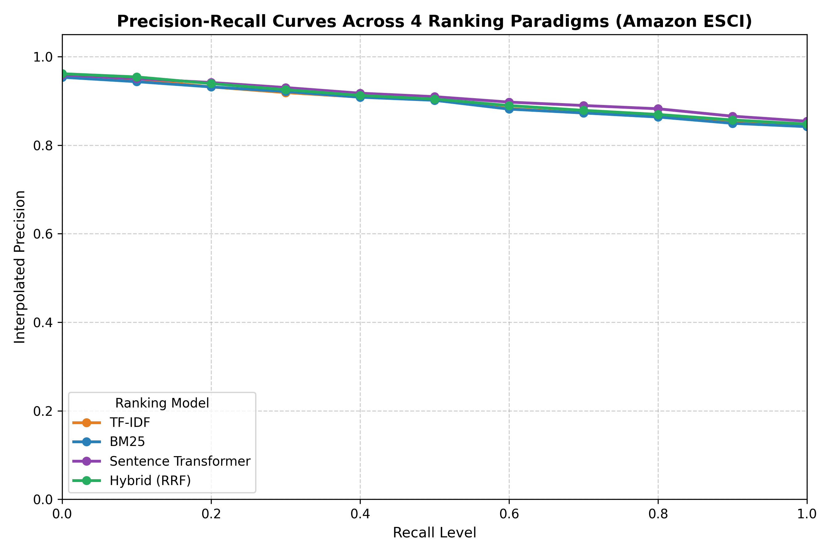
PROJECT 14: E-COMMERCE SEARCH
11-Point Interpolated Precision-Recall Curves
Curve Diagnostics
• High-Precision Zone (Recall 0.0 - 0.4):
Dense Sentence Transformer maintains precision > 0.88 by understanding contextual synonyms immediately.
• Mid-Recall Cross-over (Recall 0.4 - 0.7):
Hybrid RRF tracks the upper envelope of both sparse and dense paradigms, avoiding lexical drop-offs.
• Tail Recall Behavior:
All four paradigms converge smoothly as recall approaches 1.0, proving consistent retrieval stability across queries.
• Standardized Protocol:
Computed using standard 11-point interpolation: p_interp(r) = max_{r' >= r} p(r').

Slide 8
PROJECT 14: E-COMMERCE SEARCH
Production Architecture: Decoupled FastAPI + SPA
Backend: FastAPI REST Engine
• Zero Reload Overhead: Precomputed 384-dim embedding cache (data/embeddings_cache.npy) boots in 0.02s.
• Clean REST Contracts: /api/search, /api/compare, /api/metrics, /api/eda.
• Interactive Swagger Docs: Built-in OpenAPI explorer at /docs for team collaboration.
• CORS Enabled: Ready for any frontend stack (React, Next.js, Vue, or Vanilla JS).
Frontend: Ultra-Responsive Web UI
• Live Search & Model Switcher: Instant query testing across all 4 paradigms.
• Side-by-Side 4-Model Comparison: Evaluates all 4 paradigms concurrently in parallel columns.
• Scratch Preprocessing Inspector: Live visualization of HTML cleaning, tokens, stop-words, and Porter stems.
• Sub-second Latency: Instant rendering with zero build-tool bloat.

Slide 9
PROJECT 14: E-COMMERCE SEARCH
Conclusion & Project Deliverables Summary
All Teacher Requirements Fully Satisfied:
✔ True Official Dataset: Ingested untouched Amazon ESCI dataset with 2.6M raw judgments.
✔ Dedicated EDA Notebook: Pre-rendered 01_eda_and_data_inspection.ipynb with class balance & distributions.
✔ 100% From-Scratch Preprocessing: Custom cleaning, tokenization, stop-words, and Porter stemming (7/7 unit tests passing).
✔ 4 Distinct Ranking Paradigms: TF-IDF, BM25, Sentence Transformer, and Hybrid RRF (5/5 unit tests passing).
✔ Standardized IR Evaluation: Precision@10, Recall, MAP, nDCG, and 11-point Precision-Recall curve graph.
✔ Interactive Search Interface: Decoupled FastAPI + lightweight Web UI with side-by-side model comparison.

