Slide 1
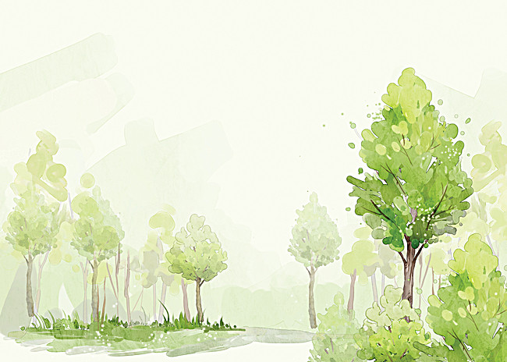
SUFFIX TREE
Group 1
Mai Hoàng Nhi – 18125015
Hoàng Minh Huy – 18125130
Nguyễn Gia Huy – 18125132
Lê Hoàng Minh – 18125134
SUFFIX TREE

Slide 2

Problem
Problem
We have a string S[1 .. N] and a string P[1 .. M]. How can we answer these questions with the shortest time?
Check if P is substring of S?
Check if P is suffix string of S?
How many times does P appear in S?
Find the longest substring repeating at least K times.
Find the suffix string has the least dictionary order.
All can be solved by using Data structure: Suffix Tree

Slide 3

Defination
Defination
1. Suffix
In string S[1 .. N], suffix i is the string beginning at position i and ended at the end of string S: H[i] = S[i .. N]

Slide 4

Defination
Defination
2. Suffix tree

Slide 5

Building suffix tree
Building suffix tree
Step 1: Start at root.
Step 2: Find the longest path from root to H[i].
Step 3: Check if it ends at a node, we will create one more branch and the remain will end at a new leaf.
Step 4: If it ends on one edge but it haven’t gone to the node yet, we will create one more temperature node and do step 3.

Slide 6
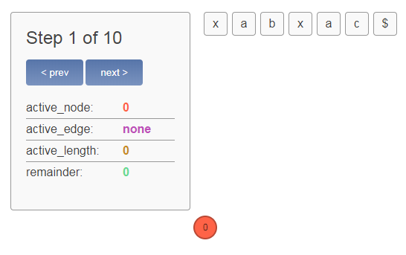

Slide 7
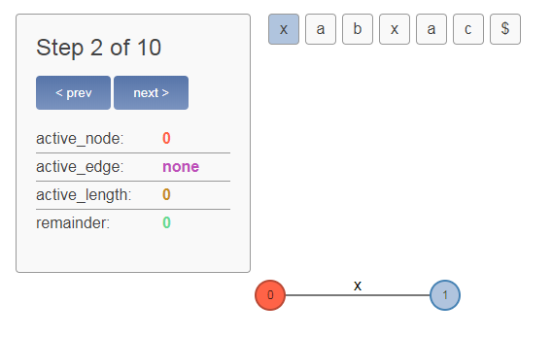

Slide 8
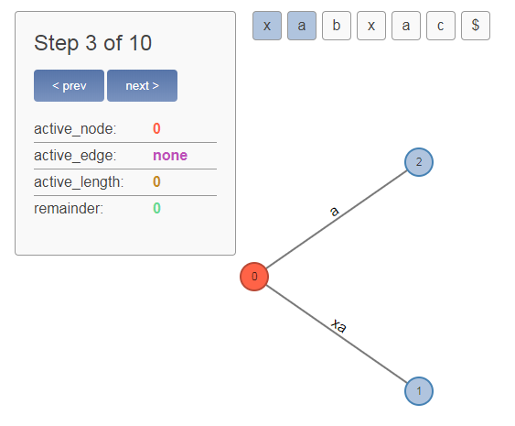

Slide 9
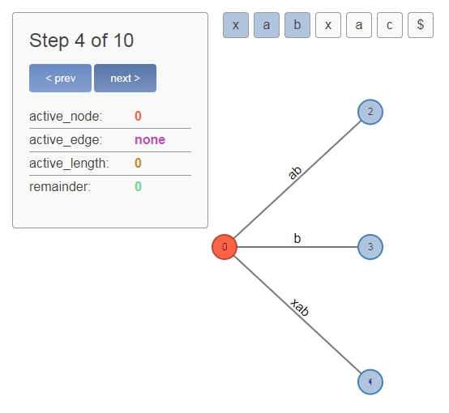

Slide 10
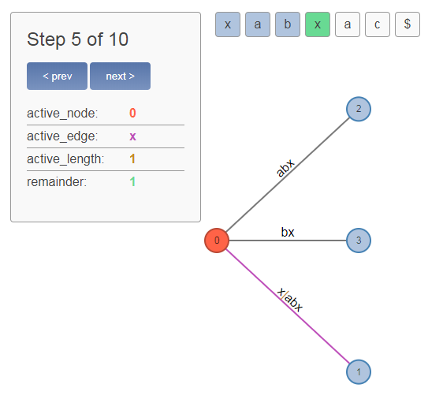

Slide 11
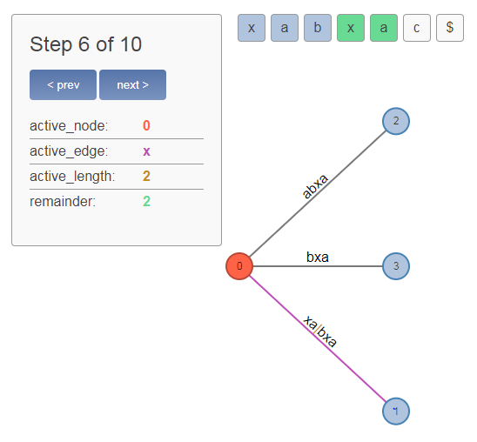

Slide 12
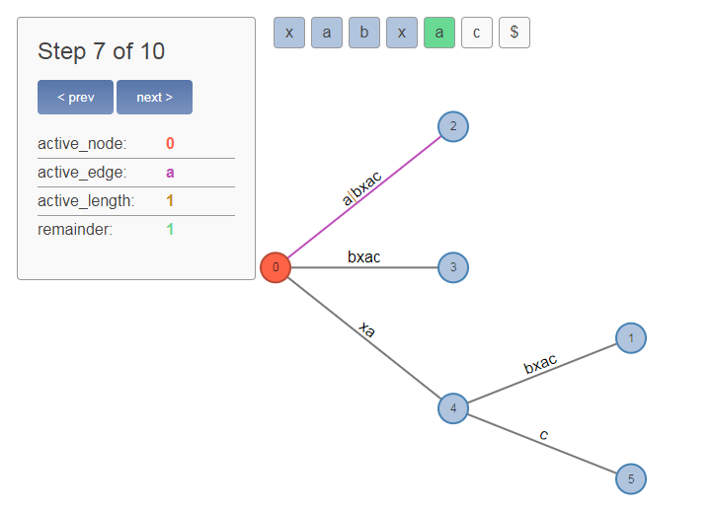

Slide 13
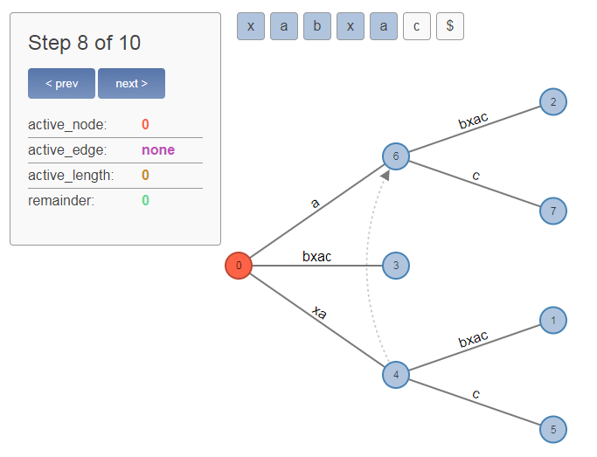

Slide 14
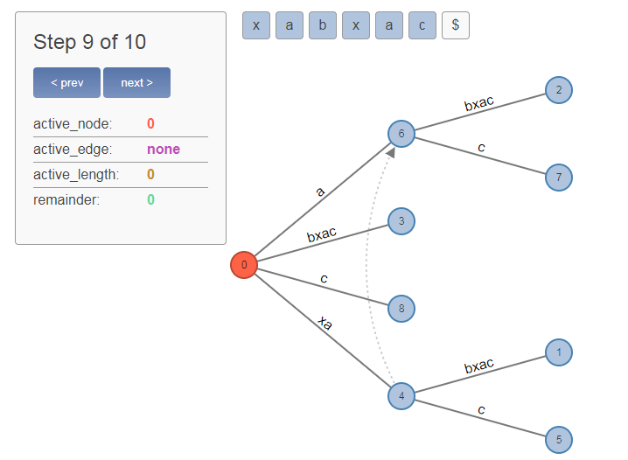

Slide 15
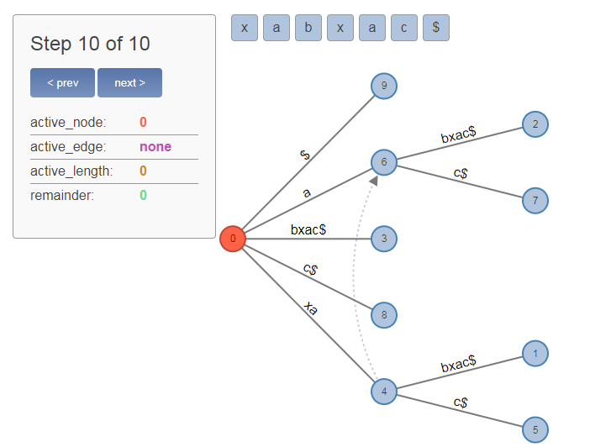

Slide 16

Comment
Comment
Check if P is substring of S? → O(M)
Check if P is suffix string of S? → O(M)
How many times does P appear in S? → O(M)
Find the longest substring repeating at least K times. → O(N)
Find the suffix string has the least dictionary order. → O(N)
Comment: Algorithm will be more outstanding than most of others in the case which S is long and P is short.

Slide 17

Improvement and Application in science
Improvement and Application in science
We can build suffix tree in shorter time O(N) based on Okkone Algorithm.
Suffix tree has a lot of applications in real life, the most popular is in computer – biology in searching the commons between the AND and organic, advantage of algorithm is allow not to fit precisely.
Is used to compress data.
The algorithm is used for finding beacause its applications don’t totally fit.

Slide 18
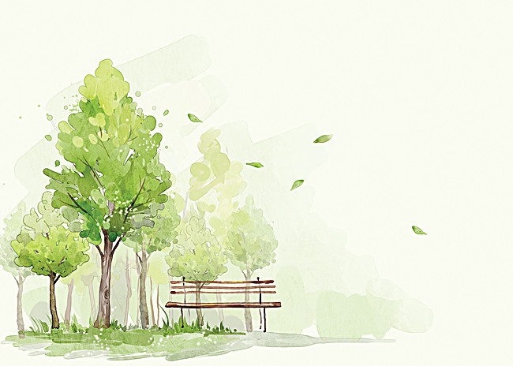
T
H
A
N
K
S
F
O
R
W
A
T
C
H
I
N
G

