Slide 1
CEERI, Pilani
PS-1 Surveillance of COVID-19 patients using drones in city: A Survey
BITS Pilani

Slide 2
Students
V. Keerthivasan - 2018A8PS0480P
Rishit Patel – 2018A7PS0189G
Karan Shetty – 2018A7PS0111G
BITS Pilani

Slide 3
Sensor Integration
Three important steps for Sensor integration:
Addition of Joint tags that contains parent and child link.
Addition of 3D model of the sensor link in the robot’s xacro file.
Adding Functionality to the sensor link through gazebo plugins.
3D MODEL
Contains inertial , visual and collision tags under link tag.
Eg. <inertial>
<mass value="1e-5" />
<origin xyz="0 0 0" rpy="0 0 0"/>
<inertia ixx="1e-6" ixy="0" ixz="0" iyy="1e-6" iyz="0" izz="1e-6" />
</inertial>
<visual>
<origin xyz="0 0 0" rpy="0 0 0"/>
<geometry>
<box size="${camera_link} ${camera_link} ${camera_link}"/>
</geometry>
<material name="red"/>
</visual>
BITS Pilani

Slide 4
Sensor Integration (Plugins)
Plugin is a software component that adds a specific feature to an existing computer program.
Gazebo plugins gives functionality to URDF models and can tie in ROS messages and service calls for sensor output and motor input.
Have to include Gazebo whenever required for URDF to SDF format.
Gazebo plugin file contains the sensor reference link along with sensor’s functionality in XML format.
Camera, Multi camera(like stereo camera) , LIDAR plugins are available within gazebo plugins.
BITS Pilani

Slide 5
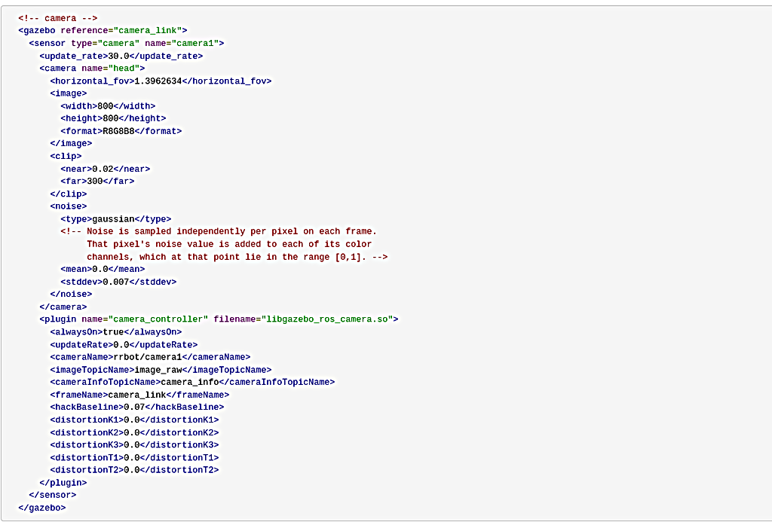
KEERTHIVASAN
BITS Pilani

Slide 6
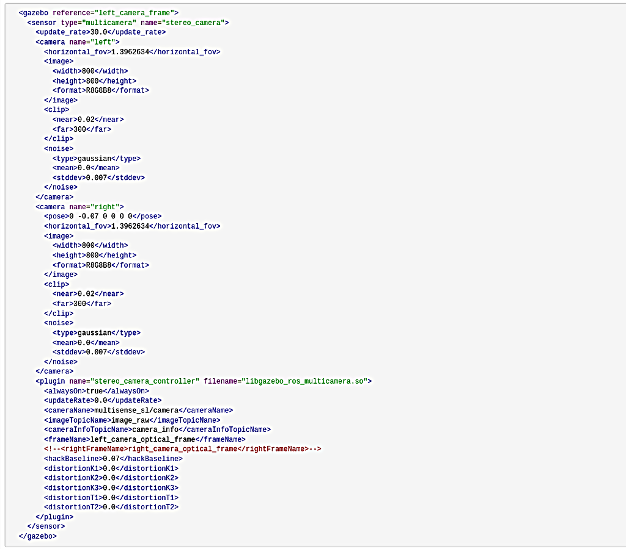

Slide 7
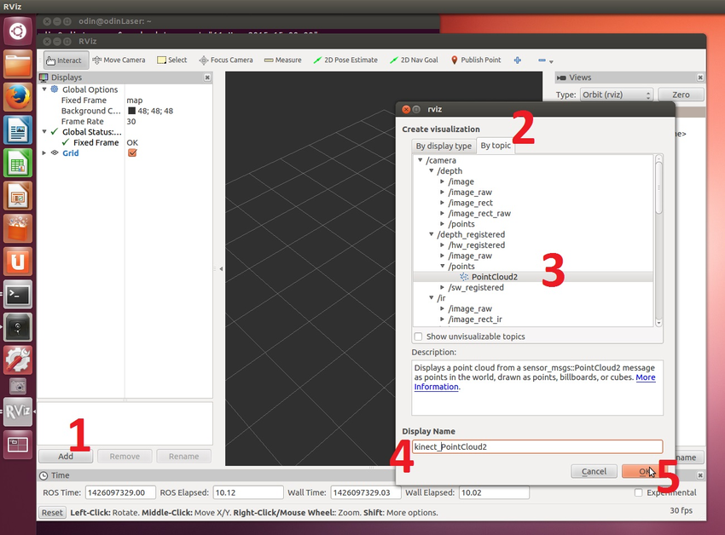
Rviz
Rviz and Gazebo are different.
Steps to view an Image in Rviz:

Slide 8
Work Done So Far

Slide 9
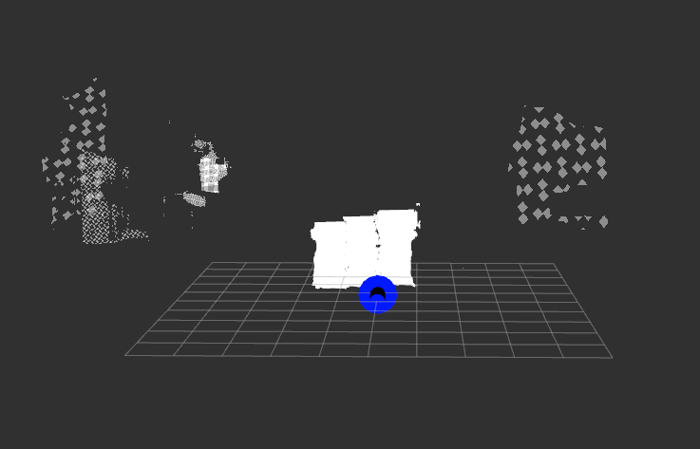
Depth Estimation Using Point Cloud
Disparity map generation
Map disparity map to 3D points in camera frame
Map 3D points in camera frame to drone body frame
BITS Pilani

Slide 10
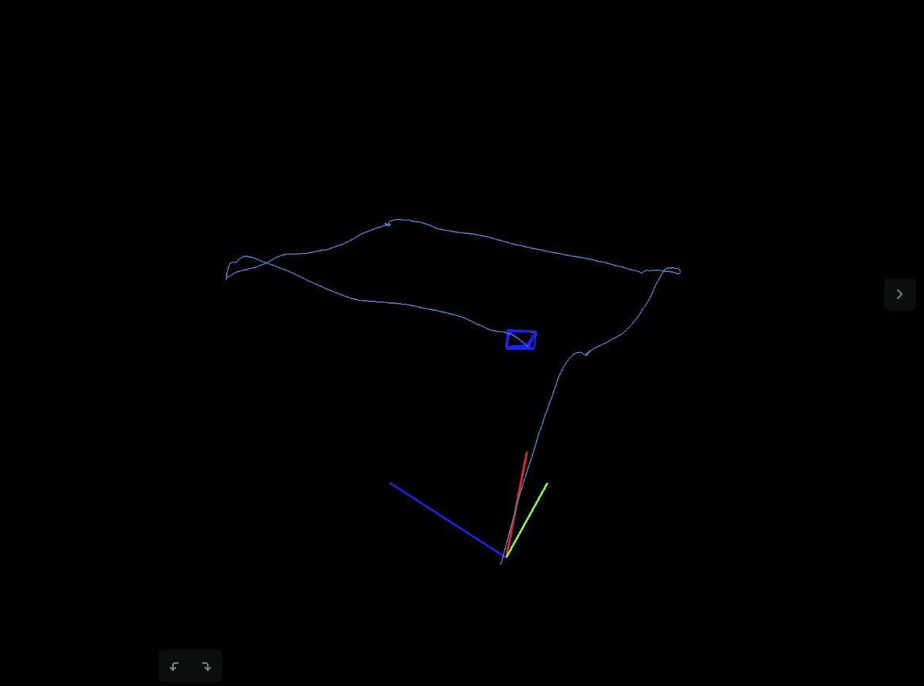
Position Estimation Using SLAM
SLAM is used to estimate the position of vehicle as well as map its precise position.
It is especially helpful in GPS denied environments like under the bridge, inside room or crowded places.
BITS Pilani

Slide 11
Vision Based Landing

Slide 12
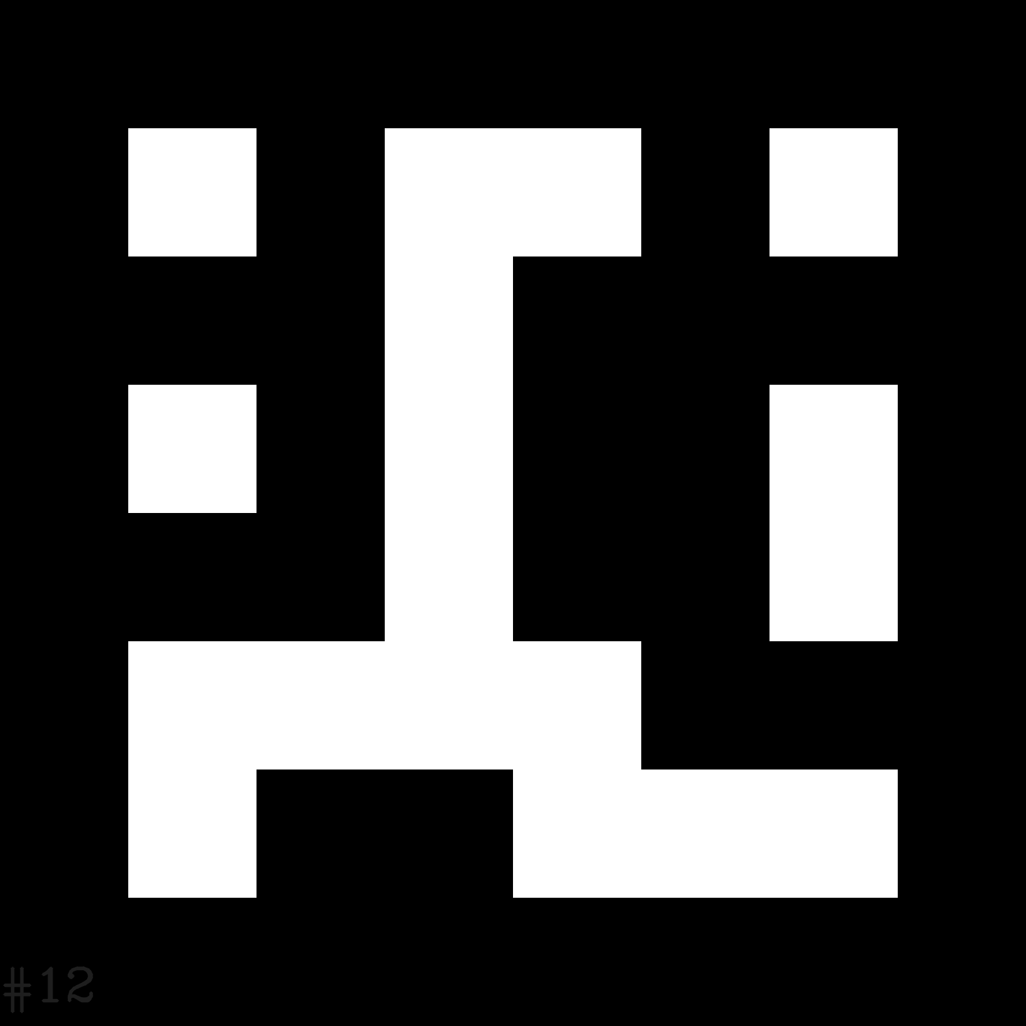
Feedback:Aruco Library
The markers we will use for landing are called Fiducial markers .They are encoded objects that are used by computer vision systems as reference points in a scene.
An aruco marker,a fiducial marker ,is a binary square with black background and boundaries and a white generated pattern within it that uniquely identifies it.(each marker has unique ID)
These targets provide orientation, location and distance information when combined with accurate size information of the markers and calibrated camera information.The distance to target is obtained automatically through pose estimation of the markers.

Slide 13
Feedback:OpenCV
OpenCV(Open Source Computer Vision Library) is a library of programming functions mainly aimed at real-time computer vision.
In order to perform any accurate Computer Vision work, you must first calibrate your camera.
OpenCV uses 'Camera Matrix' and 'Distortion Coefficients' matrices (collectively called intrinsics) for camera calibration.
They are used to 'undistort' the raw image for accurate further processing,necessary to calculate the target angular offsets for precision landing and pose estimation used for accurate distance measurements.

Slide 14
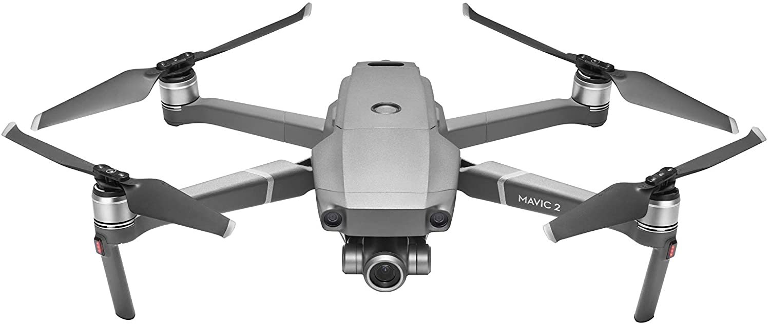
RL Architecture
The drone must ﬂy inside the area delimited by the constraint space, that is, a virtual orthogonal box. We will be considering 4 walls- left, right, front and back.
The limits of the Constraint Space: 25m height x 50m length x 50m width
State:
Consists of scalar values:
The current location of the drone (px, py coordinates)
The distance to the goal (dx, dy, dt, where dt is the Euclidean distance calculated from dx and dy)
The distance to the Constraint Space boundaries in 2D (dxmin, dxmax, dymin, dymax)
25 m
50 m
50 m
BITS Pilani

Slide 15
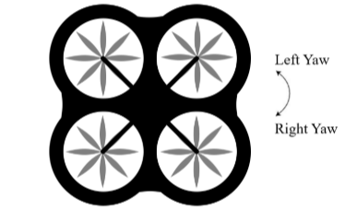
Action Space
Actions:
Horizontal action set:
Description Value
Turn left 30◦
Move forward 2 m/s
Turn right 30◦
Move backward -2 m/s
+V_{x}
-V_{x}
The action will be done for 1 second, after which the decision will be taken.
Drone starts at 20m height and descent speed is 0.5m/s, irrespective of the action.
Goal is around 70-80 m from the starting point.
BITS Pilani

Slide 16
Reward System
+100 if terminal (goal reached),
Reward = -100 if terminal (failure: obstacle or constraint space),
-1 + ∆dg otherwise.
A terminal step returns a reward of +100 or −100 depending on whether the episode has respectively succeeded (goal reached) or failed.
Intermediate steps return a reward of −1 (to penalize delays) plus ∆dg, that is, the distance-to-the-goal difference with respect to the previous step. This ∆dg is used to stimulate actions that approach the goal.

Slide 17
Conclusion
Using packages like MAVROS and PX4, we implemented basic drone waypoint navigation in Gazebo.
We then integrated some camera plugins on the drone and took the output on RViZ.
We then used a stereocam for depth estimation through point cloud formation.
We mapped the trajectory a drone, moving a square path using SLAM.
We decided on the environment for the drone, constraint spaces and the starting position.
The state for the MDP was based on our objective:the distance from the goal, and the actions were simple 2D movements. Height was kept continuously decreasing, at 0.5m/s.
We set an appropriate reward system which helped in optimizing the path and reducing delay.
BITS Pilani

Slide 18
Thank You
BITS Pilani

