Slide 1
Lending club case study
Team Members :
Karthikeyan M
K. Sathish Kumar

Slide 2
About the business
Lending club is a consumer finance company which specialises in lending various types of loans to urban customers.
The company is the largest online loan marketplace, facilitating personal loans, business loans, and financing of medical procedures. Borrowers can easily access lower interest rate loans through a fast online interface.
Problem Statement
When a person applies for a loan, there are two types of decisions that could be taken by the company:
• If the applicant is likely to repay the loan, then not approving the loan results in a loss of business to the company
• If the applicant is not likely to repay the loan, i.e. he/she is likely to default,then approving the loan may lead to a financial loss for the company
Lending club company wants to understand the driving factors (or driver variables) behind loan default, i.e. the variables which are strong indicators of default. The company can utilize this knownledge for its portfolio and risk assessment.

Slide 3
Analysis Methodology
Data Sourcing
Data cleaning and handling
Univariate Analysis
Segmented Univariate Analysis
Bivariate Analysis
Correlation matrix
Recommendations

Slide 4
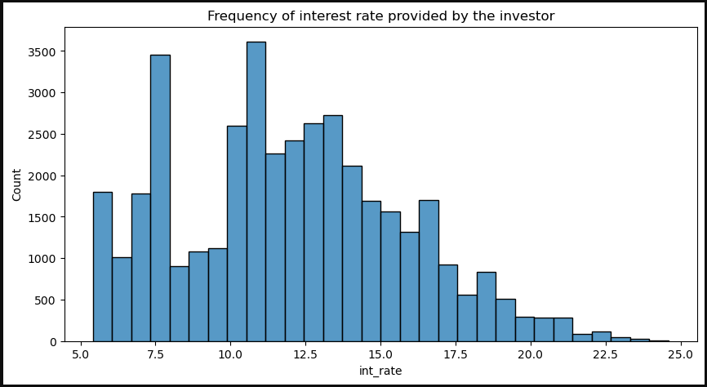
Loan Interest Rate
Lending club provides loans to its customer between 5%-25%.
According to the Histogram chart the frequency is high at around 11% followed by 7.5% and it gets reduced post 20%.

Slide 5
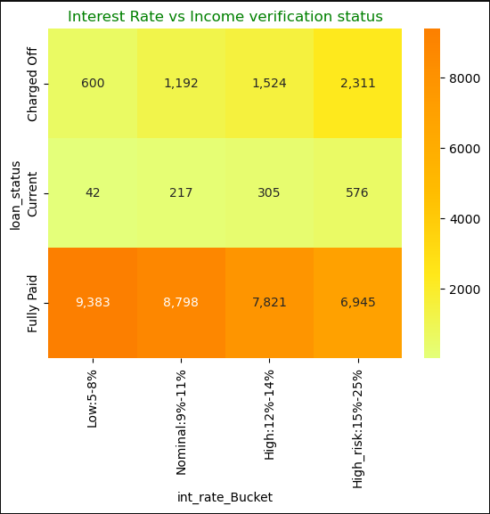
Interest Rate Vs Loan Status
According to the heat map analysis the risk of loans getting charged off or defaulted is very high when the interest rate is between 15%-25%. When the Interest rate is between 5%-8% the possibilty of loan getting ‘Fully Paid’ is very high.

Slide 6
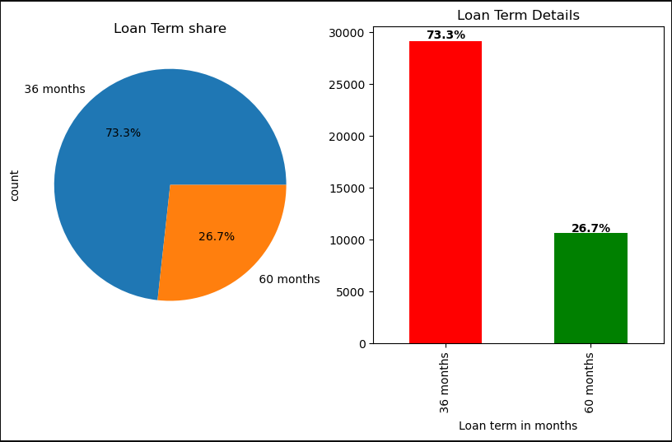
Loan Term
The consumer finance company is providing loan to its customer with two loan term period options 36 and 60 months.
Majority of the customers/borrowers are opting for 36 months loan period which amount to 73% of the total loan sanctioned

Slide 7
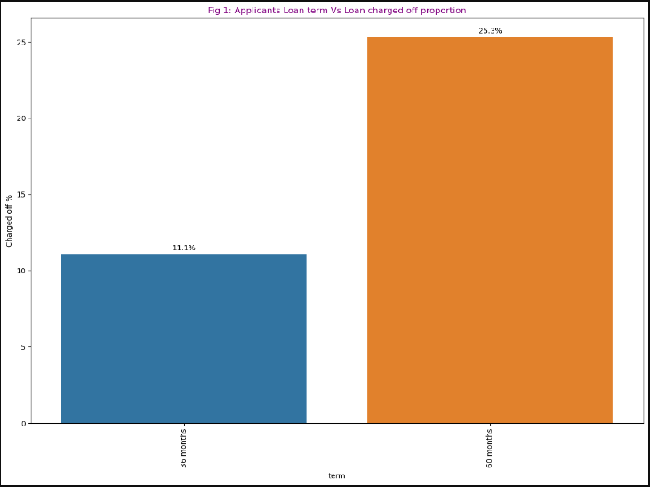
Loan Term Vs Loan Status
According to below bar graph loans with 60 months as loan tenure period has a very high risk of getting charged off compared to loans with 36 months as loan tenure.

Slide 8

Enter Title
Click here to add the text, the text is the refinement of your thought, in order to finally demonstrate the good effect of the release, please try to explain the point of view as succinctly as possible.

Slide 9
THANKS
Click here to add the text

