Slide 1
Lending club case study
Team Members :
Karthikeyan M
K. Sathish Kumar

Slide 2
About the business
Lending club is a consumer finance company which specialises in lending various types of loans to urban customers.
The company is the largest online loan marketplace, facilitating personal loans, business loans, and financing of medical procedures. Borrowers can easily access lower interest rate loans through a fast online interface.
Problem Statement
When a person applies for a loan, there are two types of decisions that could be taken by the company:
• If the applicant is likely to repay the loan, then not approving the loan results in a loss of business to the company
• If the applicant is not likely to repay the loan, i.e. he/she is likely to default,then approving the loan may lead to a financial loss for the company
Lending club company wants to understand the driving factors (or driver variables) behind loan default, i.e. the variables which are strong indicators of default. The company can utilize this knownledge for its portfolio and risk assessment.

Slide 3
Analysis Methodology
Data Sourcing
Data cleaning and handling
Univariate Analysis
Segmented Univariate Analysis
Bivariate Analysis
Correlation matrix
Recommendations

Slide 4
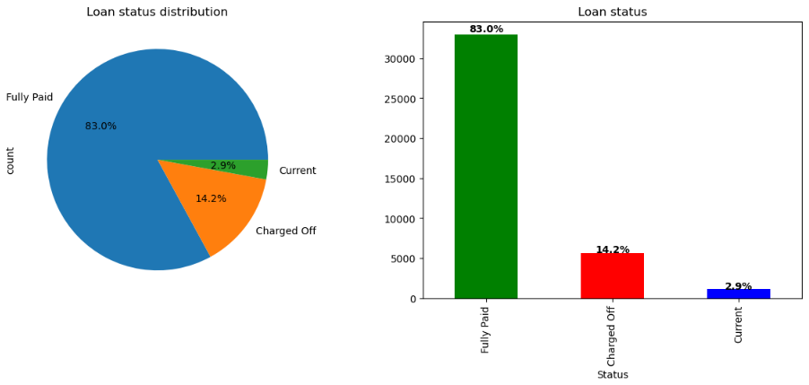
Loan Status
Lending club has issued nearly 40,000 loans out of which 83% of the loans have been ‘Fully Paid’ or closed.
There are about 5500+ loans that were charged off / defaulted.

Slide 5
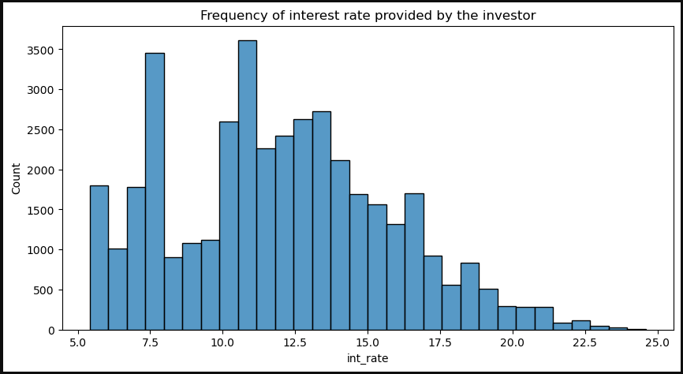
Loan Interest Rate
Lending club provides loans to its customer with interest rates between 5%-25%.
According to the Histogram chart more no. of loans were issued in the range of 10.5-11% interest rates followed by interest rates around 7.5%

Slide 6
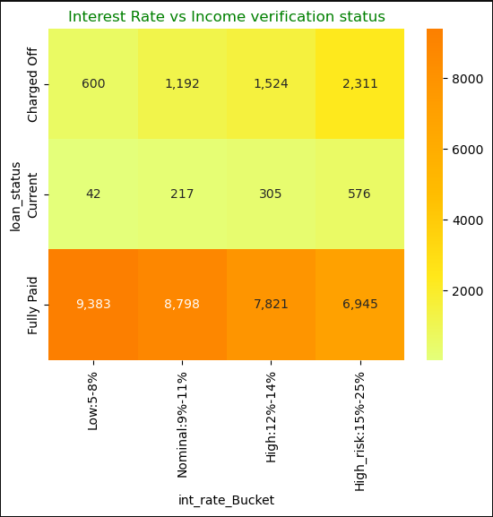
Interest Rate Vs Loan Status
According to the heat map analysis there is a very high risk of loans getting charged off or defaulted when the interest rate is between 15%-25%.
When the Interest rate is between 5%-8% there are very high chances of loans getting ‘Fully Paid’ or completed.

Slide 7
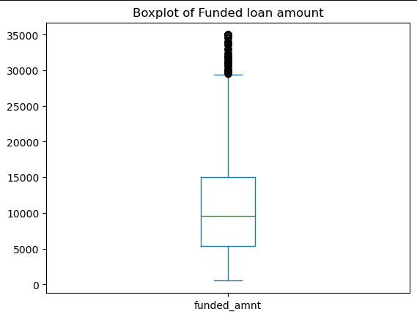
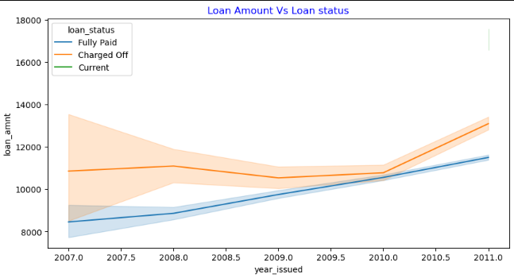
Loan Amount VS Loan Status
Lending club provides loans to its customer with loan amount ranging from $5000, the maximum limit is $35000.
Average loan amount availed by the customer is around $9500.
Line plot analysis indicates more the loan amount the probability of loans getting charged off is high.

Slide 8
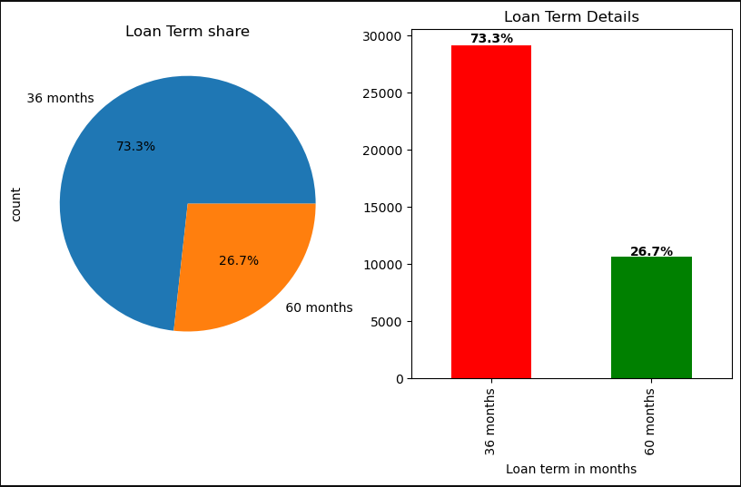
Loan Term
Lending club is providing loans to its customer with two loan tenure options 36 and 60 months.
Majority of the loans (73%) were sanctioned with 36 months as loan tenure period.

Slide 9
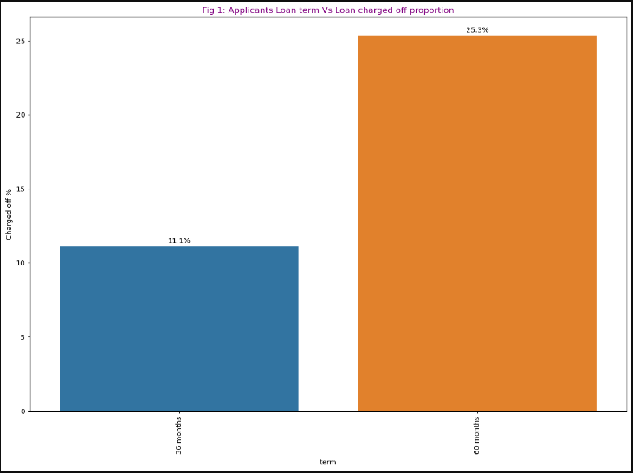
Loan Term Vs Loan Status
According to bar graph analysis loans with 60 months as loan tenure period have a very high risk of getting charged off compared to loans with 36 months as loan tenure.

Slide 10
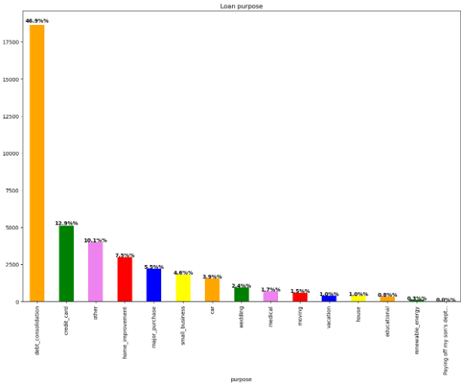
Loan Purpose
Nearly 50% of the loans borrowed by the customers were for the purpose of debt consolidation followed by credit card (13%).

Slide 11
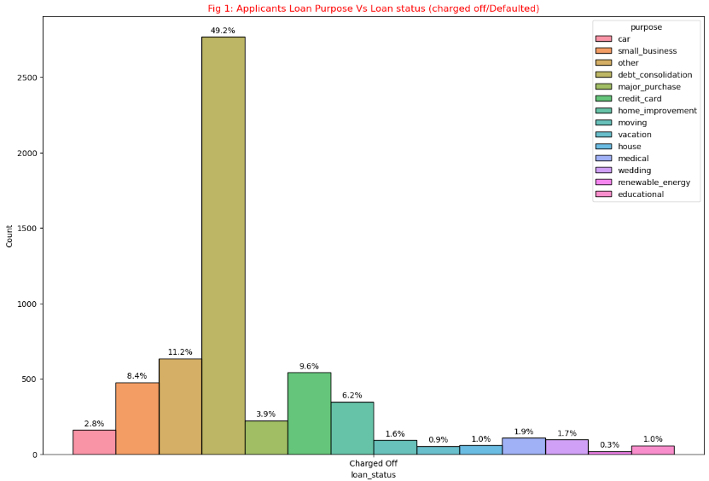
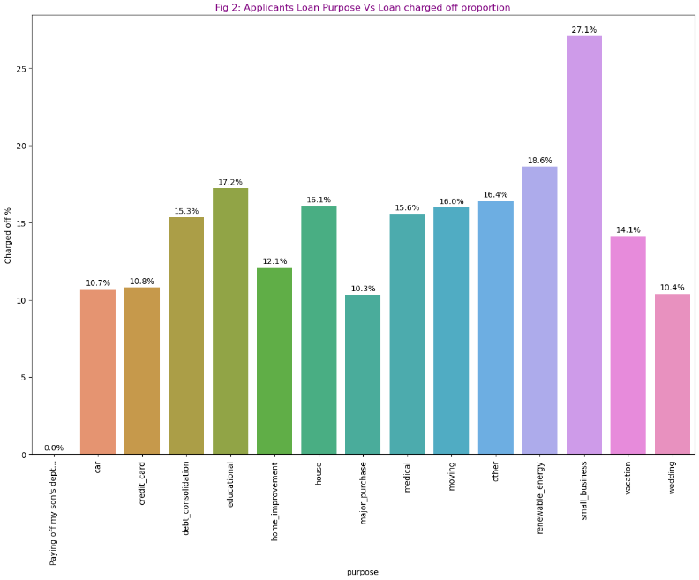
Loan Purpose Vs Loan Status
Fig 1 bar plot plotted among charged off loan data indicates that nearly half of the defaulted / charged off loans are opted for the purpose of debt consolidation followed by loans opted for other purposes.
Fig 2 bar plot plotted by calculating charged off proportion among individual purposes indicates small business loans have high charged off proportion (27%) followed by renewable energy (18%)
By analysing the two plot the ‘Risk’ loan purposes are 'debt consolidation' and 'small business'

Slide 12
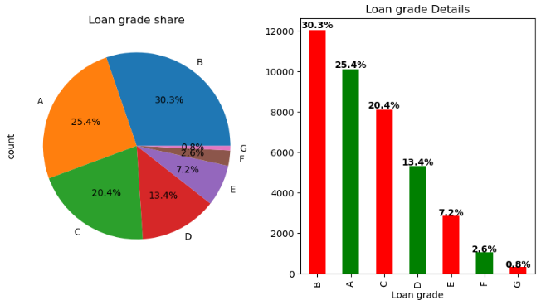
Loan Grade
Lending club has divided loans into 7 grades A (lowest grade) to E (highest grade).
About 30% of loans issue falls in category B followed by grade A (25%) and grade C (20%)

Slide 13
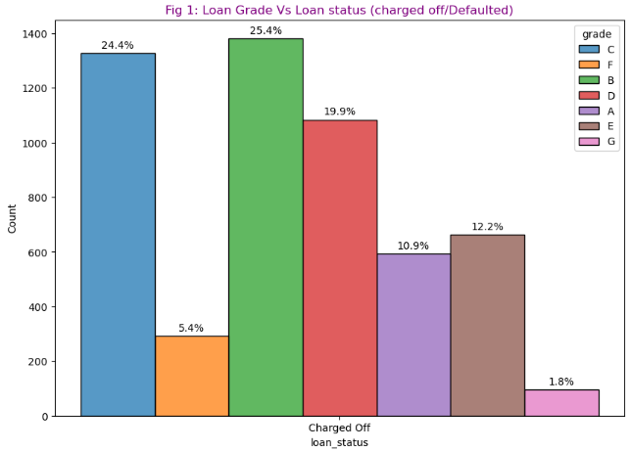
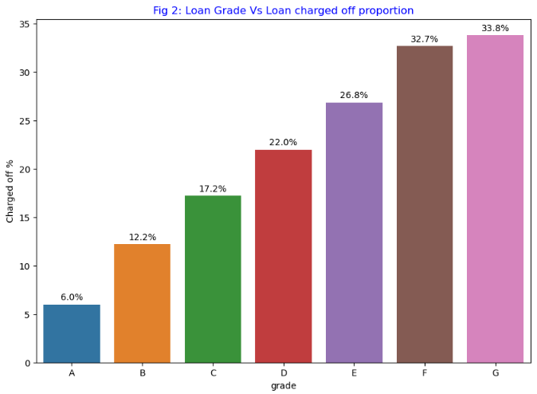
Loan Grade Vs Loan Status
Fig 1 bar plot plotted among charged off loan data indicates loans with grade 'B' and 'C' have high defaulted percentage 25% and 24% respectively.
Fig 2 bar plot plotted by calculating charged off proportion among individual grades indicates loan grade 'G' has high charged off proportion (34%) followed by grade F (33%)
By analyzing the two plot the ‘Risk’ loan grades are 'C' and 'F'

Slide 14
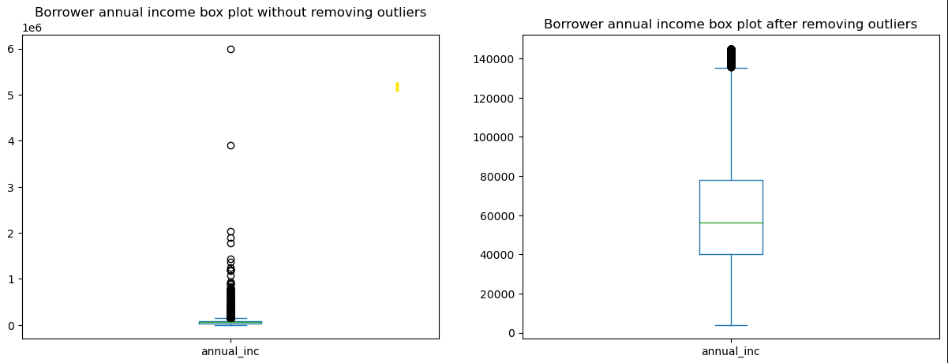
Borrowers Annual Income
Annual income of the applicants is plotted via box plot.
After the outlier entries were removed the average annual income of the applicants is around '$60000'.

Slide 15
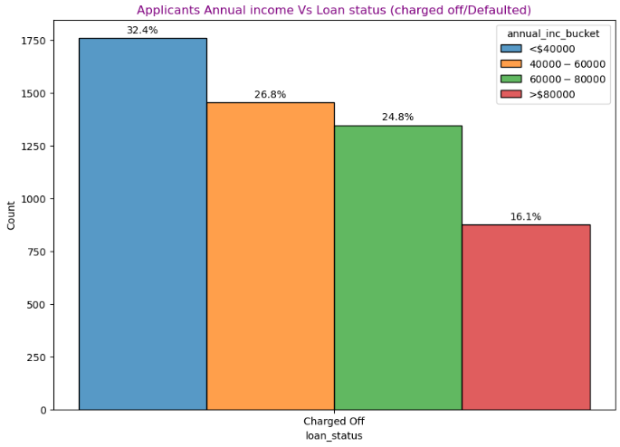
Annual Income Vs Loan Status
The bar graph shows that when the annual income increase the possibility of loan getting charged off / defaulted decreases.
When the annual income is less than $40000 the risk of loans getting charged off / defaulted is very high

Slide 16
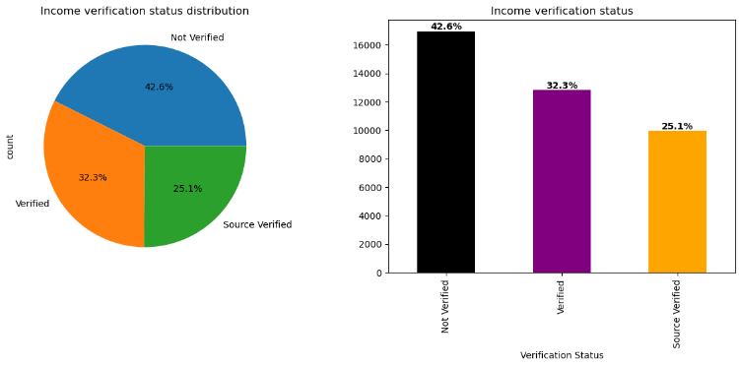
Income Verification Status
In about one third (43%) of the loans issued by the lending company, applicants income were not verified.
Only 32% of applicants income were verified whereas for about 25% of the applicants income source were verified.

Slide 17
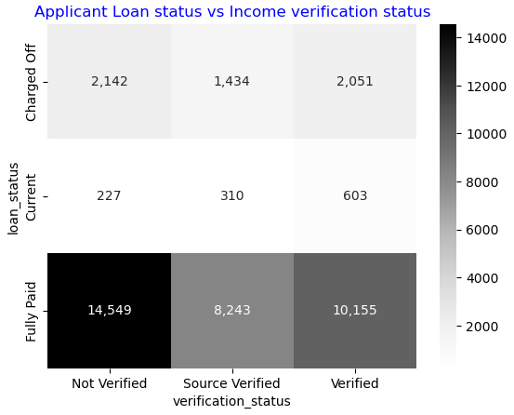
Income verification Vs Loan Status
From the heat map analysis we can infer that income verification status doesn’t have much impact on the loan repayment capability of the borrower since the no. of loans ‘Fully paid’ by the borrower whose income were ‘Not Verified is higher than those whose income / income sources were verified.
Among defaulted/charged off loans there is a very minimal difference when applicant's income 'Not verified' or 'verified'.

Slide 18
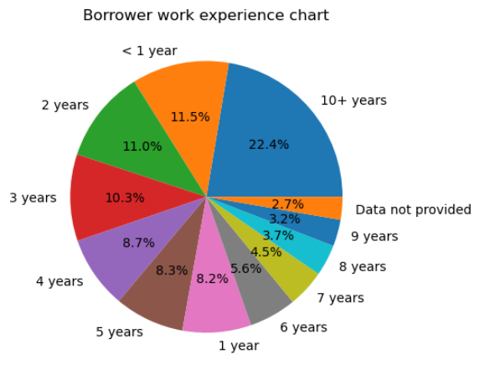
Borrower’s employment length
Around 22% of loans were issued to applicants who has work experience of more than 10 years, followed applicants who has work experience of less than 1 year (12%) and 2 years (11%).

Slide 19
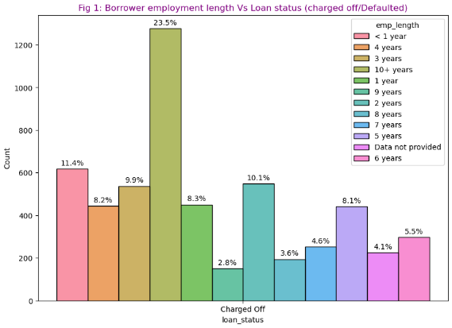
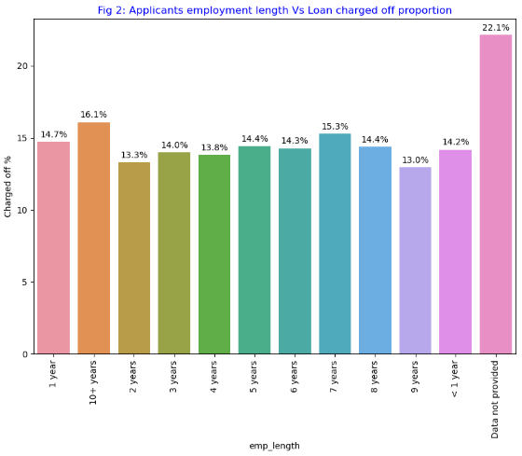
Employment Length Vs Loan Status
Fig 1 bar plot plotted among charged off loan data indicates that nearly 25% of the defaulted / charged off loans are opted by the applicants who have work experience of more than 10 years.
Fig 2 bar plot plotted by calculating charged off proportion applicants who hasn’t furnished his work experience has high (22%) charged off rate.
By analysing the two plot applicants who have 10+ years or less than 1 year of work experience have high ‘Risk’ of loan getting defaulted.
Lending club need to make sure applicants furnish their work experience details as well

Slide 20
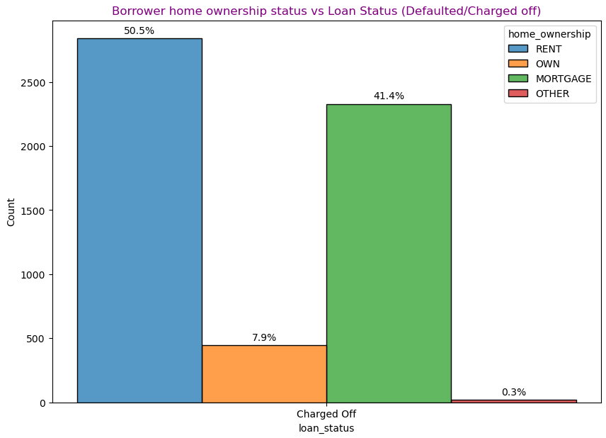
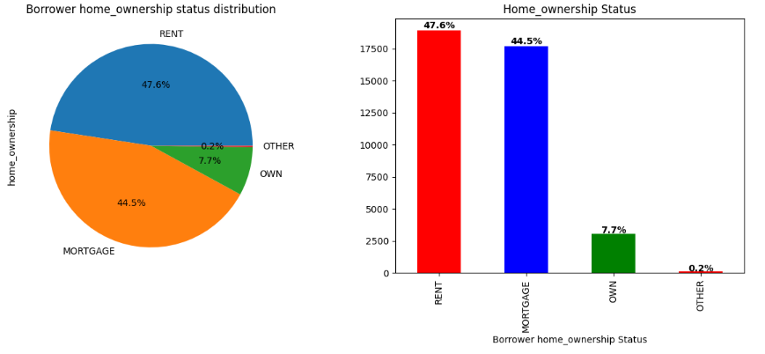
Home Ownership Status Vs Loan Status
In about 90% of the defaulted or charged off loans the applicants are either living in a rented house or has mortgaged his house.
Only 7% of the applicants have own house.
‘Risk’ home ownership status are ‘Rent’ and ‘Mortgage’

Slide 21
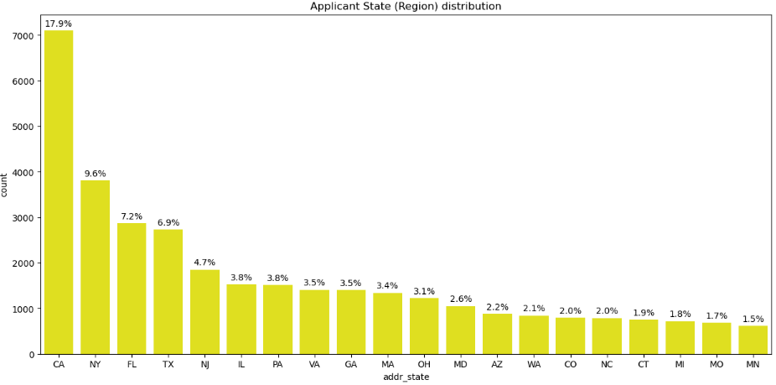
Applicant’s State (Region)
Around 7000 applicants who borrowed loan from the Lending company comes from 'California’ region followed by New York which has nearly 4000 applicants

Slide 22
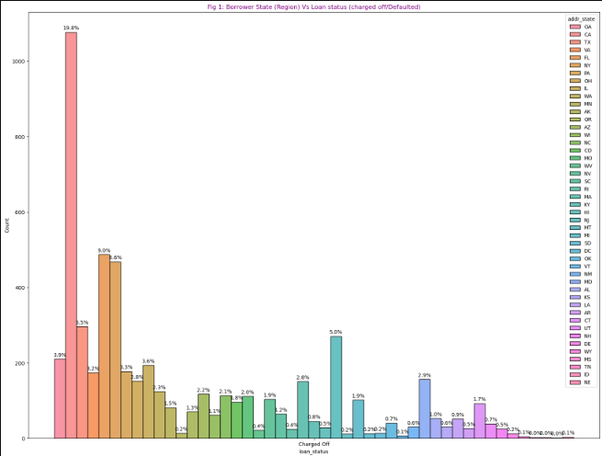
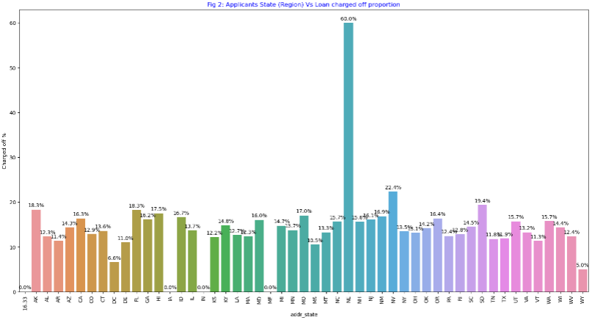
Fig 1 bar plot plotted among charged off loan data indicates around 20 % charged off loans comes from 'California' region followed by 'Florida' (9%) and 'New York' (8.6%).
Fig 2 bar plot plotted by calculating charged off proportion among individual states indicates about 60% of loans that comes from 'Nebraska' region are charged off.
By analysing the two plot the risk states are 'California', 'Florida', 'New York' and 'Nebraska'.
Applicant’s State (Region)
Vs Loan Status

Slide 23
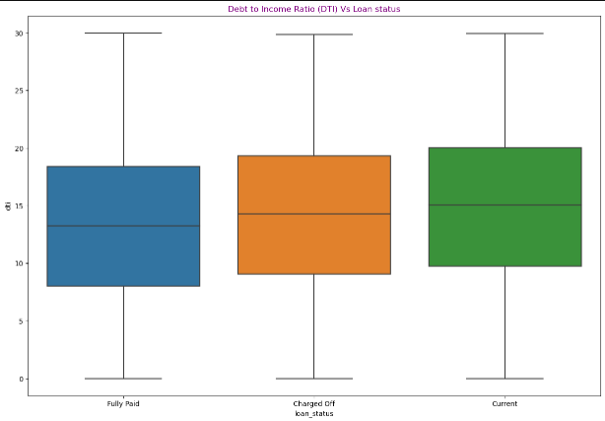
Debt to Income Ratio (DTI) Vs Loan Status
For charged off / defaulted loans the debt to income ratio is higher than 'Fully paid' loans.
Current loans are having slightly higher DTI ratio than charged off or defaulted loan. The probability of current loans getting defaulted is high.

Slide 24
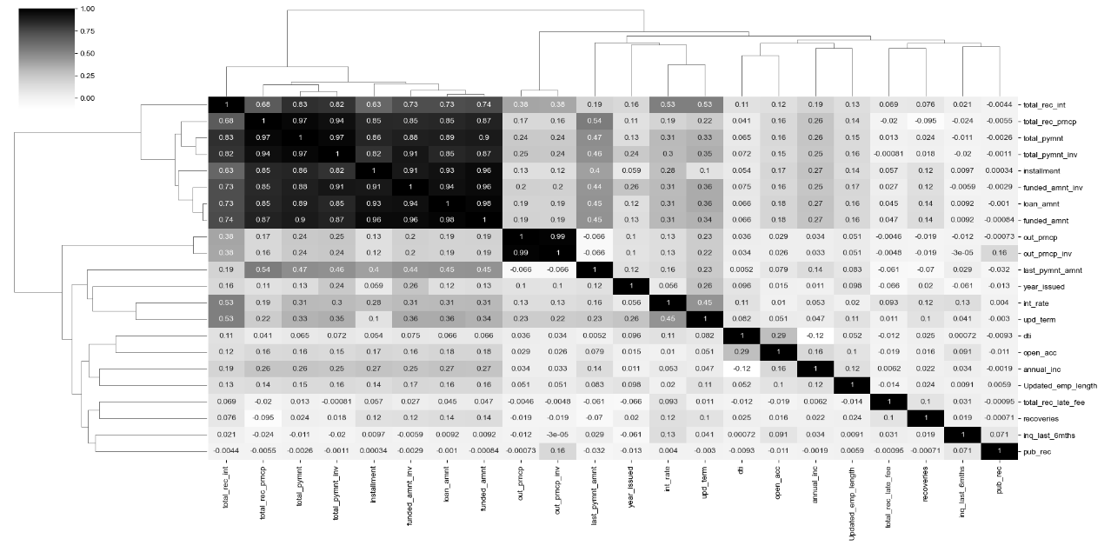
Correlation Matrix
Annual income has strong correlation with loan amount whereas the correlation is very weak with interest rate.
Loan term have a very good correlation with interest rate and loan amount
DTI has weak correlation with rest of the fields.

Slide 25


Recommendations
Lending club company should consider applicants who satisfies the below points as high risk of getting charged off / defaulted.
Applicants having home ownership status as 'Rent' or 'Mortgage'.
Applicants opting interest rate between 15%-25%.
Applicants whose annual income is less than '$40000'.
Applicants who opt loans for debt consolidation, small business.
Applicants whose employment length is either 10+ years or less than 1 year.
Applicants who opted loan term as 60 months.
Applicants who opt for higher interest grades G (higher grade) --> A (lower grade).
Applicants from 'California', 'Florida' and 'New York' region.
Applicants having high DTI ratio.
Applicants borrowing high loan amount are most likely to be defaulted or charged off.
Applicants whose income are not verified by the lending company.

Slide 26
THANK YOU
By:
Karthikeyan M
K. Sathish Kumar

