Slide 1
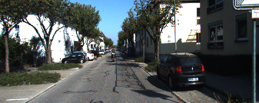
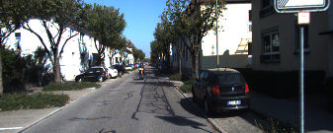

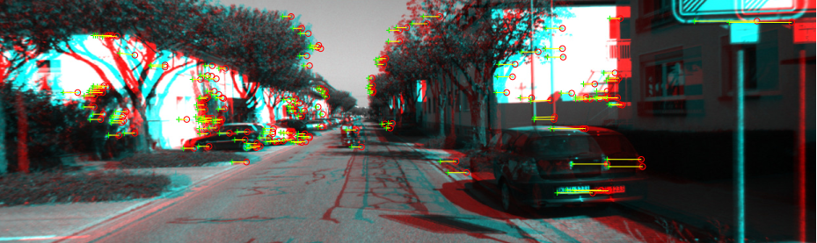

Odometry Pipeline
Left
Right
T
3D-Map
Point Clouds
ICP
$$T(R,t)$$
T+1
3D-Map
Point Clouds
Feature Map
Feature Map

