Slide 1
AI-Plagiarism Detector Agent
IBM AICTE PROJECT
Presented By:
Student name : KEERTHANRAJ B
College Name & Department : DAYANANDA SAGAR ACADEMY OF TECHNOLOGY AND MANAGEMENT [INFORMATION SCIENCE AND ENGINEERING]

Slide 2
OUTLINE
Problem Statement
Technology used
Wow factor
End users
Result
Conclusion
Git-hub Link
Future scope
IBM Certifications

Slide 3
Problem Statement
Academic institutions face increasing difficulty in detecting nuanced forms of plagiarism—especially paraphrased or AI-generated submissions. Current detectors lack contextual awareness of instructor-specific feedback and historical data.
Proposed Solution
An AI-powered plagiarism agent that:
Learns from historical assignments and instructor grading styles
Detects paraphrased, copied, and AI-generated content
Flags potential misconduct with high contextual accuracy
Enhances academic integrity

Slide 4
Technology used
IBM cloud lite services
Natural Language Processing (NLP)
Retrieval Augmented Generation (RAG)
IBM Granite model
Vector Indexing (for historical assignment comparison)

Slide 5
IBM cloud services used
IBM Cloud Watsonx AI Studio
IBM Cloud Watsonx AI runtime
IBM Cloud Agent Lab
IBM Granite foundation model

Slide 6
Wow factors
Context-aware plagiarism detection
Detects paraphrasing + AI-generated content
Learns from instructor-specific styles and past grading
Real-time similarity analysis using vector embeddings
Detailed reasoning with similarity scores
API-ready for LMS (Moodle, Canvas) integration

Slide 7
End users
College Instructors & Professors
University Administration
Students (for self-check before submission)
EdTech Platforms

Slide 8
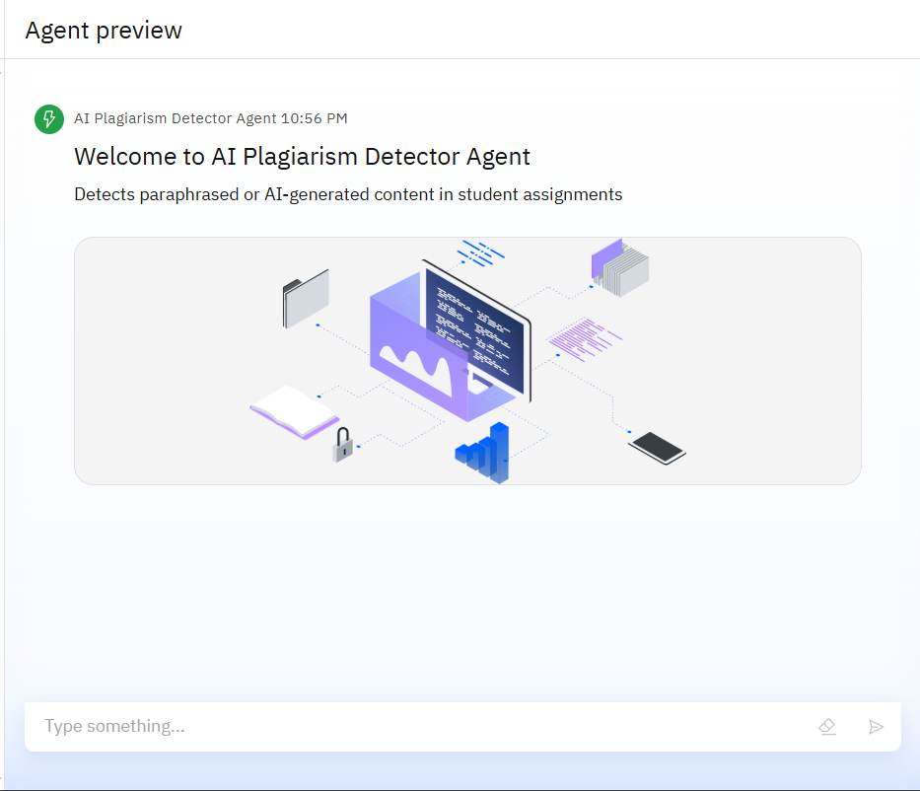
Results

Slide 9
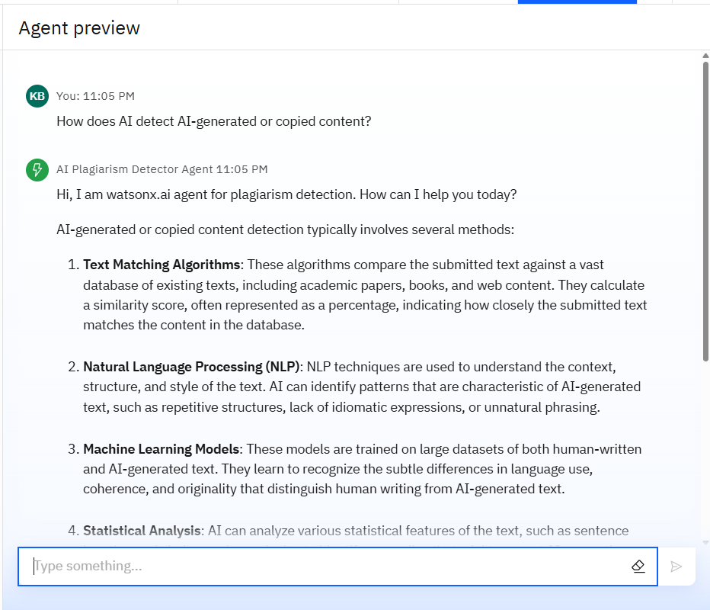
Results

Slide 10
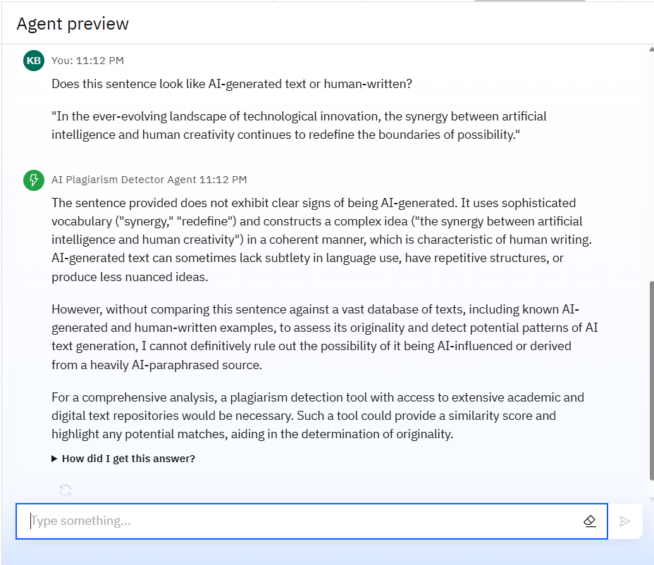
Results

Slide 11
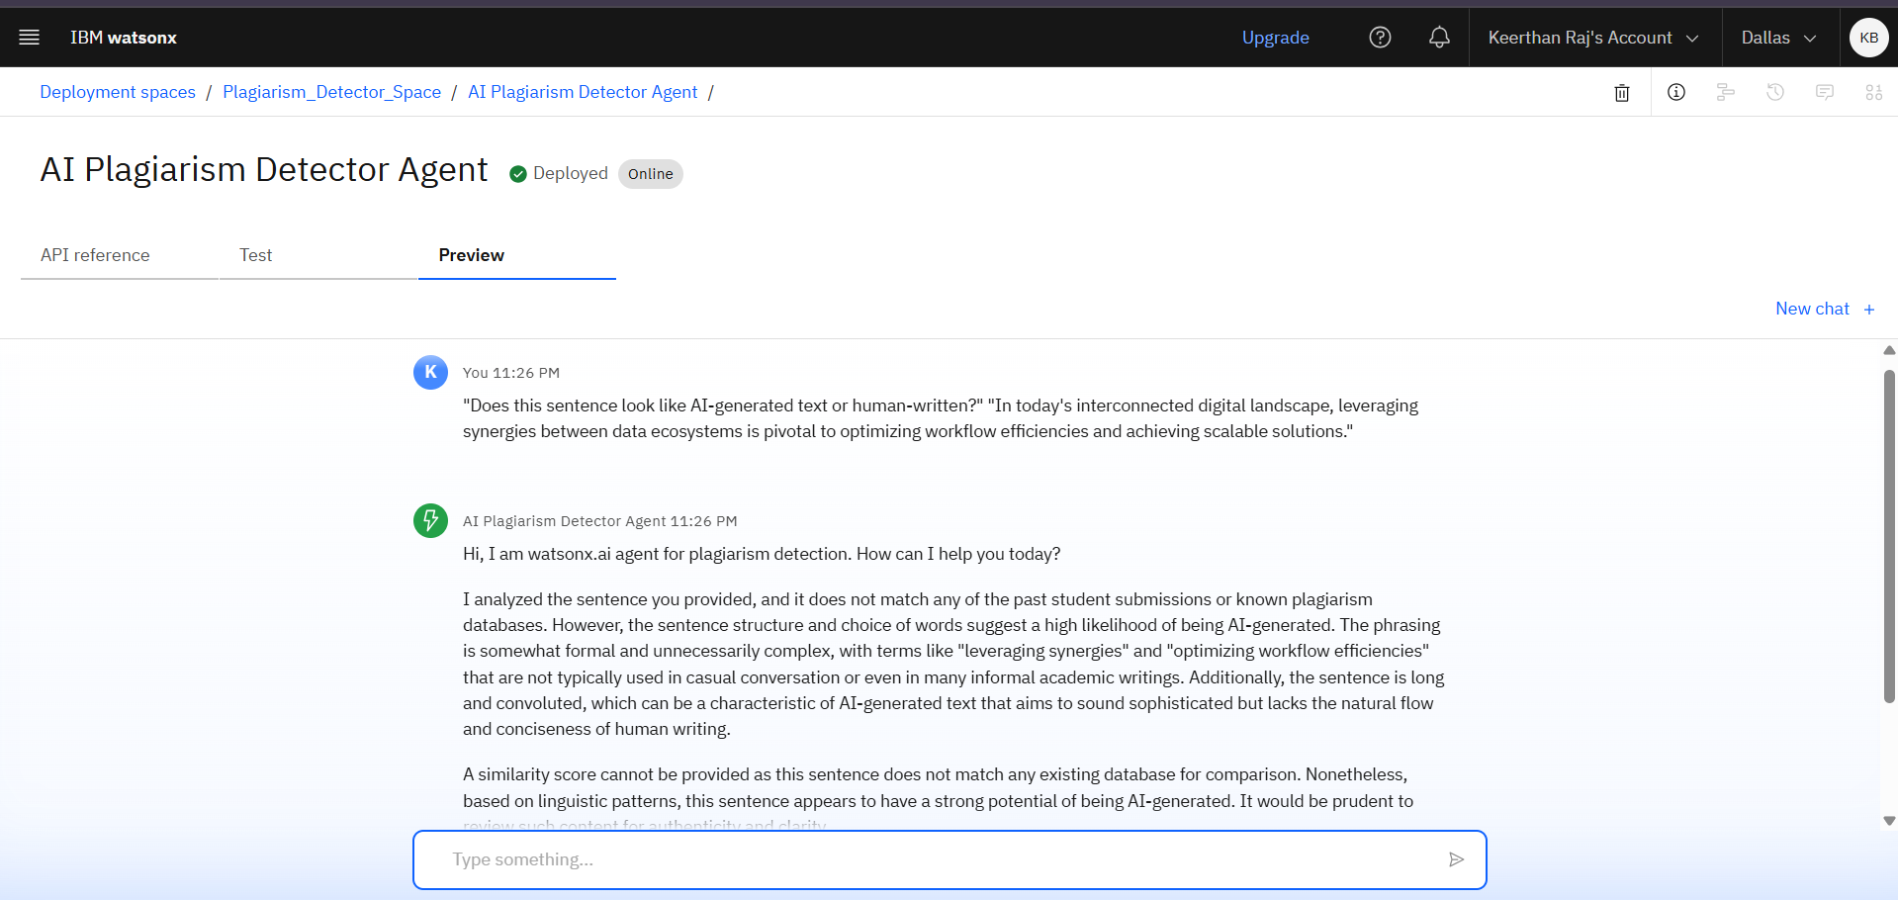
Results
Deployed AI Agent

Slide 12
Conclusion
The AI-powered agent helps promote academic honesty by detecting paraphrased and AI-generated content often missed by traditional tools.
It saves instructors time by automating plagiarism checks and comparing submissions against historical data.
The system adapts to writing styles by learning from instructor feedback, improving detection accuracy.
It’s scalable and easy to integrate into universities and online learning platforms for efficient academic integrity management.

Slide 13
Future scope
Multilingual plagiarism detection
Voice-to-text assignment checking
Integration with Turnitin/Moodle/Google Classroom
AI-powered paraphrasing assistant for students
Plagiarism heatmap visualization
Instructor-style imitation detection

Slide 14
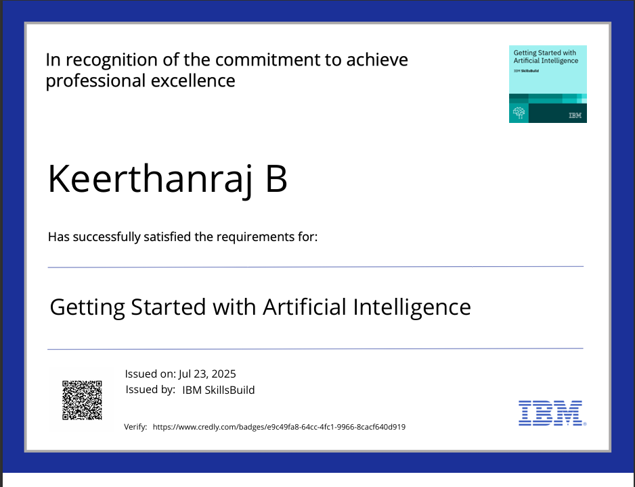
IBM Certifications

Slide 15
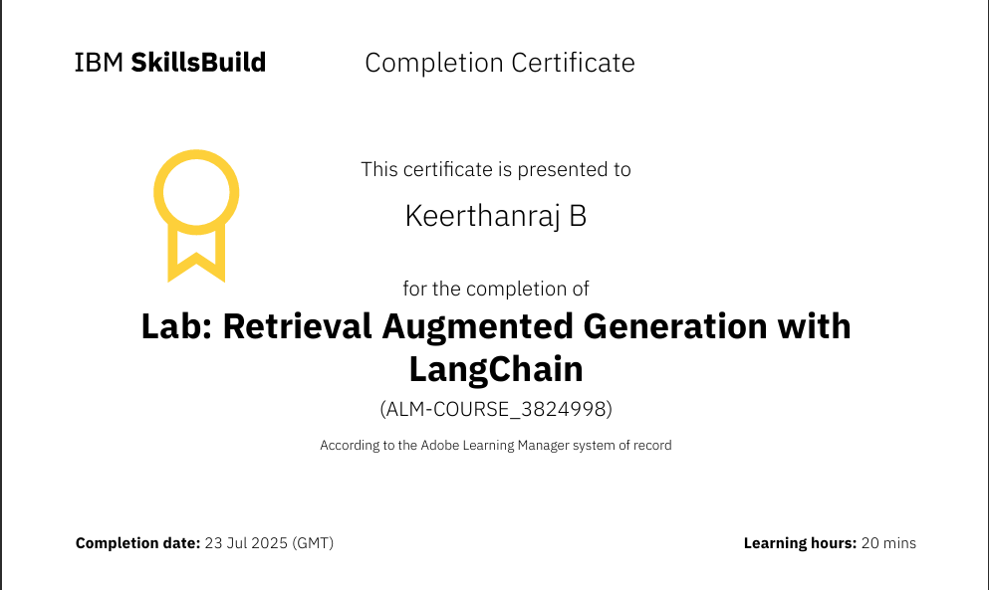
IBM CERTIFICATIONS

Slide 16
GitHub Link
https://github.com/itskeerthanraj/AI-Plagiarism-Detector-Agent.git

Slide 17
THANK YOU

