Slide 1


Build habits that grow with you
Your smart money companion—effortless tracking, powerful insights, personal financial guidance, and habit-building features that grow with you

Slide 2



Problem Statement
Expense tracking is exhausting and inconsistent
People struggle to maintain the habit of manually noting expenses, making it easy to miss where money goes.
Traditional tools don’t provide real insights
Notes and spreadsheets fail to show clear patterns, categories, money leaks, or long-term trends.
Privacy concerns block the use of bank-synced apps
Users hesitate to give apps access to bank accounts, limiting automated tracking.
Household & shared financial tracking is messy
Couples, roommates, and families find it difficult to combine expenses, categorize needs vs wants, and manage goals.
Daily spending leaks go unnoticed
Small, frequent purchases and forgotten subscriptions quietly drain significant amounts yearly.
Shared financial goals become misaligned
Without tracking, households lose clarity on priorities like saving for a home, education, or emergencies.
Untracked spending leads to debt spirals
Not knowing how much you can afford results in relying on credit cards and accumulating high-interest debt.
Lack of visibility creates financial stress
The anxiety of “where did my paycheck go?” replaces control and confidence in financial planning
Notes:
2

Slide 3


Solution
Gamification for Habit
Streaks, global rankings, and XP gained from adding expenses, weekly reviews, or chatting with the advisor.
Weekly and monthly savings challenges to keep users engaged and consistent.
Quick Insight
Shows burnout rate, spending sprees, and essential money tips in real time.
Helps users immediately understand spending patterns and take quick corrective actions.
Smart, Fast & Effortless Entry
Add expenses via snap, voice, or text in any language, automatically detecting transactions, savings/goals, or income.
Classifies entries into necessary vs luxury (wants) and 30+ subcategories, processing multiple inputs in under 5 seconds.
Multi-Person Finance Management
Supports individuals, couples, roommates, and full households with shared or separate tracking.
Monitors each person’s transactions, incomes, and goals with combined and individual dashboards.
Deep Insights & Long-Term Analysis
Generates weekly, monthly, and custom reports that reveal exactly where money is going.
Detects trends such as top spending categories, biggest spender, hidden leakages, and long-term patterns.
AI-Powered Financial Advisor
RAG-based advisor gives personalized saving tips, cheaper alternatives, and habit insights.
Analyzes years to a decade of history, identifying old receipts, Amazon purchases, and spending patterns.

Slide 4

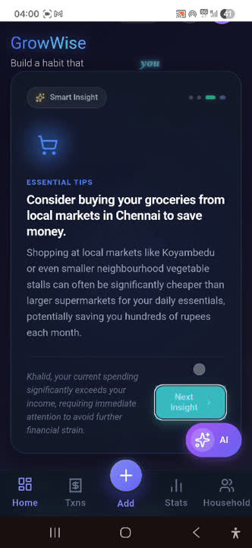
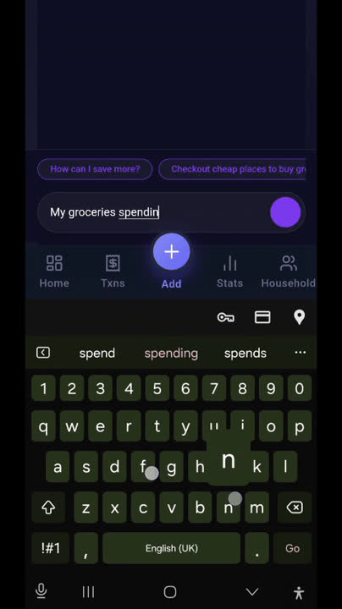
Demo
Quick Insights
Alerts: Detects category spikes.
Local Deals: Finds cheaper nearby options.
Fast Sync: 12h smart cache + instant refresh
Burn Rate: calculate the burn rate and warn the user.
AI Advisor
Affordability Check: Tells if you can afford it.
Purchase Analysis: Shows your long-term buying patterns.
Cheaper Alternatives: Suggests lower-cost options.
Personalized Insights: Gives custom advice with charts.
Learns You: Improves as it learns your habits.

Slide 5


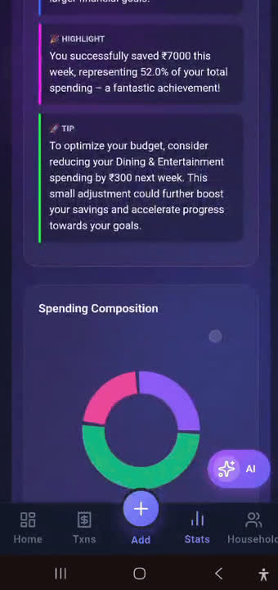
Smart Entry
Multi-Input: Voice, image, text.
Auto Sort: Income, savings, transactions.
Smart Tags: 30+ needs/wants subcategories.
Multi-Language: Handles many languages.
Super Fast: Done in under 30 seconds.
Report Generation
Flexible Reports: Weekly, monthly, custom timelines.
Visual Insights: Trends, stats, graphs & pie charts.
Deep Breakdown: Every category & subcategory analyzed.
Leak Detection: Finds and flags hidden expense leaks.

