Slide 2
PROJECT SUMMARY

Slide 3
SIDE CAMERA

Slide 4
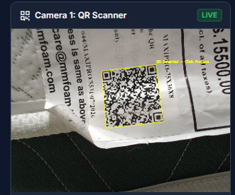

QR CODE

Slide 5
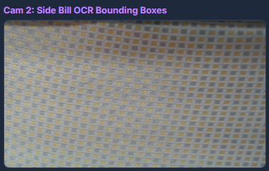

TEXTURE

Slide 6
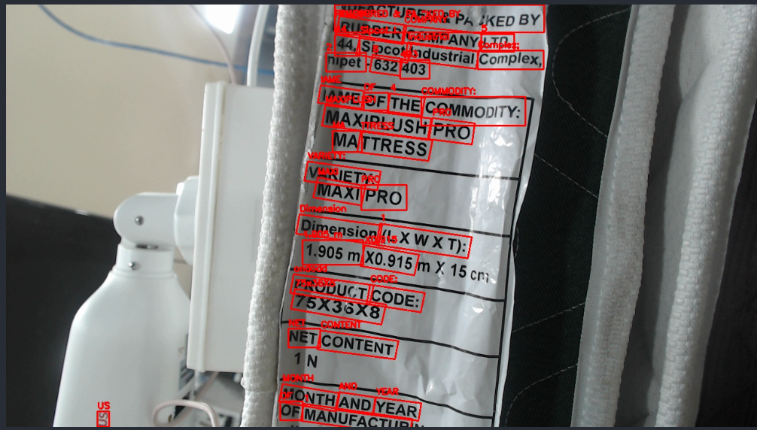
BILL

Slide 7
TOP CAMERA

Slide 8
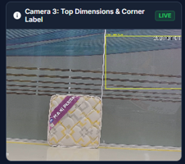
CORNER LABEL

Slide 9
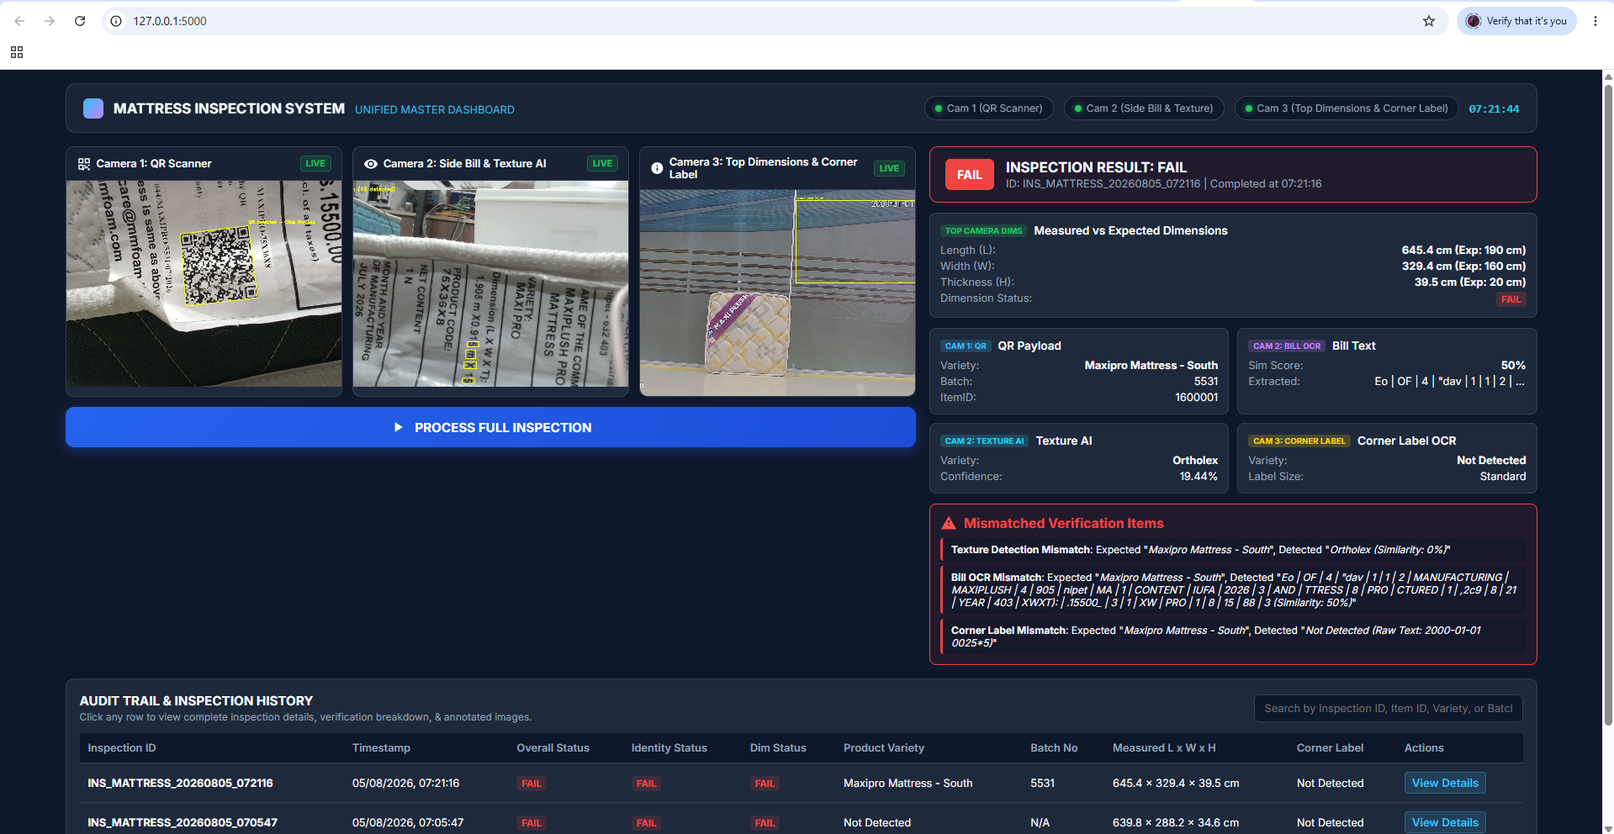
DASHBOARD

Slide 10
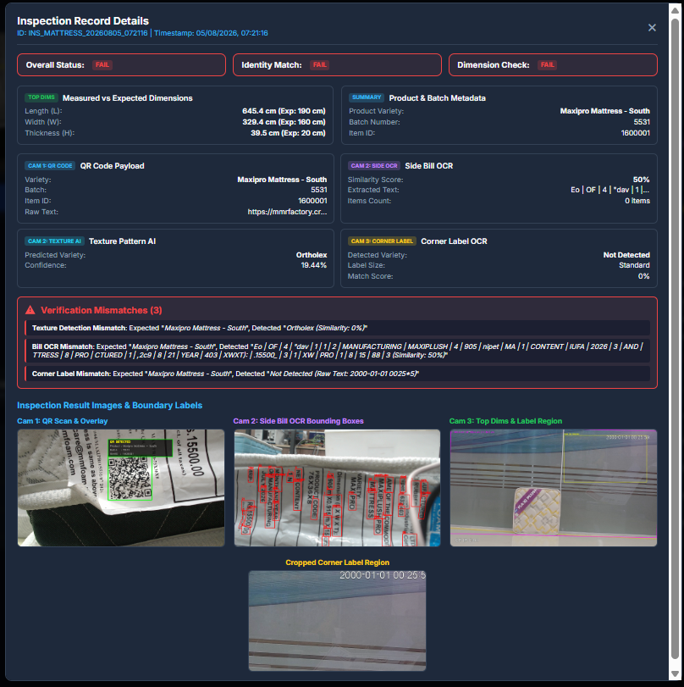
HISTORY

Slide 11
