Slide 1


Introduction to 80386

Slide 2
Syllabus
Part A:
Brief History of Intel Microprocessor
80386DX Features and Architecture
Programmers Model
Operating Modes
Addressing Mode
Data Types

Slide 3
Syllabus
Part B: Applications Instruction Set
Data Movement Instruction
Binary Arithmetic Instruction
Decimal Arithmetic Instruction
Logical Instruction
Control Transfer Instruction
String and Character Transfer Instruction
Flag Control Instruction
Coprocessor Interface Instruction
Segment Register Instruction
Mis. Instruction

Slide 4
Features of 80386

Slide 5

The 80386DX is a 32-bit microprocessor, which means it can process 32-bit data and addresses at a time.
It has 8 general purpose 32 bit registers
The original 80386DX typically runs 12 MHz to 33 MHz.
The processor can address up to 4 gigabytes of physical memory and 64 terabytes of virtual memory.
Pipeline architecture which allows simultaneous instruction fetching, decoding, and executing, the average execution time has been significantly reduced.
It allows user to switch between different OS such as DOS and UNIX
Operates in Real, Protected and Virtual 8086 mode.

Slide 6

8. It compatible with 8086,8088, 80186, 80286 architecture.
9. It can operate on 17 data types like bits, byte, word, double word, Quadword etc.
10. It has separate pins for its address and data line for higher performance and easier hardware design.
11. It support 4 level protection
12. It support high speed numeric 80387 coprocessor

Slide 7
Architecture of 80386

Slide 8
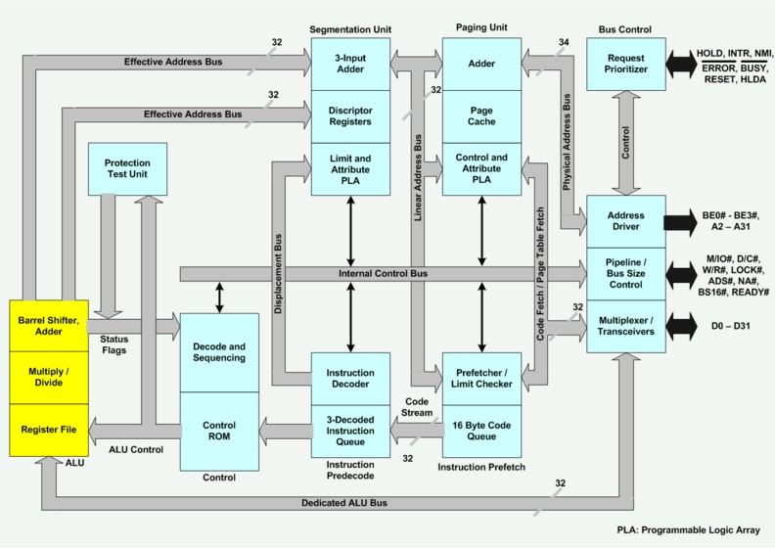
Memory management unit
Central processing unit
Bus interface unit
Prefetch Unit

Slide 9

The Internal Architecture of 80386 is divided into 3 sections.
Bus interface unit(BIU)
Central processing unit(CPU)
Execution Unit
Instruction Unit
Memory management unit(MMU)
Segmentation Unit
Paging Unit

Slide 10

Bus Control Unit:
Is the 80836 communication with the outside world. It provides a full 32 bit bi-directional data and 32- bit address bus.
Accepts internal requests for code fetch and for data transfers from the code fetch unit and from the execution unit. It then prioritize the request and generates signals to perform bus cycles.
It send address, data and control signals to communicate with memory and I/O devices
It controls the interface to external bus masters and coprocessors.
It also provides the address relocation facility.
.

Slide 11

Instruction Prefetch Unit
Fetches sequentially the instruction byte stream from the memory. It uses bus control unit to fetch instruction bytes.
These prefetched instruction bytes are stored in 16 bytes code queue.
When jump or call instructions are executed, the contents of the prefetched and decode queues are cleared out
Instruction Predecode Unit :
Takes instruction byte from the instruction prefetch queue and translate them into microcode.
The decoded instruction then stored in instruction queue

Slide 12
Central processing unit(CPU)
Execution Unit : Reads the instruction instruction queue and execute the instruction.
Control Unit: It contains microcode and special hardware allows processor to reduce time required for execution of multiply and divide instruction. It also speeds the effective address calculation.
Data Unit: Responsible for data operations requested by the control unit. It contains ALU, eight 32 bit general purpose registers and 64 bit barrel shifter. The barrel shifter is used for multiple bit shifts in one clock. Thus it increases the speed of all shift and rotate operations.
Protection Test Unit: checks for segmentation violations under the control of the microcode.

Slide 13

Memory Management Unit
Segmentation Unit:
Translate logical address to linear addresses at the request of execution unit.
Compares the effective address for the length limit specified in the segment descriptor. Adds the segment base and the effective address to generate linear address.
Before calculation of linear address it also checks access rights.
It provides a 4 level protection mechanism for protecting and isolating the system code and data from those of the application program

Slide 14
Memory Management Unit
Paging Unit:
Translate linear addresses generated by the segmentation unit into physical addresses.
If paging unit is not enabled, the physical address is the same as the linear address.
It give physical address to the Bus Interface Unit to perform memory and I/O accesses.
It organizes the physical memory in terms of pages of 4kbyts size each.

Slide 15
Programmer’s Model of 80386

Slide 16
Programmer’s Model of 80386
The 80386 programmer’s model is a picture of the registers available to the programmer .
These registers are used to hold the numbers and addresses , as well as indicate status and acts as controls.
Data Registers :EAX, EBX , ECX, EDX
Address Registers:Segment register : CS, DS, ES , SS, FS, GS and IP, SP,BP,SI,DI
Flag Registers

Slide 17
Register Organization

Slide 18

General Purpose Register
Pointer register
Index register
Segment Register
Eflags
System Address/Memory management Registers
Control Register
Debug Register
Test Register

Slide 19
General Purpose Register
The 32-bit general-purpose registers (EAX, EBX, ECX, EDX).
The 16-bit general-purpose registers (AX, BX, CX, DX).
The 8-bit general-purpose registers (AH, BH, CH, DH, AL, BL, CL, or DL).
Pointer Register
The 32 bit pointer register (EBP, ESP)
The 16-bit Pointer registers (BP, SP)

Slide 20

Index Register
The 32 bit Index register (ESI, EDI)
The 16-bit Pointer registers (SI, DI)
Instruction Pointer
The 32 bit Instruction pointer (EIP)
Segment Registers
The 16- bit segment registers (CS, DS, SS, ES, FS, and GS).

Slide 21
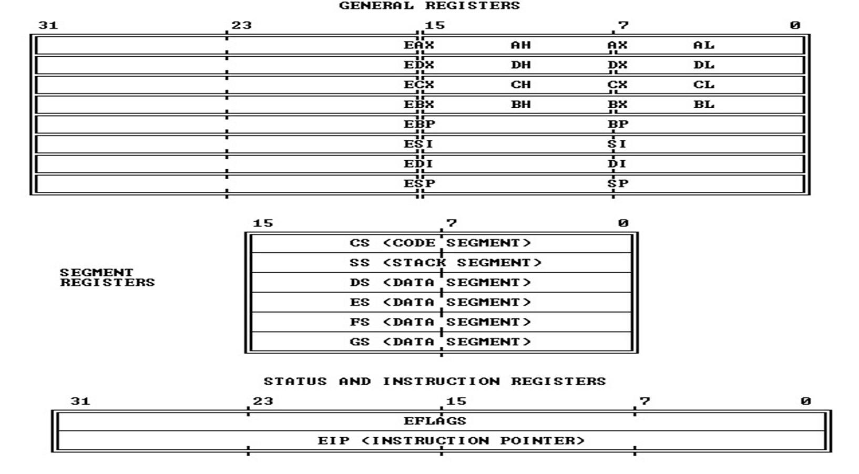

Slide 22
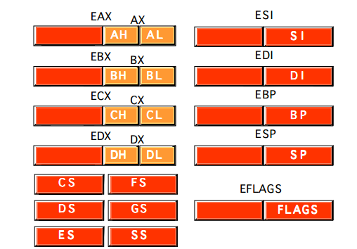
Index
Register
General Purpose Register
Pointer Register
Segment Register

Slide 23

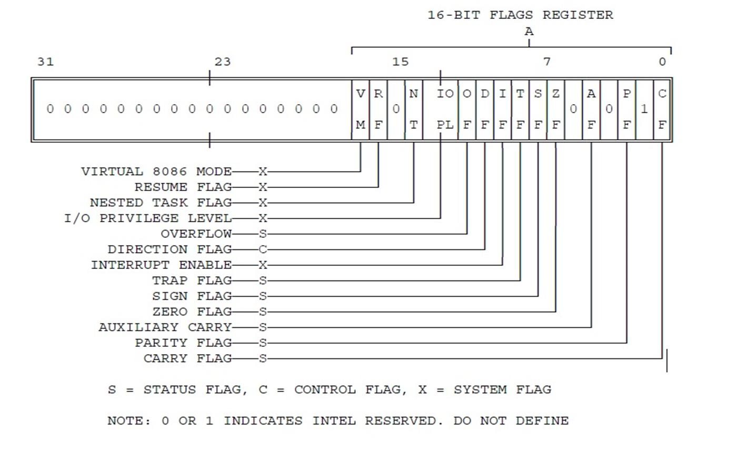

Slide 24

Six Conditional
or status Flags
Carry Flag (CF)
Parity Flag (PF)
Auxiliary Flag( AF)
Zero Flag (ZF)
Sign Flag (SF)
Overflow Flag (OF)
Three Control Flags
Interrupt Flag (IF)
Trap Flag (TF)
Direction Flag (DF)

Slide 25

Four System Flags
Input/output privilege level (IOPL)
Nested Task (NT)
Resume Flag (RF)
Virtual Mode Flag (VM)

Slide 26
Control Flags
DF ( Direction flag) : The direction flag controls the direction of string operations. When the D flag is cleared these operations process strings from low memory up towards high memory. This means that offset pointers (usually SI and DI) are incremented by 1 after each operation in the string instructions when D flag is cleared. If the D flag is set, then SI and DI are decremented by 1 after each operation to process strings from high to low memory.
IF (Interrupt Flag) : When interrupt flag is set, the 80386 recognizes and handles external hardware interrupts on its INTR pin. If the interrupt flag is cleared, 80386 ignores any inputs on this pin. The IF flag is set and cleared with the STI and CLI instructions, respectively.
TF (Trap Flag) : Trap flag allows user to single-step through programs. When an 80386 detects that this flag is set, it executes one instruction and then automatically generates an internal exception 1. After servicing the exception, the processor executes the next instruction and repeats the process. This single stepping continues until program code resets this flag for debugging programs single step facility is used.

Slide 27
System Flags
VM (Virtual Memory) flag indicates operating mode of 80386. When VM flag is set, 80386 switches from protected mode to virtual 8086 mode.
R (Resume) flag/Restart flag : This flag, when set allows selective masking of some exceptions at the time of debugging.
NT (Nested flag) : This flag is set when one system task invokes another task. (i.e. nested task).
IOPL (1/0 Privilege level) : The two bits in the IOPL are used by the processor and the operating system to determine your application's access to I/0 facilities. It holds privilege level, from O to 3, at which the current code is running in order to execute any I/0 related instruction.

Slide 28
NT (Nested flag) :
This flag is set when one system task invokes another task.(i.e. nested task).
IOPL (l/O Privilege level) :
The two bits in the IOPL are used by the processor and the operating system to determine your application's access to I/O facilities.

Slide 29
Operating Modes of 80386

Slide 30
Operating Modes of 80386
1. Real Mode:
In real mode, the processor emulates the behavior of these 8086 processors.
It has access to only 1 MB of memory.
2. Protected Mode:
Protected mode is a 32-bit operating mode all instruction and features are available
It provides access to a 4 GB address space and supports multitasking and virtual memory.
It includes features like privilege levels (Rings 0-3) to control access to system resources.
3. Virtual 8086 Mode:
This mode allows running multiple instances of real mode 8086 programs concurrently under protected mode.
It enables multitasking in a way that is compatible with older 16-bit software.

Slide 31
Operating Modes of 80386
Real Mode
When the 80386 is turned on for the first time, the Real mode is its default operating mode.
Software created for the 8086 and 8088 processors will work on the 80386 without needing to be modified because it is fully backward-compatible with these older CPUs.
The 80386 has a 20-bit address space in Real mode, giving it access to 1MB of memory. The memory is separated into 64K segments, and a 16-bit segment register can be used to access each section.
The processor uses segment-based memory addressing while operating in this mode and is not given access to sophisticated memory management and security functions. Real mode likewise has a constrained set of instructions and does not support protected or virtual memory.

Slide 32
Operating Modes of 80386
Protected Mode:
A 32-bit address space is available in protected mode, a sophisticated operating mode that gives users access to up to 4GB of memory.
Additionally, it offers sophisticated memory management and security features including segmentation and paging. Pages are fixed-size units of memory that can be moved in and out of physical memory as needed. Paging enables this.
Memory can be separated into logical units called segments through segmentation, which can be used to restrict access to particular memory locations.
The 80386 also has access to a number of privileged instructions and registers in a protected mode that are not present in regular mode. The protected mode also supports virtual memory which allows the system to use more memory than the physical memory available by swapping memory pages to and from the disk.

Slide 33
Operating Modes of 80386
Virtual 8086 Modes
The 80386 may operate numerous virtual environments that are compatible with the 8086 simultaneously in virtual 8086 modes.
Although they share the same physical memory, each virtual environment has its own set of registers and memory space. This mode enables the 80386 to mimic the actions of an 8086 processor, which is frequently used to run older applications on more modern computers. T
he 80386 may move between many virtual environments as needed thanks to the system for handling interrupts and exceptions that are provided by virtual 8086 modes.
The virtual 8086 mode allows for the simultaneous operation of numerous virtual machines without interfering with one another while simulating the behavior of a real 8086 CPU in a protected virtual memory environment.

Slide 34
Addressing Modes of 80386

Slide 35
Addressing Modes of 80386
As a part of programming flexibility, processor provides different ways to access these operands from different locations.
The different ways by which processor can access data are referred to as addressing modes.
The 80386DX provides a total of 11 addressing modes for instructions to specify operands.
These addressing modes can be categorized in three groups :
• Register operand addressing (Register Addressing mode)
• Immediate operand addressing (Immediate Addressing )
• Memory operand addressing.(Memory Addressing mode)

Slide 36
Addressing Modes of 80386
Immediate Operands : (Immediate Addressing mode)
Certain instructions use data from the instruction itself as operands.
Such an operand is called an immediate operand.
The operand may be 32-, 16-, or 8-bits long.
MOY EAX, 10B89C20H

Slide 37
Addressing Modes of 80386
Register operand addressing : (Register Addressing mode)
Operands may be located in one of the 32-bit general registers (EAX, EBX, ECX, EDX, ESI, EDI, ESP, or EBP), in one of the 16-bit general registers (AX, BX, CX, DX, SI, DI, SP, or BP), or in one of the 8-bit general registers (AH, BH, CH, DH, AL, BL, CL, or DL).
MOV EAX, EDX

Slide 38
Addressing Modes of 80386
Memory operand addressing:(Memory Addressing mode)
The remaining 9 addressing modes provide a mechanism for specifying the physical address of an operand.
In 80386DX, physical address is calculated before any read or write operation.
The physical address consists of two components : The segment base address and an effective address. The effective address can be specified in a variety of ways. One way is to encode the effective address of the operand directly in the instruction. This represents direct addressing mode. The effective address can be generated with the combinations of four addressing elements : Base, Index, Scale factor and Displacement.

Slide 39
Addressing Modes of 80386
Memory operand addressing:(Memory Addressing mode)
Direct Addressing Mode :
MOV EAX, [12345678H]
Register Indirect addressing Mode:
MOV EAX, [EBX]
Based addressing mode:
MOV EAX, [EBX+12345678H]

Slide 40
Addressing Modes of 80386
Memory operand addressing:(Memory Addressing mode)
4. Index Addressing mode:
MOV EAX, [ESI+12345678H]
5. Scaled Index addressing mode:
MOV EAX, [4*ESI+12345678H]
6. Based Index addressing mode:
MOV EAX, [EBX, ESI]

Slide 41
Addressing Modes of 80386
Memory operand addressing:(Memory Addressing mode)
7. Based scaled index addressing mode:
MOV EAX, [EBX+8*ESI]
8. Based index mode with displacement
MOV EAX, [EBX+ESI+12345678H]
9. Based scaled index mode with displacement
MOV EAX, [EBX+2*ESI+12345678H]

Slide 42
Data Types

Slide 43

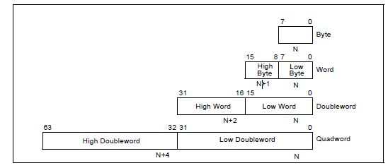
Fundamental Data Types

Slide 44
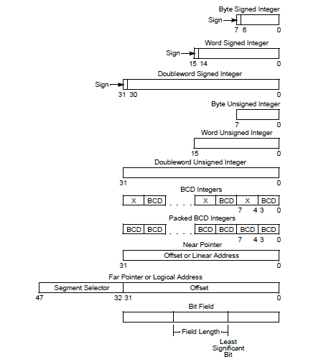

Slide 45
Instruction Set of 80386

Slide 46
Syllabus
Part B: Applications Instruction Set
Data Movement Instruction
Binary Arithmetic Instruction
Decimal Arithmetic Instruction
Logical Instruction
Control Transfer Instruction
String and Character Transfer Instruction
Flag Control Instruction
Coprocessor Interface Instruction
Segment Register Instruction
Mis. Instruction

Slide 47
Data Movement Instructions
These instructions provide convenient methods for moving bytes, words, or doublewords of data between memory and the registers of the base architecture.
They fall into the following classes:
1. General-purpose data movement instructions : MOV and XCHG
2. Stack manipulation instructions : PUSH, POP, PUSHA and POPA
3. Type-conversion instructions : CWD, CDQ CBW, CWDE, MOVSX and MOVZX

Slide 48
Binary Arithmetic Instructions
The arithmetic instructions of the 80386 processor simplify the manipulation of numeric data that is encoded in binary.
Operations include the standard add, subtract, multiply, and divide as well as increment, decrement, compare, and change sign.
Both signed and unsigned binary integers are supported. T
he binary arithmetic instructions may also be used as one step in the process of performing arithmetic on decimal integers.
1. Addition instructions : ADD, ADC, INC, AAA, and DAA.
2. Subtraction instructions SUB, SBB, DEC, AAS, DAS, CMP, and NEG
3. Comparison and Sign Change Instruction: CMP and NEG
4. Multiplication Instructions : MUL and IMUL
5. Division Instructions : DIV and IDIV

Slide 49
Decimal Arithmetic Instructions
TThe decimal arithmetic instructions are classified as :
1. Packed BCD Adjustment Instructions : DAA and DAS
2. Unpacked BCD Adjustment Instructions : AAA, AAS, AAM and AAD

Slide 50
Logical Instructions
The group of logical instructions includes:
1. The Boolean operation instructions : AND, OR, XOR and NOT
2. Bit test and modify instructions : BIT, BTS, BTR and BTC
3. Bit scan instructions : BSF and BSR
4. Shift instructions : SAL, SHL, SAR, SHR, SHLD and SHRD
5. Rotate instructions : ROL, ROR, RCL and RCR
6. Byte set on condition : SETcc
7. Test Instruction : TEST

Slide 51
Control Transfer Instructions
The 80386 provides both conditional and unconditional control transfer instructions to
direct the flow of execution. Conditional control transfers depend on the results of operations that affect the flag register. Unconditional control transfers are always executed.
1. Jump Instruction : JMP
2. Call Instruction : CALL
3. Return and Return-From-Interrupt Instruction : RET and IRET
4. Unsigned Conditional Transfers : JA/JNBE, JAE/JNB, JB/JNAE, JBE/JNA, JC, JE/JZ, JNE/JNZ,JNP/JPO and JP/JPE
5. Signed Conditional Transfers : JG/JNLE, JGE/JNL, JL/JNGE, JLE/JNG, JNO, JO
and JS
6. Loop Instructions : LOOP, LOOPE and LOOPNE
7. Executing a Loop or Repeat Zero Times : JCXZ
8. Software-Generated Interrupts : INT n, INTO, and BOUND

Slide 52
String and Character Translation Instructions
A set of primitive string operations : MOVS, CMPS, SCAS, LOOS and STOS
Control flag instructions: CLD and STD
Repeat prefixes : REP, REPE/REPZ, REPNE/REPNZ
Flag Control Instructions
The flag control instructions provide a method for directly changing the state of bits
the flag register.
1. Carry and Direction Flag Control Instructions : STC, CLC, CMC, CLD and STD
2. Flag Transfer Instructions : LAHF, SAHF, PUSHF and POPF

Slide 53
Segment Register Instructions
The instructions that deal with segment registers are
1. Segment-register transfer instructions : MOV SegReg, ... , MOV ... , SegReg, PUSH
SegReg and POP SegReg
2. Control transfers to another executable segment : JMP far, CALL far and RET far 3. Data pointer instructions : LOS, LES, LFS, LGS and LSS
3. Interrupt-related instructions capable of transferring control to another segment
INT n, INTO, BOUND and IRET

