Slide 1

Enhancing Mental Health Support in Online Communities

Slide 2

Problems of mental health related to online communities.

Slide 3

Mental Health Issues:
Inadequacy about your life or appearance.
Isolation.
Depression and anxiety.
Cyberbullying.
Self-absorption.
A fear of missing out (FOMO) can keep you returning to social media over and over again.
A false sense of connection.

Slide 4
Addiction or Dependence
Why is staying off social media hard?
Why do we stay on social media?

Slide 5

Why I chose this topic:
Growing Need: With the increasing use of online platforms, more people are seeking and sharing mental health experiences online. This creates a need for better support systems in these virtual spaces.
Impact Potential: By improving mental health support online, you can potentially reach and positively impact a large and diverse group of individuals who might not have access to traditional mental health resources.
Data Availability: Online communities generate a vast amount of data, providing a rich resource for understanding mental health trends and needs, and for developing targeted support strategies.
Technological Innovation: This area offers the opportunity to apply innovative technologies like data science and machine learning to make a meaningful difference in public health and well-being.

Slide 6
Overview:
Dataset: https://www.kaggle.com/datasets/kreeshrajani/human-stress-prediction
Exploratory Data Analysis (EDA)
Data Preprocessing and Cleaning
Feature Engineering and Selection
Model Training
Model Evaluation and Tuning
PCA , Classification report and confusion matrix.
Insights and Conclusions

Slide 7
Summary of key information about dataset:
Dataset Overview:
Shape: The dataset contains 2,838 entries and 7 columns.
Columns:
subreddit: The name of the subreddit where the post was made.
post_id: A unique identifier for the post.
sentence_range: The range of sentences in the post being analyzed.
text: The actual text content of the post.
label: A binary label indicating stress (1) or no stress (0).
confidence: A confidence score for the stress label.
social_timestamp: The timestamp of the post.

Slide 8
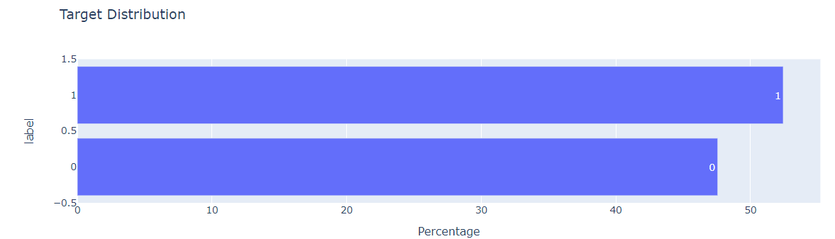
Visualizing Target Distribution:

Slide 9
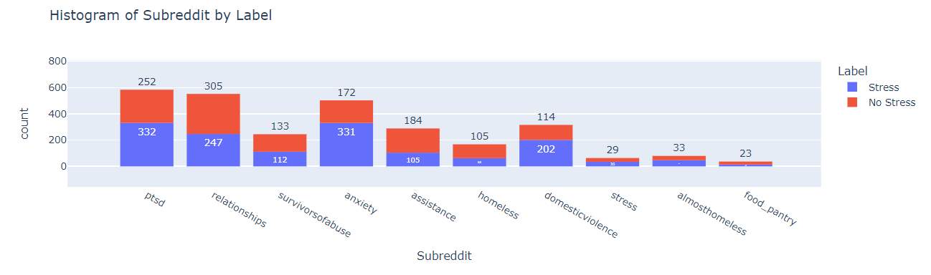
Histogram of subreddit by label:

Slide 10
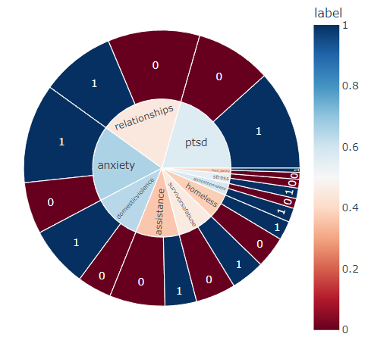
Sunburst Chart of Subreddit and Label Distribution

Slide 11
Text Preprocessing:
text = text.lower(): Converts all characters in the text to lowercase.
text = re.sub('\[.*?\]', '', text): Uses a regular expression to remove text within square brackets.
text = re.sub("\\W"," ",text): Replaces any non-word characters (anything other than letters and numbers) with a space.
text = re.sub('https?://\S+|www\.\S+', '', text): Removes URLs from the text, which are not necessary for most NLP tasks.
text = re.sub('<.*?>+', '', text): Removes HTML tags, which are common in text scraped from the web but are usually irrelevant to text analysis.
text = re.sub('[%s]' % re.escape(string.punctuation), '', text): Strips all punctuation from the text.
text = re.sub('\n', '', text): Removes newline characters from the text.
text = re.sub('\w*\d\w*', '', text): Removes words containing numbers.

Slide 12
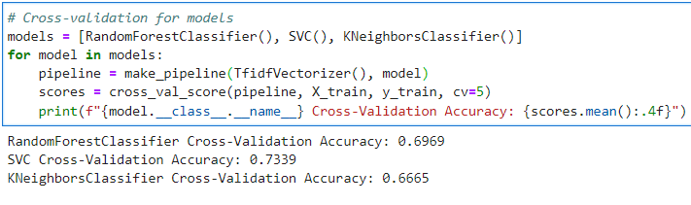
Model Training and cross validation
X = data['text'] is featured variable
y = data['label'] is target variable
Three different machine learning models are used: Randomforestclassifer, SVC (Support Vector Classifier), and KNeighboursClassifier.
For each model, a pipeline is created using make_pipeline.
The pipeline includes TfidfVectorzier followed by the model itself.
TfidfVectorzier is a feature extraction method that converts text data into a matrix.

Slide 13
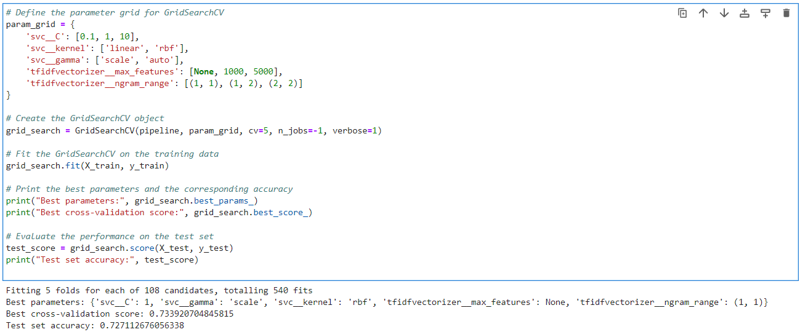
Hyperparameter tuning and grid search cv:
Optimizing the performance and systematically searches for the best model parameters, ensuring that your model is as effective as possible.
This approach is fundamental in machine learning to avoid overfitting and to enhance the model's ability to generalize to new, unseen data.

Slide 14
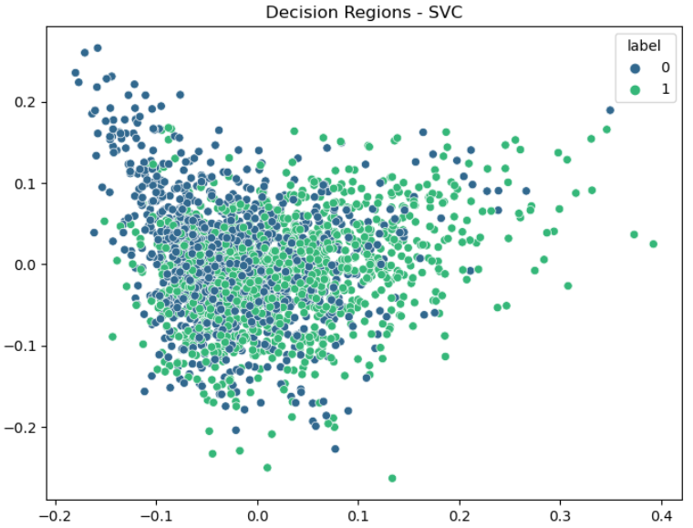
Principal Component Analysis (PCA)
PCA is used here primarily for visualization purposes to understand the data distribution in a lower-dimensional space. The SVC model itself is trained on the full set of high-dimensional features.

Slide 15
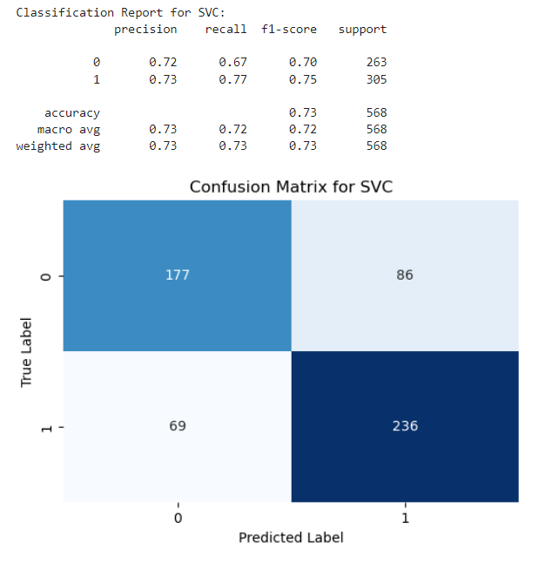
Classification report and confusion matrix:

Slide 16
Overall Interpretation:
The model has a moderate overall accuracy of 73%.
It's better at identifying class 1 instances (higher recall for class 1).
The precision is relatively balanced between the two classes.
There's a reasonably good balance between precision and recall, as evidenced by the F1-scores.
The confusion matrix visualizes the distribution of predictions, showing where the model makes correct predictions and where it errs.

Slide 17
Solution of this problem:
Sentiment Analysis: Machine learning algorithms can be trained to analyze the sentiment of users' posts in online communities. This helps in identifying negative or harmful content, potentially signaling individuals who may need mental health support.
Predictive Analysis: By analyzing historical data, machine learning models can predict potential mental health crises before they occur, allowing for timely intervention.
Overall, the goal is to use machine learning to create online communities that are supportive, safe, and responsive to the mental health needs of their members. However, it's important to balance the use of technology with human oversight and to respect privacy and ethical considerations.

Slide 18

Thank You And Merry Christmas

