Slide 1

Project Presentation
on
LectraAI: An AI-Powered Lecture Intelligence and Personalized Learning Platform
SESSION 2026-27 | COURSE: BCS 753
Department of Information Technology
ABES Engineering College, Ghaziabad
Team Members:
Lakshay Anand (Roll No: 2300320130137, IT-D)
Harshit Chaudhary (Roll No: 2300320130113, IT-D)
Ayush Mavi (Roll No: 2300320130078, IT-D)
Guided By:
Ms. Shivani Garg
Assistant Professor
Department of CSE-AIML

Slide 2

Contents
01. Problem Statement
Problems in studying from long video lectures
02. Project Objectives
Main goals and deliverables of LectraAI
03. Updated Methodology
5-stage step-by-step system pipeline
04. System Architecture
System modules and technology stack
05. Dataset & Experimental Setup
7 real CS lectures and evaluation baselines
06. Implementation Progress
Completed modules and current progress
07. Working Demonstration
Live web app, study pack and PDF export
08. Preliminary Results
Clear findings across RQ1, RQ2, RQ3, and RQ4
09. Research Paper Submission Status
Status of completed IEEE research paper
10. Remaining Work & Timeline
Future evaluation and cloud deployment plans
11. Challenges & Solutions
Technical problems faced and how we solved them
12. References
Standard academic references in IEEE format
Department of IT | Review-2 | ABES Engineering College

Slide 3
Problem Statement
1. Finding Important Parts of Long Lectures Takes Time
• Students spend hours scrubbing through recorded lectures to find specific concepts or formulas.
• Re-watching long videos during revision is slow and causes study fatigue.
2. Simple Summaries Do Not Provide Enough Study Material
• Standard AI tools generate flat text paragraphs that are not enough for exam preparation.
• Students need different study materials: organized notes, quizzes, flashcards, and interview questions.
3. Using Many AI Calls Increases Processing Time and Cost
• Making separate AI calls for notes, quizzes, and flashcards takes too much time and API quota.
• Multiple AI calls also increase the risk of inconsistent or contradictory information.
4. AI-Generated Timestamps Can Sometimes Be Incorrect
• Many AI tools make up timestamps or guess video times that do not match the actual lecture.
• Students need trustworthy timestamps so they can jump straight to the exact moment in the video.
Summary: LectraAI solves these problems by converting a lecture into structured study material with useful timestamps.
Department of IT | Review-2 | ABES Engineering College

Slide 4
Project Objectives
Objective 1: Collect Transcripts Reliably from YouTube
• Download lecture captions automatically using a reliable dual-method approach, and mark timestamps at regular intervals.
Objective 2: Generate Clear Study Notes Using One AI Call
• Use a single AI call with strict instructions so the notes are accurate and stick strictly to what the teacher explained.
Objective 3: Connect Topics with Valid Lecture Timestamps
• Match key topics to real points in the lecture video so students can click and jump directly to that part of the video.
Objective 4: Create Quizzes, Flashcards & Practice Questions
• Automatically build quizzes, flashcards, a 5-stage revision plan, and interview questions directly from the notes without extra AI calls.
Objective 5: Provide a Full Web Application with PDF Export
• Deliver all features through a clean, responsive web dashboard where students can read notes, take quizzes, and download printable A4 PDFs.
Department of IT | Review-2 | ABES Engineering College

Slide 5
Updated Methodology
Stage 1: Lecture Input & Task Creation
• User enters a YouTube lecture URL on the web dashboard.
• System creates a background task and immediately checks if a cached copy already exists.
Stage 2: Transcript Extraction
• System automatically downloads the lecture subtitles from YouTube.
• Cleans up spoken fillers and adds regular timestamp markers throughout the transcript.
Stage 3: AI Note Generation
• One Gemini AI call creates well-structured study notes (overview, core concepts, diagrams, and tables).
• The AI is given strict instructions to write notes based only on the lecture transcript.
Stage 4: Study Material Generation
• The generated notes are used to create: topics, timestamps, quiz questions, flashcards, revision plan, and interview questions.
• No extra AI call is needed for these outputs — saving time and API cost.
Stage 5: Study Pack & PDF Export
• All generated materials are combined into one unified study pack.
• The user can view them in interactive web workspaces and download a clean A4 PDF.
Department of IT | Review-2 | ABES Engineering College

Slide 6
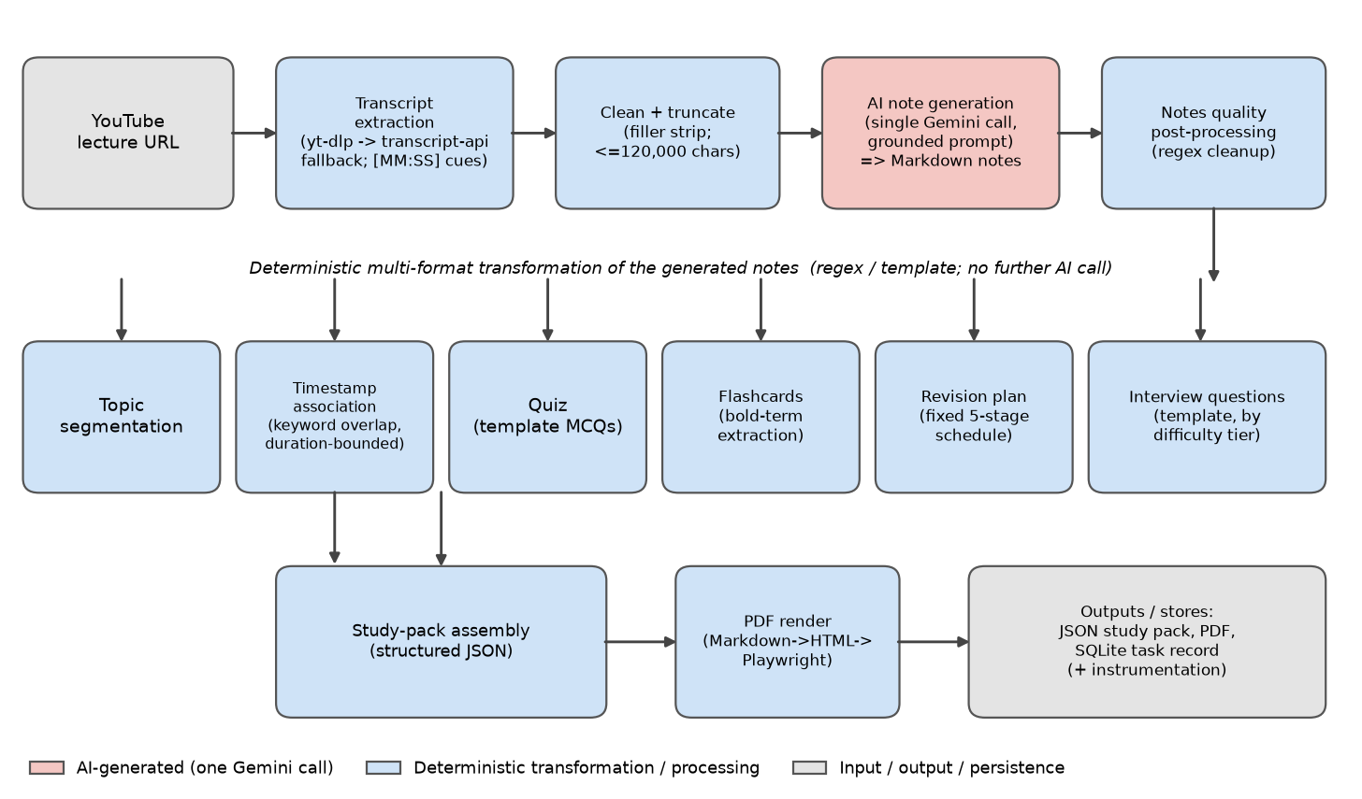
System Architecture
System Modules
• Lecture Input: User submits a YouTube lecture link on the web interface.
• Transcript Extraction: Downloads subtitles and adds timestamp markers at regular intervals.
• AI Processing: One Gemini AI call generates clean, structured study notes.
• Study Material Engine: Creates topics, timestamps, quiz, flashcards, revision, and interview questions from the notes.
• Database: Stores background task status (pending, processing, completed, failed).
• PDF Engine: Converts study material into a printable A4 PDF.
Technology Stack:
- Frontend: React 19, Vite, Tailwind CSS / Vanilla CSS, Mermaid.js
- Backend: Python 3.10+, FastAPI, Uvicorn, SQLite3
- AI Model: Google Gemini API (gemini-3.6-flash)
- PDF Compiler: Playwright (Headless Chromium)
Fig. 1: LectraAI pipeline architecture (Pink: Single AI call; Blue: Automated transformation; Grey: I/O & storage).
Department of IT | Review-2 | ABES Engineering College

Slide 7
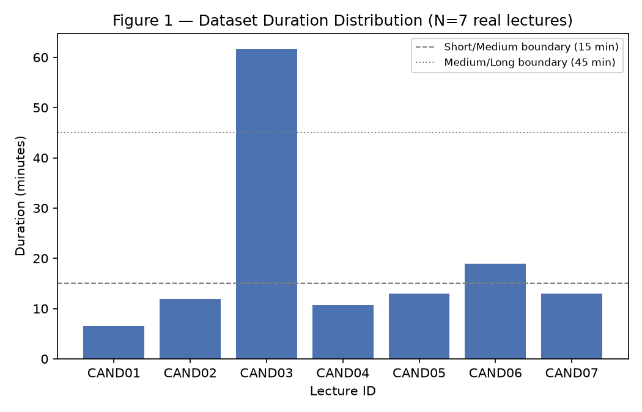
Dataset & Experimental Setup
Tested Dataset (N = 7 Real CS Lectures)
• 7 real Computer Science lectures from YouTube were tested.
• Subjects covered: Operating Systems, Computer Networks, DBMS, and Artificial Intelligence.
• Lecture formats included comparison, architecture, algorithms, and theory.
• Lecture length ranged from 6.5 to 61.7 minutes (Average length: ~19.4 minutes).
• Transcripts ranged from about 5,300 to 59,800 characters.
• All lectures were in English.
• Google Gemini 3.6 Flash was used for all note generations (0 failures, 0 fallbacks).
Research Comparison Baselines:
- Equal-Interval Baseline: Places timestamps evenly across the lecture video.
- Direct AI Baseline: Generates quizzes and flashcards using separate AI calls.
- Unconstrained Prompt: Tests notes generated without strict grounding instructions.
- Excluded Baseline: Traditional text summarizer (failed on spoken lecture transcripts).
Fig. 2: Duration distribution of the seven tested CS lectures.
Department of IT | Review-2 | ABES Engineering College

Slide 8
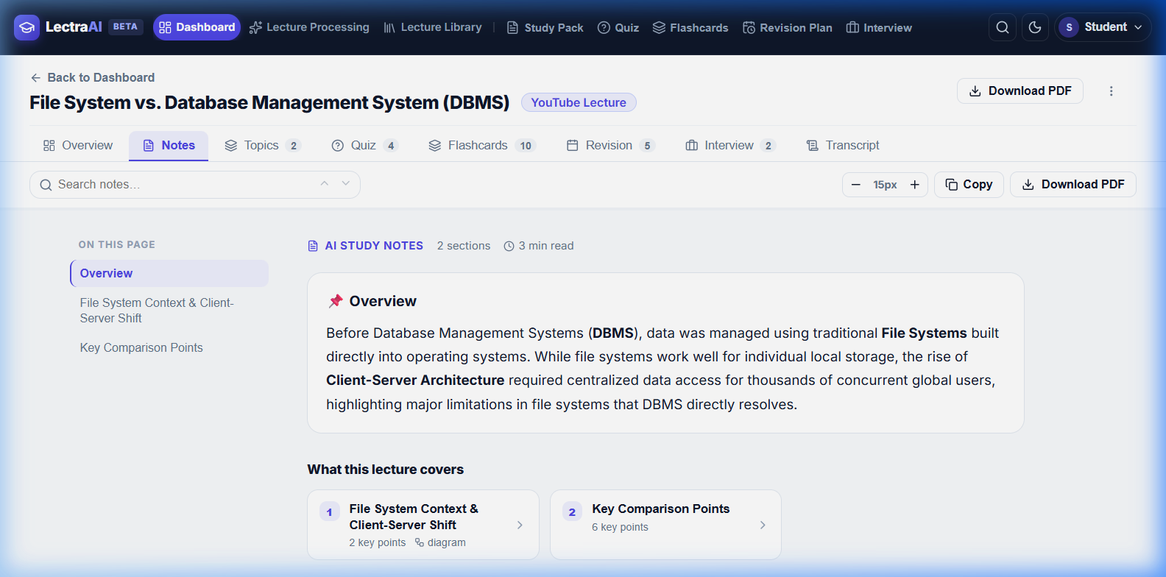
Implementation Progress
Completed Modules:
✓ Transcript extraction from YouTube videos
✓ AI-based note generation using one Gemini call
✓ Topic and timestamp generation for key moments
✓ Quiz and flashcard generation from notes
✓ Revision plan and interview questions generator
✓ Printable A4 PDF generation using Playwright
✓ Background task processing with SQLite storage
✓ React-based web dashboard with dark and light themes
Evaluation Setup Completed:
✓ Human evaluation forms and instructions prepared for all 7 lectures.
✓ Automated unit tests completed for backend and timestamp logic.
Fig. 3: LectraAI Study Notes screen with explanations, diagrams, and math formulas.
Department of IT | Review-2 | ABES Engineering College

Slide 9
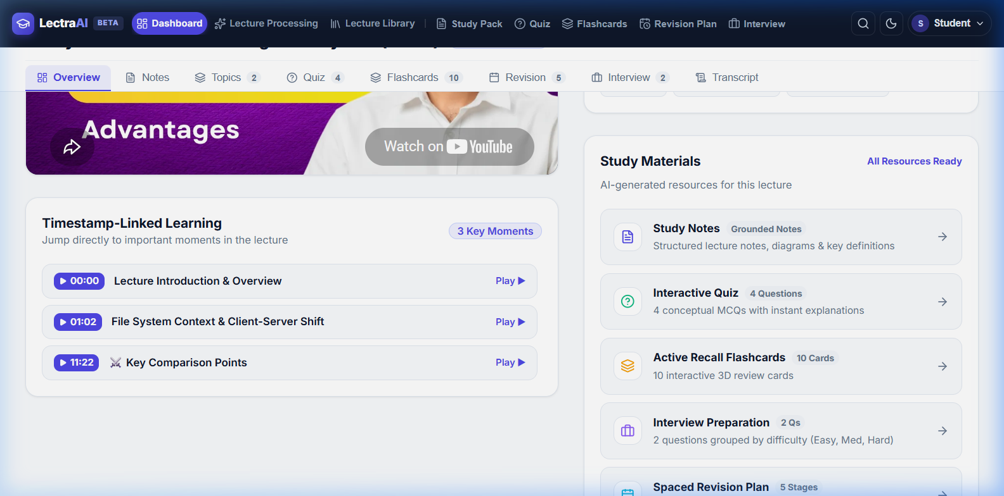
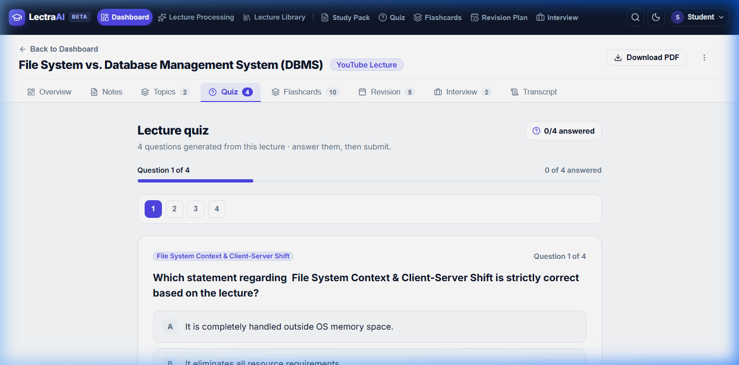
Working Demonstration
Overview Screen: Video details, processing status & key lecture moments
Interactive Quiz Screen: Multiple-choice questions with instant scoring
Simple User Steps: 1. Enter YouTube URL → 2. Process the lecture → 3. View notes & timestamps → 4. Practice Quiz & Flashcards → 5. Download PDF
Study Materials Provided: Comprehensive Study Notes • Interactive Quiz • Active Flashcards • 5-Stage Revision Timeline • Interview Prep
Department of IT | Review-2 | ABES Engineering College

Slide 10
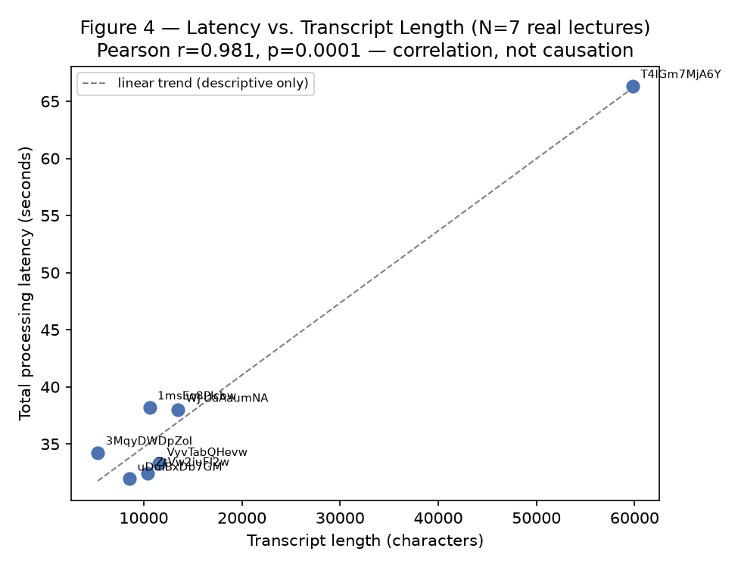
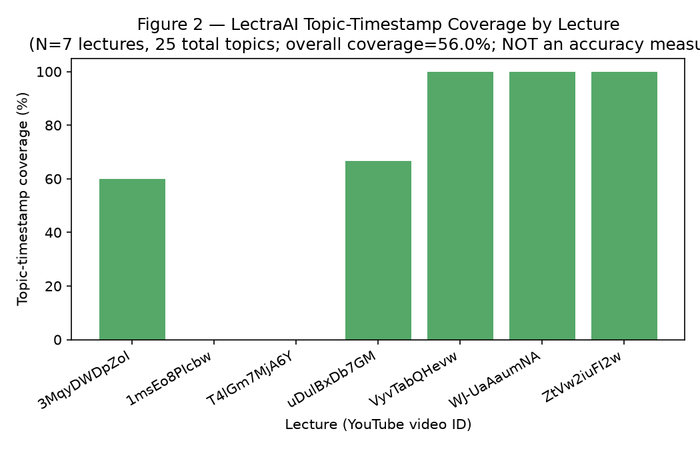
Preliminary Results (RQ1–RQ4 Analysis)
RQ1 — Topic & Timestamp Matching
• 56% of topics received timestamps (14 of 25 topics).
Result: Not enough human data to confirm timestamp accuracy (INCONCLUSIVE).
• Average difference from simple even spacing was 147.3 seconds.
• Two lectures received zero timestamps due to strict matching rules.
RQ2 — Quiz & Flashcard Quality
• Deterministic quiz: 44.4% unique options | Direct AI quiz: 100% unique options.
Result: More testing with humans is needed for quality (INCONCLUSIVE).
• Flashcard answers match notes exactly (100%), while direct AI paraphrases (11.1%).
RQ3 — Note Grounding (Sticking to Transcript)
• Human evaluation is still pending.
Result: Cannot make a final claim yet (INCONCLUSIVE).
• Automated text check was tested and rejected as unreliable; human testing needed.
RQ4 — Processing Time & Reliability
• Average processing time: 39.21 seconds | Failures: 0 out of 7.
Result: System is fast and reliable for tested lectures (SUPPORTED for N = 7).
• Strong relationship with transcript length (r = 0.98). AI note generation takes ~58% of time.
Key Takeaway: LectraAI processes the tested lectures reliably, but human evaluation is still needed for content quality and timestamp accuracy.
Department of IT | Review-2 | ABES Engineering College

Slide 11
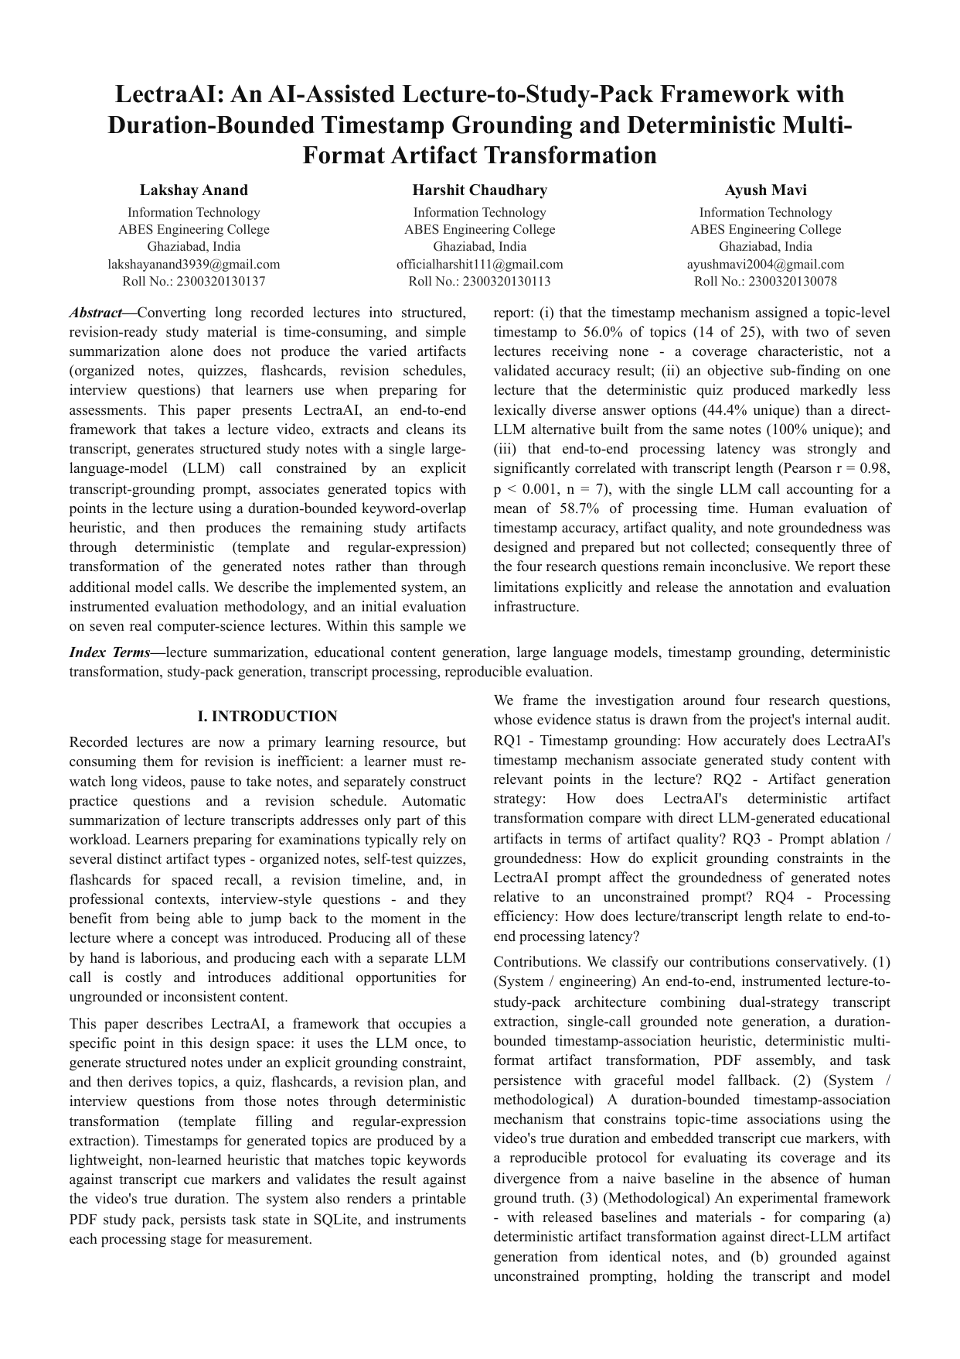
Research Paper Submission Status
Research Paper Status
✓ Paper Prepared
• Full research manuscript written in standard IEEE two-column format.
• Exactly 6 pages complete with 6 figures, 4 tables, and 19 references.
• Formats generated: PDF, Word (.docx), LaTeX (.tex), and Markdown.
✓ Faculty Guide Reviewed and Approved
• Thoroughly reviewed and approved by project guide: Ms. Shivani Garg (Assistant Professor, Department of CE/IT, ABES Engineering College).
• System methodology and honest evaluation reporting verified.
→ Conference/Journal Submission: Pending
• The research paper is completed and approved by the project guide.
• External submission is still pending and will follow the college review process.
• (No submission ID or conference name finalized yet).
Research Paper Title:
"LectraAI: An AI-Assisted Lecture-to-Study-Pack Framework with Duration-Bounded Timestamp Grounding and Deterministic Multi-Format Artifact Transformation"
Authors: Lakshay Anand, Harshit Chaudhary, Ayush Mavi
Completed IEEE Paper (Page 1 of 6)
Department of IT | Review-2 | ABES Engineering College

Slide 12
Remaining Work & Future Timeline
1. Collect Human Ratings for Timestamp Accuracy
• Have students and teachers verify if topic timestamps accurately match what is being taught in the video.
2. Test the System on 18–20 Lectures
• Expand the test set from 7 lectures to 18–20 lectures across more computer science subjects.
3. Add More Coding and Numerical Lectures
• Include programming tutorials and math-heavy lectures to test how well the system handles code and formulas.
4. Improve Timestamps for Acronym-Heavy Lectures
• Improve matching for lectures with many short technical abbreviations (such as OSI model layers or AI algorithms).
5. Improve Quiz Option Generation
• Make wrong quiz options more topic-specific and realistic so quizzes provide better revision value.
6. Move from Local SQLite to Cloud PostgreSQL
• Upgrade the database to support multiple users simultaneously with secure account management.
7. Deploy the System on Cloud Infrastructure
• Package the web application in Docker containers and host it online for public student access.
Department of IT | Review-2 | ABES Engineering College

Slide 13
Challenges & Solutions
Challenge: Lecture transcripts often have poor punctuation.
• Problem: Spoken speech from YouTube lacks full stops and commas, which breaks normal text summarizers.
• Solution: Use AI to understand and structure the raw transcript directly.
Challenge: Long lectures can cause API timeouts.
• Problem: Processing a 60-minute lecture takes time, which can cause the web page to time out or freeze.
• Solution: Process lectures in the background and reuse cached results.
Challenge: Some technical lectures produce poor timestamps.
• Problem: Lectures with many short abbreviations (like OSI layers) did not match keyword rules, giving 0% coverage on 2 lectures.
• Solution: Keep timestamps strictly within the lecture duration, and improve matching in future work.
Challenge: Some quiz options were too similar.
• Problem: Using fixed templates meant some incorrect options were repeated across different questions.
• Solution: Documented this clearly in the paper, and will use topic-based option generation in future work.
Department of IT | Review-2 | ABES Engineering College

Slide 14
References
[1] E. Apostolidis, E. Adamantidou, A. I. Metsai, V. Mezaris, and I. Patras, 'Video summarization using deep neural networks: A survey,' arXiv:2101.06072, 2021.
[2] D. W. Lee, C. Ahuja, P. P. Liang, S. Natu, and L.-P. Morency, 'Multimodal lecture presentations dataset: Understanding multimodality in educational slides,' in Proc. IEEE/CVF ICCV, 2023.
[3] C. Xu, R. Wang, S. Lin, X. Luo, B. Zhao, L. Shao, and M. Hu, 'Lecture2Note: Automatic generation of lecture notes from slide-based educational videos,' in Proc. IEEE ICME, 2019, pp. 898–903.
[4] T. Shahzad, T. Mazhar, M. U. Tariq, W. Ahmad, K. Ouahada, and H. Hamam, 'A comprehensive review of large language models: Issues and solutions in learning environments,' Discover Sustainability, Springer, 2025.
[5] J. Lin, J. Rao, Y. Zhao, Y. Wang, A. Gurung, A. Barany, J. Ocumpaugh, R. S. Baker, and K. R. Koedinger, 'Automatic large language models creation of interactive learning lessons,' arXiv:2506.17356, 2025.
[6] N. Scaria, S. D. Chenna, and D. Subramani, 'Automated educational question generation at different Bloom's skill levels using large language models: Strategies and evaluation,' in Proc. AIED, 2024.
[7] E. Alhazmi, Q. Z. Sheng, W. E. Zhang, M. Zaib, and A. Alhazmi, 'Distractor generation in multiple-choice tasks: A survey of methods, datasets, and evaluation,' in Proc. EMNLP, 2024.
[8] B. Tabibian, U. Upadhyay, A. De, A. Zarezade, B. Schölkopf, and M. Gomez-Rodriguez, 'Enhancing human learning via spaced repetition optimization,' Proc. National Academy of Sciences (PNAS), vol. 116, no. 10, pp. 3988–3993, 2019.
[9] H. Zhang, A. Sun, W. Jing, and J. T. Zhou, 'Temporal sentence grounding in videos: A survey and future directions,' IEEE Trans. Pattern Analysis and Machine Intelligence, 2023.
[10] R. Zhao, Z. Jiang, X. Zhang, C. Chang, H. Chen, W. Deng, L. Jin, X. Qi, X. Qian, and E. C. H. Ngai, 'NoteIt: A system converting instructional videos to interactable notes through multimodal video understanding,' in Proc. ACM UIST, 2025.
Department of IT | Review-2 | ABES Engineering College

