Slide 1


知汇：企业知识管理系统
第六组 杨佳兴 吴亚南 赖智垣

Slide 2















Pitch Deck 2025
What is Quantum Computing?
Feature
Classical Computing
Quantum Computing
Traditional computers process data using bits (0s and 1s), while quantum computers use qubits, which leverage superposition and entanglement to perform complex calculations much faster.
Data Representation
Uses bits (0 or 1)
Qubits (0, 1, or both)
Processing
Sequential tasks
Parallel processing
Accessibility
Limited access for SMEs
Exponentially faster
Security
Regulated but centralized
Higher errors, needs stability
Innovation
General computing, business apps
AI, cryptography, simulations

Slide 3


Pitch Deck 2025
History & Evolution of Quantum Computing
2019-Present
Google achieves quantum supremacy, industry scales quantum processors.
Overview of key milestones in quantum computing, from early theoretical foundations to modern advancements.
2000s
Superconducting qubits enable experimental quantum computers.
1994s
Shor’s Algorithm proves quantum advantage in cryptography.
1950s-1980s
Quantum theory applied, Richard Feynman proposes quantum computing.
Illustrates the evolution of quantum computing, marking breakthroughs in quantum algorithms, superconducting qubits, and industrial applications.

Slide 4
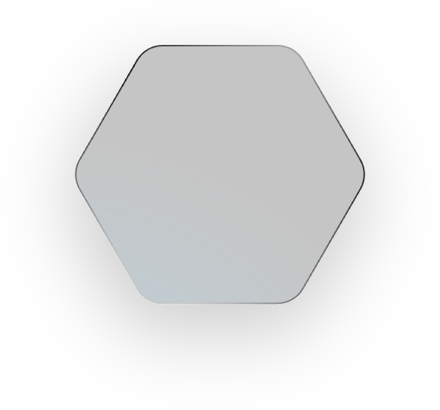



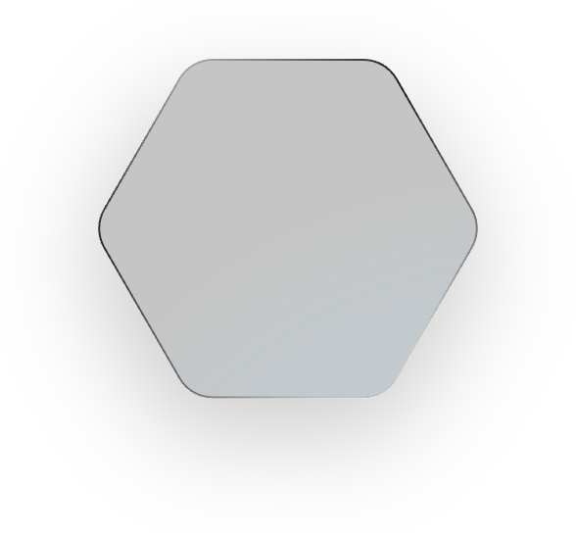












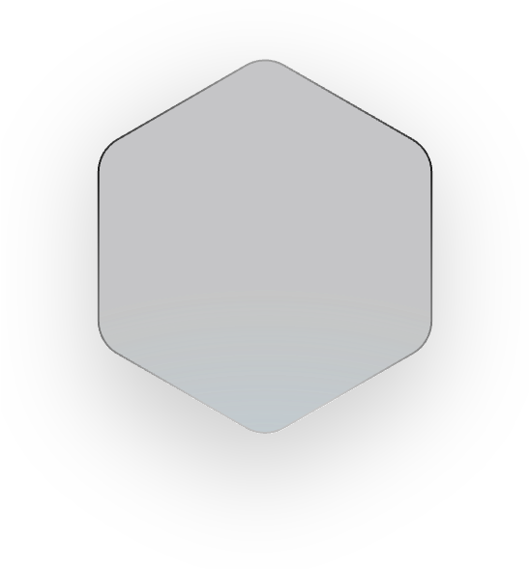




Pitch Deck 2025
Why Quantum Computing Matters?
Classical computers struggle with highly complex calculations that involve massive datasets and exponential variables. Quantum computing unlocks new possibilities by solving these problems exponentially faster.
Cryptography
Strengthens encryption, breaking classical methods.
Drug Discovery
Speeds up molecular simulations for new medicines.
Financial Modeling
Improves risk analysis, fraud detection, and forecasting.
Materials Science
Optimizes superconductors and battery design.
Artificial Intelligence
Speeds up machine learning and optimizations.

Slide 5



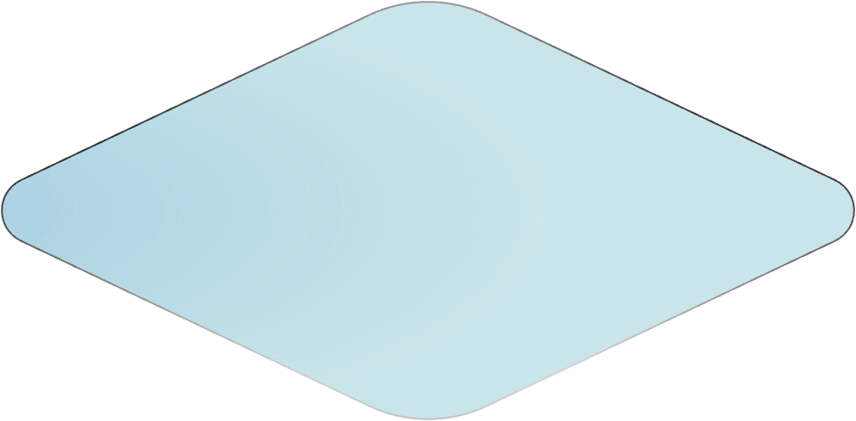
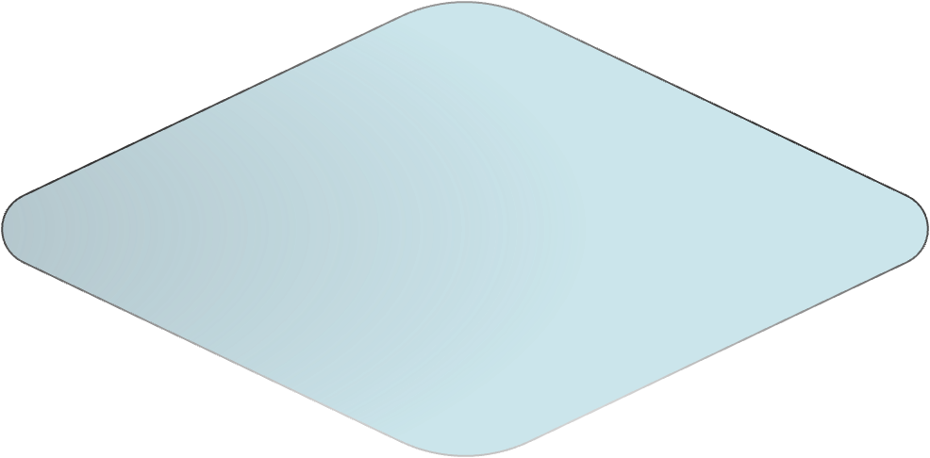
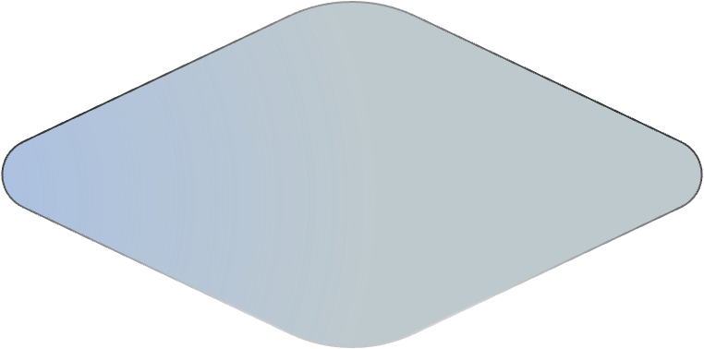


Pitch Deck 2025
Key Principles of Quantum Computing
Quantum computers operate using fundamental quantum mechanics principles that differentiate them from classical computers.
Superposition
Superposition
Qubits exist in multiple states (0 & 1) simultaneously, enabling massive parallelism.
Entanglement
Entanglement
Interconnected qubits affect each other instantly, improving computational efficiency.
Quantum Gates
Quantum Gates
Special quantum operations (Hadamard, Pauli, CNOT) manipulate qubits for computations.

Slide 6



Pitch Deck 2025
Superposition & Entanglement: The Core of Quantum Computing
Quantum computing is fundamentally different from classical computing because of two key principles: superposition and entanglement.
Superposition
Entanglement
Unlike classical bits (0 or 1), qubits can be 0, 1, or both at the same time, enabling exponential computational power.
Two or more qubits become interdependent, meaning a change in one instantly affects the other, no matter the distance.
Superposition
Entanglement

Slide 7


Pitch Deck 2025
Quantum Computing vs. Classical Computing
Classical Computing
Quantum Computing
Traditional computers process data using bits (0s and 1s), while quantum computers use qubits, which leverage superposition and entanglement to perform complex calculations much faster.
Classical computers handle one operation at a time, limiting speed.
Quantum computers process multiple calculations, enabling parallelism.
Slow Computational Speed.
Provide exponential speed-ups for complex problems like cryptography, simulations, and AI.
These comparison showing how quantum computing surpasses classical computing in speed, power, and efficiency.
Struggle with highly complex computations.
Quantum computing excels at optimization problems.

Slide 8





Pitch Deck 2025
Four Major Quantum Computing Architectures
Different types of quantum computers utilize unique architectures to process qubits, each with distinct advantages and applications.
Superconducting Qubits
Superconducting Qubits - Use cryogenically cooled circuits for high-speed processing (IBM, Google).
Trapped Ion Qubits
Photonic Qubits
Trapped Ion Qubits - Manipulate ions with lasers for high coherence times (IonQ, Honeywell).
Topological Qubits
Photonic Qubits - Use light-based qubits for scalable and low-energy computing (PsiQuantum).
Topological Qubits - Error-resistant qubits based on exotic quantum states (Microsoft).

Slide 9





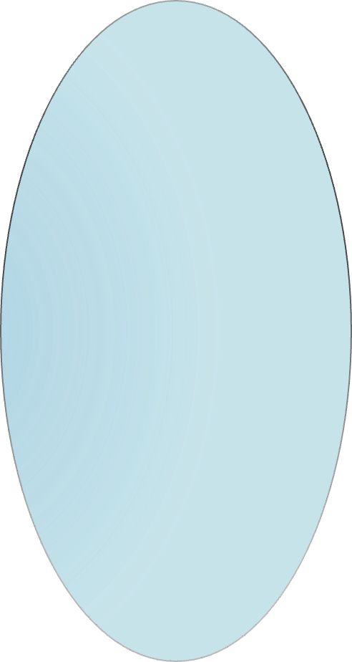
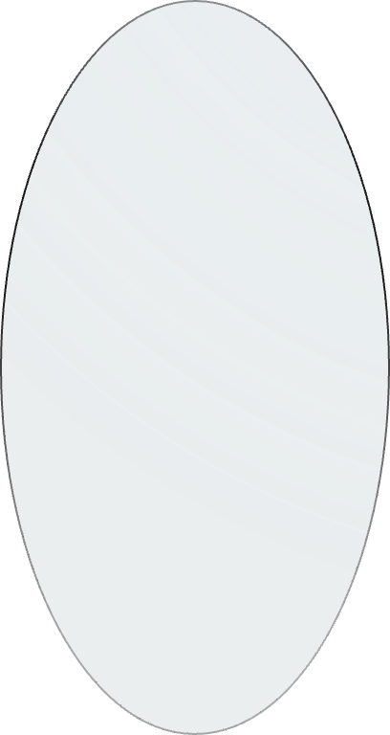
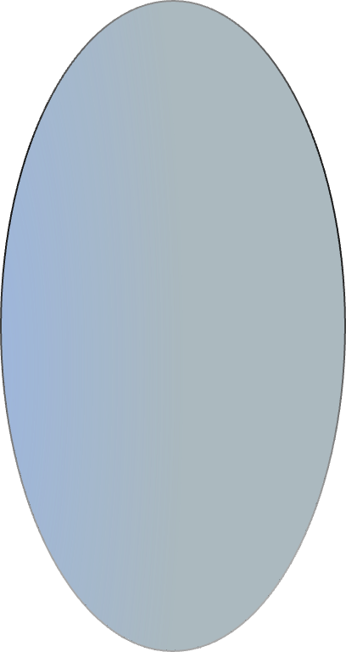
Pitch Deck 2025
Hardware Challenges in Quantum Computing
Despite its potential, quantum computing faces significant hardware limitations that must be overcome for practical applications.
Decoherence
Qubits lose information quickly due to environmental interference.
Qubit Stability
Maintaining quantum states requires extreme precision.
High Error Rates
Quantum gates introduce computational errors over time.
Scalability
Expanding quantum processors without increasing noise is difficult.

Slide 10

Pitch Deck 2025
What is Quantum Supremacy?
Quantum supremacy refers to the moment when a quantum computer performs a task beyond the capability of classical supercomputers.
Google’s 2019 Breakthrough:
The 53-qubit Sycamore processor solved a complex problem in 200 seconds that would take the best supercomputer 10,000 years.
This milestone proved quantum computing's exponential advantage over classical systems.
53
qubit
Solved complex problem
200
Sycamore processor
seconds

Slide 11


Pitch Deck 2025
Quantum Algorithms Shor’s & Grover’s
Shor’s and Grover’s algorithms highlight quantum computing’s vast potential in cryptography, AI, and beyond.
Quantum computing enables powerful algorithms that surpass classical methods in solving complex problems.
Shor’s Algorithm (1994)
Grover’s Algorithm (1996)
Breaks RSA encryption by factoring large numbers exponentially faster than classical computers.
Could render current cryptographic systems obsolete
Speeds up unstructured search from O(N) to O(√N), making searches exponentially faster.
Useful in database search, AI, and optimization problems.
Why Are These Algorithms Important?
Shor’s Algorithm threatens encryption, while Grover’s speeds up AI and data. Both showcase quantum computing’s exponential power.

Slide 12


Pitch Deck 2025
The Role of Quantum Gates & Circuits
Quantum gates are the building blocks of quantum circuits, manipulating qubits to perform computations. Unlike classical logic gates (AND, OR, NOT), quantum gates operate using superposition and entanglement principles.
Toffoli Gate
(H)
Pauli Gates
(X,Y,Z)
Controlled-NOT Gate
(CNOT)
Toffoli Gate
Places a qubit into superposition (0 & 1 at the same time).
Rotate qubit states on different quantum axes.
Performs entanglement, linking two qubits.
A quantum equivalent of classical logic gates, used in computation.

Slide 13

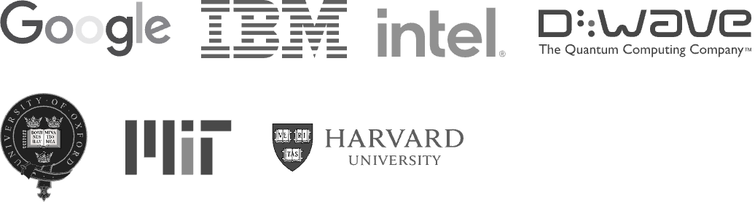
Pitch Deck 2025
Major Players in Quantum Computing
Several tech giants and research institutions are at the forefront of quantum computing, each contributing unique innovations.
Google
IBM
Intel
D-Wave
Achieved quantum supremacy with its Sycamore quantum processor (2019).
Pioneers in superconducting qubits, cloud, and quantum computing.
Developing Horse Ridge quantum chip for scalable quantum systems.
Specializes in Quantum Annealing for optimization problems.

Slide 14

Pitch Deck 2025
Quantum Computing’s Threat to Traditional Cryptography
Quantum computing poses a serious risk to modern encryption methods, as it can break cryptographic algorithms that protect sensitive data today.
To counteract quantum threats, researchers are developing new cryptographic techniques:
Shor’s Algorithm can break RSA and ECC encryption exponentially faster.
Post-Quantum Cryptography (PQC) - Classical algorithms designed to withstand quantum attacks.
Public-key cryptography (used in banking, communication, and data security) will become obsolete.
Lattice-Based Encryption - Uses complex mathematical structures resistant to quantum decryption.
Quantum Key Distribution (QKD) - Uses quantum mechanics to ensure secure communication.

Slide 15




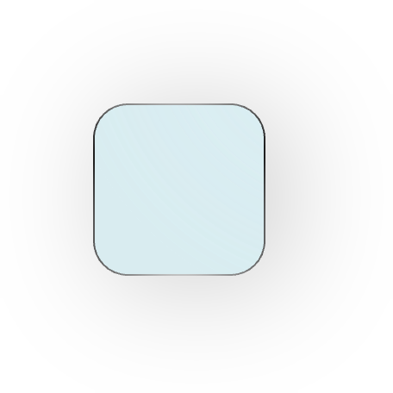

Pitch Deck 2025
How Quantum Computing Enhances AI & Machine Learning
Quantum computing revolutionizes Artificial Intelligence (AI) and Machine Learning (ML) by providing exponential speed and efficiency in processing complex data.
Quantum Neural Networks (QNNs)
Process data more efficiently than classical AI.
Faster AI Training
Quantum computing speeds up AI model optimization.
Quantum Feature Selection
Helps identify the most relevant data for machine learning.

Slide 16
Pitch Deck 2025
Applications of Quantum Computing
Finance
Enhances risk analysis, fraud detection, and portfolio optimization.
Pharmaceuticals
Accelerates drug discovery and molecular simulations.
Quantum computing is transforming various sectors by solving problems far beyond classical computing capabilities.
AI & Machine Learning
Optimizes deep learning models and big data analysis.
Materials Science
Designs superconductors, advanced batteries, and new materials.
Cybersecurity
Strengthens encryption, threat detection, and secure communications.

Slide 17




Pitch Deck 2025
The Quantum Computing Market
7.8 B
18 B
The quantum computing industry is rapidly expanding, with significant investments from tech companies, governments, and research institutions.
On 2027
On 2030
1.3 B
3.5 B
Visualizes the market’s projected growth from 2023 to 2030.
On 2023
On 2025

Slide 18




Pitch Deck 2025
Investment & Funding in Quantum Computing
Quantum computing requires substantial financial backing, with investments pouring in from venture capital, governments, and corporations.
Government Grants
Venture Capital (VC)
Corporate Investments
Governments (USA, EU, China, UK, Canada) are investing billions in national quantum initiatives.
Startups receive funding from quantum-focused VCs like Quantum Valley Investments, Andreessen Horowitz, and Sequoia Capital.
Tech giants like Google, IBM, Microsoft, Amazon, and Intel are leading quantum R&D funding.

Slide 19


Pitch Deck 2025
Ethical Considerations & Risks
Quantum computing has the potential to reshape industries but also presents serious ethical risks that must be addressed.
Privacy Threats
Potential Misuse
Economic Disruption
Quantum decryption could break current encryption standards, exposing sensitive data.
Quantum AI and computing power could be exploited for cyber threats or economic manipulation.
Industries reliant on classical cryptography and computing may face job displacement and system vulnerabilities.

Slide 20






Pitch Deck 2025
Quantum Computing and Government Regulations
Governments worldwide are investing in and regulating quantum technology to ensure secure and responsible development.
USA - National Quantum Initiative Act (NQI) (2018)
Federal investment in quantum research & workforce development.
Focus on national security and quantum cryptography.
EU - Quantum Flagship Program
€1 billion investment over 10 years to advance quantum communication and computing.
Supports academic and industrial partnerships in quantum R&D.
China - Quantum Science Satellite & National Investments
Major funding in quantum networks and satellite encryption.
Developed one of the first quantum communication networks.

Slide 21




Pitch Deck 2025
Roadmap for Quantum Computing Development
Quantum computing is expected to progress through key milestones, shaping the next decades of scientific and technological breakthroughs.
2040
2040
Widespread commercial adoption of quantum computing across industries.
2035
2035
2030
Quantum AI integration, enhancing deep learning, simulations, and optimization problems.
2025
Scalable quantum processors enable commercial applications in finance, AI, and cryptography.
Advancements in qubit stability and quantum error correction improve computational accuracy.

Slide 22
Pitch Deck 2025
Challenges to Overcome
Qubit Stability
Quantum states are fragile, leading to computational errors.
High Operational Costs
Quantum hardware requires extreme cooling and specialized environments.
Despite its potential, quantum computing faces major barriers that must be solved for widespread adoption.
Error Rates & Decoherence
Solving these challenges is crucial for making quantum computing a practical and scalable technology for the future.
Quantum systems struggle with maintaining coherence over time.
Security Risks
Quantum computing threatens traditional encryption methods.

Slide 23

Pitch Deck 2025
Future Applications & Predictions
AI & Machine Learning
Enhances deep learning, neural networks, and pattern recognition for faster AI training.
Quantum computing is expected to redefine industries by solving complex problems that classical computers cannot handle efficiently.
Quantum computing will revolutionize AI, climate science, and defense, shaping the future of innovation.
Defense & Cybersecurity
Climate Modeling
Enhances quantum encryption, secure communication, and threat detection.
Enables precise weather forecasting and climate impact predictions.

Slide 24

Pitch Deck 2025
Final Thoughts & Summary
Revolutionary Potentials
Current Limitations
Quantum computing is on the brink of revolutionizing technology, but it still faces significant hurdles before mass adoption.
Exponential Computing Power: Solves problems far beyond classical computing capabilities.
Hardware Challenges: Qubits require extreme stability and cryogenic cooling.
AI Breakthroughs: Accelerates machine learning, optimization, and deep learning.
High Costs: Quantum systems are expensive to build and maintain.
Ongoing research enhances qubit stability and error correction. Growing investments drive industry expansion. Overcoming scalability challenges is key to mainstream adoption.
Security Advancements: Enables quantum encryption for next-gen cybersecurity
Error Rates: Quantum calculations need better error correction for reliability.

Slide 25





Pitch Deck 2025
How to Get Involved in Quantum Computing Research.
There are multiple ways to contribute to and explore the field of quantum computing, from academic research to industry initiatives.
Academic Institutions
Industry Research Programs
Quantum Startups & Initiatives
MIT, Harvard, Oxford – Leading quantum computing research programs.
IBM Quantum, Google Quantum AI – Open platforms for hands-on quantum experimentation.
Government-funded projects and private companies pioneering quantum advancements.
NeuroZ
contact@neuroz.com
www.neuroz.com
Instagram.com/neuroz
Facebook.com/neuroz

