Slide 1

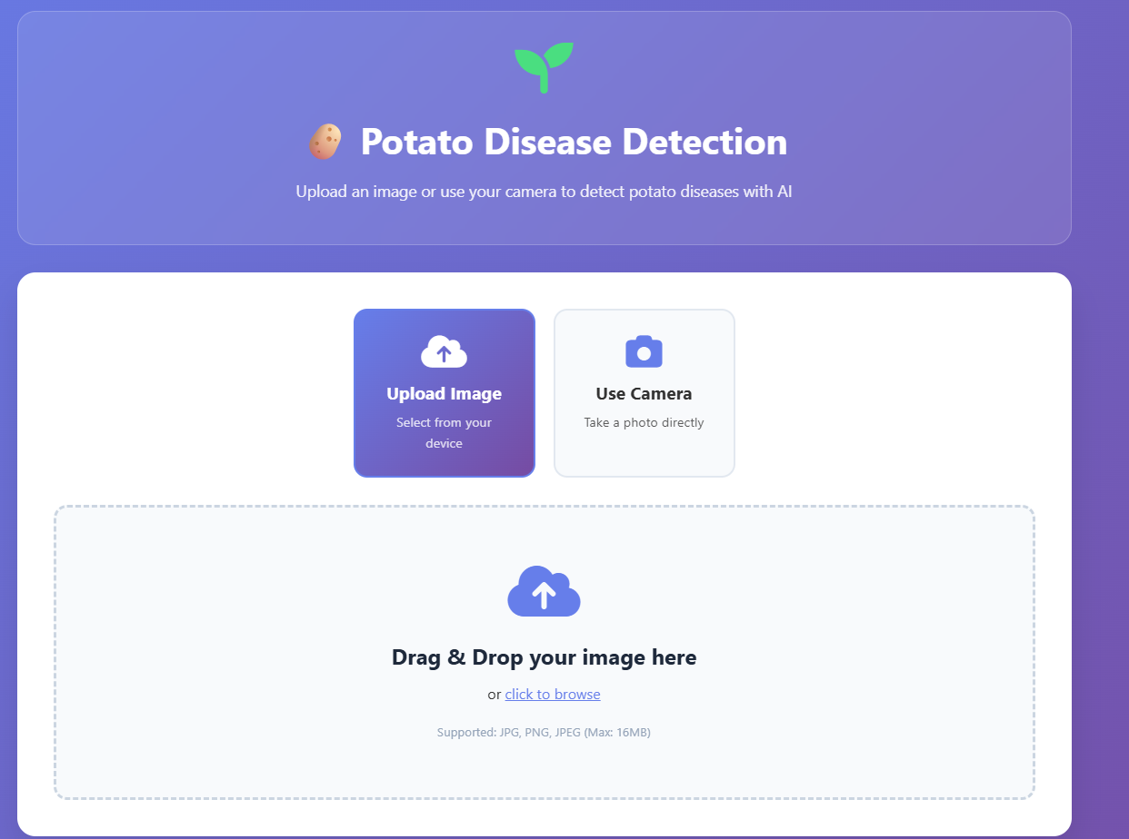

Revolutionizing Agriculture: Deep Learning for Potato Disease Detection
Represented By:-
Lucky Sharma
Deployment Link:-
https://huggingface.co/spaces/itsluckysharma01/Potato_Diseases_Detection_with_Deep_Learning

Slide 2
Potato Diseases detection Using Deep Learning
The Silent Threat: Potato Diseases
Potato diseases pose a significant global threat, causing substantial yield losses and economic damage. Annually, these diseases are responsible for 20% to 40% of potato yield loss worldwide.
Late Blight's Devastation
Challenges of Manual Detection
Late Blight, caused by the oomycete Phytophthora infestans, gained notoriety for triggering the Irish Potato Famine in the 1840s, leading to widespread starvation and mass emigration. Today, it still causes over $10 billion in global economic losses annually.
Traditional methods of disease detection rely on manual inspection, which is slow, subjective, and labor-intensive. This often leads to delayed responses, allowing diseases to spread and cause more damage before intervention.

Slide 3

Potato Diseases detection Using Deep Learning
Why Potatoes Matter: A Global Staple
Potatoes are far more than just a vegetable; they are a critical staple food for over one billion people worldwide. With global production exceeding 376 million metric tons in 2023, they play a vital role in food security.
Nutritional Powerhouse: Potatoes are an excellent source of essential nutrients, including Vitamin C, Vitamin B6, and potassium.
Economic Impact: Disease outbreaks directly threaten the livelihoods of farmers globally, particularly in developing countries where potatoes are a primary cash crop.

Slide 4





Potato Diseases detection Using Deep Learning
Deep Learning: A Powerful Ally in Agriculture
Deep learning, a specialized subfield of Artificial Intelligence, is revolutionizing how we approach complex problems by learning intricate patterns directly from data.
Data-Driven Learning
CNNs for Image Analysis
Deep learning models automatically learn representations from raw data, eliminating the need for manual feature engineering.
Convolutional Neural Networks (CNNs) are particularly adept at image recognition tasks, making them ideal for identifying plant diseases from visual data.
Automated Feature Extraction
Reduced Human Error
Deep learning automates the complex process of extracting relevant visual features, such as lesions, discoloration, and mold patterns, from images.
By automating detection, deep learning significantly reduces human error and subjectivity, ensuring consistent and reliable diagnoses.

Slide 5










Potato Diseases detection Using Deep Learning
From Pixels to Diagnosis: How Deep Learning Works
Deep learning models process images to identify and classify potato diseases, providing quick and accurate diagnoses.
Dataset Training
Models are trained on extensive datasets, such as PlantVillage, which contains over 2,000 potato images covering various diseases and healthy samples.
Image Capture
Images of potato leaves are captured using various devices like smartphones or drones, providing a visual input for the model.
Model Architectures
Common deep learning architectures like ResNet-50 and InceptionV3 are employed for their robust image classification capabilities.
Output & Confidence
The output includes the predicted disease type and a confidence score, indicating the model's certainty in its diagnosis.
Disease Identification
The models analyze images to identify subtle disease signs, including lesions, discoloration, and changes in leaf texture.

Slide 6


Potato Diseases detection Using Deep Learning
Quantifiable Benefits: Precision and Speed
Deep learning brings tangible improvements to potato disease detection, delivering high accuracy and rapid results.
95-99%
<1s
Accuracy Achieved
Real-time Detection
Deep learning models achieve remarkable accuracy for common potato diseases, often ranging from 95% to 99%.
Diagnosis often takes less than one second per image, enabling immediate action in the field.
20-30%
15-25%
Reduced Fungicide Use
Increased Yield
Early and precise detection helps farmers optimize fungicide applications, leading to a 20-30% reduction in chemical use.
By enabling timely interventions, deep learning can increase marketable yields by 15% to 25%, boosting farmer profitability.

Slide 7
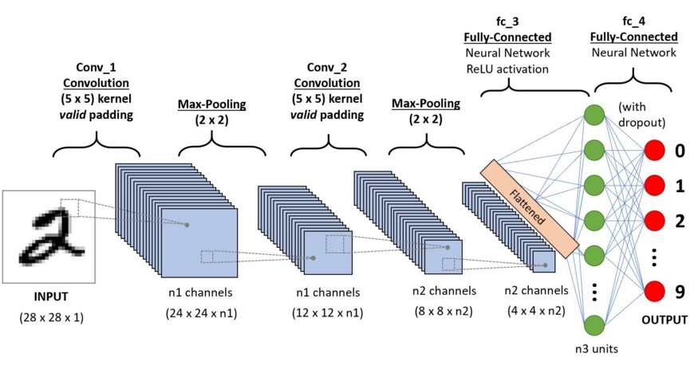

Slide 8




Potato Diseases detection Using Deep Learning
Practical Applications: From Field to Farmer
Deep learning models are being integrated into various tools and systems, bringing advanced disease detection directly to agricultural practices.
Smartphone Apps
Drone Surveillance
Farmers can use smartphone applications to get instant diagnoses by simply taking a photo of affected leaves in the field.
Drone-mounted cameras can survey vast areas of potato fields, identifying disease hotspots quickly and efficiently.
IoT Integration
Early Warning Systems
IoT sensors can collect environmental and plant health data, integrating it with deep learning models for comprehensive insights and predictive analysis.
Automated systems provide timely alerts for potential outbreaks, allowing farmers to implement protective measures before widespread damage occurs.

Slide 9
Potato Diseases detection Using Deep Learning
Case Study: Smart Potato Farming in Action
A pioneering research initiative demonstrated the efficacy of deep learning in identifying potato diseases, yielding remarkable accuracy and practical utility for farmers.
High Accuracy: The model achieved an impressive 98.6% classification accuracy, showcasing its ability to reliably distinguish between healthy and diseased plants.
Model Development: Researchers developed a deep learning model specifically designed to detect three common potato diseases: Early Blight, Late Blight, and healthy leaves.
Mobile Implementation: This advanced deep learning tool was implemented as a user-friendly mobile application, providing farmers with an accessible and immediate diagnostic solution.
Extensive Dataset: The model was trained using a dataset of 2,152 images, carefully curated to include both healthy and diseased potato leaves, ensuring comprehensive learning.
Time Savings: The mobile tool dramatically reduced diagnosis time from several days—often required for laboratory testing—to mere seconds, enabling prompt disease management.

Slide 10




Potato Diseases detection Using Deep Learning
Challenges & Future Directions
While deep learning offers immense potential, several challenges and opportunities exist for further development in potato disease detection.
Data Scarcity
AI Interpretability
Lack of comprehensive datasets for rare or newly emerging diseases limits model training and generalization.
Improving the transparency and explainability of AI decisions is crucial for building farmer trust and adoption.
Robotics Integration
Edge Computing
Combining deep learning with robotics could enable autonomous spraying and targeted treatment, further enhancing efficiency.
Deploying models directly on devices for offline processing ensures functionality in remote areas with limited internet access.

Slide 11
Potato Diseases detection Using Deep Learning
Cultivating the Future: A Healthier Harvest
Deep learning is not just a technological advancement; it's a transformative force shaping the future of agriculture.
"By embracing deep learning, we are moving towards a future where potato farming is more resilient, productive, and environmentally conscious, ensuring food security for generations to come."
Enhanced Disease Management: Deep learning provides powerful tools for precise and proactive disease management, minimizing crop losses.
Food Security & Farmer Prosperity: By safeguarding yields, it directly contributes to global food security and strengthens farmer livelihoods.
Sustainable Agriculture: Reduced reliance on chemical fungicides promotes more environmentally friendly and sustainable farming practices.
Continued Innovation: Ongoing research and development in AI will continue to redefine farming efficiency, leading to even greater advancements.

Slide 12



