Slide 1
Building or planning
a Bitcoin startup?
🙋 Raise your hand.
Boy! You've chosen an interesting problem for yourself.

Slide 2
C O N G R A T U L A T I O N S . Y O U C H O S E . . .
THE HARDEST
BOSS BATTLE.
Difficulty Level:
500%
Customers don't care. Marketing doesn't work. Distribution is broken.

Slide 3
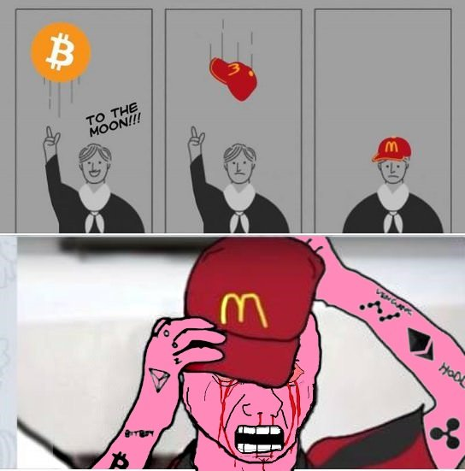
THE EX-BITCOINER PROBLEM
Came for the bull. Clocked out for the bear.
Many bitcoiners stop caring in the bear cycle — which we are in.

Slide 4
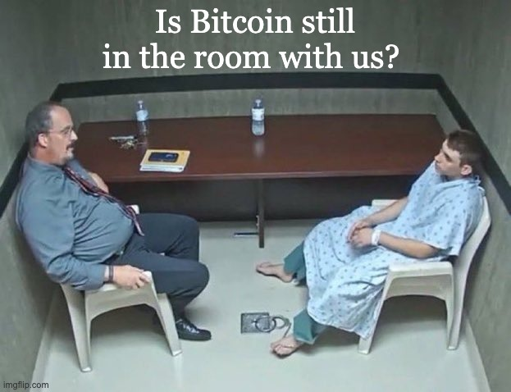
THE NORMIE PROBLEM
The other 1.4 billion Indians? They've never thought about Bitcoin. Not once.

Slide 5
M A R K E T I N G C H A N N E L 1 / 3
Want to run Bitcoin ads?
REJECTED.
✕
Google Ads
Crypto advertising requires certification & ongoing compliance
✕
Meta / Instagram
Crypto ads require prior written permission. Often denied.
✕
Twitter / X
Allowed but requires financial services certification per market

Slide 6
M A R K E T I N G C H A N N E L 2 / 3
Go organic? 📱
📉
🤖
😮‍💨
High CAC
AI Slop
Fatigue
Cost per Bitcoin-curious user is 3–5× a regular fintech customer — a niche audience in a restricted channel.
Feeds are flooded with AI-generated content. Organic reach is dying. Your post disappears in seconds.
People have learned to scroll past anything that looks like marketing. Especially in crypto.

Slide 7
M A R K E T I N G C H A N N E L 3 / 3
Pay to play? 💸
🎙️
🌟
Bitcoin Conference
Bitcoin Influencer
$250,000+
₹5L – ₹25L
to sponsor the mainstage
per campaign, per creator
Bitcoin Nashville 2025
Top 10 Indian Bitcoin creators
For Coinbase. Not for your seed-stage startup.
No guaranteed conversion. No attribution. No retargeting.

Slide 8
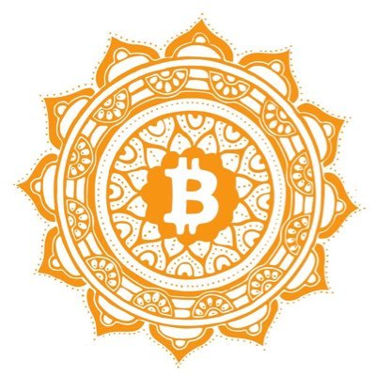

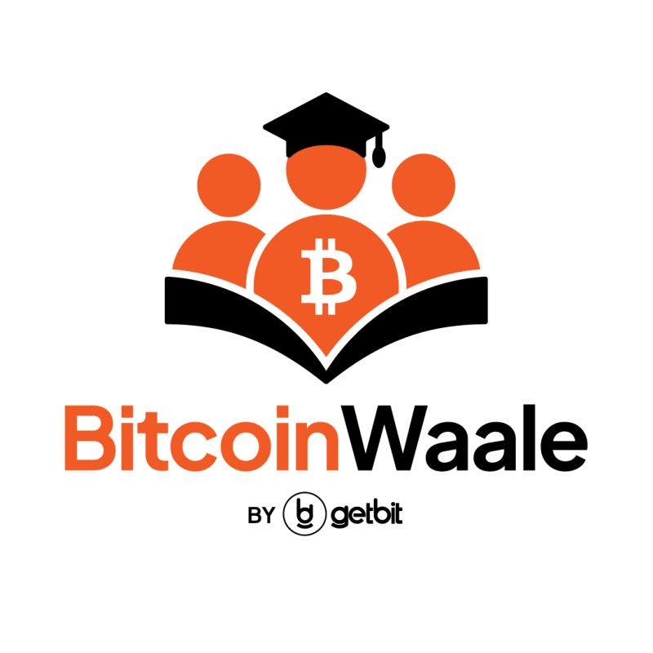
C U R R E N T W O R K A R O U N D S
Smart founders already
figured it out.
B4I Community
Bitcoin Bharat
Bitcoinwaale
↓ powers ↓
↓ powers ↓
↓ powers ↓
Bitcoin Keeper
SwapSo
GetBit
Keeper built B4I to demo their custody product to a warm, pre-qualified Bitcoin audience — without paying for ads.
SwapSo's founding team built Bitcoin Bharat so college students could discover and use SwapSo through community first.
GetBit created Bitcoinwaale — a Bitcoin education community — so more Indians discover GetBit through learning, not ads.
bitcoincierge.in

Slide 9
B U T T H I S M O D E L H A S P R O B L E M S
Building your own community
breaks at scale.
🧠
Org time & energy
🗺️
Physical presence across cities
Organising meetups, community management, 1-on-1 guidance, customer education — all diverts from building the product.
Every city has its own nuance. Language, examples, culture — you can't copy-paste what works in Bangalore to Delhi.
⚙️
Operations & hiring
✈️
Travel & accommodation budget
Booking venues, hiring educators, speakers, managing invites, attendance — a full-time job with no playbook.
Team members flying in for every city activation. It burns cash fast with no direct attribution to revenue.
📊
End-to-end attribution
Who came? Who touched the product? Who activated? Who's a warm lead? Without tracking, it's all vanity.
bitcoincierge.in

Slide 10
T h e P r o b l e m
IRL events & community management
are the most effective way
to get to a billion+ Indians.
But Bitcoin products and services lack the
execution & operations muscle to actualise it.
bitcoincierge.in

Slide 11
Bitcoincierge
IRL Event and Community Management.
For Bitcoin brands. In India.
D e m o s . W o r k s h o p s . M e e t u p s .
SofB Accelerator Pitch
2026

Slide 12
O u r S o l u t i o n
IRL event & community management
as a service — for Bitcoin brands.
Plug in on Day 1. Demo, acquire, and activate users — without building a team, traveling, or starting a community from zero.
📍
👥
🎤
📊
Venue & Logistics
Curated Audience
Expert Mentors
Attribution Reports
We handle booking, setup, and operations across 7 cities
Pre-qualified participants from our community — not a random crowd
Bitcoin-native coaches, hand-picked or approved by you
Post-event summary: attendance, demos, leads generated
bitcoincierge.in

Slide 13
W h y N o w
Two big forces are on our side.
1
2
Bitcoin mentors & community are seeded in major Indian cities
The pendulum is swinging back offline
Thanks to years of work by Bitshala and other Bitcoin communities, a dense mentor network exists across Delhi, Mumbai, Bangalore, Hyderabad, Chennai, Ahmedabad, and Goa — trained, ready to demo and onboard.
People are burned out by social media and AI-generated content. The new generation wants to experience things in person. The utility of being terminally online is decreasing fast — and we meet people exactly where they are going next.
bitcoincierge.in

Slide 14
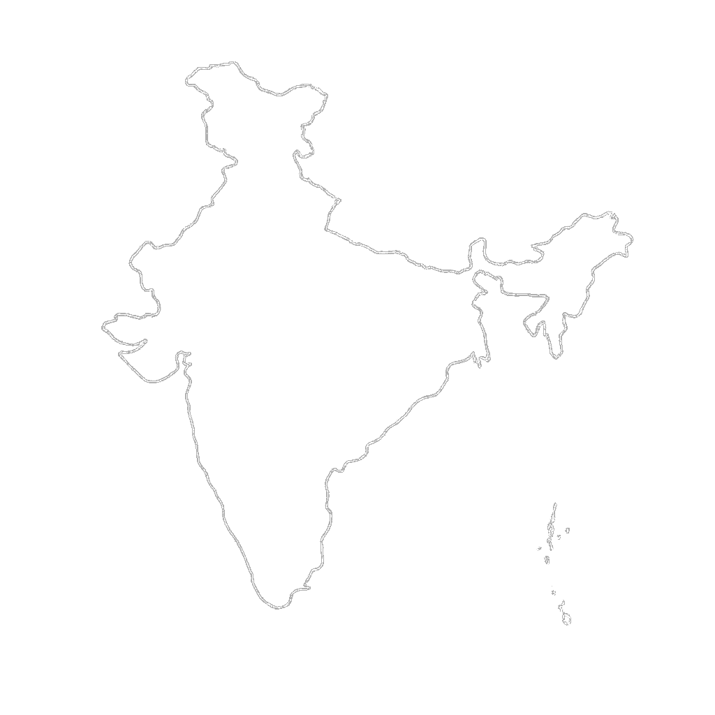
B i t c o i n m e n t o r s a n d c o m m u n i t y a r e s e e d e d i n m a j o r c i t i e s
Delhi
7 Cities
Active
Ahmedabad
Mentors present, community active,
ready to run activations
Mumbai
Hyderabad
Goa
Bangalore
Expanding to
more cities
Chennai
bitcoincierge.in

Slide 15
ONLINE
OFFLINE
📱 📱 📱
🤖 🤖 🤖
📲 📲 📲
🙌 🙌 🙌
🤝 🤝 🤝
⚡ ⚡ ⚡
→
— AI-generated content flood
The pendulum is swinging
back offline.
— Crypto ad restrictions
— Doomscrolling & fatigue
People want to meet in person. They want to hold the hardware. They want to feel the experience — not scroll past another post about it.
— Low ROAS, high burnout

Slide 16
T h e M a r k e t A n d T r a c t i o n
India is open to Bitcoin products.
We are just getting started.
1B+
8 / 97
200+
Indians reachable
through IRL activations
Tier-1 cities and
Tier-2 cities in India
Bitcoin products &
services usable in India
2,000+
6 / 1
6
Existing community
members
Tier-1 and Tier-2
cities we cover
Existing brand
partnerships
bitcoincierge.in

Slide 17
G o - t o - M a r k e t
Warm intro → Proof of work → Expand.
01
02
03
04
05
Warm intro or cold outreach
Partner for First Pilot
Pilot event
First activation
Retainer & revenue share
Bitshala refers brands outside open-source mandate. We also do cold outreach to our target list.
Show proof of work from past partners (GetBit, Trezor, Zebpay, Ourpool)
Brand sponsors one event — fixed fee only, no risk. We handle everything.
Brand joins a meetup as attendee first, sees the audience and experience.
After proven CPA, brand moves to ongoing IRL strategy with performance fees.
bitcoincierge.in

Slide 18
B u s i n e s s M o d e l
We charge brands. Not participants.
FIXED
VARIABLE
Event Execution Fee
Performance / Revenue Share
₹15,000 – ₹20,000
0.5% – 2%
per event
on attributed sales or activations
—
Venue booking & management
—
KYC completions / deposits
—
Mentor / speaker time
—
Hardware wallet sales
—
Snacks, logistics, ops
—
Loan / custody product sign-ups
—
Post-event summary report
—
Referrals through mentor network
bitcoincierge.in

Slide 19
P r o o f o f W o r k
We've already done this
with 6 brands.
BRANDS
Delhi
GetBit
Bitcoin-only exchange
Ourpool
Bitcoin mining
Cryobrick
Mumbai
Hardware wallet
Jetking
Goa
Bitcoin treasury
Bangalore
Bitasha
Bitcoin product
Zebpay
Crypto exchange
bitcoincierge.in

Slide 20
T h e A s k
Let's do IRL event and
activation for your brand.
📍
Select a city
Pick any of our 7 active cities. We know the community, the venue, the right audience.
🤝
Select a mentor
Browse our Bitcoin mentor network or recommend your own. We brief, manage, and pay them.
🌐
Get your first activation
Pilot event — fixed fee only. We handle everything. You show up and demo your product.
bitcoincierge.in

Slide 21
Q & A
Watch our 2-minute explainer 👆 then ask us anything.
bitcoincierge.in

