Slide 1
PRATIRAKSHA-Lite
AI-Powered Ransomware Detection & Prevention System
Mini Project Presentation
Mentor – Mr. Mohit Tiwari
Team Members:
Manoj (07611502722)
Akshay Kumar (08311502722)
Yash Kaushik (20511502722)
1

Slide 2
Introduction
A critical gap in current cybersecurity measures the pressing need for more effective and proactive ransomware detection techniques.
The increasing strategies of ransomware operators, who now use ransomware-as-a-service (RaaS) models to coordinate assaults, highlight these inadequacies.
The proposed system aims to provide a more holistic solution to the ransomware threat.
CSE , BVCOE, New Delhi
Topic Name: RDPS , Mentor Name: Mr. Mohit Tiwari
2

Slide 3
Problem Statement
The growing frequency and complexity of ransomware attacks pose a serious threat to cybersecurity. When it comes to efficient prevention and early detection, current options frequently fall short.
By creating a tool or system that incorporates sophisticated detection algorithms and preventive actions, this initiative seeks to close these gaps. Improving the capacity to recognize and neutralize ransomware threats before they inflict serious harm is the aim.
CSE , BVCOE, New Delhi
Topic Name: RDPS , Mentor Name: Mr. Mohit Tiwari
3

Slide 4
Objective
• Create an effective framework for ransomware detection and prevention utilizing advanced techniques.
• To implement advanced detection techniques into practice in order to identify ransomware threats early on.
• To develop strong defenses against ransomware attacks in order to minimize their impact and risk.
CSE , BVCOE, New Delhi
Topic Name: RDPS , Mentor Name: Mr. Mohit Tiwari
4

Slide 5
Literature Review
Serial No. | Topic | Author(s) | Country & Year | Research Gap
*1. | ransomware: ransomware as a service (raas), methods to detects, prevent, mitigate and future direction (Journal) | Amos Kibet | Philippines , 2022 | Lack of Real-Time Detection and Prevention
2. | Introduction to Ransomware (Journal) | Qasem Abu Al- Haija, Noor A. Jebril | Usa , 2023 | Unable to deal with sophisticated Ransomware attacks
3. | Evolution of ransomware: a review of the detection, prevention and mitigation techniques (Journal) | Adedolapo Adedoyin , Ayomide Adedoyin | Usa , 2022 | Inadequate Detection of Fileless Ransomware
5
CSE , BVCOE, New Delhi
Topic Name: RDPS , Mentor Name: Mr. Mohit Tiwari

Slide 6

Serial No. | Topic | Author(s) | Country & Year | Research Gap
4. | The Evolution of Ransomware: Tactics, Techniques, and Mitigation Strategies (Journal) | Gourav Nagar | Bangladesh , 2024 | Gaps in Proactive, AI-Driven Detection
5. | Advancements in Ransomware Detection and Prevention Techniques (Journal) | Jayant Verma, D. Lakshmi | 2023 | current tools and technologies are unable tackle sophisticated Ransomware attacks
6. | Ransomware Detection Using Machine Learning Techniques (Journal) | Indra Chaudhary, Suyash Adhikari | Nepal , 2022 | Requires Improved Machine Learning Models
7. | network traffic based ransomware detection (Journal) | Sivaguru R. , Srinath R. , Sathiya Rubha M. etc | India , 2024 | Limitations in Detecting Encrypted Command-and-Control Traffic
6

Slide 7
Serial No. | Topic | Author(s) | Country & Year | Research Gap
8. | Crypto- Ransomware Detection and Prevention Techniques and Tools A Survey(Journal) | Alshaikh, Hesham; Hefny, Hesham A.; Darwish, Nagy R. | Bahrain , 2023 | Detection of New/Unknown Ransomware Strains
9. | Ransomware Early Detection Techniques (Journal) | Asma a. Alhashmi , Abdulbasit a. Darem , Ahmed b. Alshammari , Laith a. Darem , etc | Saudi Arabia , 2024 | Unable to Response in Real-Time
10. | Ransomware and phishing cyberattacks(Journal) | Ali Hosseini | Sweden , 2022 | Detection of Sophisticated Phishing Techniques
7
CSE , BVCOE, New Delhi
Topic Name: RDPS , Mentor Name: Mr. Mohit Tiwari

Slide 8
Methodology
Feature extraction
Graph construction
Model inference
Threshold-based decision
Detection Layer
Console
Log file
Database
Alert & Logging
Prevention
Layer
Automatically block malicious traffic sources
Supports (iptables) & (Windows Firewall)
8
CSE , BVCOE, New Delhi
Topic Name: RDPS , Mentor Name: Mr. Mohit Tiwari

Slide 9
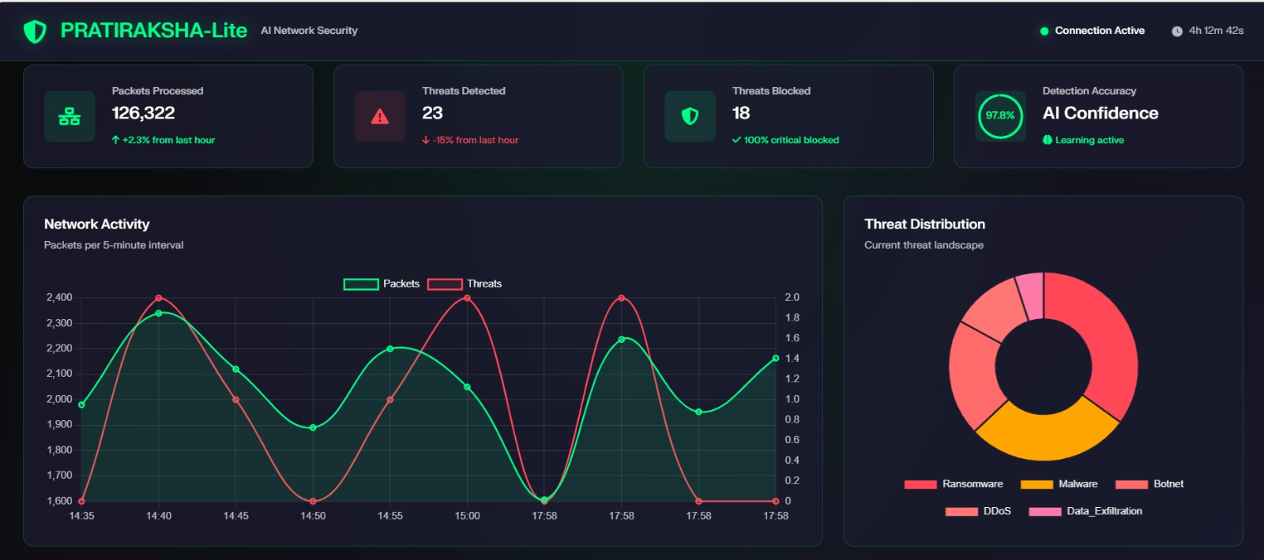
Result & Analysis
9
CSE , BVCOE, New Delhi
Topic Name: RDPS , Mentor Name: Mr. Mohit Tiwari

Slide 10
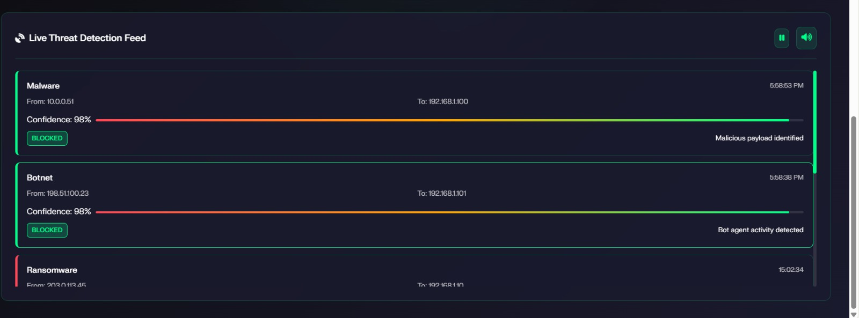
Result & Analysis
The system is scalable and can handle a significant volume of network data in real-time.
Each threat is identified with a high confidence score (e.g., 98%), demonstrating the reliability of our AI model.
For critical threats, the system's response is immediate and automated, as shown by the "BLOCKED" status.
10

Slide 11
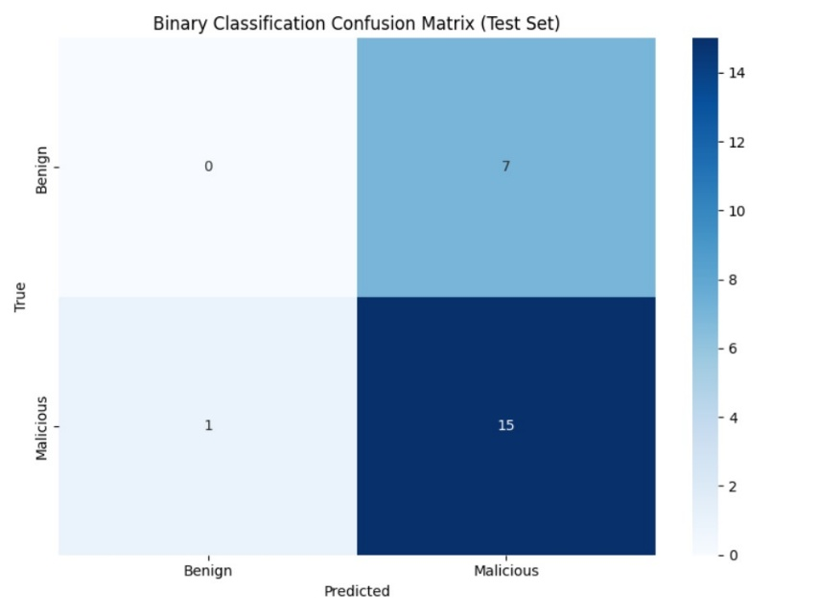
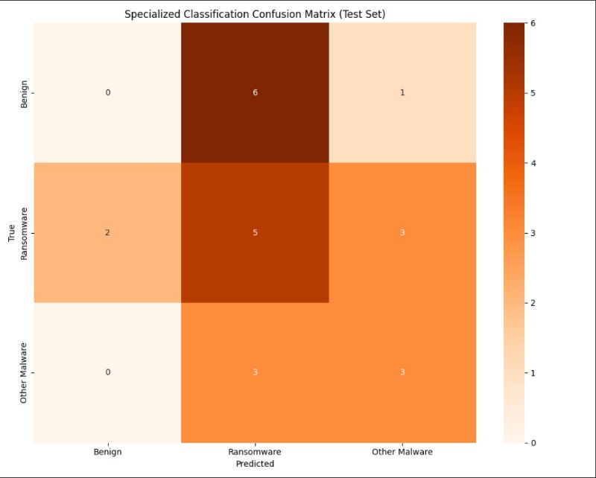
Result & Analysis
.
Binary classification
Evaluate the performance of a model by summarizing the predictions against the actual results
Specialized classification
Detailed Error Analysis
Performance Metric Calculation
11

Slide 12
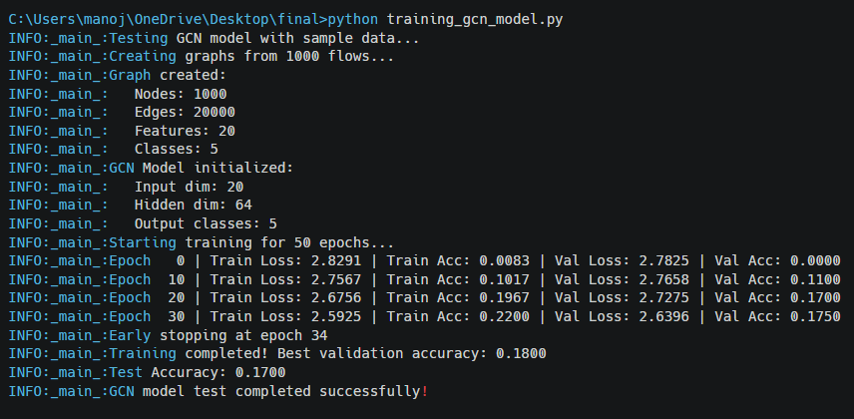
Result & Analysis
The GCN model has a clear and logical architecture, with an input dimension of 50 features, a hidden layer of 128 dimensions, and an output of 5 classes, matching the dataset's complexity.
12

Slide 13
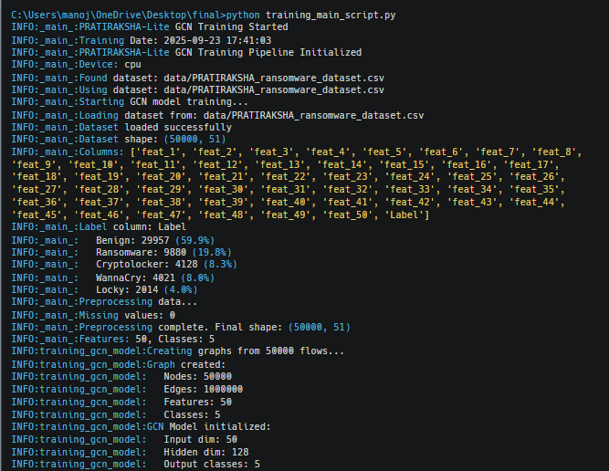
Result & Analysis
The GCN model has a clear and logical architecture, with an input dimension of 50 features, a hidden layer of 128 dimensions, and an output of 5 classes, matching the dataset's complexity.
13

Slide 14
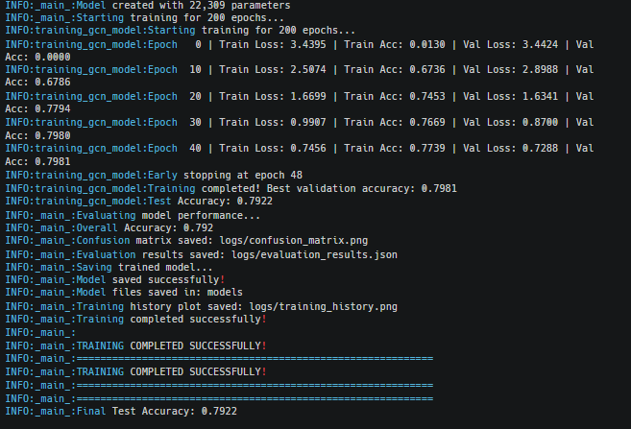
Result & Analysis
The training logs show a consistent decrease in both training loss and validation loss over epochs, while accuracy steadily increases. This confirms the model is learning effectively.
14

Slide 15
Result & Analysis
We evaluated our system on a dataset of network traffic containing both benign and malicious (ransomware and other malware) packets. The GCN model achieved:
Accuracy: 83% overall accuracy in classifying packets as benign or malicious.
Precision: 94.3% precision in identifying malicious packets
Recall: 90.1% recall in identifying malicious packets
F1-score: 92.1% F1-score for malicious packet detection
15

Slide 16
Conclusion & Future Scope
Conclusion :
This methodology ensures a comprehensive ransomware detection and prevention system using modern machine learning techniques and open-source tools.
Our real-time ransomware detection system leverages Graph Convolutional Networks (GCNs) to analyse network traffic patterns also system captures network packets, extracts relevant features, and applies a pre-trained GCN model to classify traffic as benign(where software or activity is considered harmless and not malicious), ransomware, or other malware.
Future Scope :
Better Models: Explore more advanced Graph Neural Networks to boost accuracy.
Real-time Analysis: Adapt the model to analyze dynamic, live network traffic.
Explainable AI: Add features to help users understand how and why the AI makes decisions.
16

Slide 17
REFERENCES
A. K. Kibet, R. A. Esquivel, and J. A. Esquivel, "Ransomware: Ransomware as a service (RaaS), methods to detect, prevent, mitigate and future direction," 2014.
T. Y. Lin and M. F. Zolkipli, "Study on prevention and solution of ransomware attack," 2021.
R. Effghi, H. K. Sheatah, L. A. Darem, A. B. Alshammari, A. A. Darem, and A. A. Alhashmi, "Ransomware early detection techniques," 2024.
FNU Jimmy, "Understanding ransomware attacks: Trends and prevention strategies," 2023.
J. Cable, I. W. Gray, and D. McCoy, "Understanding the modern ransomware ecosystem," 2024.
H. Alshaikh, H. A. Hefny, and N. Ramadan, "Crypto-ransomware detection and prevention techniques and tools: A survey," 2023.
A. K. Maurya, N. Kumar, A. Agrawal, and R. A. Khan, "Ransomware: Evolution, target and safety measures," 2018.
17
CSE , BVCOE, New Delhi
Topic Name: RDPS , Mentor Name: Mr. Mohit Tiwari

Slide 18
REFERENCES
D. Lakshmi, "Advancements in ransomware detection and prevention techniques," 2023.
R. Sivaguru, R. Srinath, and M. Sathiya Rubha, "Network traffic based ransomware detection," 2024.
N. A. Jebril, Introduction to Ransomware, 2023.
Y. Dou, Z. Liu, L. Sun, Y. Deng, H. Peng, and P. S. Yu, "Enhancing graph neural network-based fraud detectors against camouflaged fraudsters," in Proc. 29th ACM Int. Conf. Inf. Knowl. Manage., 2020, pp. 315–324.
L. Zhou, K. Ren, Y. Xue, X. Zhang, and J. Li, "Graph neural networks for link prediction in heterogeneous networks," in Proc. 29th ACM Int. Conf. Inf. Knowl. Manage., 2020, pp. 1035–1044.
J. Yan, Y. Qi, and Q. Rao, "Detecting malware with an ensemble method based on deep neural network," Security and Communication Networks, vol. 2018, 2018.
O. M. Alhawi, J. Baldwin, and A. Dehghantanha, "Leveraging machine learning techniques for Windows ransomware network traffic detection," in Cyber Threat Intelligence, Cham: Springer, 2018, pp. 93–106.
R. Vinayakumar, M. Alazab, K. P. Soman, P. Poornachandran, A. AlNemrat, and S. Venkatraman, "Deep learning approach for intelligent intrusion detection system," IEEE Access, vol. 7, pp. 41525–41550, 2019.
18
CSE , BVCOE, New Delhi
Topic Name: RDPS , Mentor Name: Mr. Mohit Tiwari

Slide 19
Thank you
19

