Slide 1
Multi-Threaded Server and Client Application
By:
Mario Dias
Hansie Aloj

Slide 2
What is Multithreading?
Multithreading is the ability of a program or an operating system process to manage its use by more than one user at a time and to even manage multiple requests by the same user without having to have multiple copies of the program running in the computer.
Each user request for a program or system service (and here a user can also be another program) is kept track of as a thread with a separate identity.
As programs work on behalf of the initial request for that thread and are interrupted by other requests, the status of work on behalf of that thread is kept track of until the work is completed.

Slide 3
What is Multithreading used for?
The main reason for incorporating threads into an application is to improve its performance. Performance can be expressed in multiple ways:
A web server will utilize multiple threads to simultaneously process requests for data at the same time.
An image analysis algorithm will spawn multiple threads at a time and segment an image into quadrants to apply filtering to the image.
A ray-tracing application will launch multiple threads to compute the visual effects while the main GUI thread draws the final results.

Slide 4
Advantages of Multithreading
Minimization and more efficient use of computing resources.
Improved application responsiveness as requests from one thread do not block requests from other threads.
Less resource-intensive than running multiple processes at the same time.

Slide 5
Disadvantages of Multithreading
Deadlocks and data inconsistency when multiple threads try to access the same shared resource without proper locking.
Thread starvation and resource contention can degrade performance of multithreaded applications.
Display issues can surface if threads are not coordinated correctly when displaying data.

Slide 6
Example
Text Editors: Spell-checking, formatting, typing all happen concurrently.
Web Browser: Downloading files and opening multiple tabs and images in each web page is done by launching multiple threads.
Computer Games: Every object, person, enemy and their interactions and movement is executed using multiple threads.
Web Servers: Websites handle multiple requests from multiple users which requires multiple threads to service each user simultaneously.

Slide 7
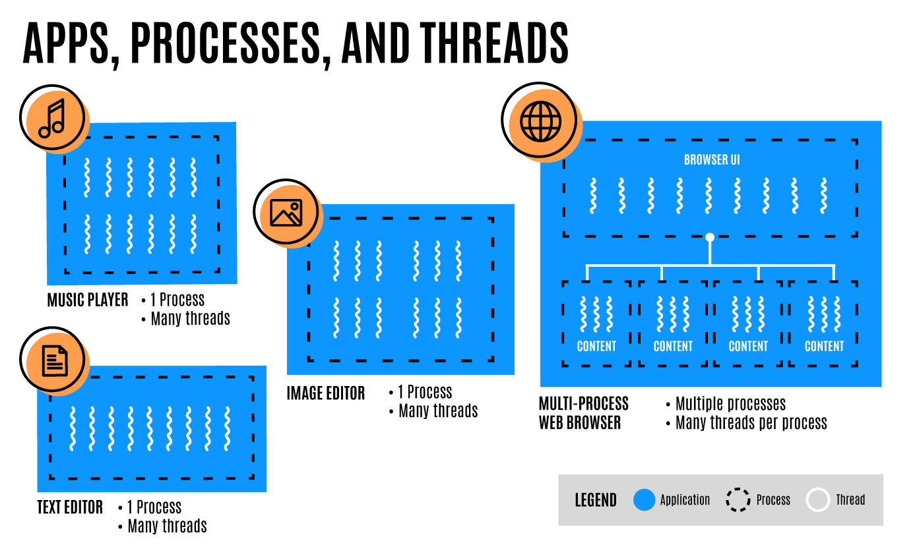
Example

Slide 8
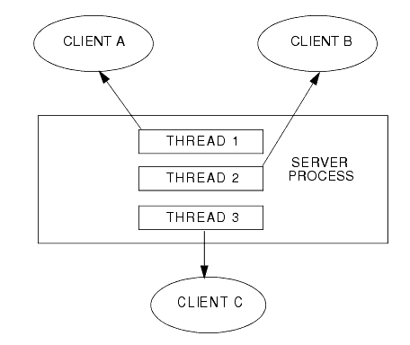
What is a Multithreaded Server?
A server that can handle multiple threads, where each thread is responsible to process a separate request from every client(user).
Example: Web Servers

Slide 9
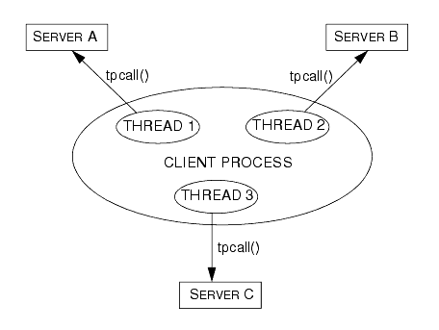
What is a Multithreaded Client?
A client that can spawn multiple threads to fetch multiple resources from multiple servers simultaneously to prevent the user from being blocked by slow I/O operations.
Example: Web Browsers.

Slide 10
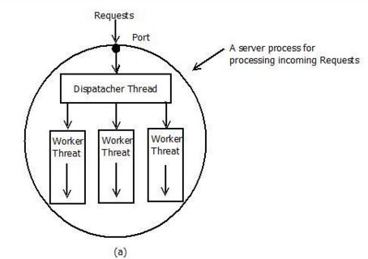
Multithreading in Java
There are different ways to organize threads in a multithreaded application. In this experiment we will utilize the Dispatcher – Worker model.
In this model, the process consist of one dispatcher thread and several worker threads. The dispatcher thread accepts the client’s request and chooses one of the free worker threads to handover this request for further processing. Hence, multiple client requests can be processed by multiple worker threads in parallel.

Slide 11
Multithreading in Java
Threads can be created by using two mechanisms :
Extending the Thread class
Implementing the Runnable interface
Both ways require to override the run() method whose code is executed separately on each new thread.
For client/server application we first initialize the DispatcherThread who then initializes the WorkerThreads and assigns tasks to them accordingly.

Slide 12
Multithreading in Java
In case of the server, the dispatcher thread assigns tasks to individual worker threads whenever they are free and a new client connection request arrives so the worker thread can handle the request.
In case of the client, the dispatcher thread continuously sends data to multiple worker threads so that the data can be sent to the different servers to be processed concurrently.

Slide 13
Multithreading in Java
Worker threads can be created statically or dynamically. In static creation of threads, the number of threads remains fixed till the lifetime of the process. In dynamic creation of threads, initially process is started with single thread and new worker threads are created when needed during execution of process and if existing threads are busy. Existing threads can destroy themselves after finishing their jobs.
In Java, the assignment and management of worker threads can be implemented using Executors. This interface manages the assignment of tasks to multiple threads.

Slide 14
Multithreading in Java
Using the newFixedThreadPool() method of Executors package, we can create a thread pool with a fixed number of threads and a shared queue. The dispatcher thread then sends tasks to the pool and it then gets submitted to free threads. If no thread is free, then the tasks wait in the queue until a thread is available.
Using the newCachedThreadPool() method allows us to perform dynamic thread creation creating threads and reusing them when they are free but can create more if the need arises.

Slide 15
Multithreading in Java
In our experiment we simulate multithreaded interactions between a client and server process. The client reads in data and sends the data to the server process through multiple workers. The server then receives the client requests and services them through multiple workers as well.
This allows the client to process all the data parallelly and the server to handle multiple client requests simultaneously as well.
We use fixed worker threads to observe the dispatcher thread role clearly.

