Slide 1
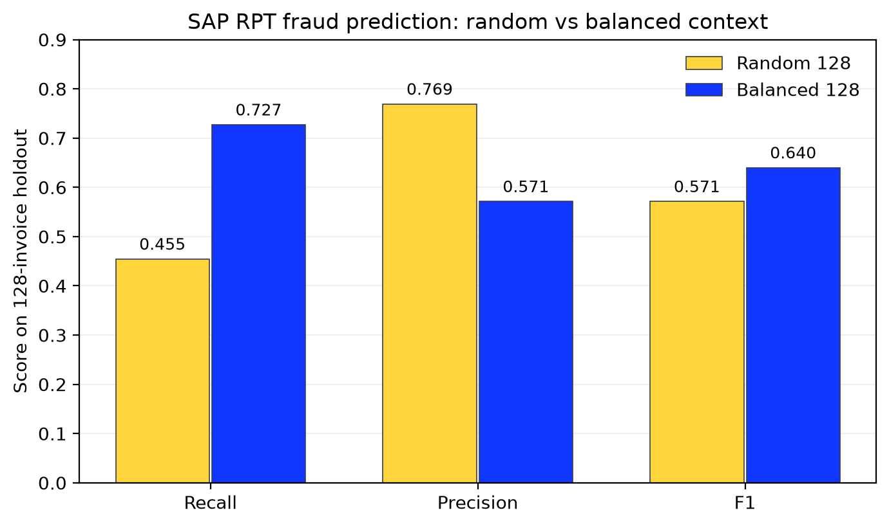
Context selection
| SAP RPT fraud result
Does the choice of context rows change SAP RPT predictions?
Matched 128-row test
Random context
10 of 22 fraud cases found
3 false alarms; F1 0.571
Balanced context
16 of 22 fraud cases found
12 false alarms; F1 0.640
Six more fraud cases detected, with nine more false alarms.
Same 128 test invoices, same context budget, same SAP RPT weights.
2026 SAP Fioneer. All rights reserved. | Public
17
Notes:
Source: notebooks/after_context_engineering/01_original_22_case_after_benchmark.ipynb; saved chart in reports/figures/original22_rpt_fraud_random_vs_balanced.png; metrics in data/original_context_comparison/results.csv. Both conditions use the original 22-fraud-case synthetic holdout and seed 11. Random context: recall 45.5%, precision 76.9%, F1 0.571, 10 true positives, 3 false positives. Balanced context: recall 72.7%, precision 57.1%, F1 0.640, 16 true positives, 12 false positives. This is descriptive evidence from one split and one seed.

Slide 2
In-context engineering
| How we built the SAP RPT request
SAP RPT weights stayed fixed; only the labeled context rows changed.
1,024 eligible labeled invoices
Select 128 rows
›
Random: 27 fraud, 101 nonfraud
Balanced: 64 fraud, 64 nonfraud
Request and evaluation checks
1
Keep the final 128 test invoices outside the context pool
2
Verify unique invoice IDs and selected class counts
3
Mask the test target; omit the other target column
4
Predict the same held-out invoice IDs in both conditions
The comparison tests context selection without retraining SAP RPT.
2026 SAP Fioneer. All rights reserved. | Public
18
Notes:
Source: notebooks/context_engineering/00_original_22_case_context_workflow.ipynb and reports/original_22_case_context_comparison.md. The first 1,024 original synthetic invoices form the eligible context pool. The final 128, including 22 fraud cases, are held out. With seed 11, the random 128-row context has 27 fraud cases; the balanced 128-row context has 64. Request construction checks unique IDs, masks the requested test target, and omits the other target to avoid leakage. SAP RPT weights remain unchanged.

