Slide 1

One Click RTL-to-GDSII Automation Framework for Single Clock Designs
Department of Electronics and Communication Engineering
M. TECH (Microelectronics and VLSI)
Project by
Md. Irfan | Roll No. 25EC4211
Under the supervision of
Dr. Hemanta Kumar Mondal, Assistant Professor Dept. of ECE
Department of Electronics and Communication Engineering
राष्ट्रीय प्रोद्योगिकी संस्थान दुर्गापुर
National Institute of Technology Durgapur
Mahatma Gandhi Avenue, Durgapur-713209, West Bengal
INDIA

Slide 2
Index
Introduction
Why Automation is Needed
Scripts and Technologies Used
What is Automated in This Framework
Automation Flow Overview
Key Automation Components
Tested Design Example (Single Clock 8-bit ALU)
Generated Outputs and Results
Benefits of the Framework
Scope and Future Enhancement

Slide 3
Introduction
This is a framework that automates the complete RTL-to-GDSII backend flow using a single command.
It accepts a single RTL design file (source.v) as input.
The flow automatically runs synthesis and physical design without manual intervention.
The final output is a clean GDSII layout generated at the end of the flow.
The goal is to simplify backend execution and reduce repetitive manual work.
Input: RTL design (source.v)
Output: Final layout (source.gds)

Slide 4
Why Automation is Needed
RTL-to-GDSII flow involves the same sequence of steps for every new design.
Manual Padframe creation and netlist edits are time-consuming and error-prone.
Padframe definition and floorplan sizing depend on the number of IO ports and must be recalculated manually for each design.
Automating these steps improves productivity, ensures repeatability, and allows designers to focus more on design intent.

Slide 5
Scripts and Technologies Used
Bash Scripting
  Bash controls the complete flow execution from start to end.
  It handles environment setup, tool sourcing, and step sequencing.
  Cadence tools are invoked through Bash as part of the automation.
Tcl Scripting
  Tcl scripts are used to drive Cadence Genus and Innovus commands.
  All synthesis and physical design operations are executed through Tcl.
  Bash internally calls Tcl scripts to control tool behavior.
Tools Used
  Cadence Genus
  Cadence Innovus

Slide 6
What is Automated in This Framework
RTL synthesis execution using Cadence Genus.
Automatic Padframe generation based on design ports.
Automated netlist modification to insert IO pad cells.
Dynamic floorplan sizing based on pad count.
Complete physical design flow up to GDSII generation.
Automatic generation and storage of reports and outputs.
Portability Across VLSI Lab PCs

Slide 7
Automation Flow Overview
Flow:
Start
End
Input: source.v
Synthesis
Netlist and Reports Generated
Padframe Generation
Input: Generated Netlist
Modifying Netlist
Input: Padframe and Netlist
Floorplan Setup
Core size computed from Padframe
Power planning
Placement
Clock Tree Synthesis (CTS)
Routing
GDSII Generation
Output: “.gds” file

Slide 8
Automated Padframe Generation
The script detects all top-level input, output, and clock ports automatically.
Bus widths are identified and expanded into individual pad connections.
Pads are evenly distributed across all four sides of the die.
Dummy pads are added when required to maintain symmetry.
A clean and uniform padframe.io file is generated without user input.

Slide 9
Automated Netlist Modification
The synthesized netlist is used as the base input for modification.
The generated padframe.io file is also used as an input to guide pad instantiation.
IO pad cells are inserted for every design port automatically.
A dedicated clock pad cell is used for the clock signal.
All pad connections are generated.
The modified netlist is ready for physical design without manual edits.

Slide 10
Automated Floorplan and Physical Design Flow
Floorplan size is computed dynamically based on the number of pads per side.
Core dimensions are adjusted automatically to provide sufficient IO spacing.
The complete physical design flow is executed using Innovus.
This includes floorplanning, power planning, placement, CTS, routing, and GDSII generation.
The entire backend flow runs without any manual command entry.

Slide 11
Portability Across VLSI Lab PCs
The framework is designed to run on our VLSI lab PCs.
Lab PC paths are detected automatically by the script.
The same automation works across different lab systems without modification.
No machine-specific configuration is required for execution.
This ensures consistent results across the lab environment.

Slide 12
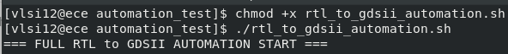
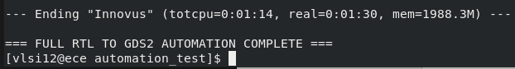
Tested Design Example
The automation framework was tested using an 8-bit single-clock ALU design.
The RTL design was provided as source.v, and placed in the project directory along with the automation Bash script.
The flow is started by giving execution permission and running the script from the terminal using a single command.
The script runs all stages and completes without manual intervention.
At each PD stages, the design state is saved as .enc checkpoints, allowing the layout to be restored later for validation.
All intermediate and final outputs were generated successfully.

Slide 13
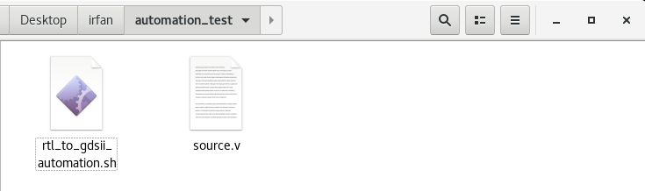
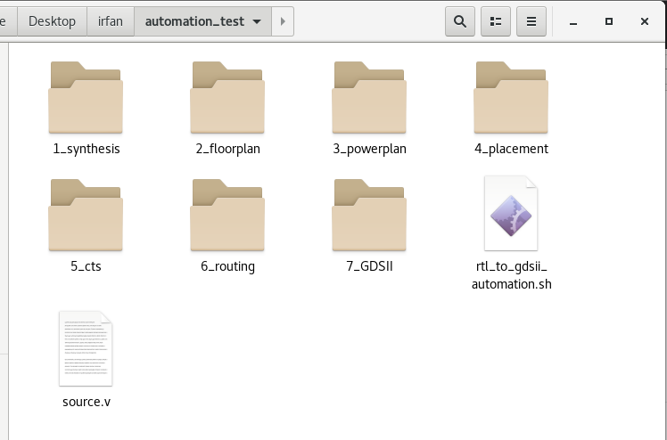
Outputs Generated for ALU Design
Before execution:
After execution:

Slide 14
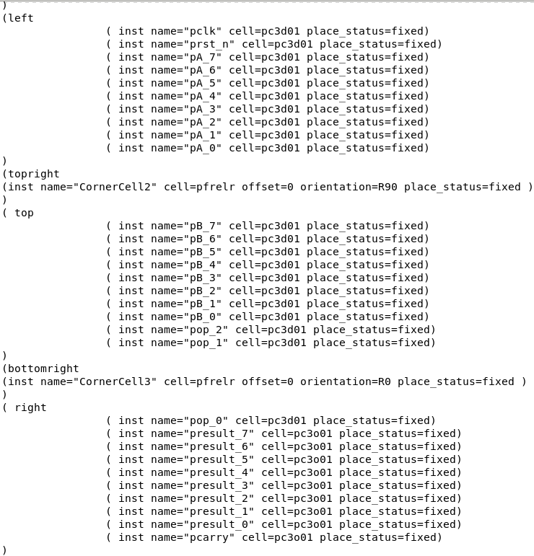
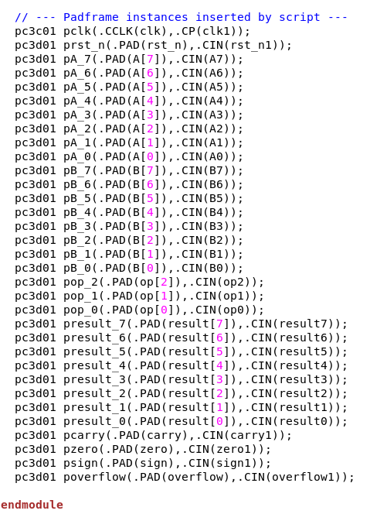
Design Specific Outputs (ALU Example)
Padframe file (padframe.io):
Modified Netlist:

Slide 15
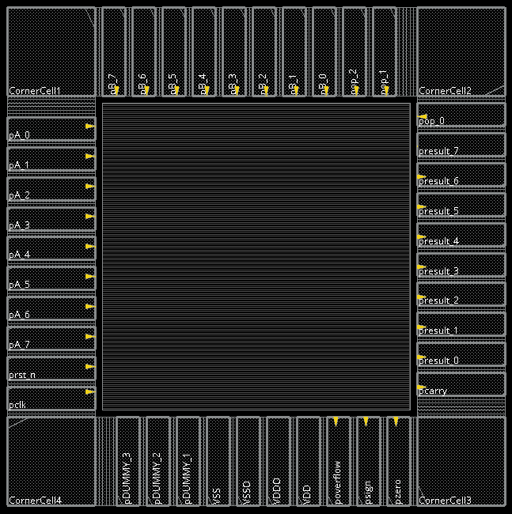
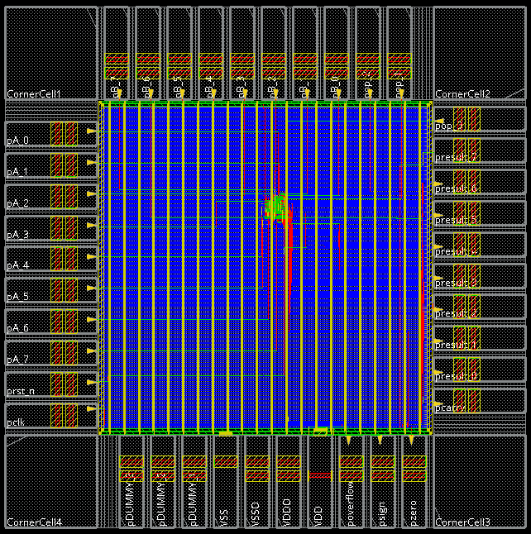
Physical Design Results (ALU Example)
Floorplanning
Final Routed Design

Slide 16
Key Benefits of the Framework
Enables one-click execution of the complete backend flow.
Eliminates repetitive manual backend tasks.
Reduces the chance of human errors in netlist and padframe handling.
Improves productivity and learning efficiency for students.
Demonstrates practical backend automation skills.

Slide 17
Scope and Future Enhancement
The framework currently supports single-clock designs only.
It assumes a single RTL file with a fixed top module name (source).
Timing and physical violation analysis is not the primary focus.
The objective is flow automation, not signoff closure.
The framework can be extended to multi-clock and multi-file designs in the future.
Signoff checks can be added as future extensions

Slide 18
References
Cadence Genus Documentation
Cadence Innovus Documentation
Bash Scripting Manual (GNU Bash Manual)
  https://www.gnu.org/software/bash/manual/
Tcl Language Manual
  https://www.tcl.tk/man/tcl8.6/TclCmd/contents.htm
SCL PDK Documentation

Slide 19
Thank You for Your Attention!
Let’s Dive into Your Questions!
Department of Electronics and Communication Engineering
राष्ट्रीय प्रोद्योगिकी संस्थान दुर्गापुर
National Institute of Technology Durgapur
Mahatma Gandhi Avenue, Durgapur-713209, West Bengal
INDIA

